Slide 1


LO: To add the suffix –er to lists of words ending in a vowel and a singular consonant
Can you remember yesterday’s
rule?

Slide 2
Rules for adding -er
1. Just add -er
high fast low slow rough

Slide 3
Rules for adding -er
1. Just add -er
2. If the word ends in a consonant with a short vowel before it, double the final consonant and then add -er
3. If the word ends in an 'e' drop the 'e' and add -er
4. If the word ends in a 'y' change the 'y' to an 'i' and add -er

Slide 4
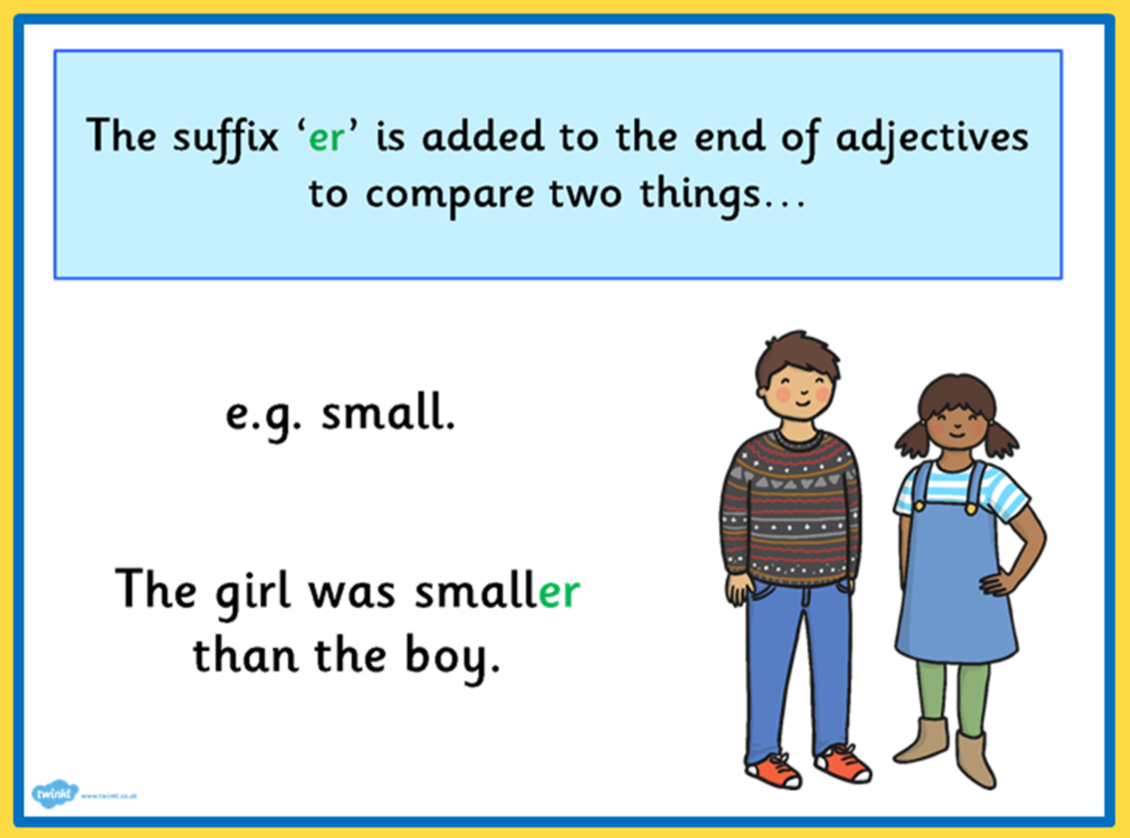
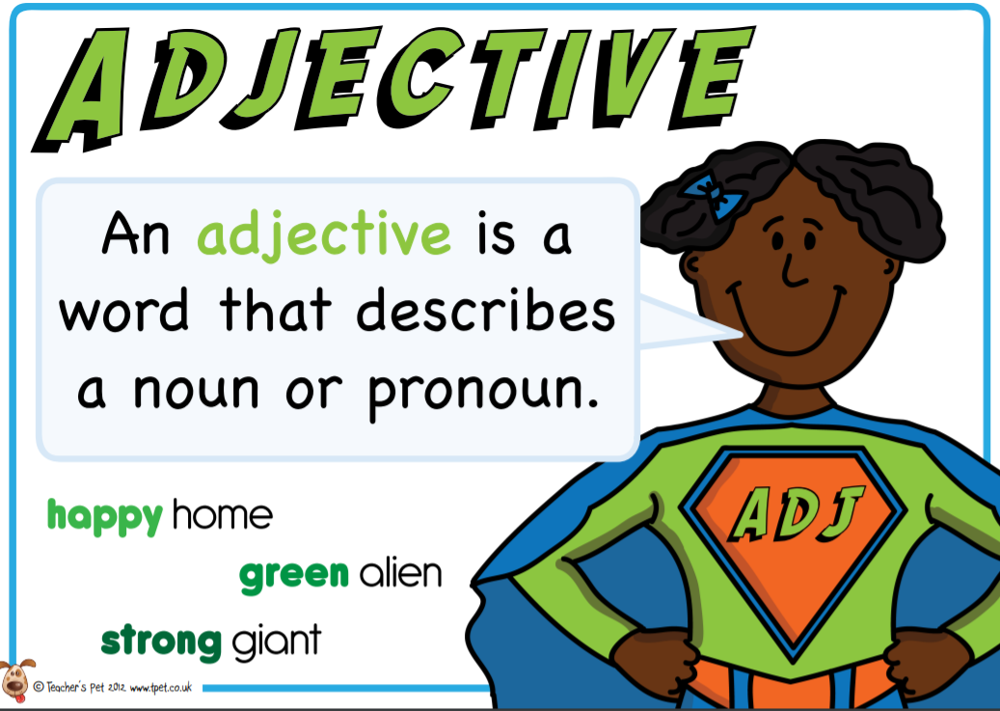

Today we are going to focus on:
2. If the word ends in a consonant with a short vowel before it, double the final consonant and then add -er
a e i o u
hot hotter
red redder

Slide 5
Today we are going to focus on:
2. If the word ends in a consonant with a short vowel before it, double the final consonant and then add -er
fit
thin
wet
big
flat
sad

Slide 6
Today we are going to focus on:
2. If the word ends in a consonant with a short vowel before it, double the final consonant and then add -er
fit fitter
thin thinner
wet wetter
big bigger
flat flatter
glum glummer

Slide 7
Use your English book - Add the suffix –er to these words. Remember to double the consonant because you can hear a vowel sound before the last consonant.
Then choose at least six words from the list and write them into sentences.
fat slow drum shop wet
flat jog swim big fit

