Slide 1

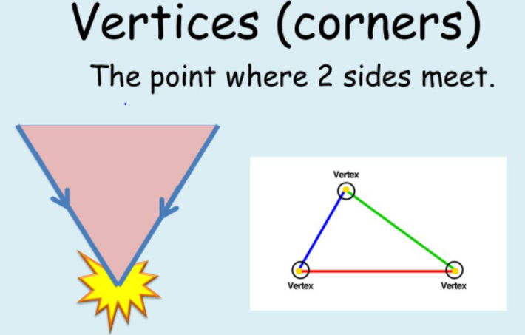

LO: To count vertices (corners) of 2D shapes

Slide 2
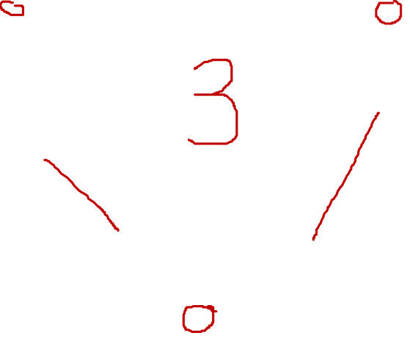

Slide 3
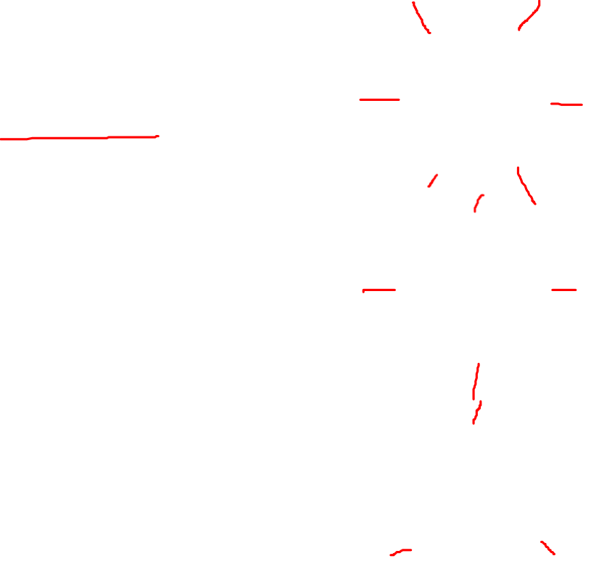
Fluency
Complete the table.
Name | Shape | Number of vertices
Hexagon
Rhombus
Triangle
6
4
3

Slide 4
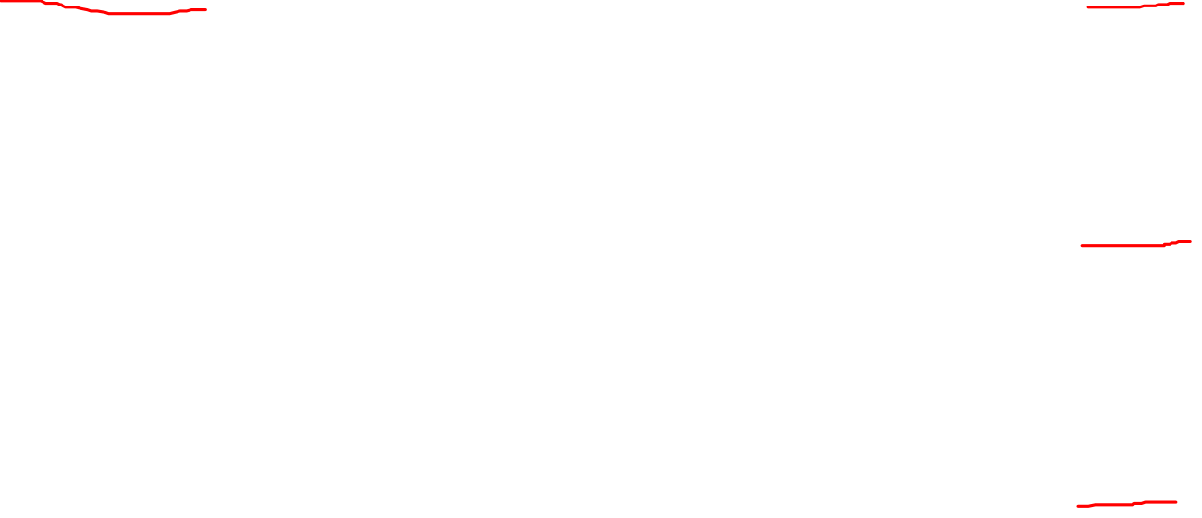
Fluency
Complete the table.
Name | Shape | Number of vertices
Square |  | 4
 |  | 8
 |  | 5
Octagon
Pentagon

Slide 5
Fluency
Which shapes have more than 4 vertices?

Slide 6
Fluency
I am thinking of a shape.
I have 0 vertices.
What shape am I?
Circle

Slide 7

Fluency
I am thinking of a shape.
I have 5 vertices.
What shape am I?
Pentagon

Slide 8

Fluency
I am thinking of a shape.
I have 1 more than 7 vertices.
What shape am I?
Octagon

Slide 9
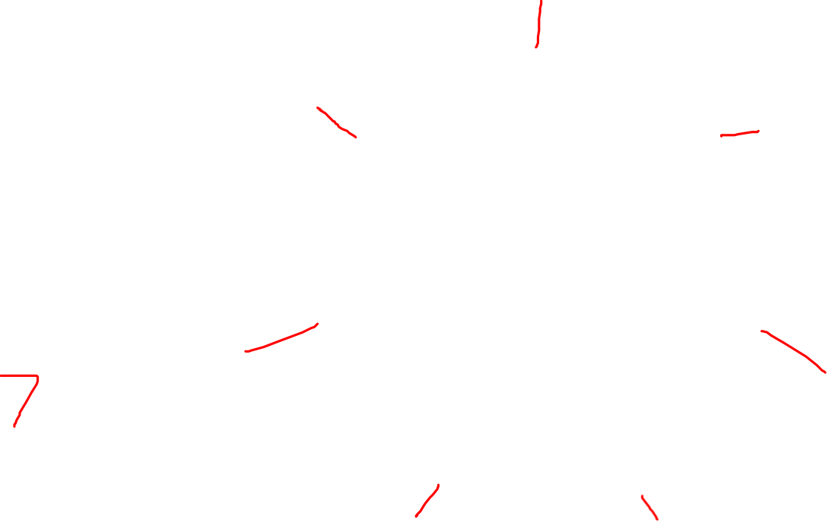
Fluency
I am thinking of a shape.
I have less than 8, but more than 6 vertices.
What shape am I?
Heptagon

Slide 10

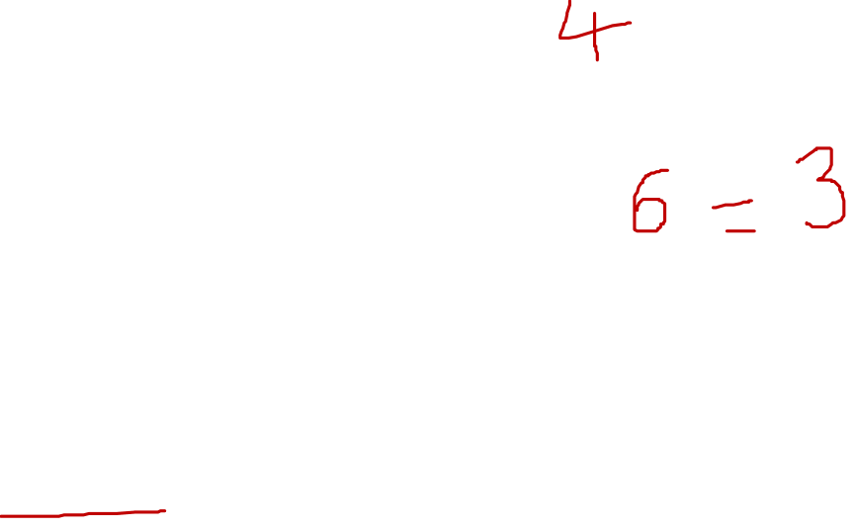
Reasoning
Gina says,
I have a square.
It has half the number of vertices than a hexagon.
Is Gina’s statement true or false?
False.
A hexagon has 6 vertices and a square has 4.
3 is half of 6 (not 4).

Slide 11
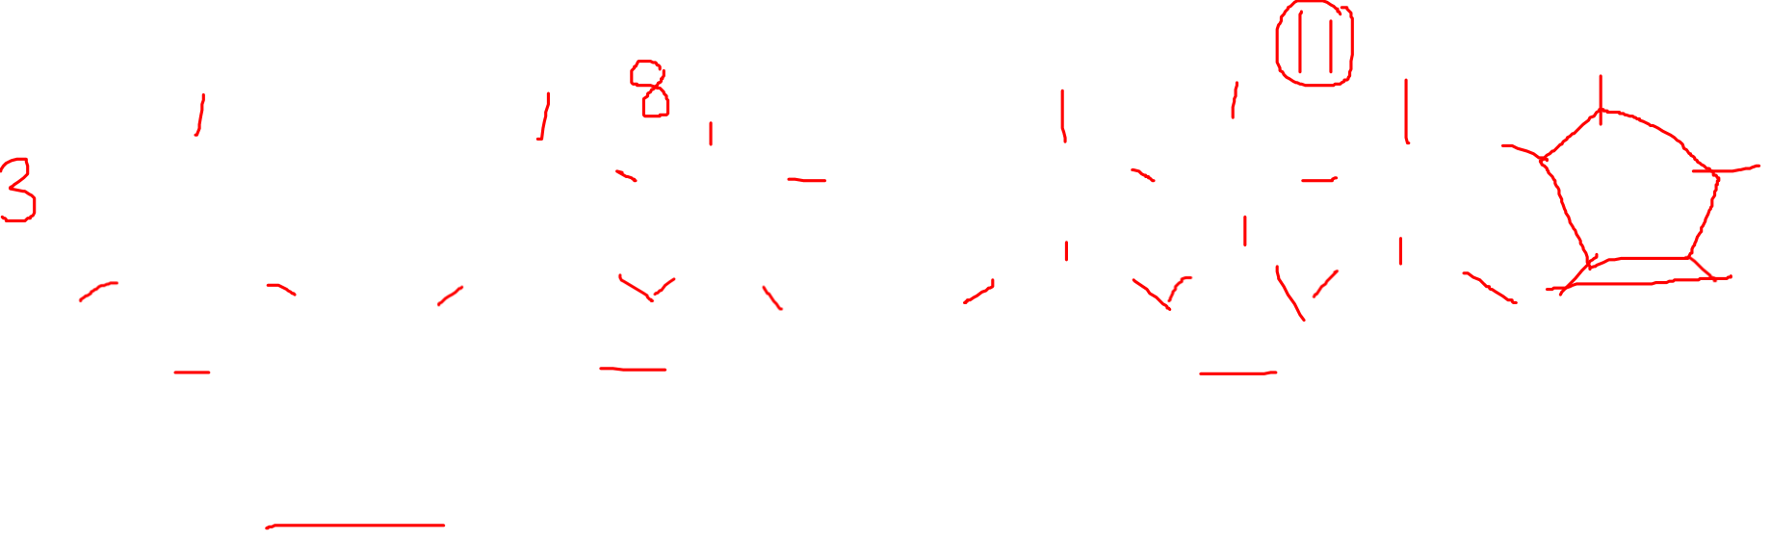
Problem solving
Kat has created this pattern.
1
2
3
How many vertices does each step have?
Step 1 has 3.
Step 2 has 8.
Step 3 has 11.
How many vertices will step 4 have and how do you know?
Step 4 will have 16 as another pentagon will be added.

Slide 12
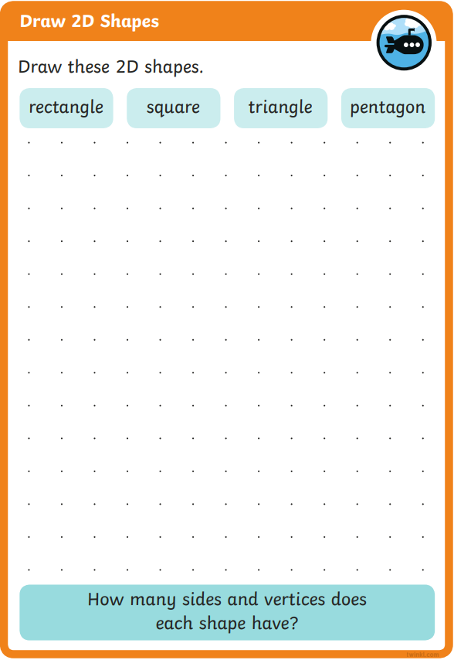
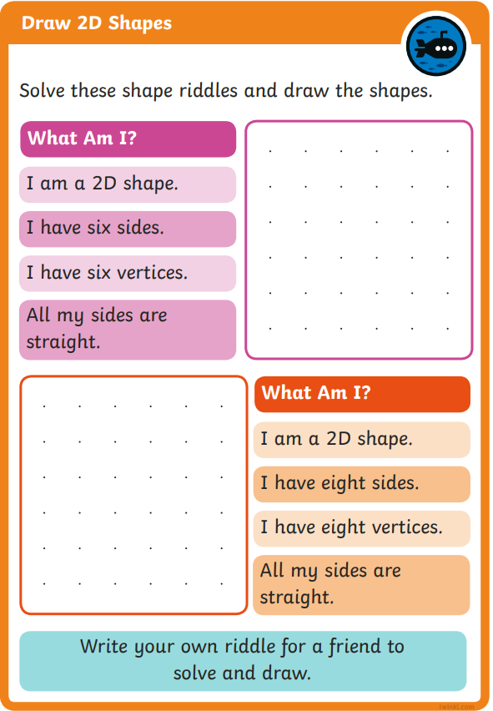
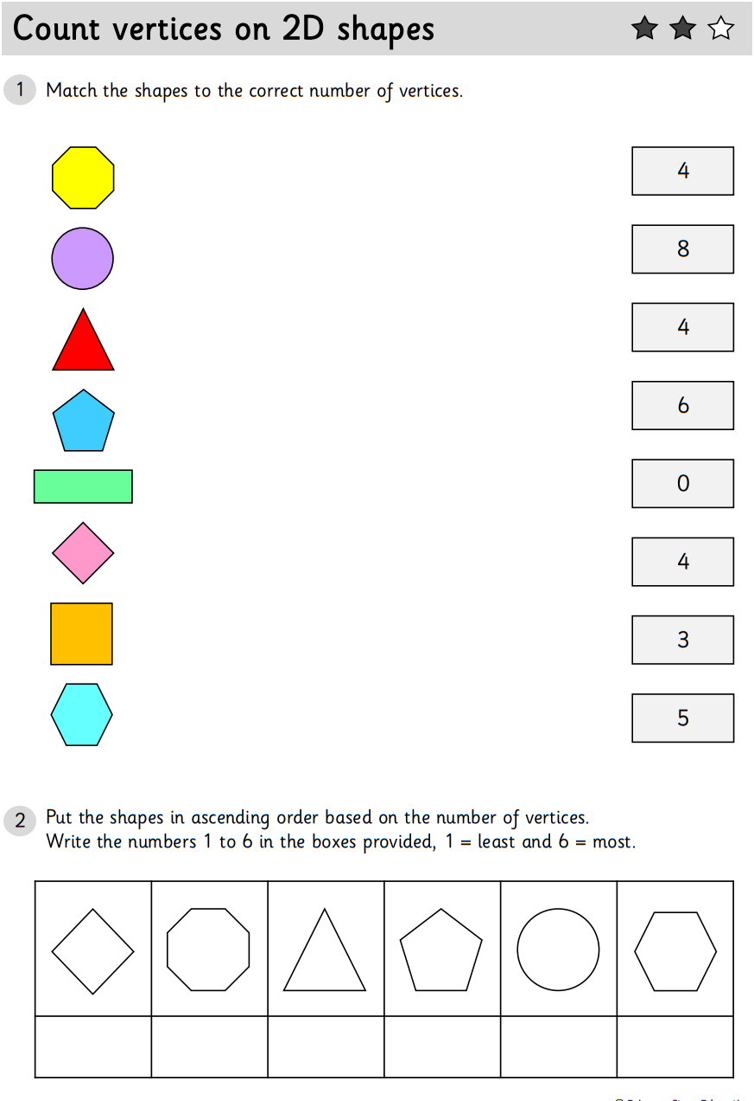
For your activity today choose a 1, 2 or 3 Star worksheet to complete.
Then complete some of the activity cards by drawing the missing shapes.

