Slide 1
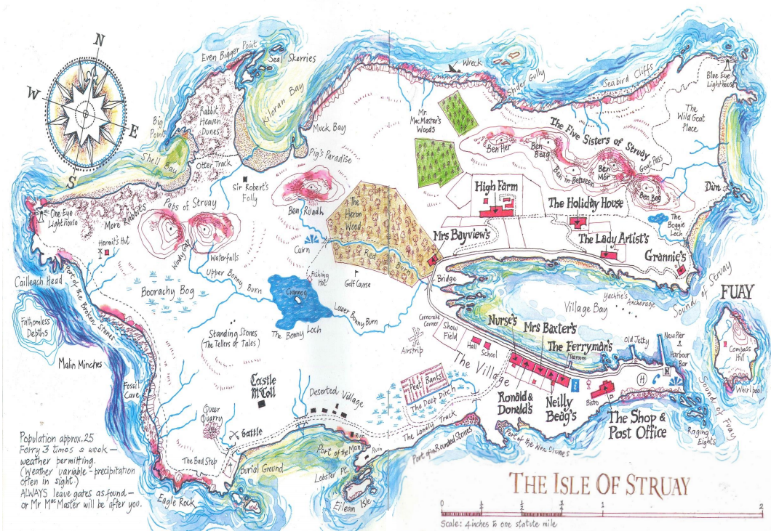
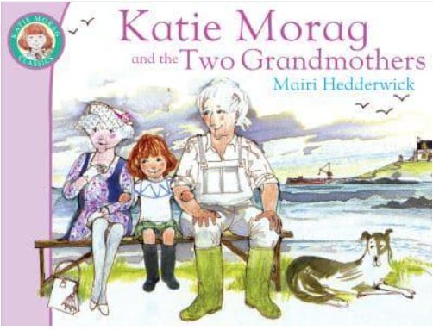

LO: To identify the main features and places of interest on a map

Slide 2
Where is this Katie Morag story set?
Who wrote this story?

Slide 3
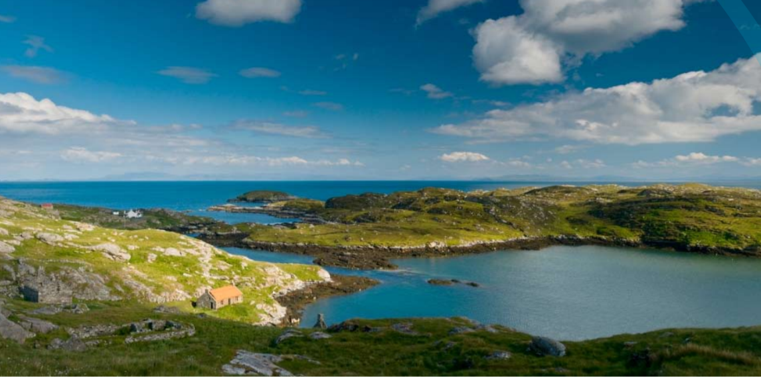
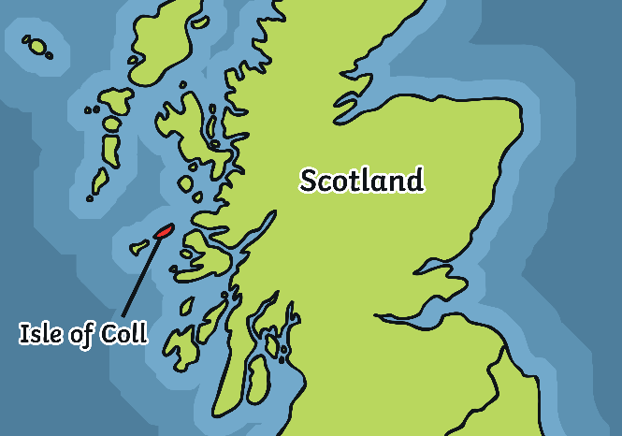
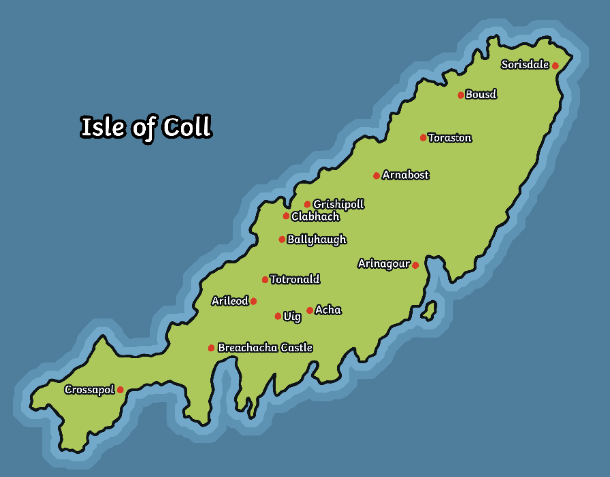

The author Mairi Hedderwick used to live on the Isle of Coll in Scotland. Living there inspired her to write stories for children. She used her experiences to help her to create a fictional island for her stories called
The Isle of Struay.

Slide 4
Katie Morag’s Isle of Struay is similar
to the real Isle of Coll.
Both islands are surrounded by water and you need to travel by boat or small plane to reach them.
They are not very big, Coll is only 13 miles long and 3 miles wide.
Not many people live on the islands. The Isle of Coll has a population of about 160 people.
Both islands are quiet places to live. There are only a few shops, a post office and one small primary school on the Isle of Coll.
People visit the Islands to cycle, walk and enjoy the scenery, to look at the wildlife, go fishing and bird watching and to relax and visit the beautiful beaches.

Slide 5
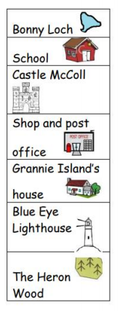


Slide 6



