Slide 1


LO: To add the suffix –er to lists of words ending in ‘e’
Can you remember yesterday’s
rule?

Slide 2
Rules for adding -er
2. If the word ends in a consonant with a short vowel before it, double the final consonant and then add -er
hot red flat wet glum

Slide 3
Rules for adding -er
1. Just add -er
2. If the word ends in a consonant with a short vowel before it, double the final consonant and then add -er
3. If the word ends in an 'e' drop the 'e' and add -er
4. If the word ends in a 'y' change the 'y' to an 'i' and add -er

Slide 4
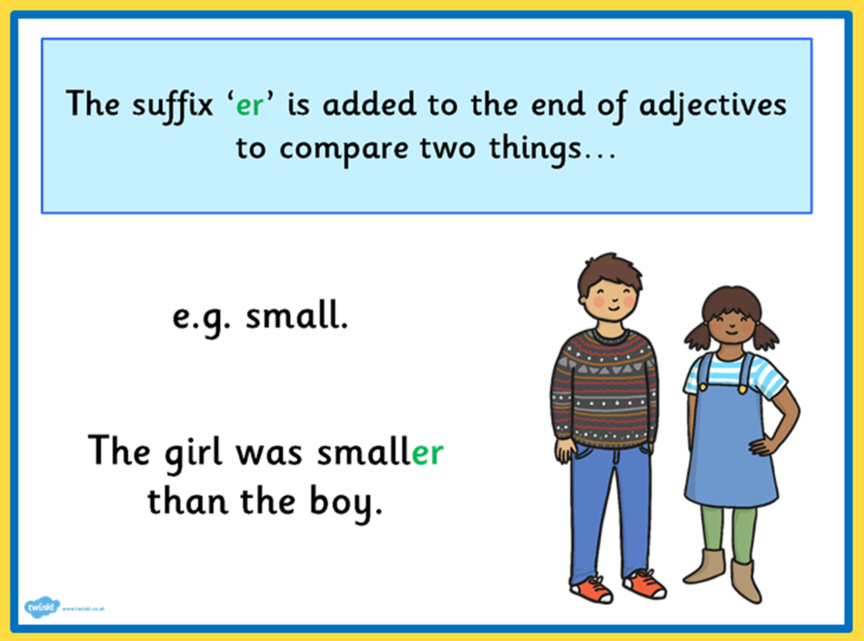
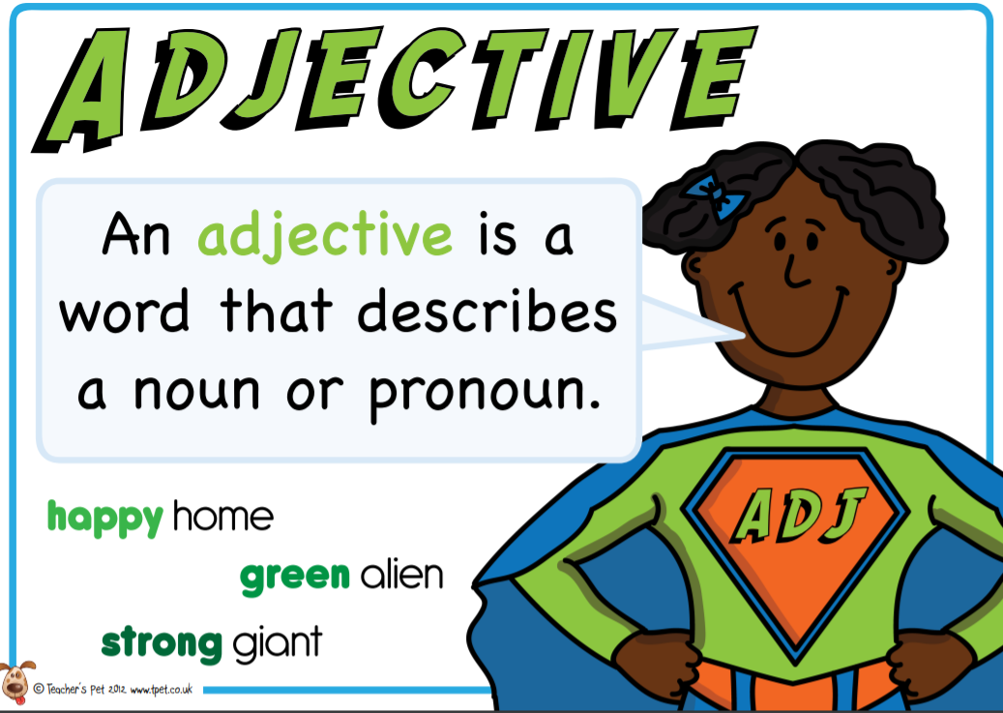

Today we are going to focus on:
3. If the word ends in an 'e' drop the 'e' and add -er
late later
brave braver

Slide 5
Today we are going to focus on:
3. If the word ends in
an 'e' drop the 'e' and
add -er
blue
close
fine
large
nice
late

Slide 6
Today we are going to focus on:
3. If the word ends in
an 'e' drop the 'e' and
add -er
blue bluer
close closer
fine finer
large larger
nice nicer
late later

Slide 7
Use your English book - Add the suffix –er to these words. Remember to drop the 'e' and add -er
Then choose at least six words from the list and write them into sentences.
safe simple wide wise brave
drive ride bake time write

