Slide 1


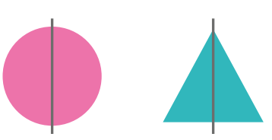

LO: To recognise lines of symmetry

Slide 2
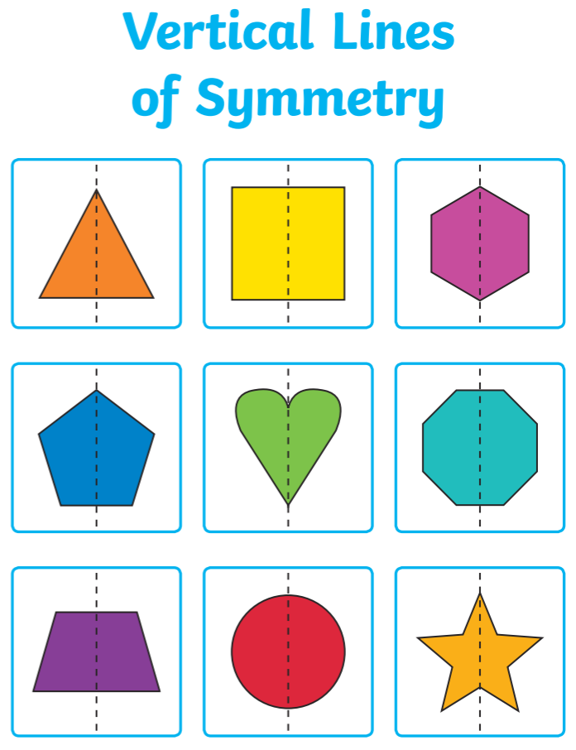
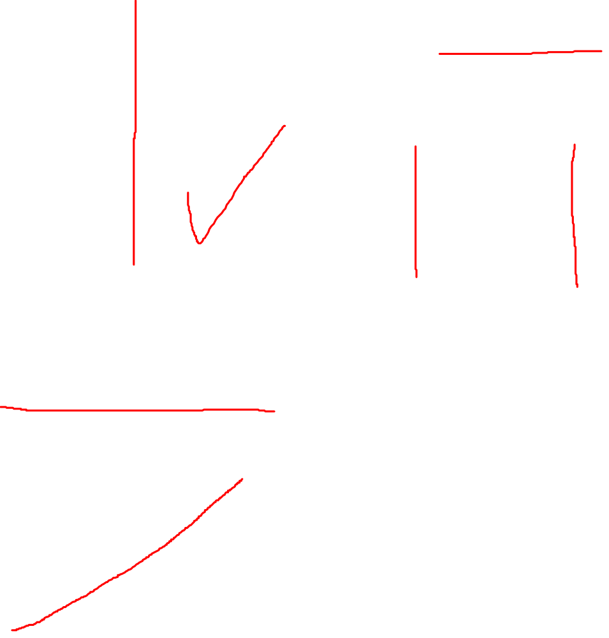

Slide 3
Fluency
Create and cut out the shape.
Fold the shape to show a vertical line of symmetry.

Slide 4
Fluency
Create and cut out the shape.
Fold the shape to show a vertical line of symmetry.

Slide 5
Fluency
Create and cut out the shape.
Fold the shape to show a vertical line of symmetry.

Slide 6
Fluency
Which shapes have a vertical line of symmetry?
✓
✓
X

Slide 7
Fluency
Sort the shapes in the table below.
No vertical line of symmetry | Vertical line of symmetry

Slide 8
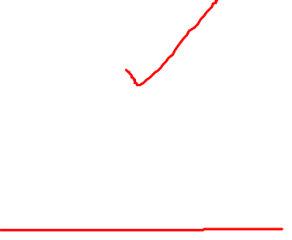
Matt has drawn a vertical line of symmetry on each of
the shapes below.
Reasoning
Spot Matt’s mistake and explain how it can be corrected.
Matt has drawn a horizonal line which does not show symmetry.
The line needs to be turned to a vertical position.

Slide 9
Problem solving
Which shape when split using its vertical line of symmetry
will create rectangles?
Square

Slide 10
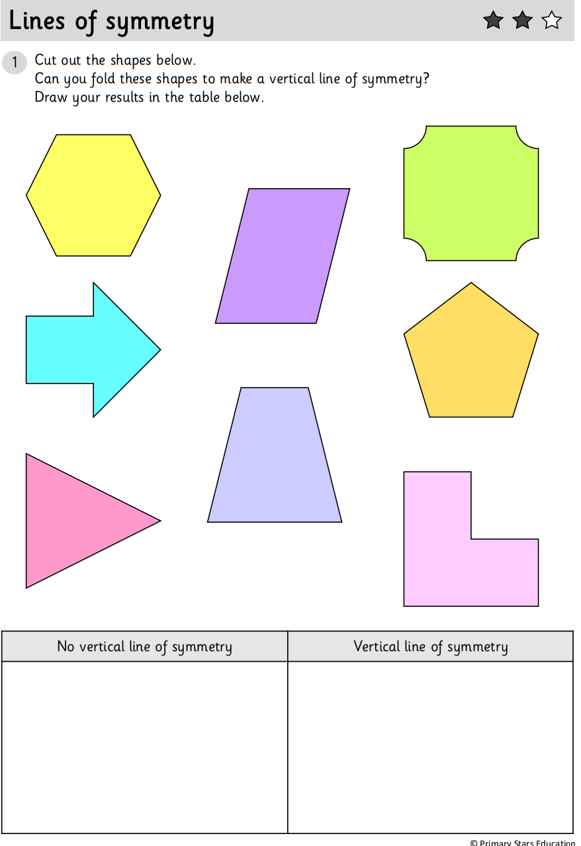
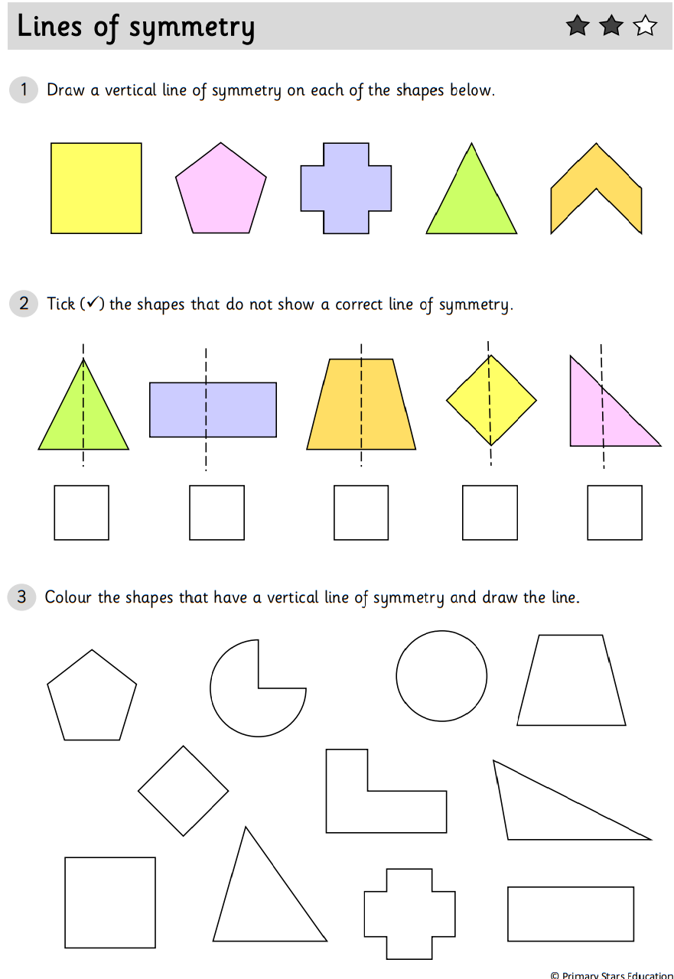
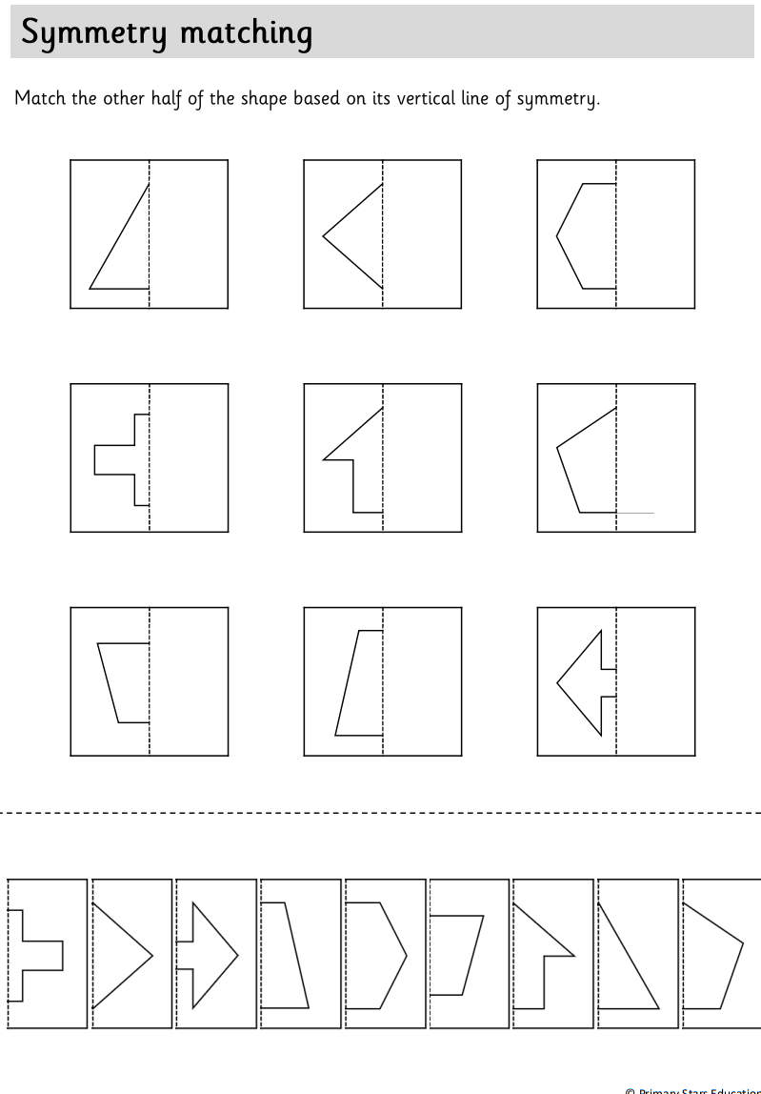
Now choose two 1, 2 or 3 Star worksheets to complete. You will need scissors for the first worksheet; cut out the shapes and fold them to make a vertical line of symmetry.
On the second worksheet draw a vertical line of symmetry on each shape. There is also a ‘Symmetry Matching’
Worksheet you could complete by cutting out the pictures and matching them to each shape

