Slide 1


LO: To add the suffix –er
Can you remember what a
suffix is?

Slide 2
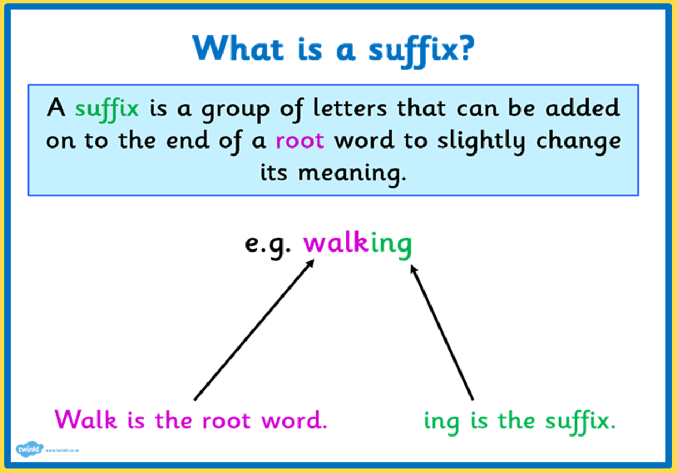

Slide 3
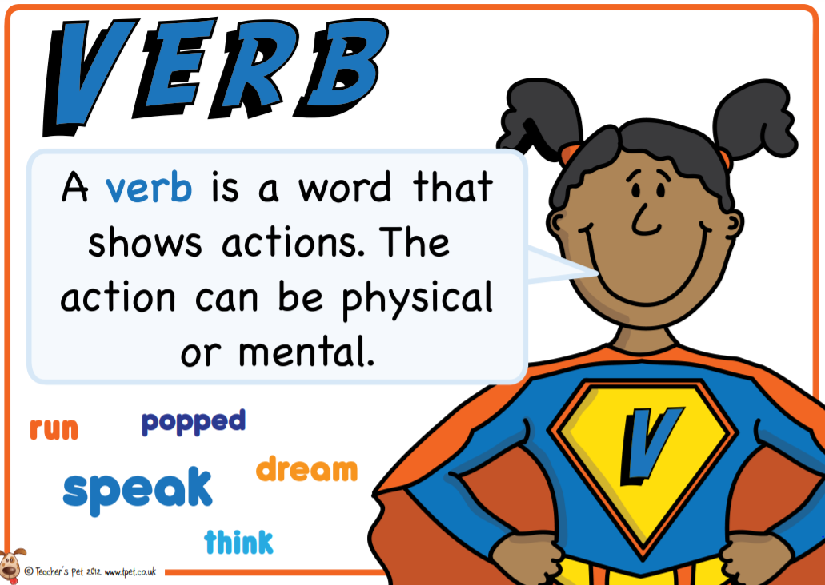
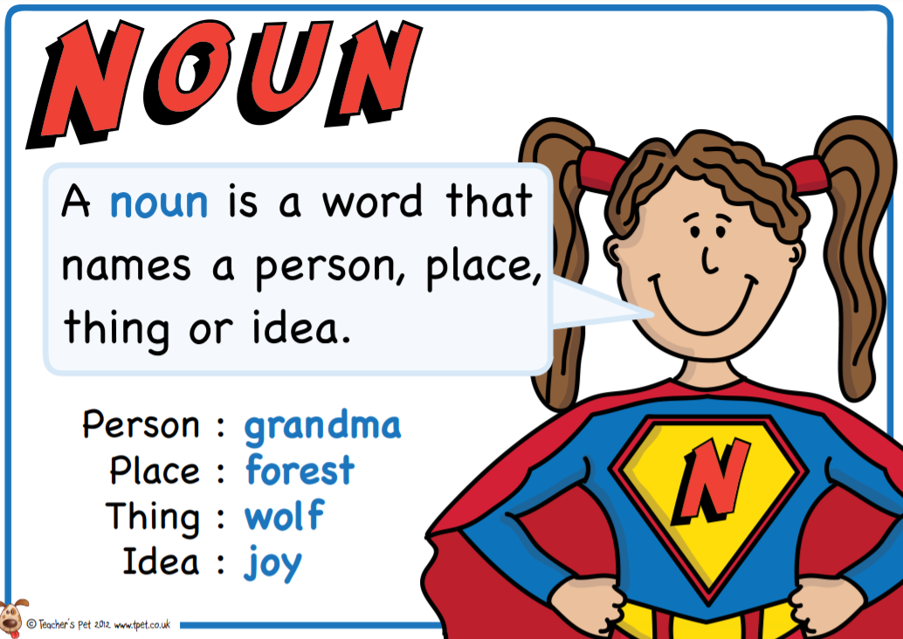
By adding -er to verbs it then changes the verb into a noun.
run runner
build builder

Slide 4
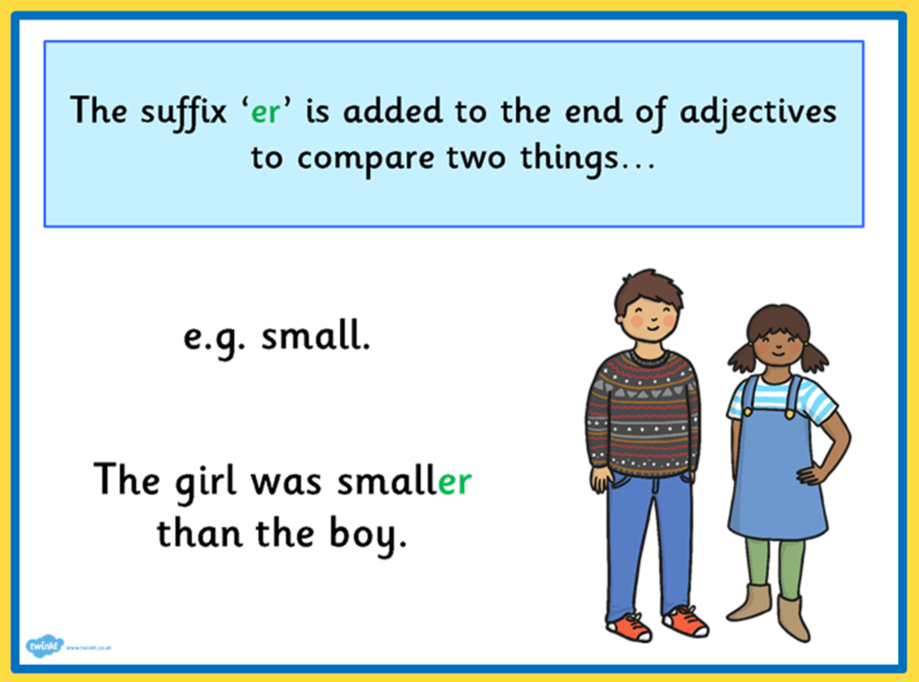
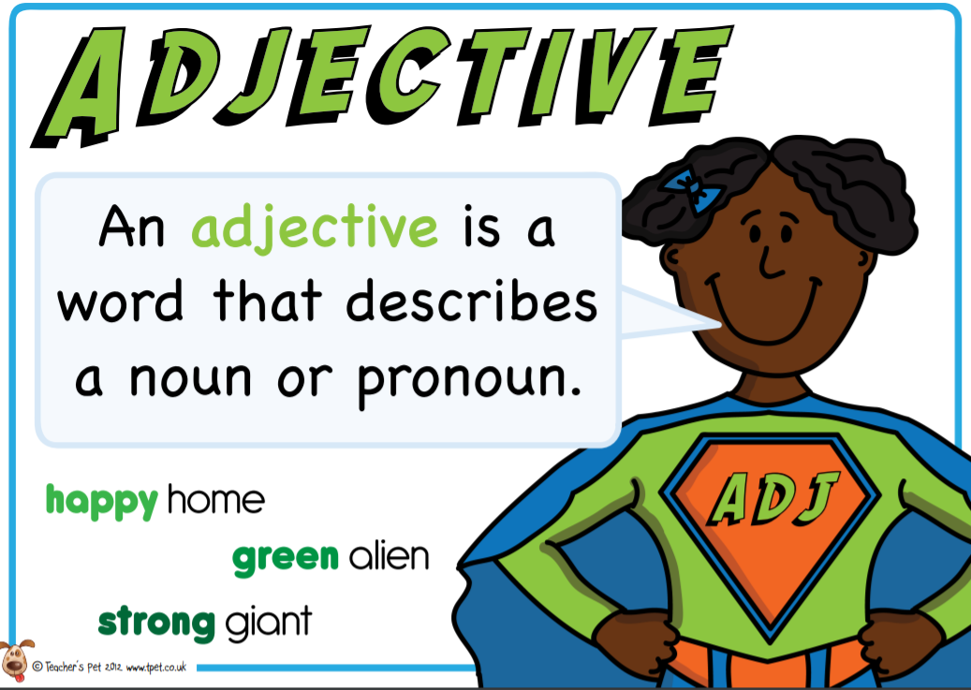
By adding -er to adjectives it changes the adjective into a comparative adjective.
strong stronger
sweet sweeter

Slide 5
Rules for adding -er
1. Just add -er
2. If the word ends in a consonant with a short vowel before it, double the final consonant and then add -er
3. If the word ends in an 'e' drop the 'e' and add -er
4. If the word ends in a 'y' change the 'y' to an 'i' and add -er

Slide 6
Today we are going to focus on:
1. Just add -er
call
play
learn
help
read
listen

Slide 7

Today we are going to focus on:
1. Just add -er
call caller
play player
learn learner
help helper
read reader
listen listener

Slide 8
Today we are going to focus on:
1. Just add -er
clean
quick
green
tall
sweet
smooth

Slide 9

Today we are going to focus on:
1. Just add -er
clean cleaner
quick quicker
green greener
tall taller
sweet sweeter
smooth smoother

Slide 10
Use your English book - Add the suffix –er to these words.
Then choose at least six words from the list and write them into sentences.
high fast low slow rough
soft dark bright loud light
Set your work out like this:
high higher

