Slide 1



Slide 2
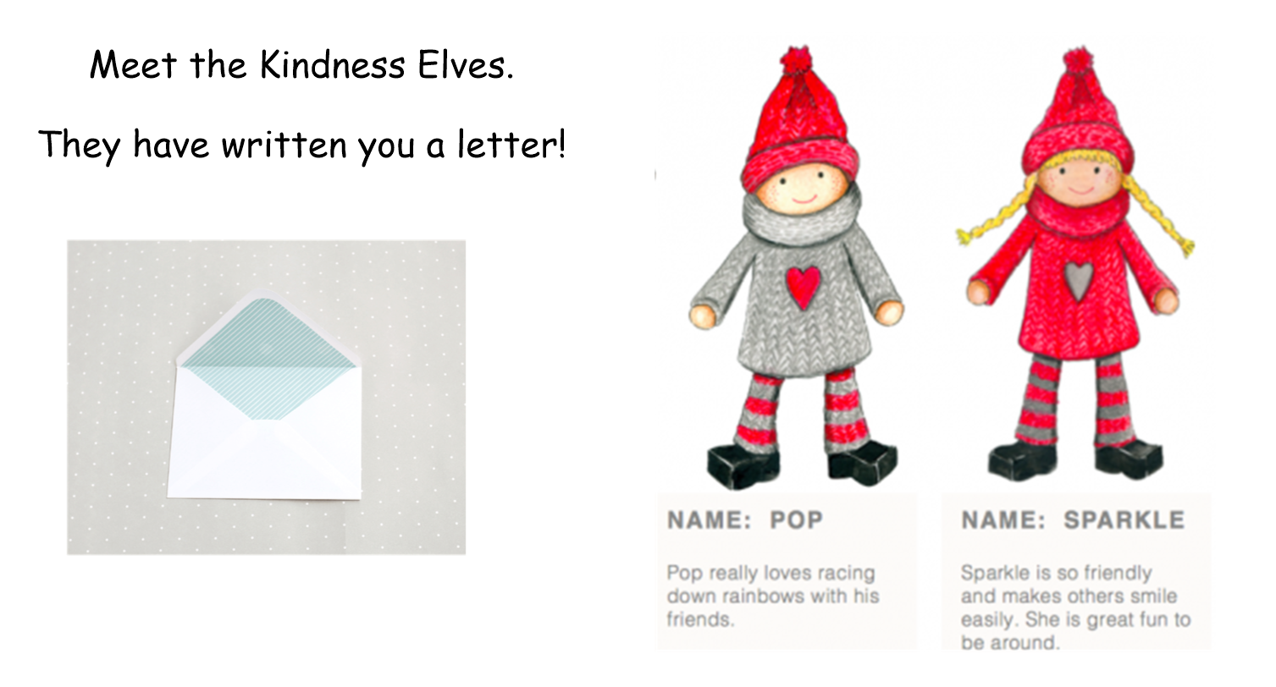

Slide 3
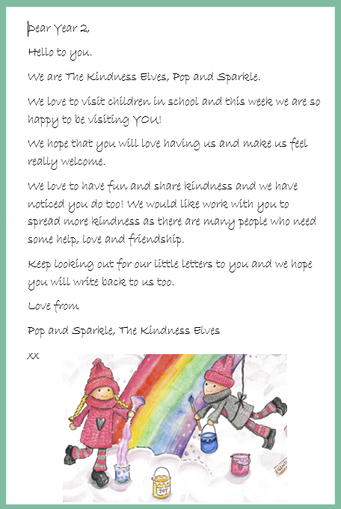

Slide 4


Slide 5
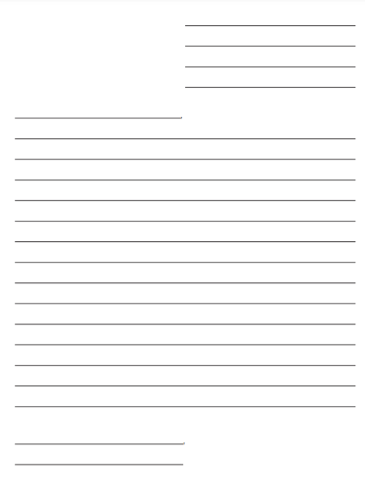
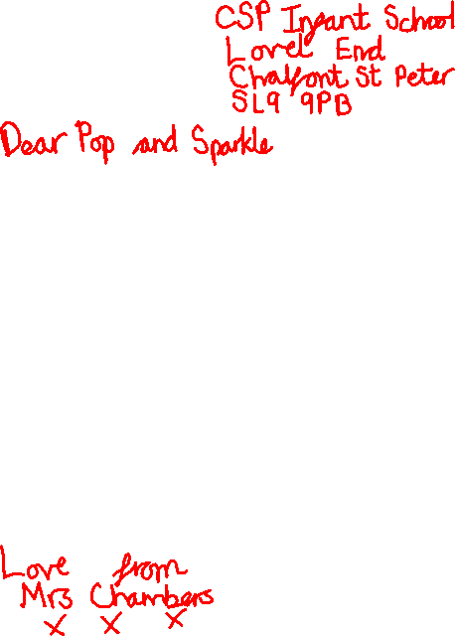
Add your address
Who are you writing to?
Who is the letter from?

Slide 6
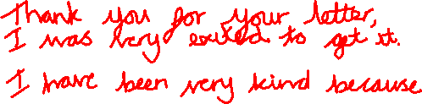
Add your address
Who are you writing to?
Who is the letter from?

