Slide 1


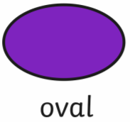











LO: To name 2D shapes and count the number of sides

Slide 2
Fluency
Match 2D shape to its name.
circle
triangle
square
oval

Slide 3
Fluency
Match 2D shape to its name.
hexagon
octagon
pentagon
rectangle

Slide 4


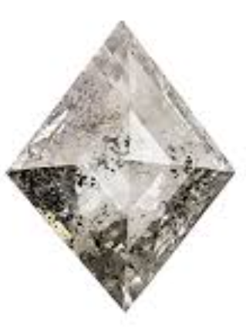

It looks like diamond
jewel!
It looks like a flying
kite!
4 straight sides with
2 pairs of equal length sides
4 equal length sides

Slide 5
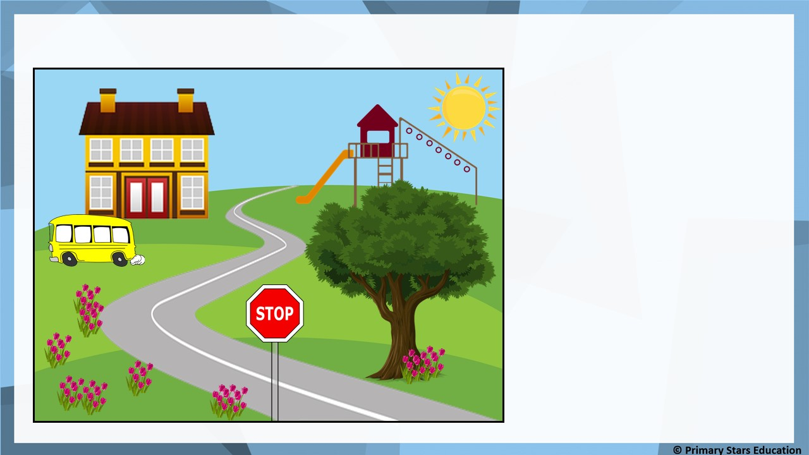

Problem solving
Which 2D shapes can you see in the picture?
Rectangles
Squares
Octagon
Triangles
Circles
Pentagon

Slide 6

Fluency
Complete the table.
Name | Shape | Number of sides
Square
Triangle
Pentagon
4
3
5

Slide 7

Fluency
Complete the table.
Name | Shape | Number of sides
Hexagon
Rectangle
Octagon
6
4
8

Slide 8
Fluency
Which shapes have 4 sides?

Slide 9

Fluency
I am thinking of a shape.
I have 5 sides.
What shape am I?
Pentagon

Slide 10

Fluency
I am thinking of a shape.
I have 1 more than 7 sides.
What shape am I?
Octagon

Slide 11
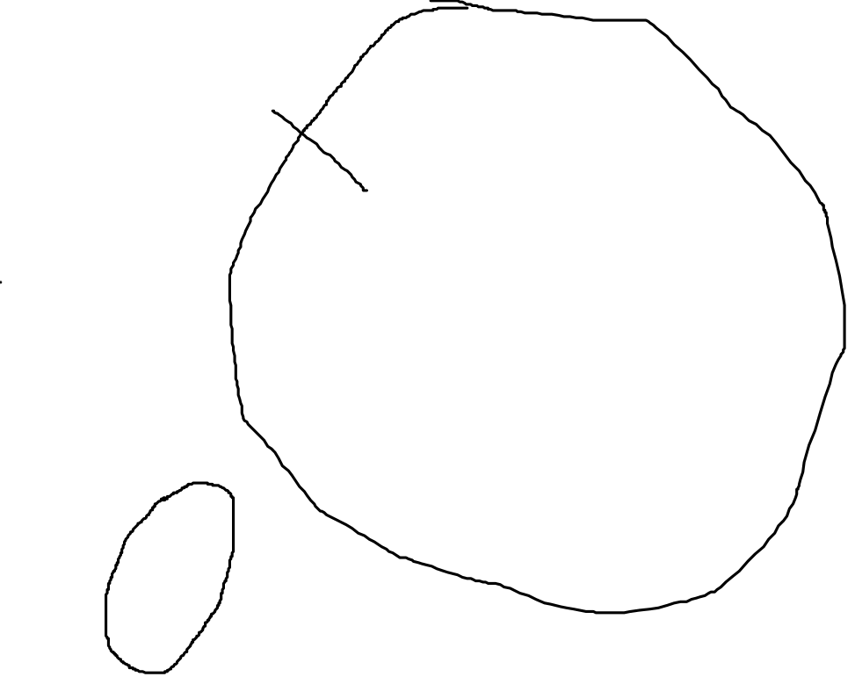
Fluency
I am thinking of a shape.
I have less than 2 sides.
What shape am I?
Circle

Slide 12
Reasoning
Which shape is the odd one out?
Explain how you know.
The odd shape out is the green shape as this has 5 sides.
All the other shapes have 4 sides.

Slide 13

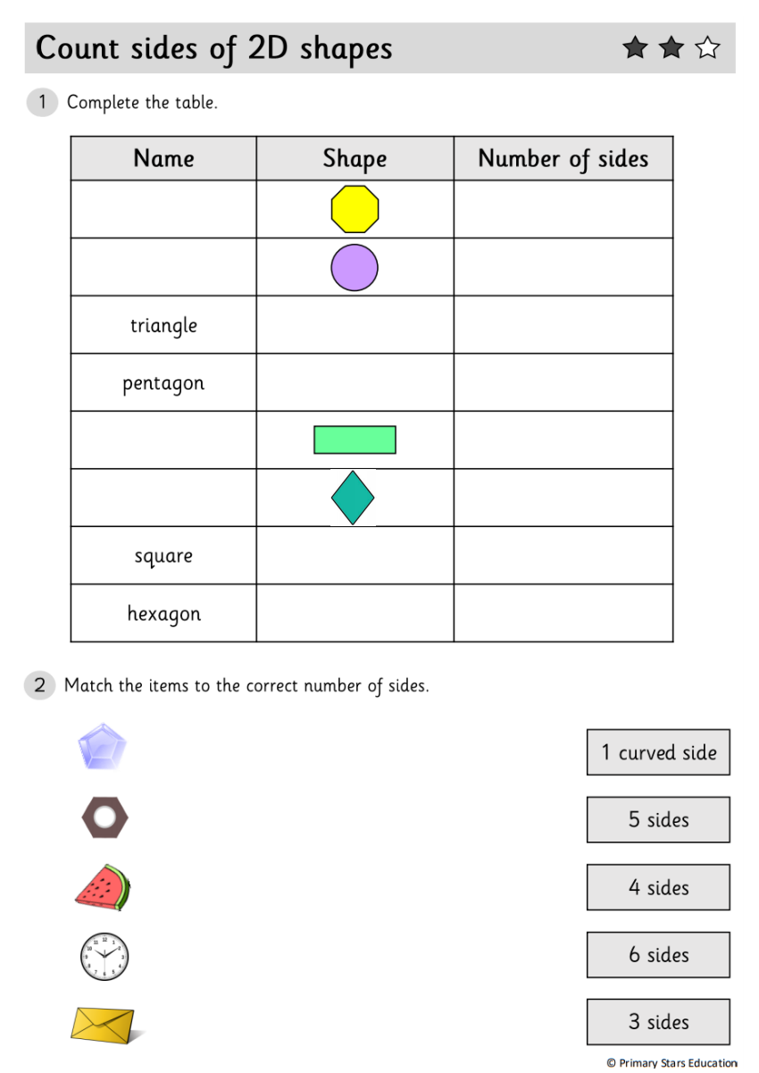
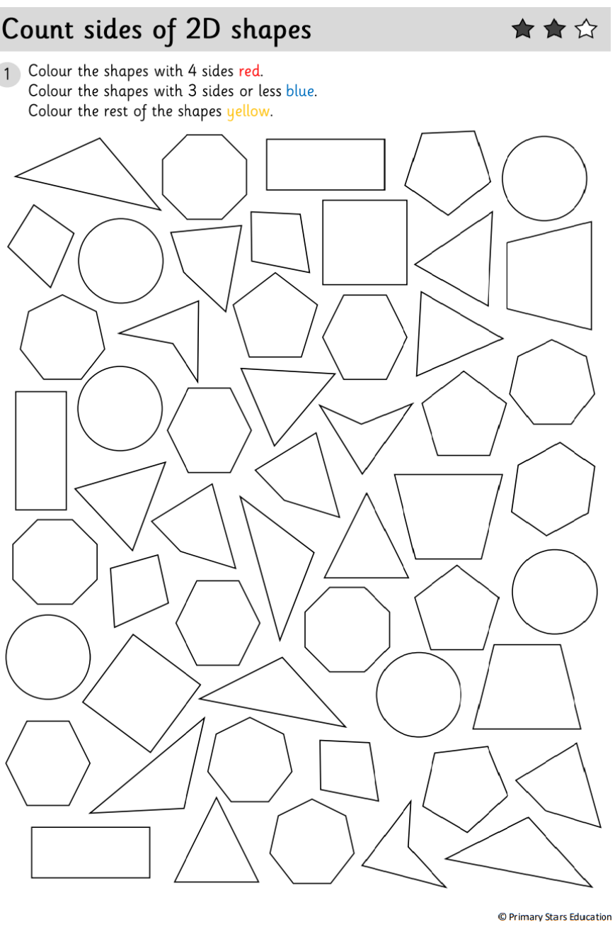
For your activity choose a 1, 2 or 3 Star worksheet ‘Name 2D shapes and Count the Sides’ to complete.
Then choose a 1, 2 or 3 Star worksheet to colour to sort the number of sides on the 2D shapes.
2D Shape Resources – We have added a selection of 2D shape resources into a folder on Twinkl Go! for you to use this week.
You don’t need to have an individual account. Just click on the link on the weekly planner and enter the Child Login
PIN Code: EQ1793

