Slide 1


LO: To add the suffix –er to lists of words ending in ‘y’
Can you remember yesterday’s
rule?

Slide 2
Rules for adding -er
3. If the word ends in an 'e' drop the 'e' and add -er
late brave close nice write

Slide 3
Rules for adding -er
1. Just add -er
2. If the word ends in a consonant with a short vowel before it, double the final consonant and then add -er
3. If the word ends in an 'e' drop the 'e' and add -er
4. If the word ends in a 'y' change the 'y' to an 'i' and add -er

Slide 4
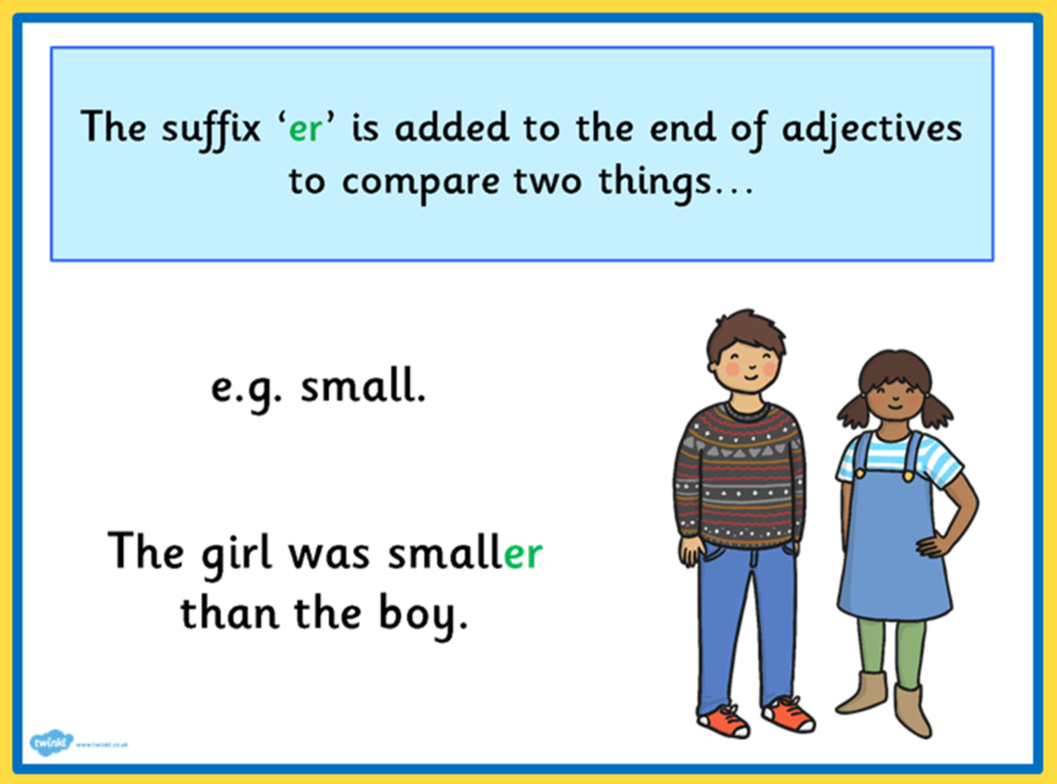
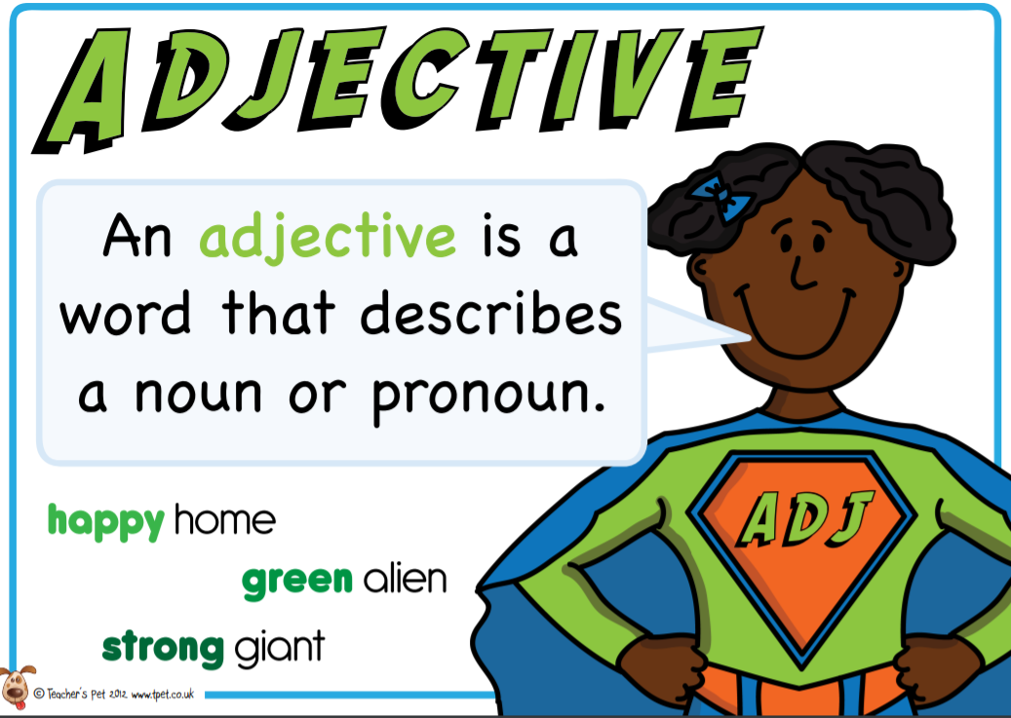
Today we are going to focus on:
4. If the word ends in a 'y' change the 'y' to an 'i' and add -er
lucky luckier
sunny sunnier

Slide 5
Today we are going to focus on:
4. If the word ends in a 'y' change the 'y' to an 'i' and add -er
angry
bumpy
dirty
early
silly
hairy

Slide 6

Today we are going to focus on:
4. If the word ends in a 'y' change the 'y' to an 'i' and add -er
angry angrier
bumpy bumpier
dirty dirtier
early earlier
silly sillier
hairy hairier

Slide 7
Use your English book - Add the suffix –er to these words. Remember to change the ‘y’ to an ‘i’ and add -er
Then choose at least six words from the list and write them into sentences. Try to include a question and an exclamation and use ? and ! in your sentences.
lumpy crazy heavy sunny messy
rainy lucky easy happy funny

