Slide 1

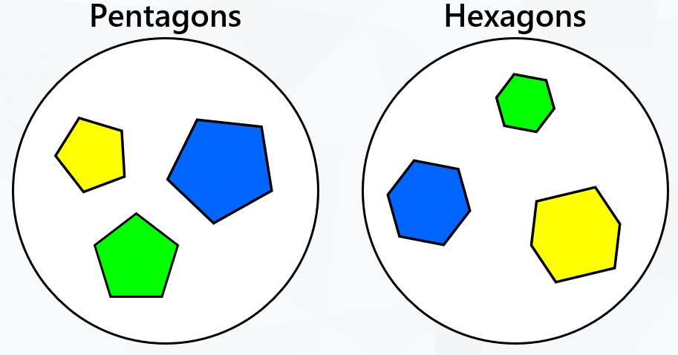

LO: To sort 2D shapes in different ways

Slide 2
Fluency
Sort the shapes into two groups.
Rectangles
Circles

Slide 3
Fluency
Sort the shapes into two groups.
3 sides
4 sides

Slide 4
Fluency
Sort the shapes into three groups.
Pentagons
Hexagons
Triangles

Slide 5
Fluency
Sort the shapes into three groups.
Less than 4 sides
4 sides
More than 4 sides

Slide 6
Fluency
How have these shapes been sorted?
Curved sides
Straight sides
How else could they be sorted?
They could also be sorted by large shapes and small shapes or 1 side more than one side.

Slide 7





Fluency
How have these shapes been sorted?
Rectangles
Triangles
How else could they be sorted?
They could be sorted by 3 sides and 4 sides.

Slide 8

Reasoning
Spot the mistake.
Red shapes
More than 4 sides
The pentagon on the outside should be in the middle section of the Venn diagram as it is red and has more than 4 sides.

Slide 9
Problem solving
How can the following shapes be sorted?
Is there more than one way?
Possible answers:
They could be sorted by colour, size and shape.

Slide 10
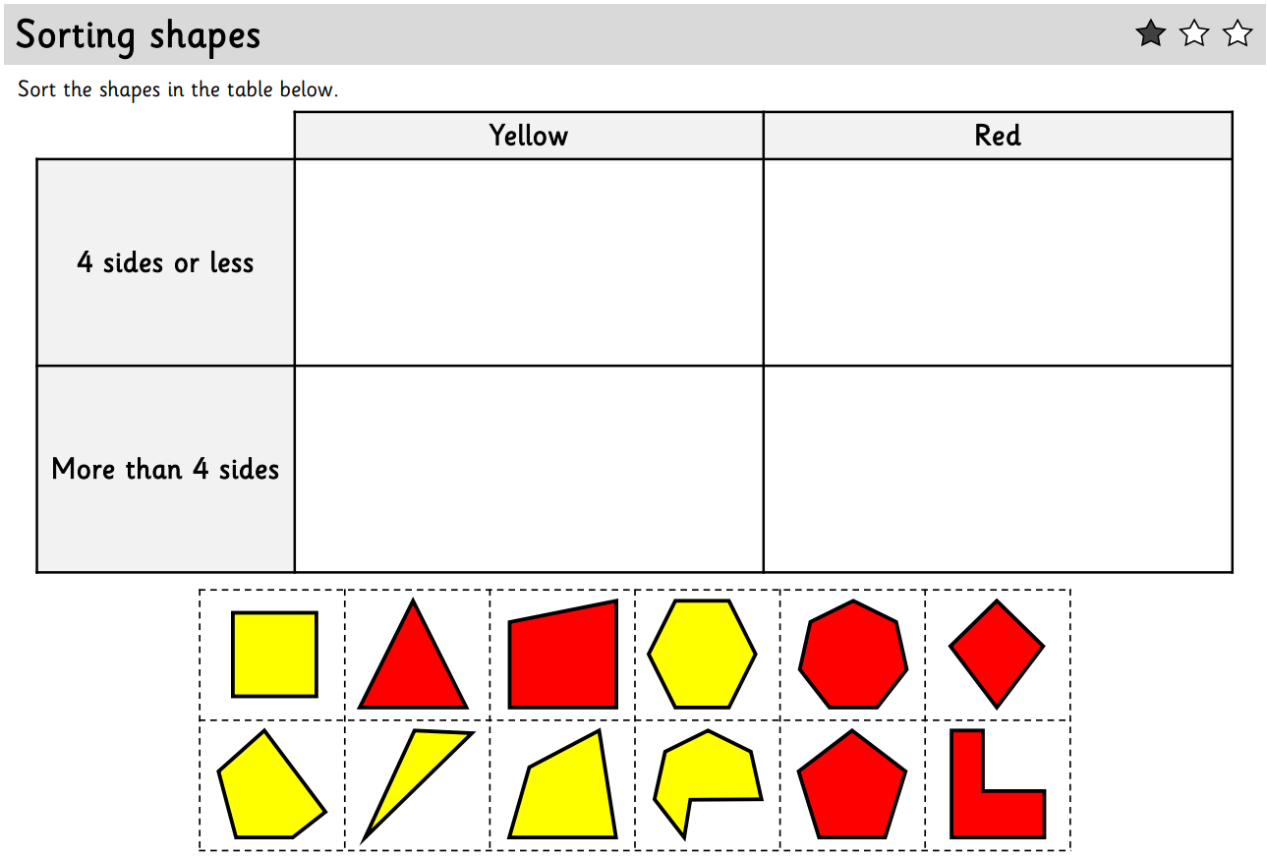
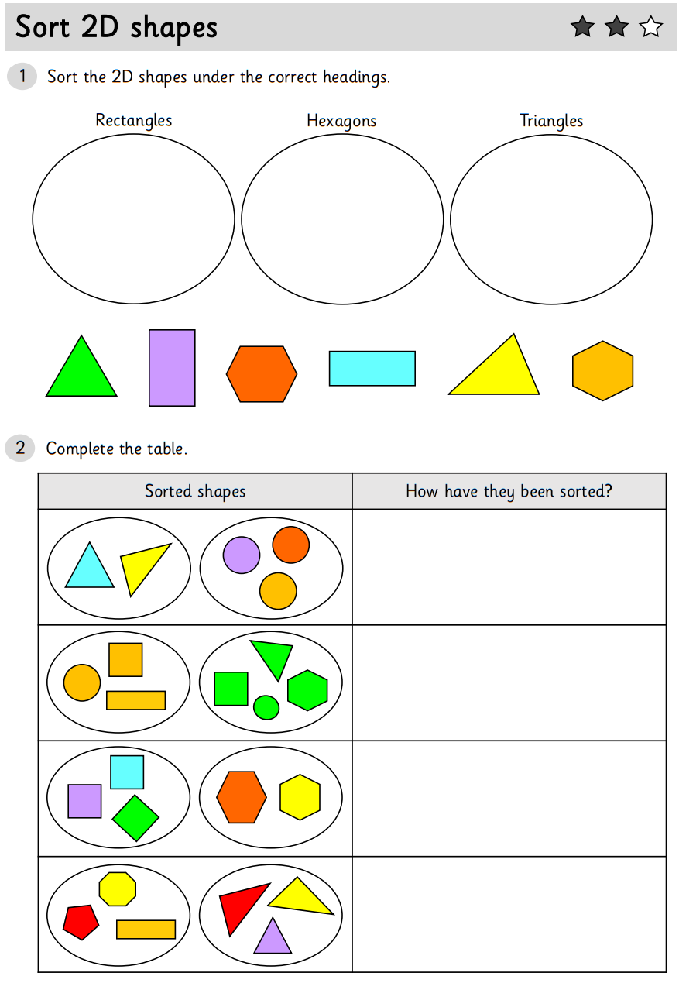
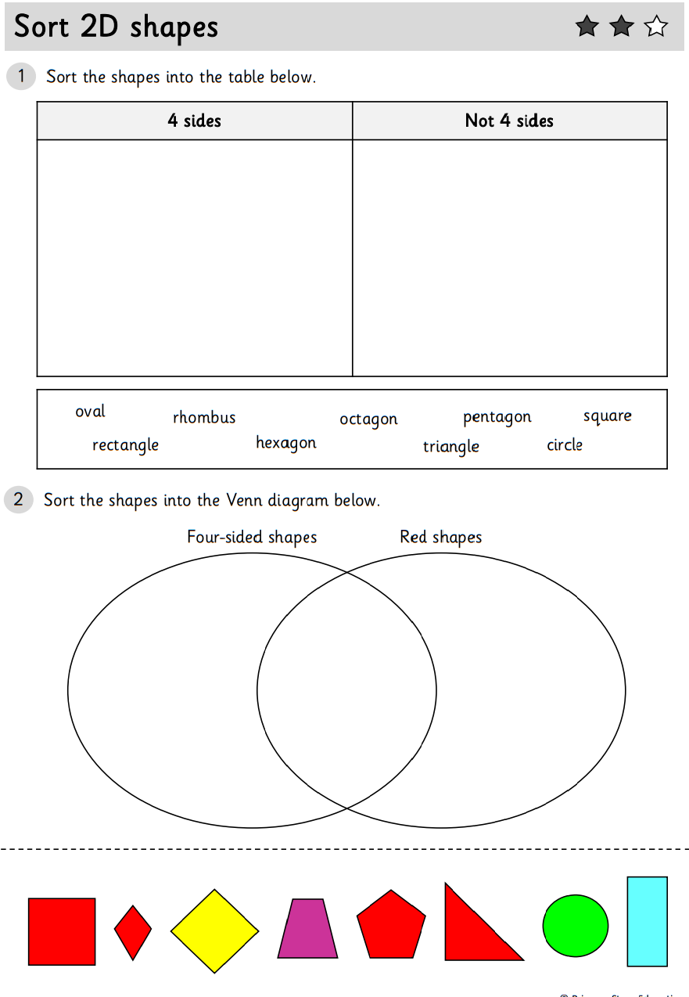
Now choose two 1, 2 or 3 Star worksheets to complete. On the first worksheet sort the shapes and explain how sets of shapes have been sorted. You will need scissors and glue for the second worksheet; cut and stick the shapes to sort them.
There are also 1, 2 and 3 Star ‘Sorting Shapes’ worksheets in the folder that you could complete. You will need your scissors and glue.

