Slide 1
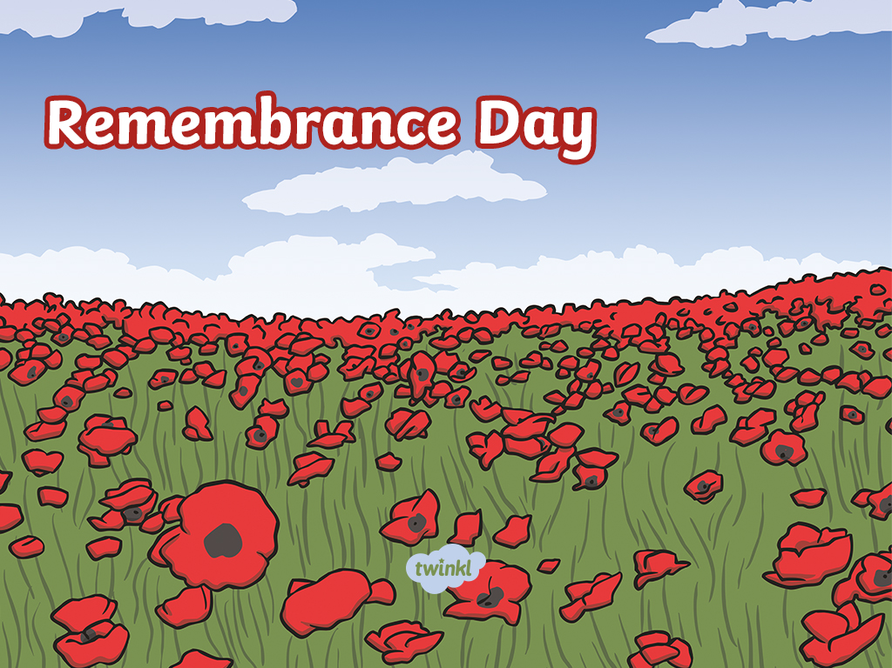

Slide 2
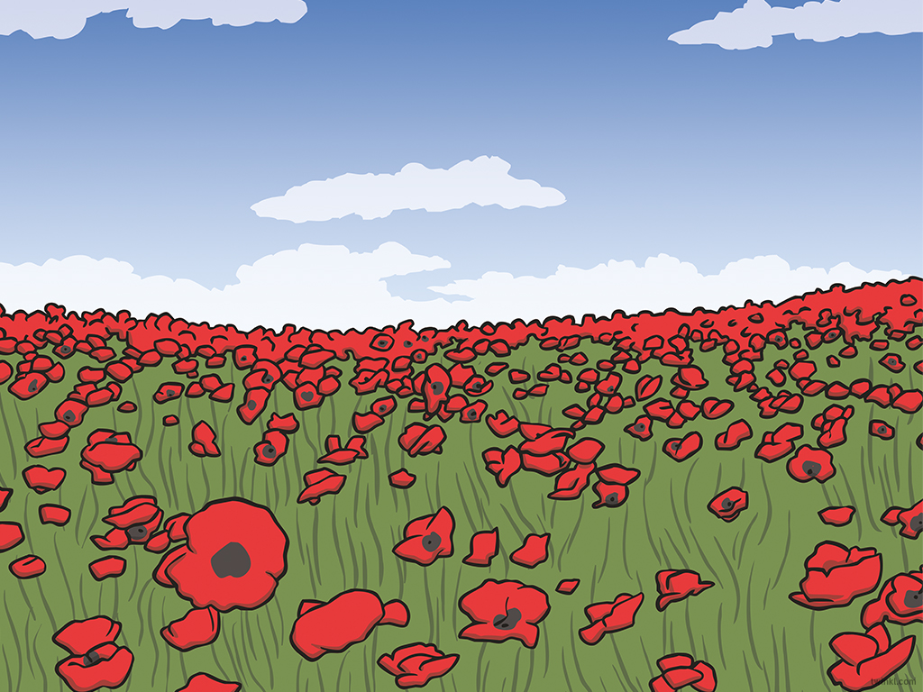
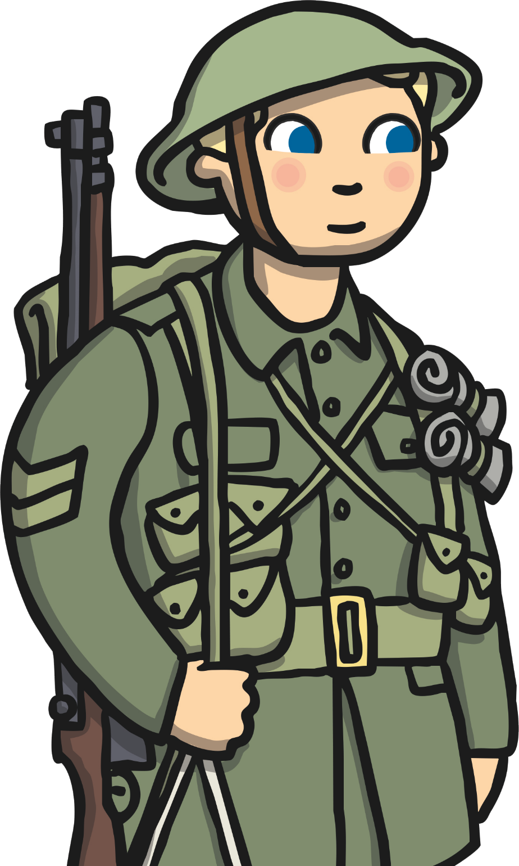
Remembrance Day is held on the 11th of November - the 11th day of the 11th month of the year. A two minute silence is always held at 11am to remember the millions who have died at war.

Slide 3
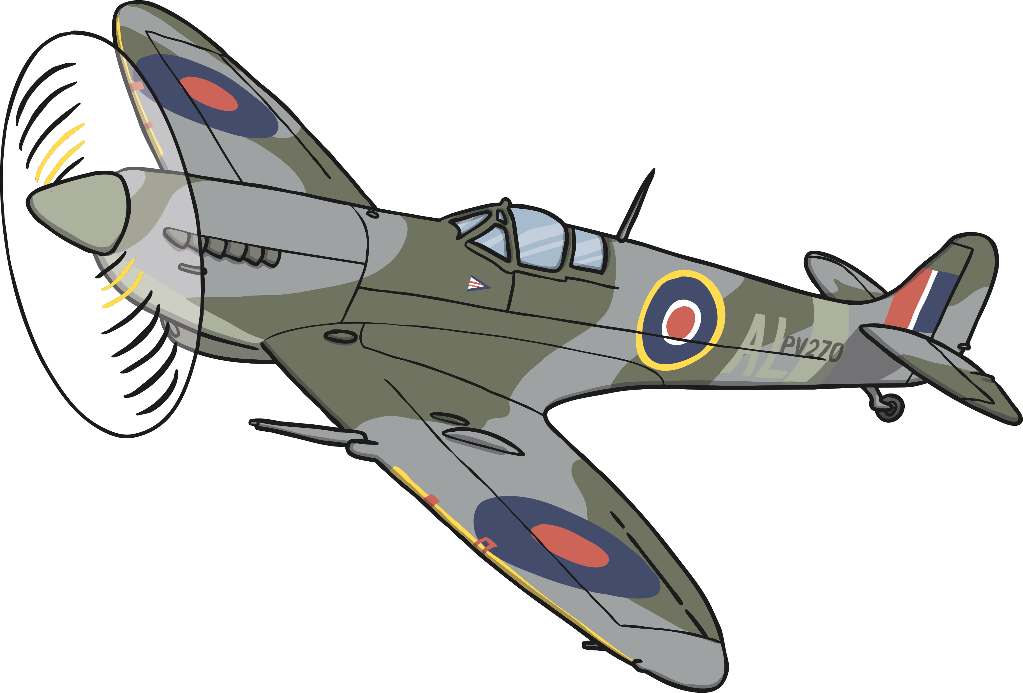
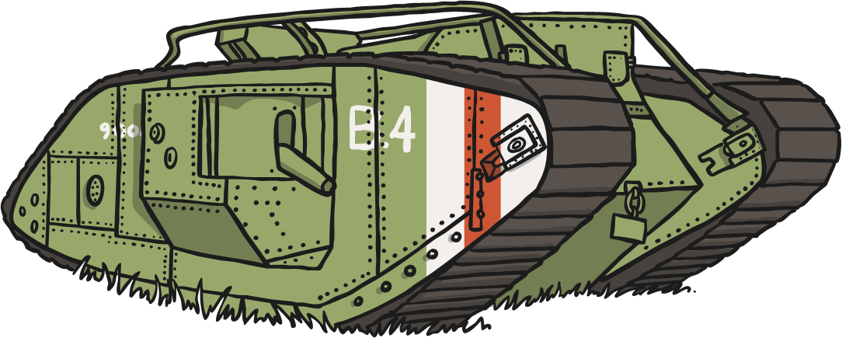
Remembrance Day was first held in 1919, one year after the First World War ended. It is sometimes known as Armistice day.

Slide 4
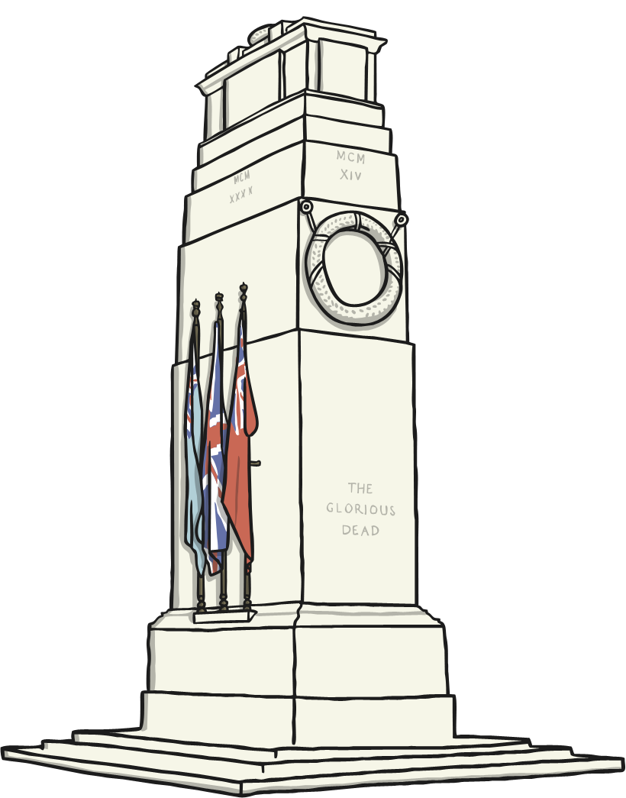
On Remembrance Day, people will lay wreaths of poppies on statues and monuments to remember all the soldiers who died for us.

Slide 5
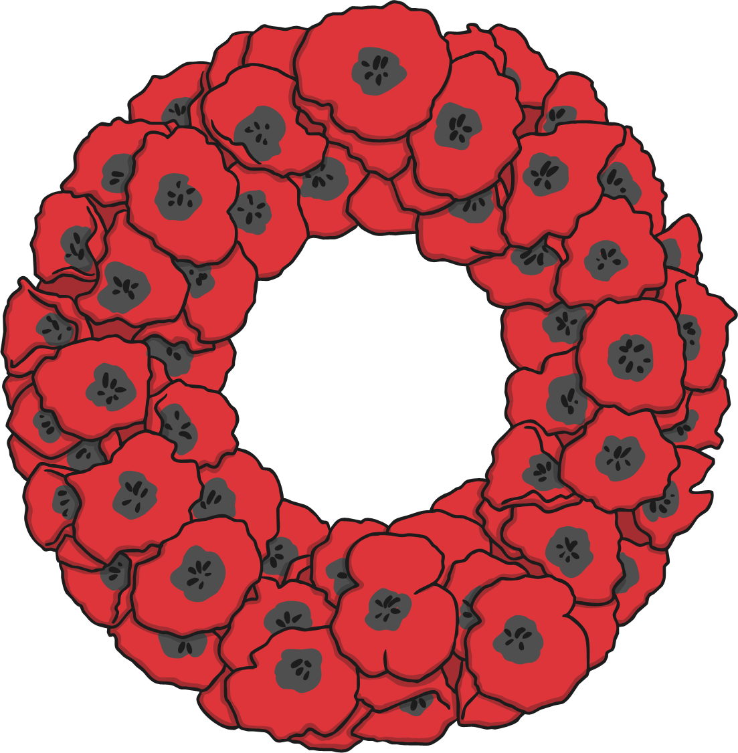
Poppies are worn on Remembrance Day because they are the flowers which grew on the battlefields after the First World War ended.

Slide 6
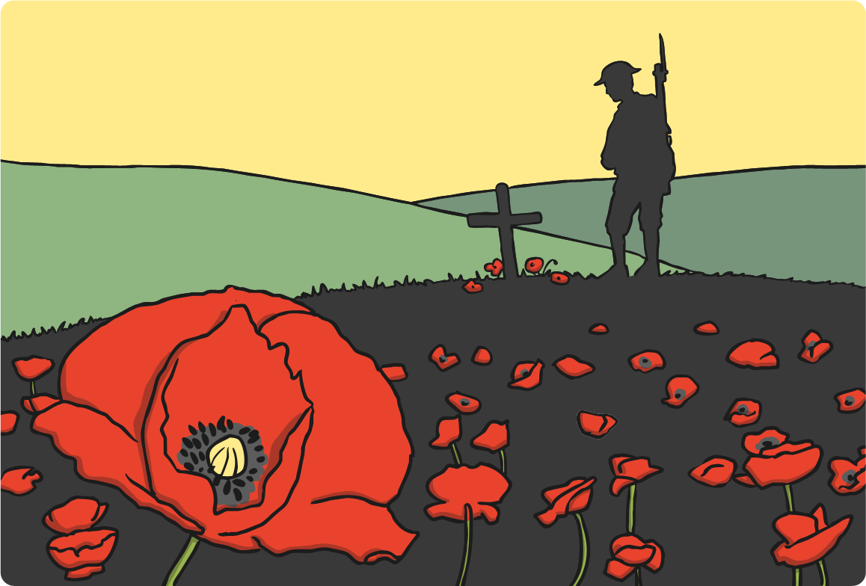
We use Remembrance Day to remember all those who fought for their country, those who died and those who came home.

Slide 7
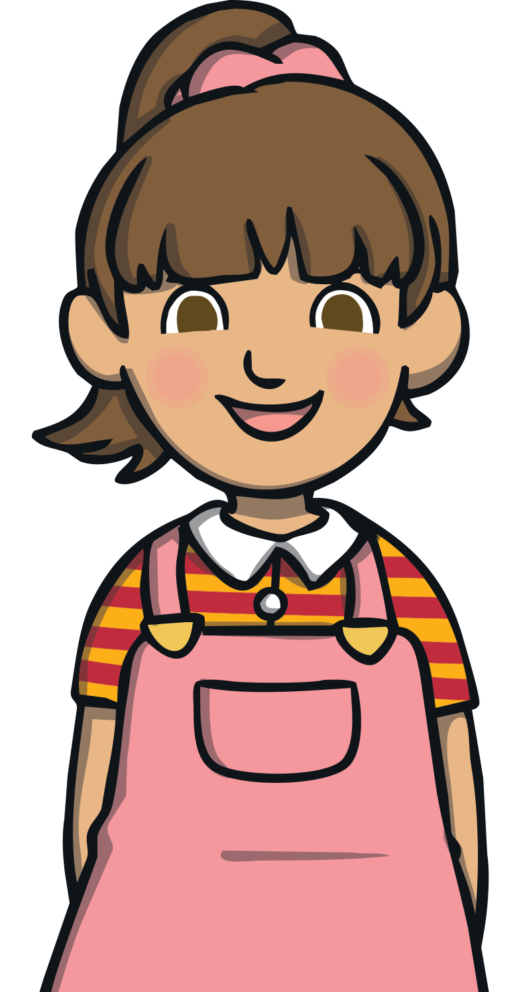
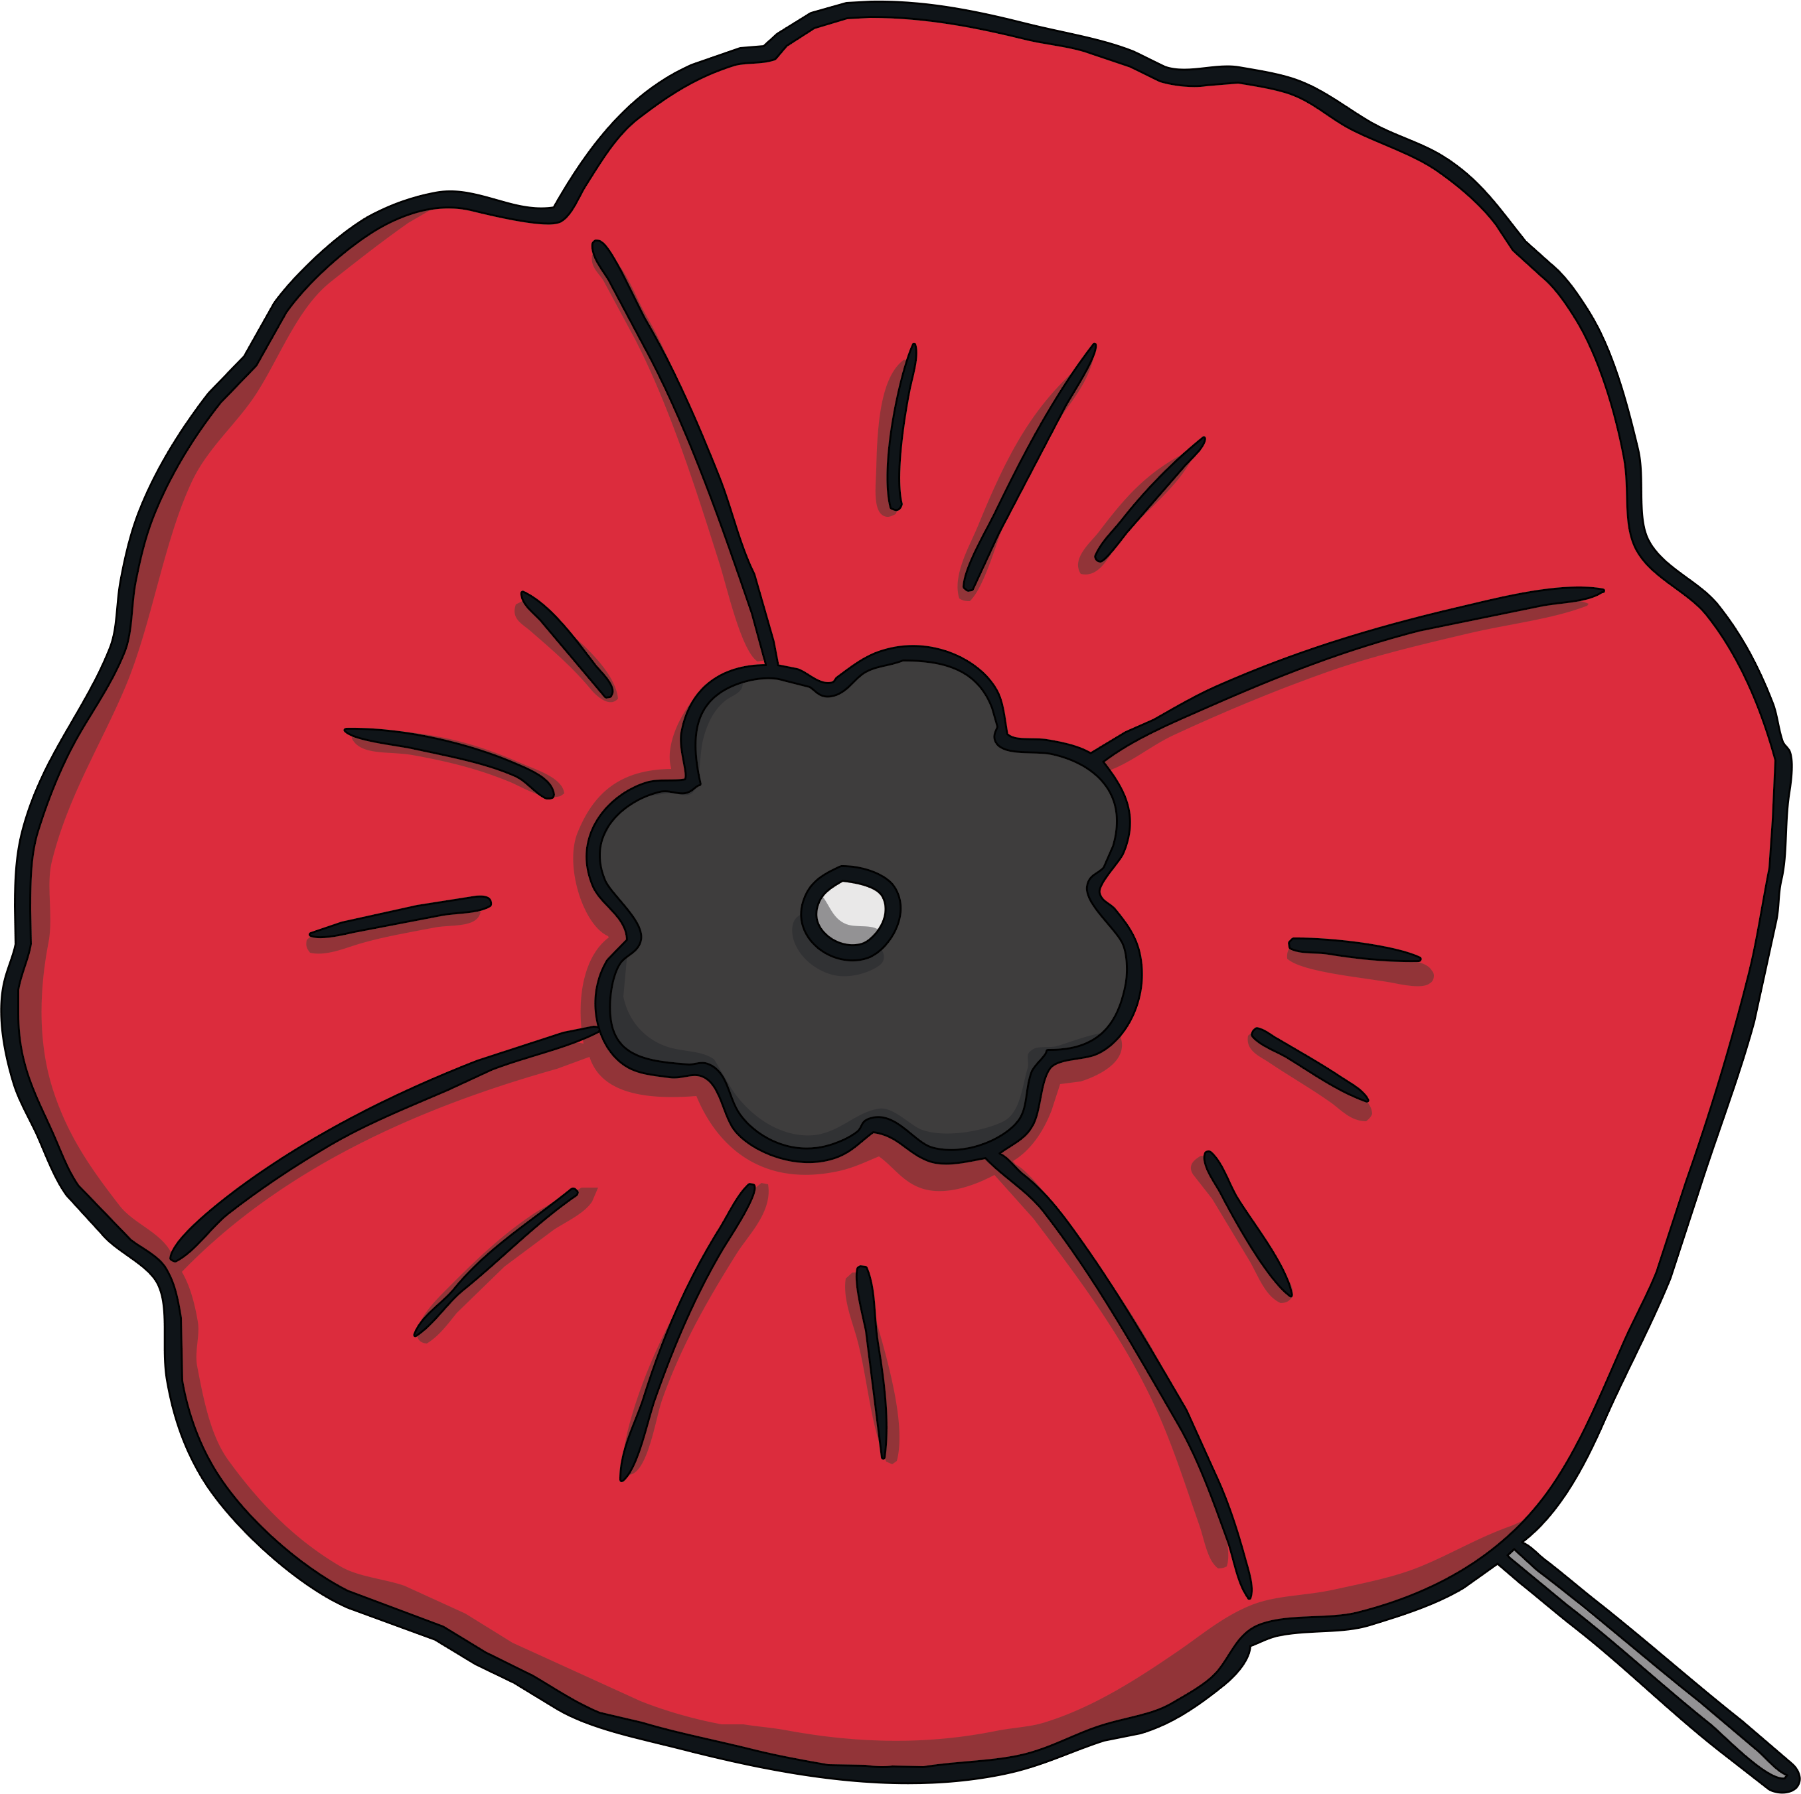
An organisation called the RBL (Royal British Legion) run the Poppy Appeal every year to raise money for men and women who have served or are serving in the Armed Forces. They raise money by selling small poppies.

Slide 8
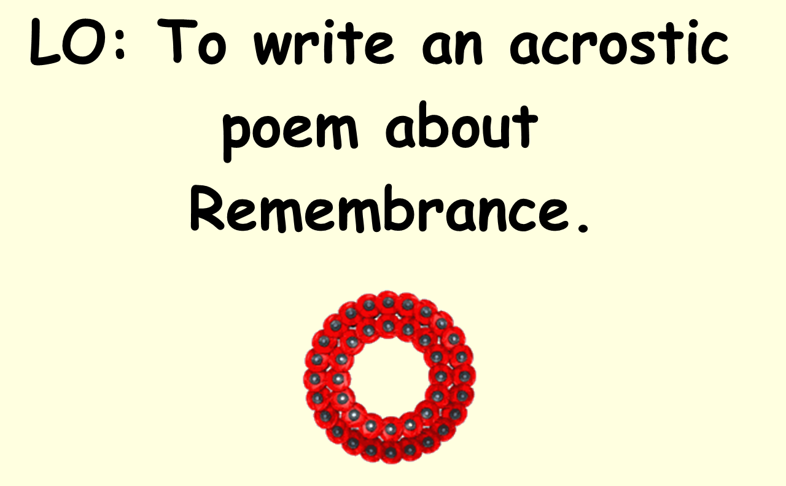

Slide 9
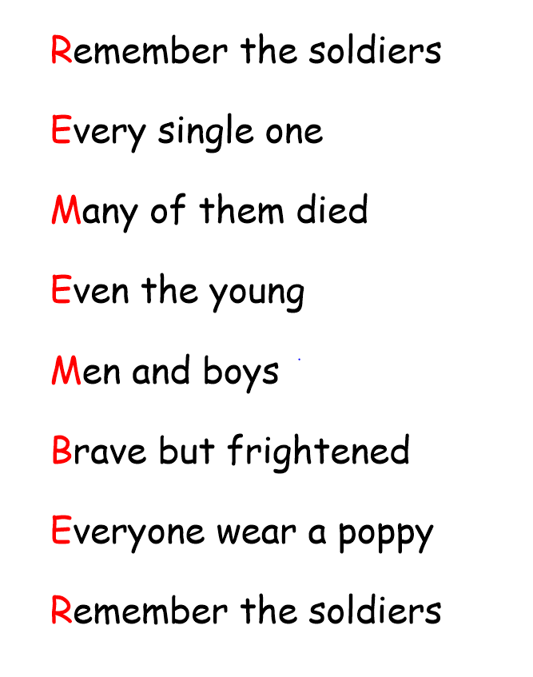

Slide 10
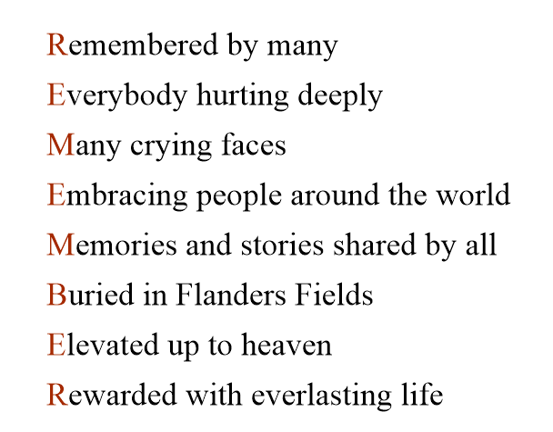

Slide 11
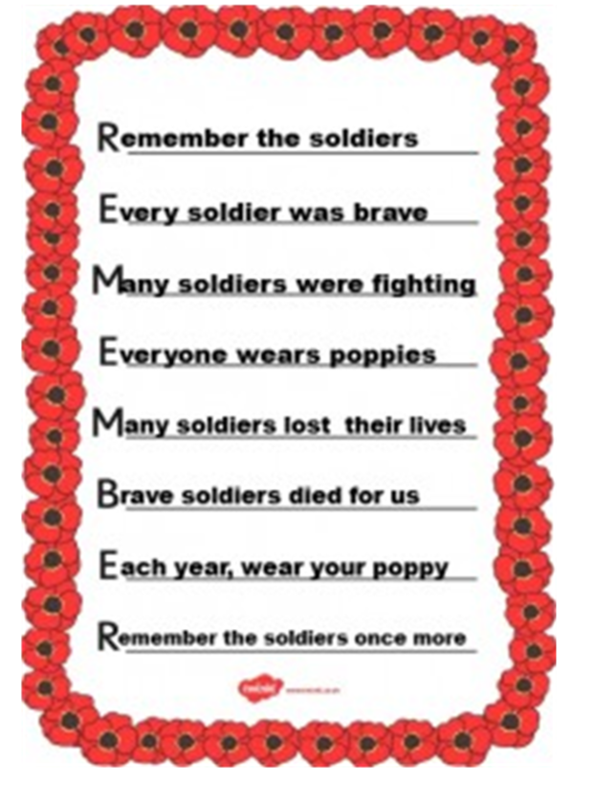

Slide 12


