Slide 1
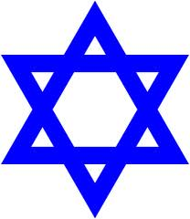
Judaism
Important Jewish occasions

Slide 2
What is Bar Mitzvah or Bat Mitzvah?
Move from being a child to being an adult.
Judaism says a boy is a "bar mitzvah" when he turns 13 and a girl becomes "bat mitzvah" when she turns 12.
The child is now responsible for what they do. If they do anything wrong, it is their fault and not their parents’.

Slide 3
Bar Mitzvah or Bat Mitzvah
The children must now make sure that they follow the Jewish laws.
No ceremony is needed to celebrate this but many people choose to have a special party.

Slide 4
What happens in the service?
On the shabbat following his thirteenth birthday a Jewish boy is called up in front of the congregation (the people) in the synagogue to read a passage from the Torah in Hebrew (quite a long one sometimes!).
He also usually makes a speech, which traditionally begins with the phrase "today I am a man."

Slide 5
Hanukkah
An 8 day Jewish festival.

Slide 6
What is Hanukkah celebrating?
An eight-day festival celebrating a time in
history when the Jews won a battle against
the Greeks to practise their religion freely.

Slide 7
Why does it last for 8 days?
To celebrate, an oil lamp was lit in the temple. There was only enough oil to burn for one day - but miraculously it burned for eight days.
This is why the Hanukkah festival lasts for eight days and why light is the main item in the celebration.
They light a candle each night on a special candle holder called a Menorah.

Slide 8
When is Hanukkah?
December
Do families do anything special at Hanukkah?
Children play with a spinning top called a dreidel.
Families eat special potato cakes called latkes and other oily food to remind them of the importance of the oil lamp.
Presents are also given at this time.

Slide 9
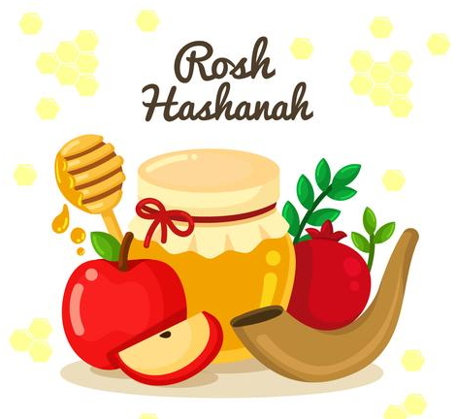
Rosh Hashanah
‘The Head of the Year’
For Jewish people, the New Year is not on the 1st of January.
It is in late September.

Slide 10
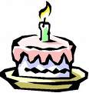

During the festival Jews recall how God created the world in 6 days and rested on the seventh.
Rosh Hashanah
Is a day of rest and a day for new beginnings.
Rosh Hashanah is the birthday of the world.

Slide 11
Rosh Hashanah is also the start of the most solemn part of the year, which last for 10 days. These ten days are called the Days of Repentance.

Slide 12
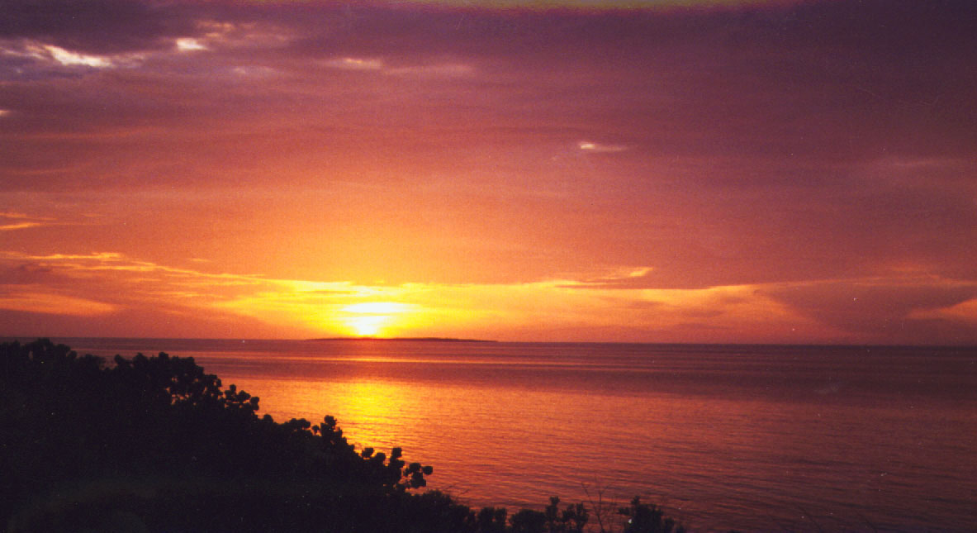
Like all Jewish Festivals, Rosh Hashanah starts at sunset.

Slide 13
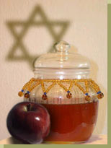
At homes Jews have a special evening meal.
Sometimes this is fish.
A special part of the meal is eating apple dipped in honey.

Slide 14
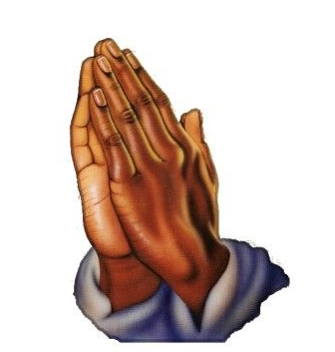
Just before these are eaten the following prayer is recited.
‘Blessed are you O Lord our God, King of the Universe, who creates the fruit of the tree. May it be your will, God of our fathers, to renew us in a good and sweet year.

