Slide 1

Rules for adding ed

Slide 2
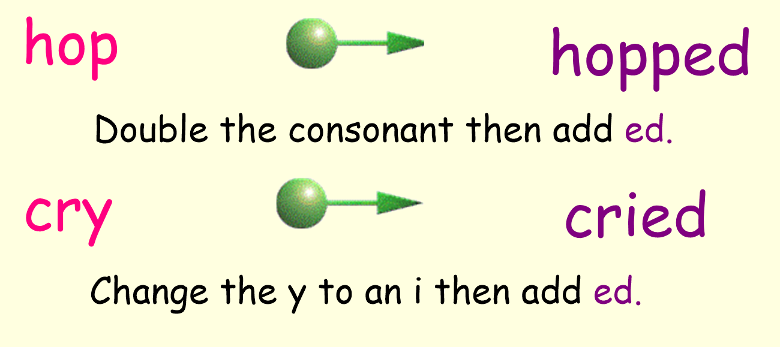
Rules for adding ed

Slide 3
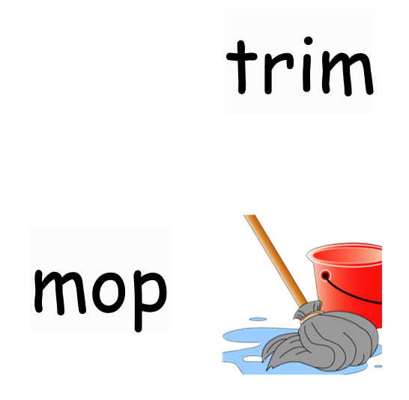

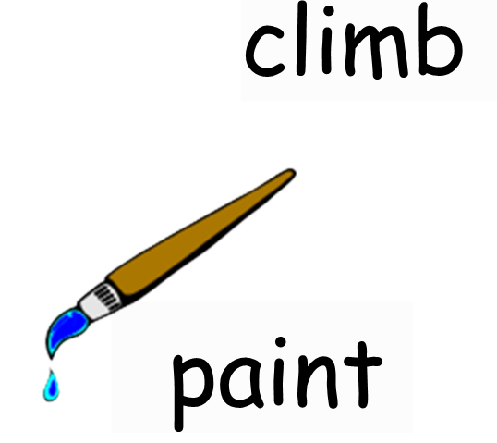

Add ed to these words then add them to the ed sorting grid

Slide 4




Add ed to these words then add them to the ed sorting grid

