Slide 1
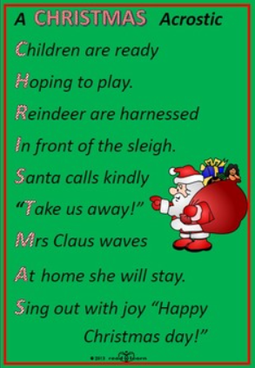


Christmas acrostic poems

Slide 2
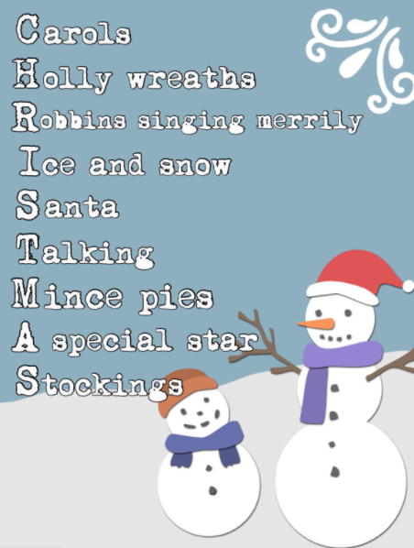
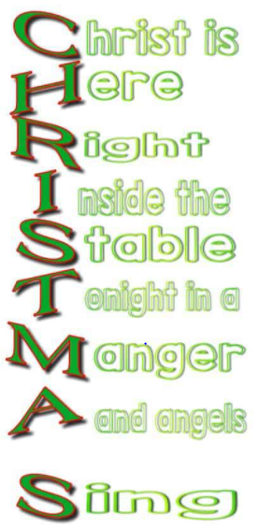

Slide 3
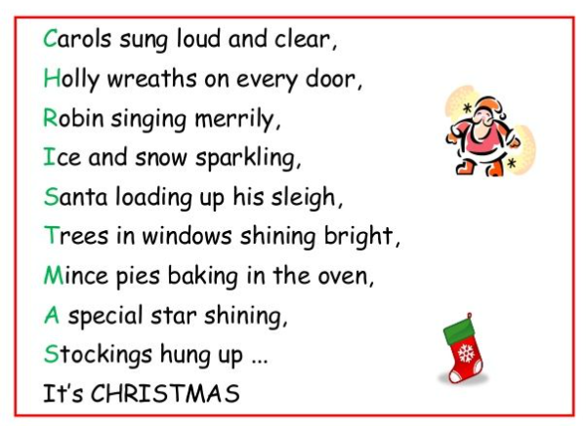

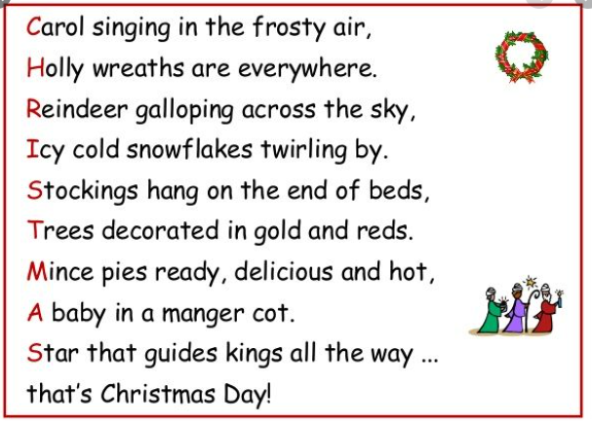


Slide 4




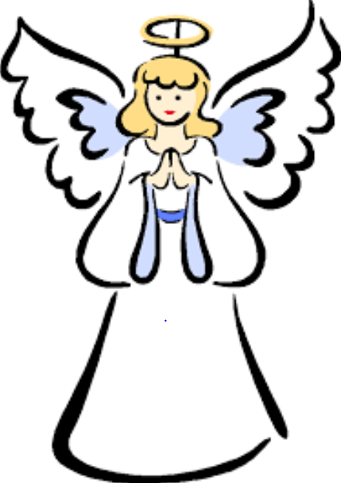
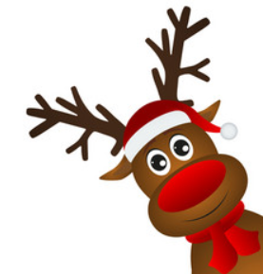
Christmas holly crackers tree
presents reindeer Santa sing
snow robin star mince pie merry
angels manger baby Jesus icy
elves stocking holy Rudolph turkey

