Slide 1
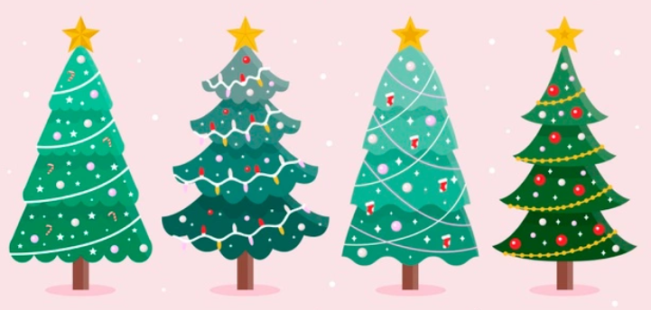

Friday comprehension

Slide 2


