Slide 1



Slide 2
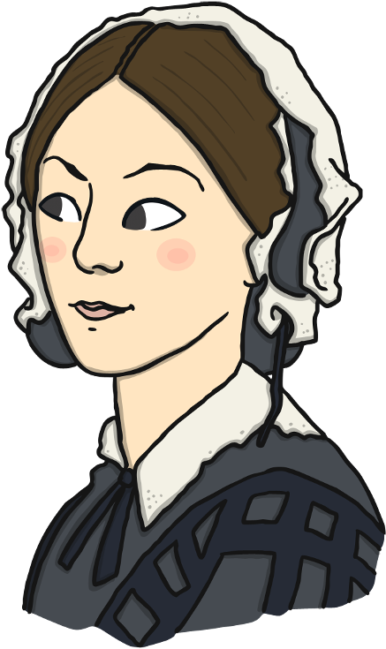
Who Was Florence Nightingale?
Florence Nightingale was born in 1820.
She became a nurse and helped soldiers who were hurt in the war.
Florence changed the way hospitals looked after their patients and, by doing this, saved many, many lives.
She is known as the ‘Lady of the Lamp’ because she carried a lamp with her when she checked on her patients in the night.
She is still famous today.
v

Slide 3
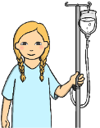
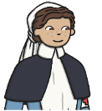

Why Is Florence Nightingale Remembered?
She changed the way that hospitals looked after their patients.
She changed the way that people thought about nurses.
She changed the way that people thought about women.

Slide 4
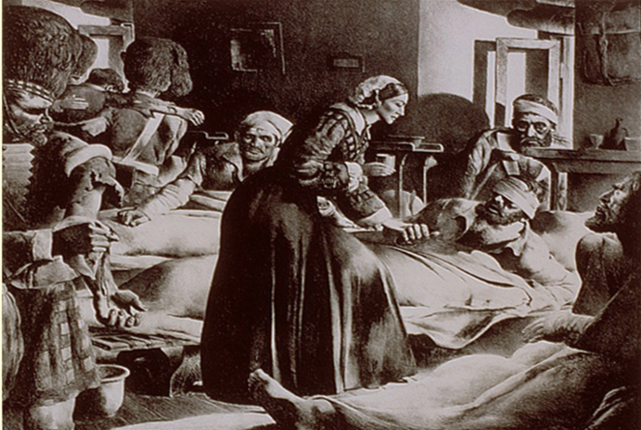
How Did Florence Nightingale Help?
She changed the way hospitals looked after their patients.
Before Florence Nightingale arrived at the Scutai Hospital, hospitals were overcrowded and filthy dirty. Rats ran everywhere! There were no proper toilets and the drains were blocked. The smell was terrible! There were not enough beds so men lay on the floor. Their clothes and bandages were dirty because they were hardly ever changed. There weren’t enough doctors to help the patients and more soldiers were dying from diseases than in battles.
Florence Nightingale knew
she had to change the way
hospitals looked after their patients.

Slide 5



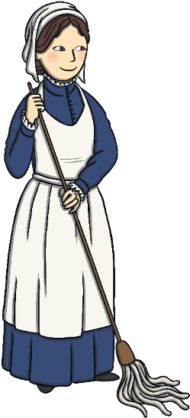


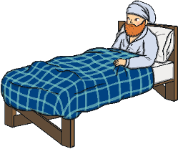
How Did Florence Nightingale Help?
Florence worked for twenty hours a day to improve the hospital.
She…
Scrubbed the floors
Cleaned the wards
Washed the bedclothes
Provided fresh, healthy food
Paid men to clear the drains
Changed bandages and kept wounds clean
Made sure the soldiers were properly fed and clothes
At night Florence walked around the wards to make sure
the men were comfortable.
Florence trained a team of nurses to help her improve
hospitals

Slide 6
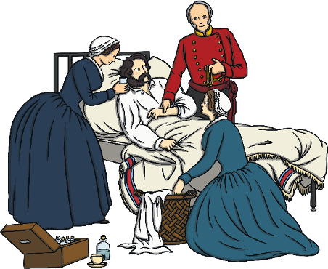
How Did Florence Nightingale Help?
Florence Nightingale showed that trained nurses and clean hospitals could help sick people to get better.
Because of this, she is called the founder of modern nursing.

Slide 7

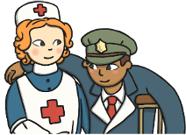
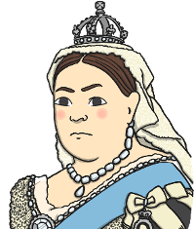
How Did Florence Nightingale Help?
She changed the way that people thought about nurses.
In the past, most people thought that only male doctors could look after patients and that nurses should only do the tidying and cleaning up.
In the past, nurses were not trained.
Florence Nightingale met Queen Victoria and told her what was wrong with army hospitals.

Slide 8
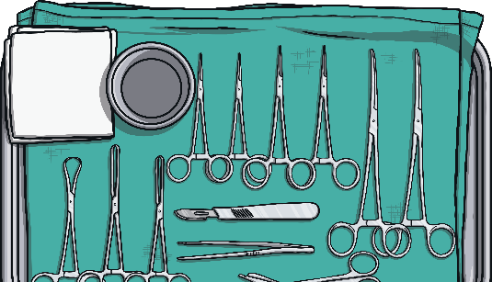



How Did Florence Nightingale Help?
She changed the way that people thought about nurses.
She opened a nursing school called the ‘Nightingale Training School for Nurses’.
Florence Nightingale wrote a book called Notes for Nursing.

Slide 9
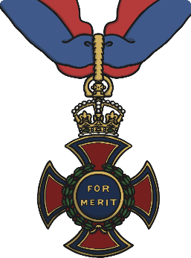
How Did Florence Nightingale Help?
In 1907, Florence Nightingale was awarded the Order of the Merit by Queen Victoria.
She was the first woman to receive this honour.

Slide 10
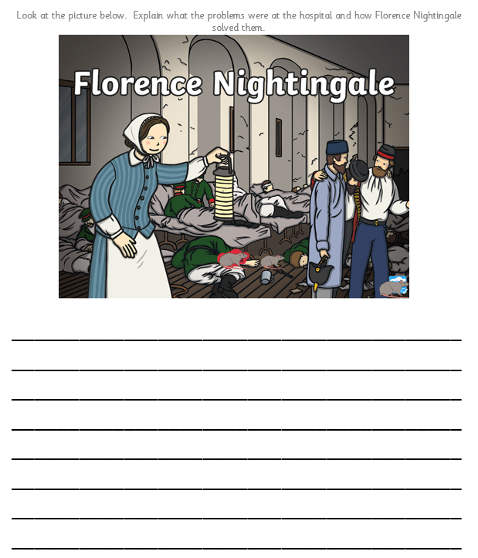
For your activity you are going to think about the problems at the hospital before Florence Nightingale arrived. Then you are going to think about how Florence solved the problems to make the hospital a cleaner and safer place to be.
Use the information in this PowerPoint and the picture on your activity sheet in the folder to help you write your sentences.

