Slide 1

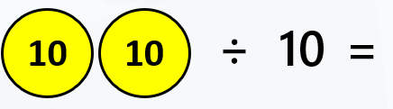


LO: To divide by 10
2

Slide 2

Fluency
How many 10s in 30?
10
10
10
÷
10
=
3
30
10
3
_____ ÷ _____ = _____
3
There are _____ tens in 30.

Slide 3
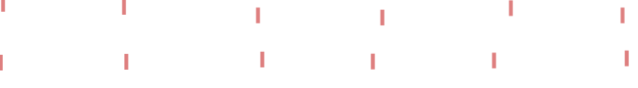
Fluency
How many 10s in 60?
10
10
10
10
10
10
÷
10
=
6
60
10
6
_____ ÷ _____ = _____
6
There are _____ tens in 60.

Slide 4

Fluency
How many 10s in 70?
10
10
10
10
10
10
10
÷
10
=
7
70
10
7
_____ ÷ _____ = _____
7
There are _____ tens in 70.

Slide 5
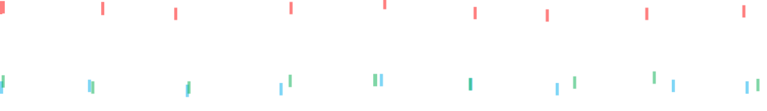
Fluency
How many 10s in 90?
10
10
10
10
10
10
10
10
10
÷
10
=
9
90
10
9
_____ ÷ _____ = _____
9
There are _____ tens in 90.

Slide 6
Fluency
How many 10s in 40?
10
10
10
10
÷
10
=
4
40
10
4
_____ ÷ _____ = _____
4
There are _____ tens in 40.

Slide 7

This representation shows there are 5 tens in 50.
True or false?
Reasoning
10
10
10
10
10
÷
10
=
50
False
The answer should be 5 (not 50).
50 ÷ 10 = 5 tens.

Slide 8
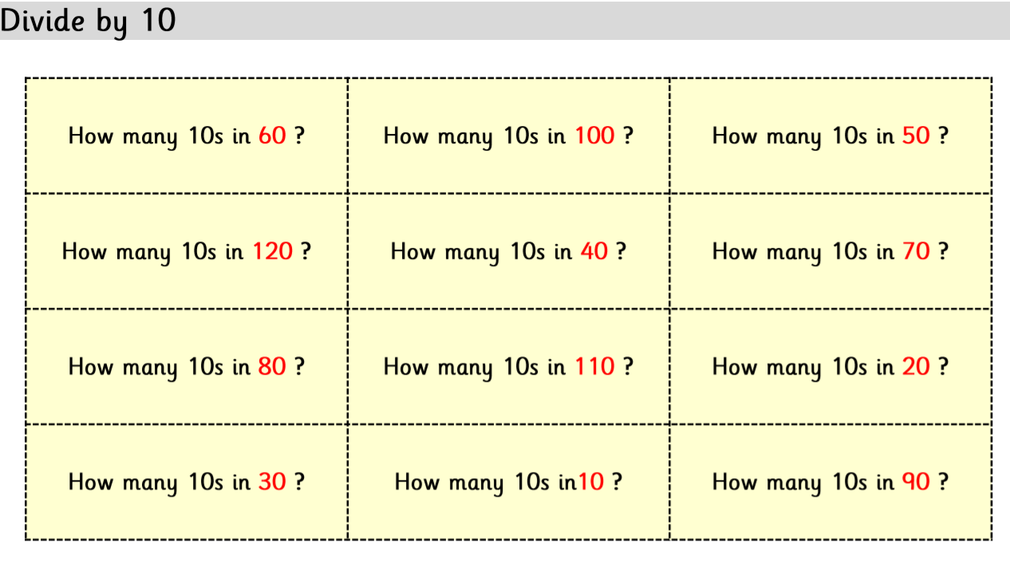
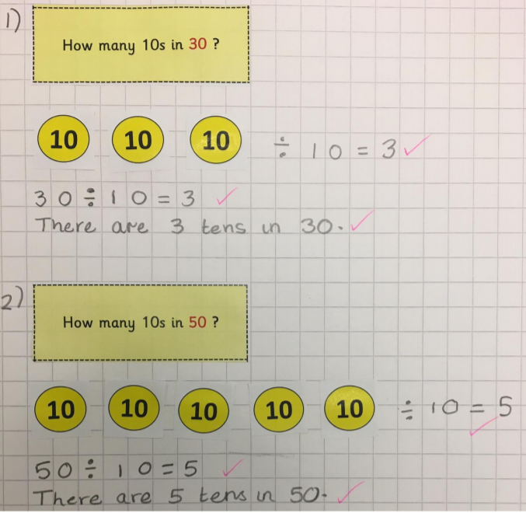
For your activity use the squared paper in the folder or your Maths book if you have collected it.
Alternatively use the 1 Star sheet in the folder for extra support.
Answer the division questions on this slide by drawing groups of 10, in circles, to represent the tens number (coloured in red).
Then count how many groups you have made and write this as you answer. Now show this representation as a sum and complete a sentence to explain how many tens are in each number.
Set your work out like this:

