Slide 1
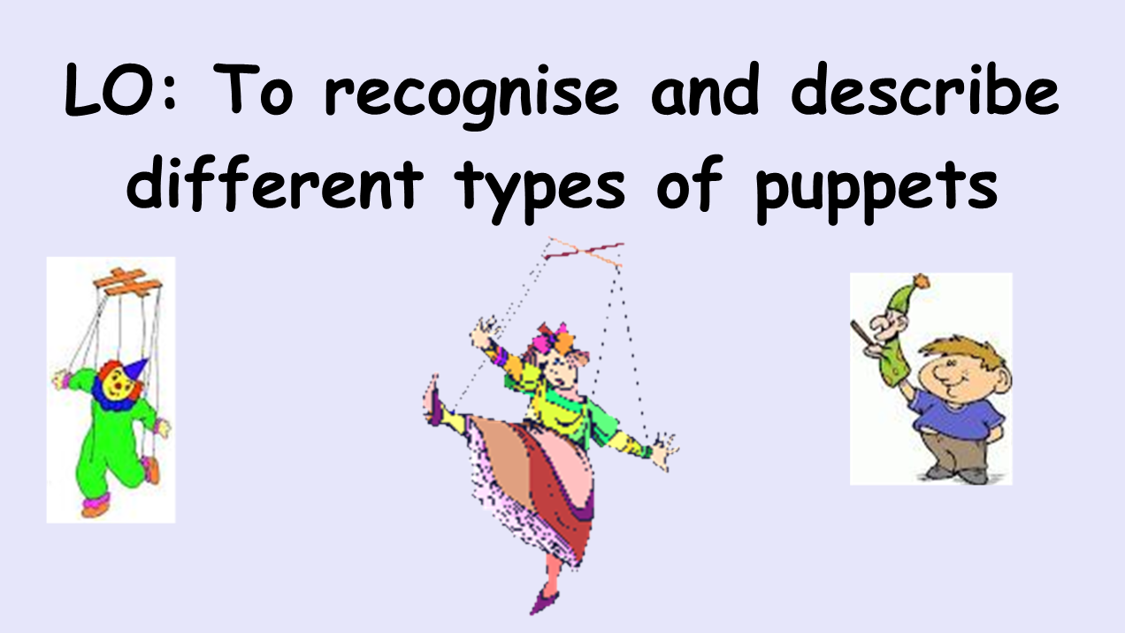


Slide 2
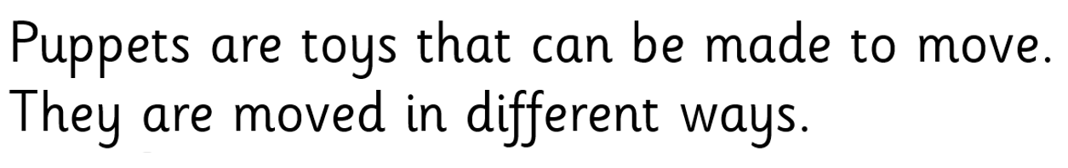
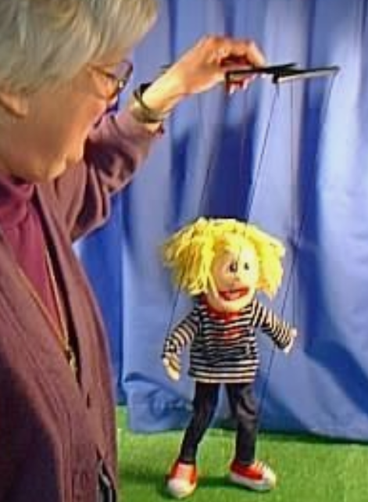
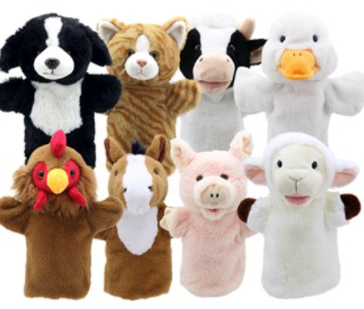

Slide 3
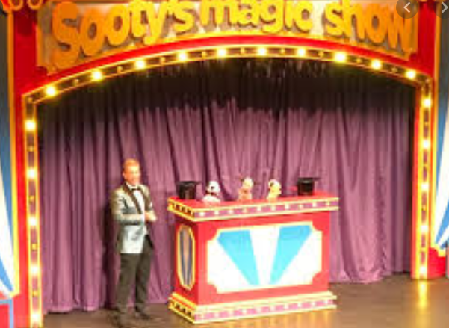
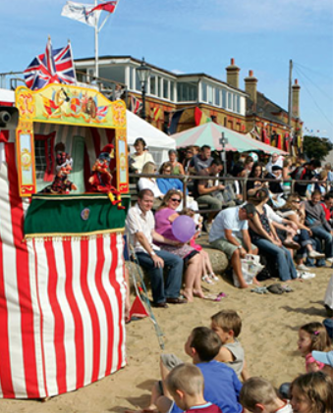
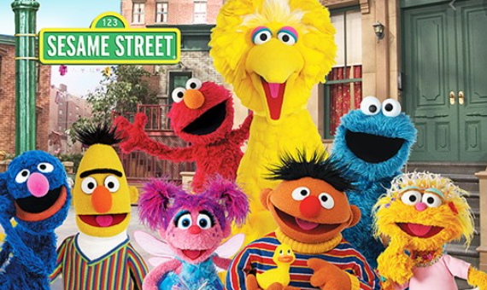
Puppets can be used as a form of entertainment.
Punch and Judy show
at the seaside
Sesame Street TV
programme
Sooty Show at the theatre

Slide 4
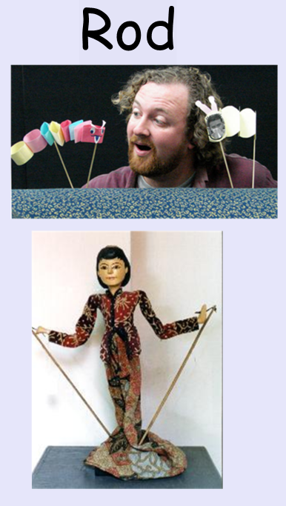
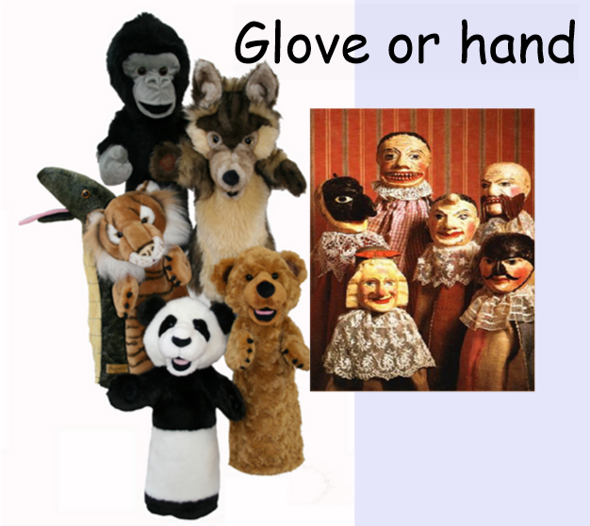

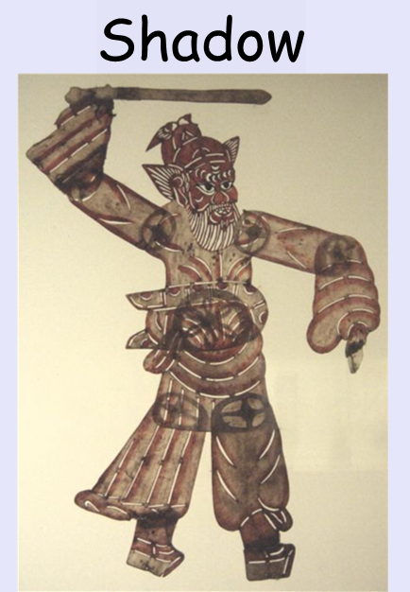
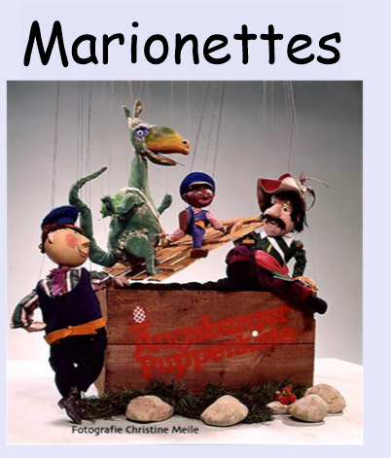
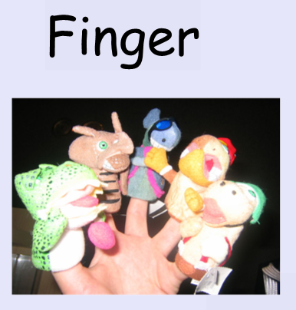

Slide 5

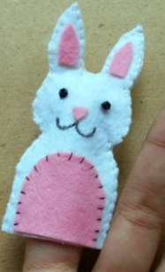
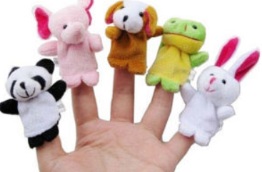
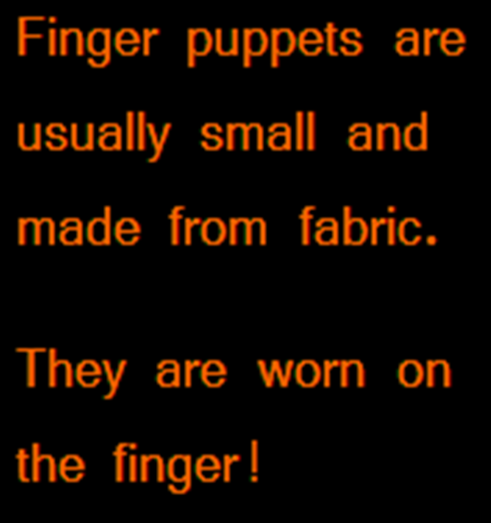
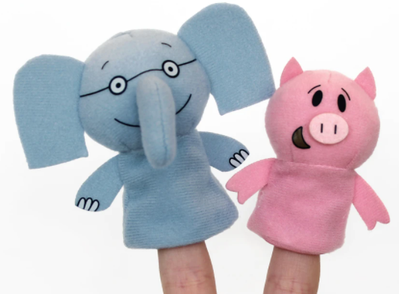
Fabric is soft and comfortable to wear on your finger.

Slide 6

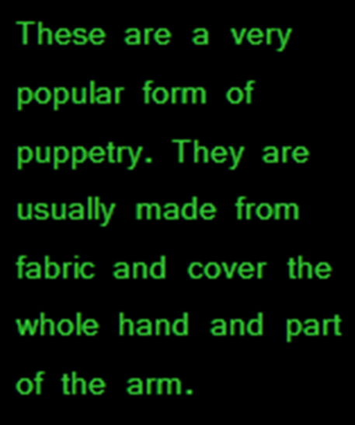
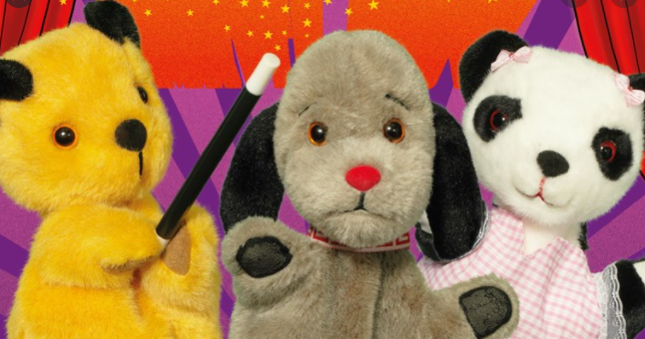
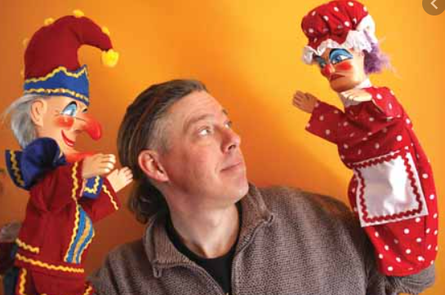

Slide 7
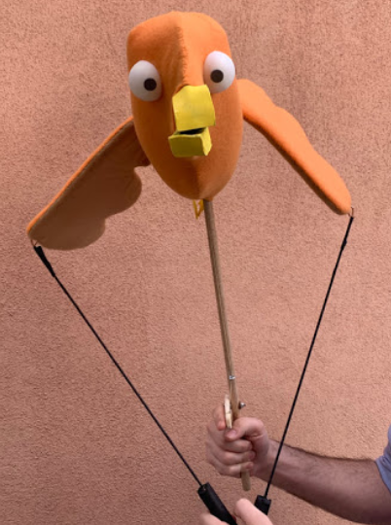

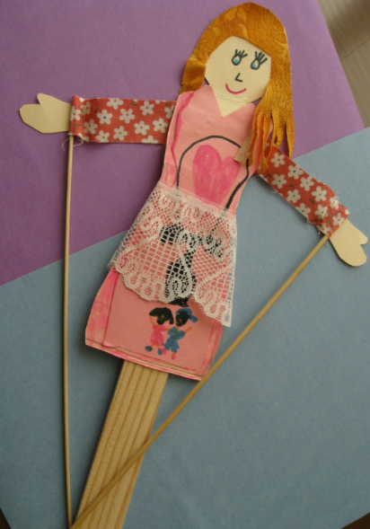
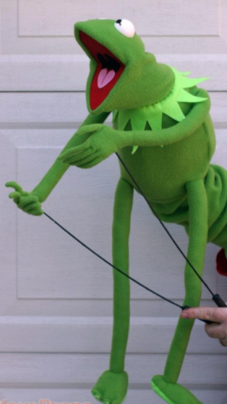
A rod puppet is controlled by long, thin, metal or wooden rods. The person moving the puppet is beneath it and uses the rods to move the puppet’s arms or legs.
Kermit the Frog and the other Muppet
Characters are well known rod puppets.

Slide 8

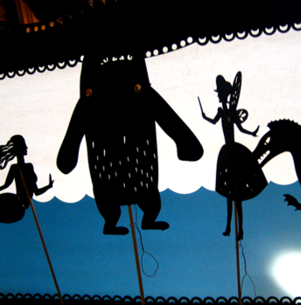
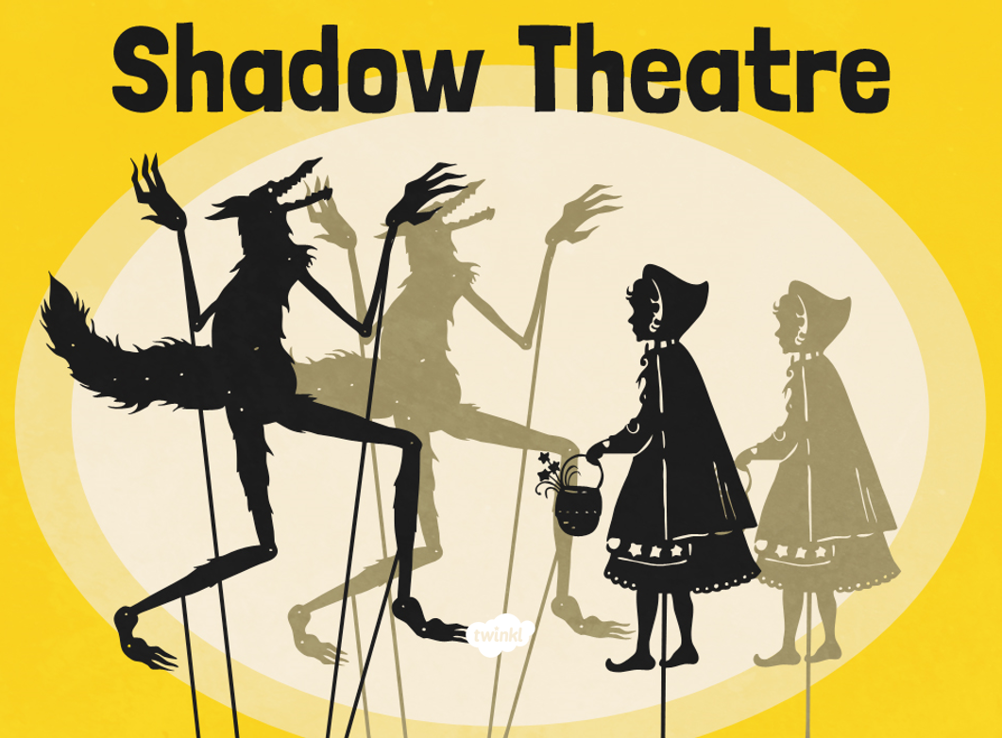
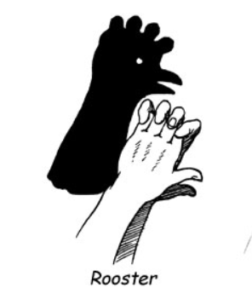
The use of shadows to amuse and entertain has a very long history. There are records of shadow puppets being used in
performances in China and India more than two thousand years ago.
Shadow puppets are figures that are placed between a light and a screen. Moving them creates the illusion of moving images on the screen.
The simplest shadow shows are created by our own hands.
There is a video clip on the weekly plan about shadow puppets that you might like to watch.

Slide 9

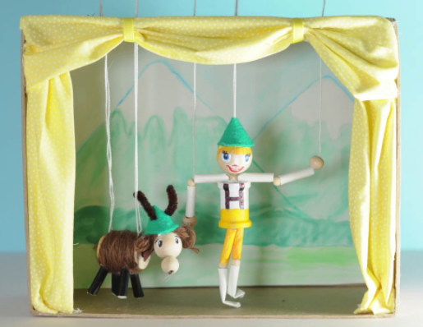
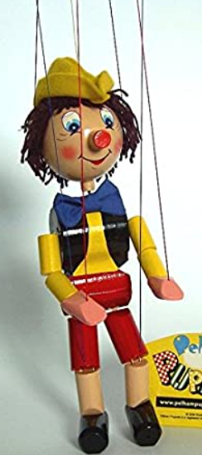
This type of puppet is moved around with strings that hang from above the theatre. This is one of the more complex types of puppetry and is hard to master as some marionettes can have up to thirty strings.
Marionettes are made from a variety of materials including fabric, wood and papier mâché.
There is a video clip on the weekly plan showing marionette puppets in action that you might like to watch.

Slide 10
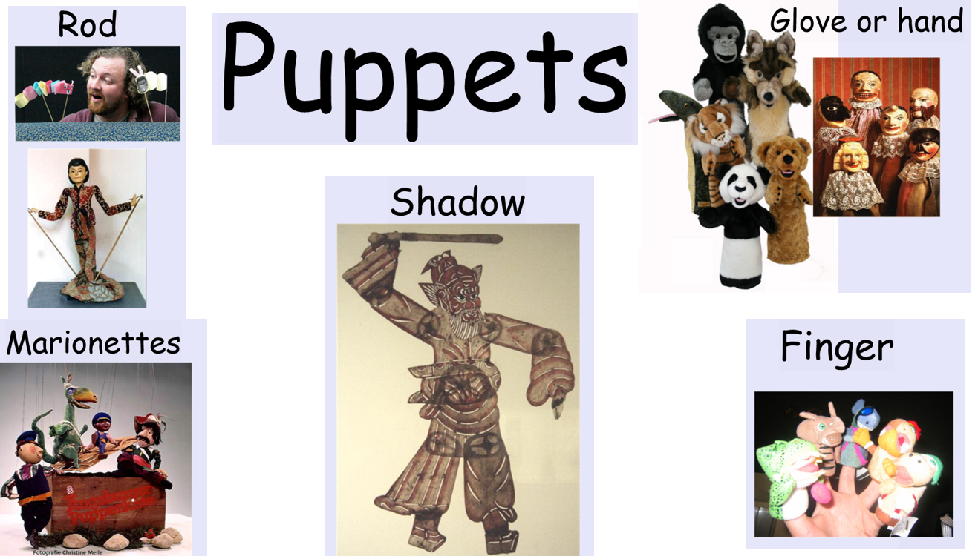
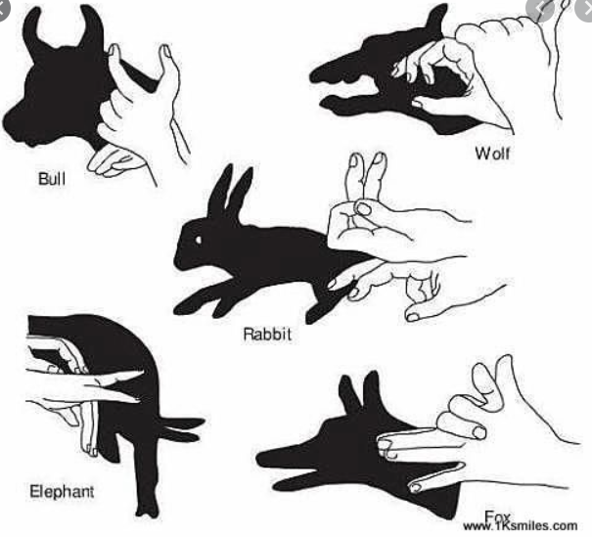
Now choose at least two of the puppets you have learned about and draw a picture of them. Now write sentences to explain what type of puppets they are, what they are made from and how they work.
When you have finished there are some animal hand shadow cards in the folder you could try to create. All you need is a lamp or torch, a wall and your hands.

