Slide 1

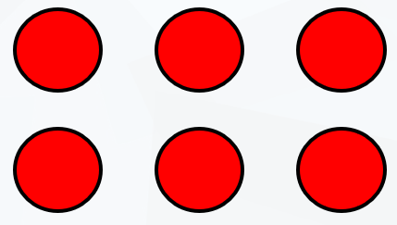
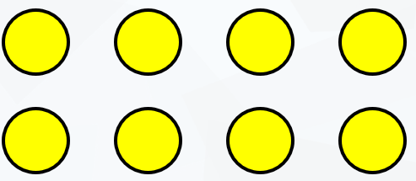

LO: To use arrays to multiply

Slide 2
Write number sentences to match the array.
2
3
3
2
________ x ________ and ________ x ________

Slide 3
Fluency
Write number sentences to match the array.
3
5
5
3
________ x ________ and ________ x ________

Slide 4
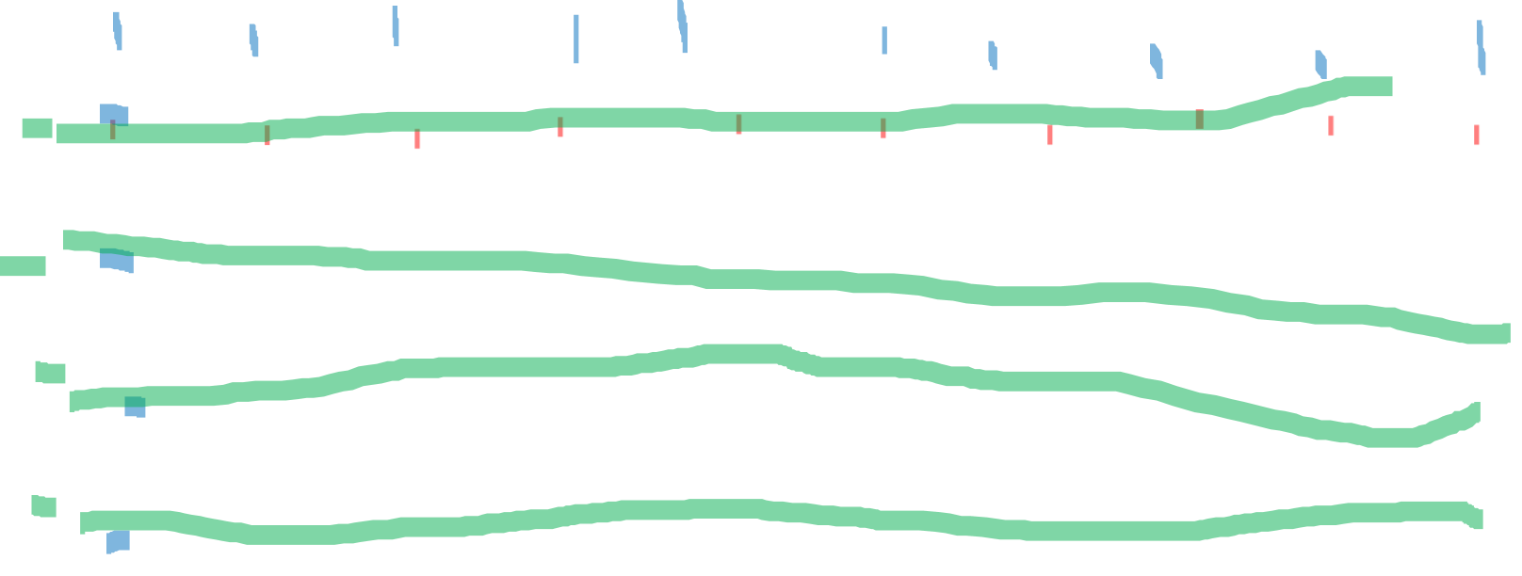
Fluency
Write number sentences to match the array.
4
10
10
4
________ x ________ and ________ x ________

Slide 5


Fluency
Write number sentences to match the array.
4
2
2
4
________ x ________ and ________ x ________

Slide 6


Fluency
Write number sentences to match the array.
6
5
5
6
________ x ________ and ________ x ________

Slide 7
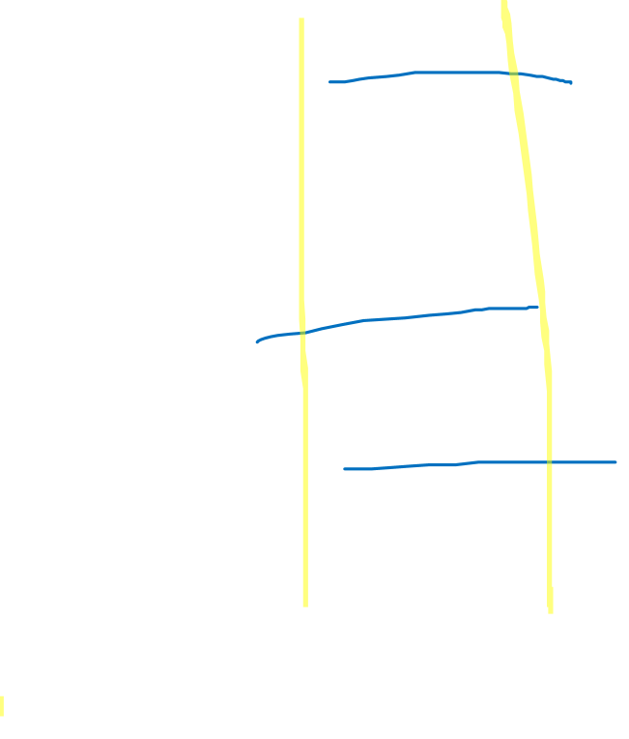
Fluency
Draw an array that will show 3 x 2.
2
3
How else could you describe this array? ________ x ________

Slide 8
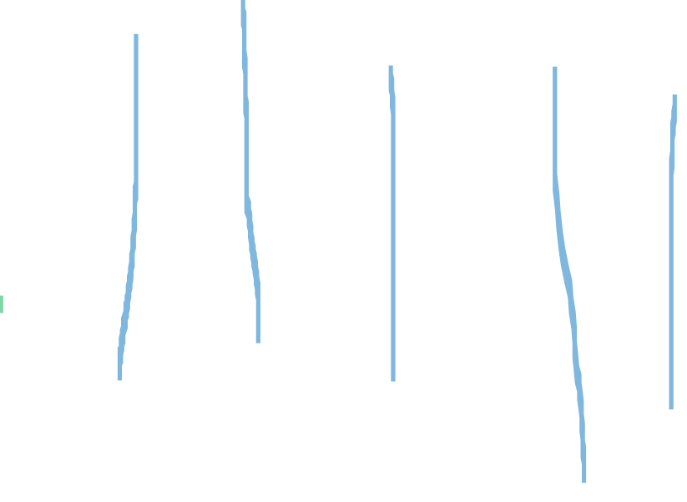
Fluency
Draw an array that will show 5 x 3.
3
5
How else could you describe this array? ________ x ________

Slide 9


Fluency
Match the arrays to their multiplication.
2 x 8
4 x 5
2 x 10

Slide 10

Reasoning
The array below shows 3 x 10.
True or false?
Example how you know.
False.
The array shows 3 x 9.

Slide 11
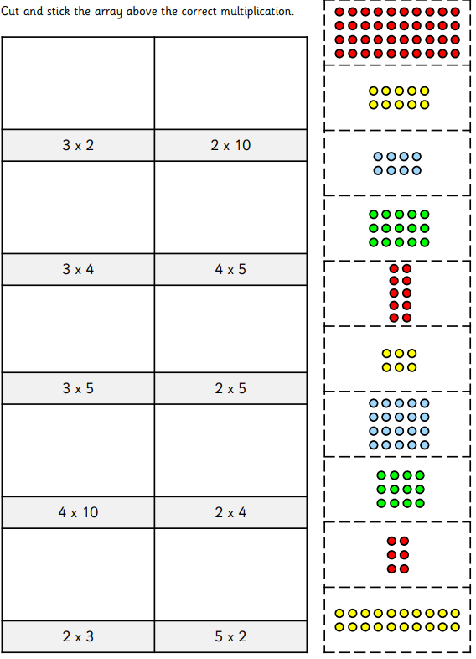
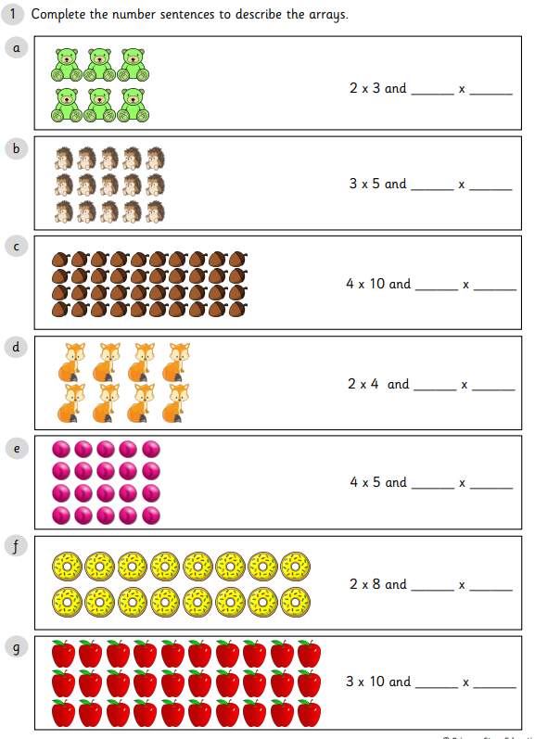
Now choose two worksheets from the folder to complete – one from ‘Matching Arrays’ and one from ‘Using Arrays’

