Slide 1

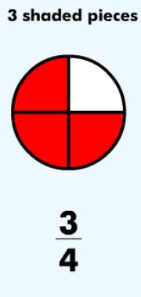
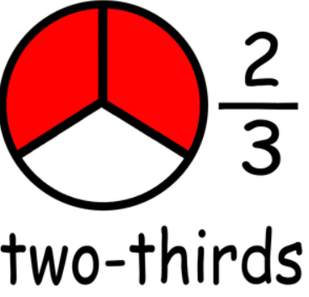

LO: To recognise 3 quarters
and 2 thirds of a shape

Slide 2
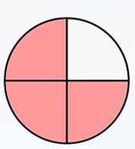
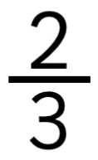

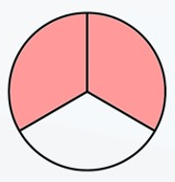
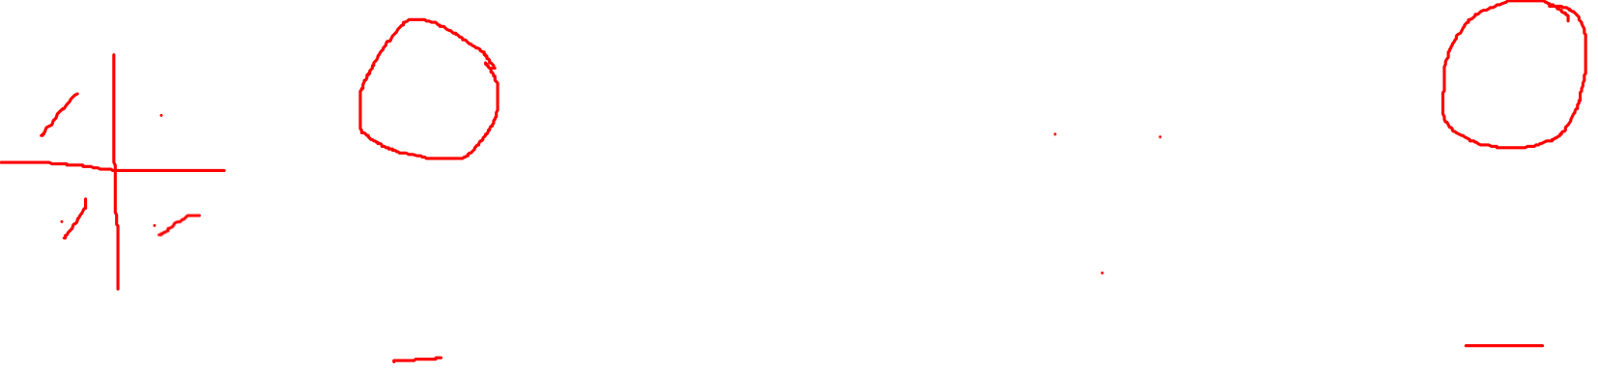
three quarters
two thirds
3 out of 4 pieces are shaded pink.
2 out of 3 pieces are shaded pink.

Slide 3
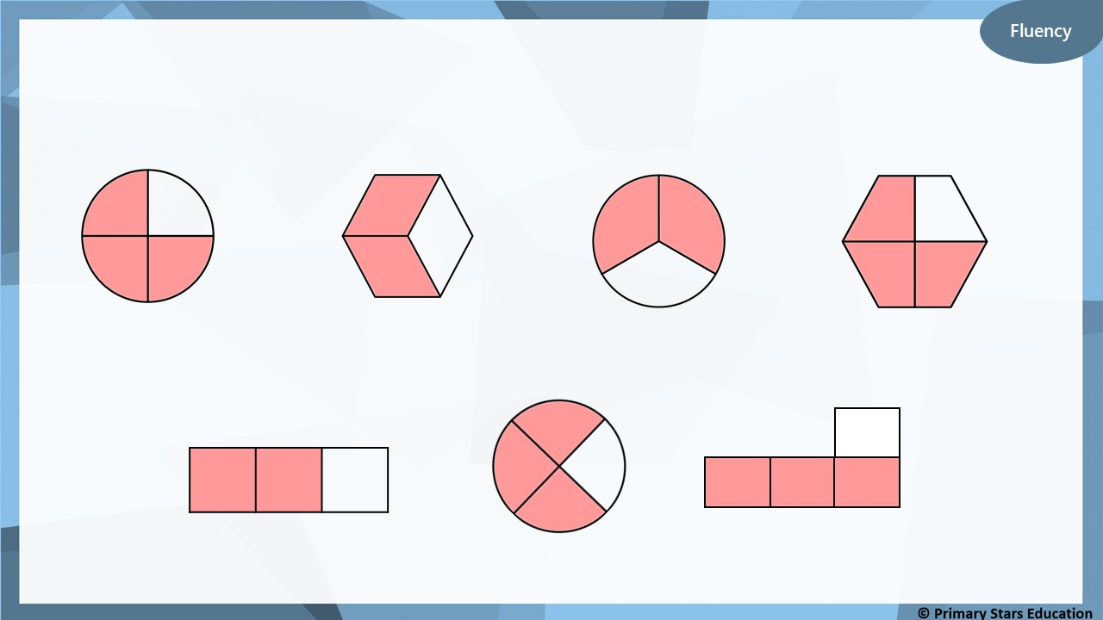
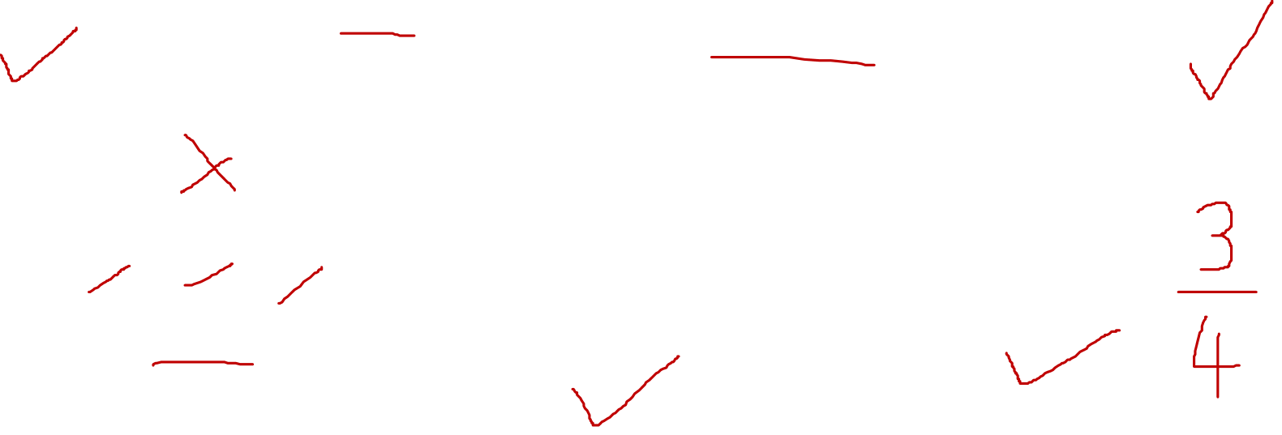
Which shapes show $\frac{\text{3}}{\text{4}}$ ?

Slide 4
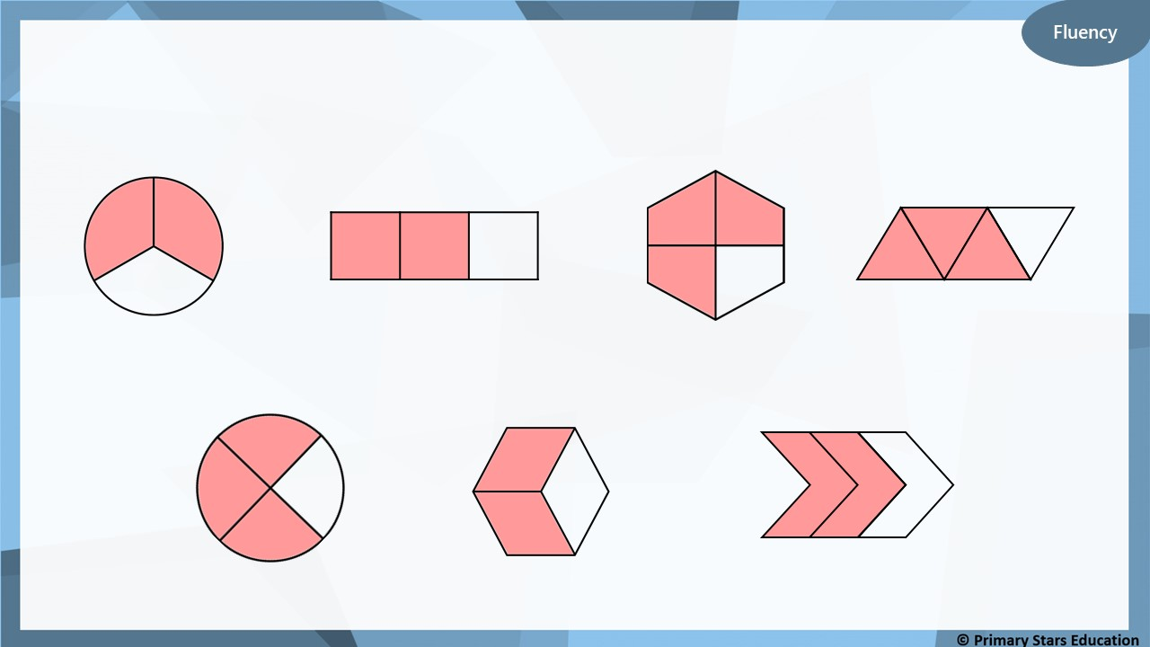
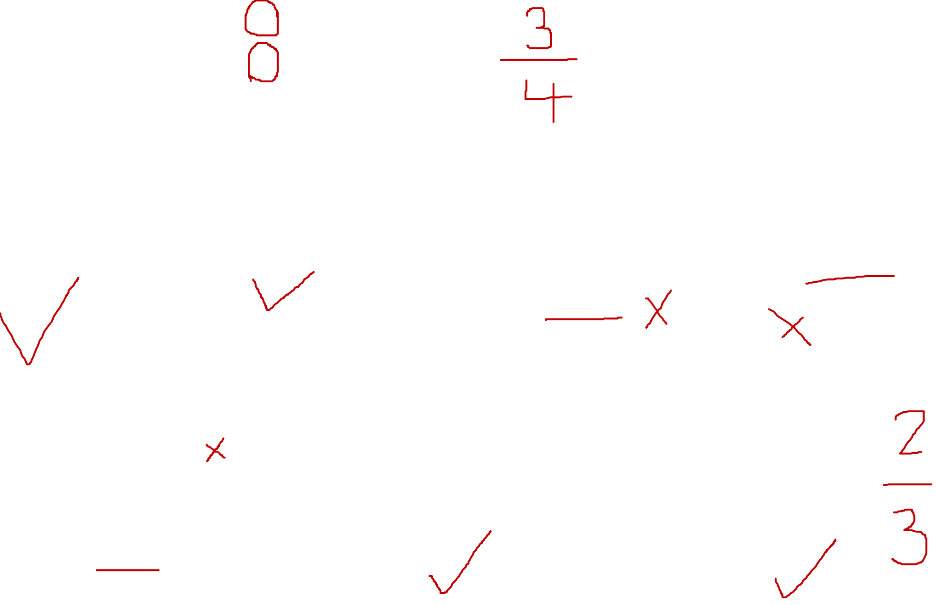
Which shapes show $\frac{\text{2}}{\text{3}}$ ?

Slide 5
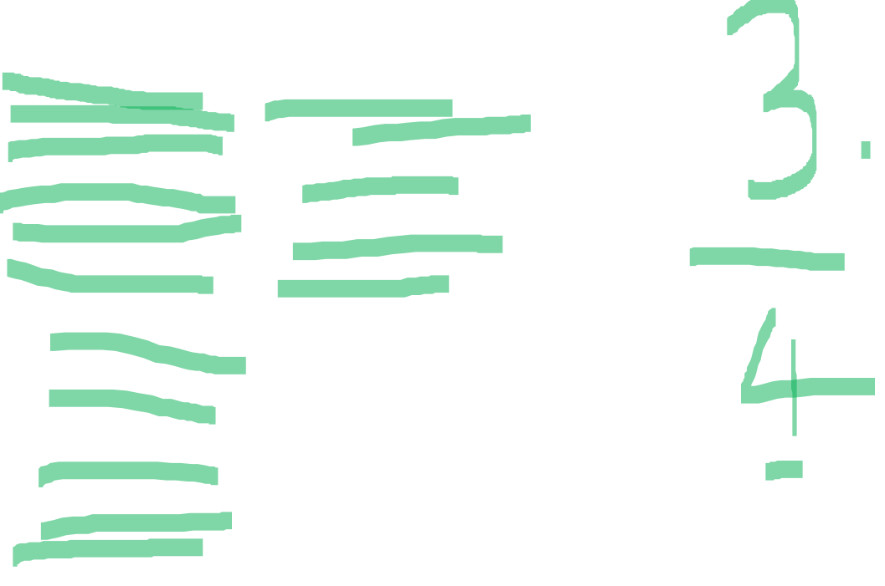
Fluency
How many parts would be shaded to show $\frac{\text{3}}{\text{4}}$ ?
How do you know?

Slide 6

Fluency
How many parts would be shaded to show $\frac{\text{2}}{\text{3}}$ ?
How do you know?

Slide 7
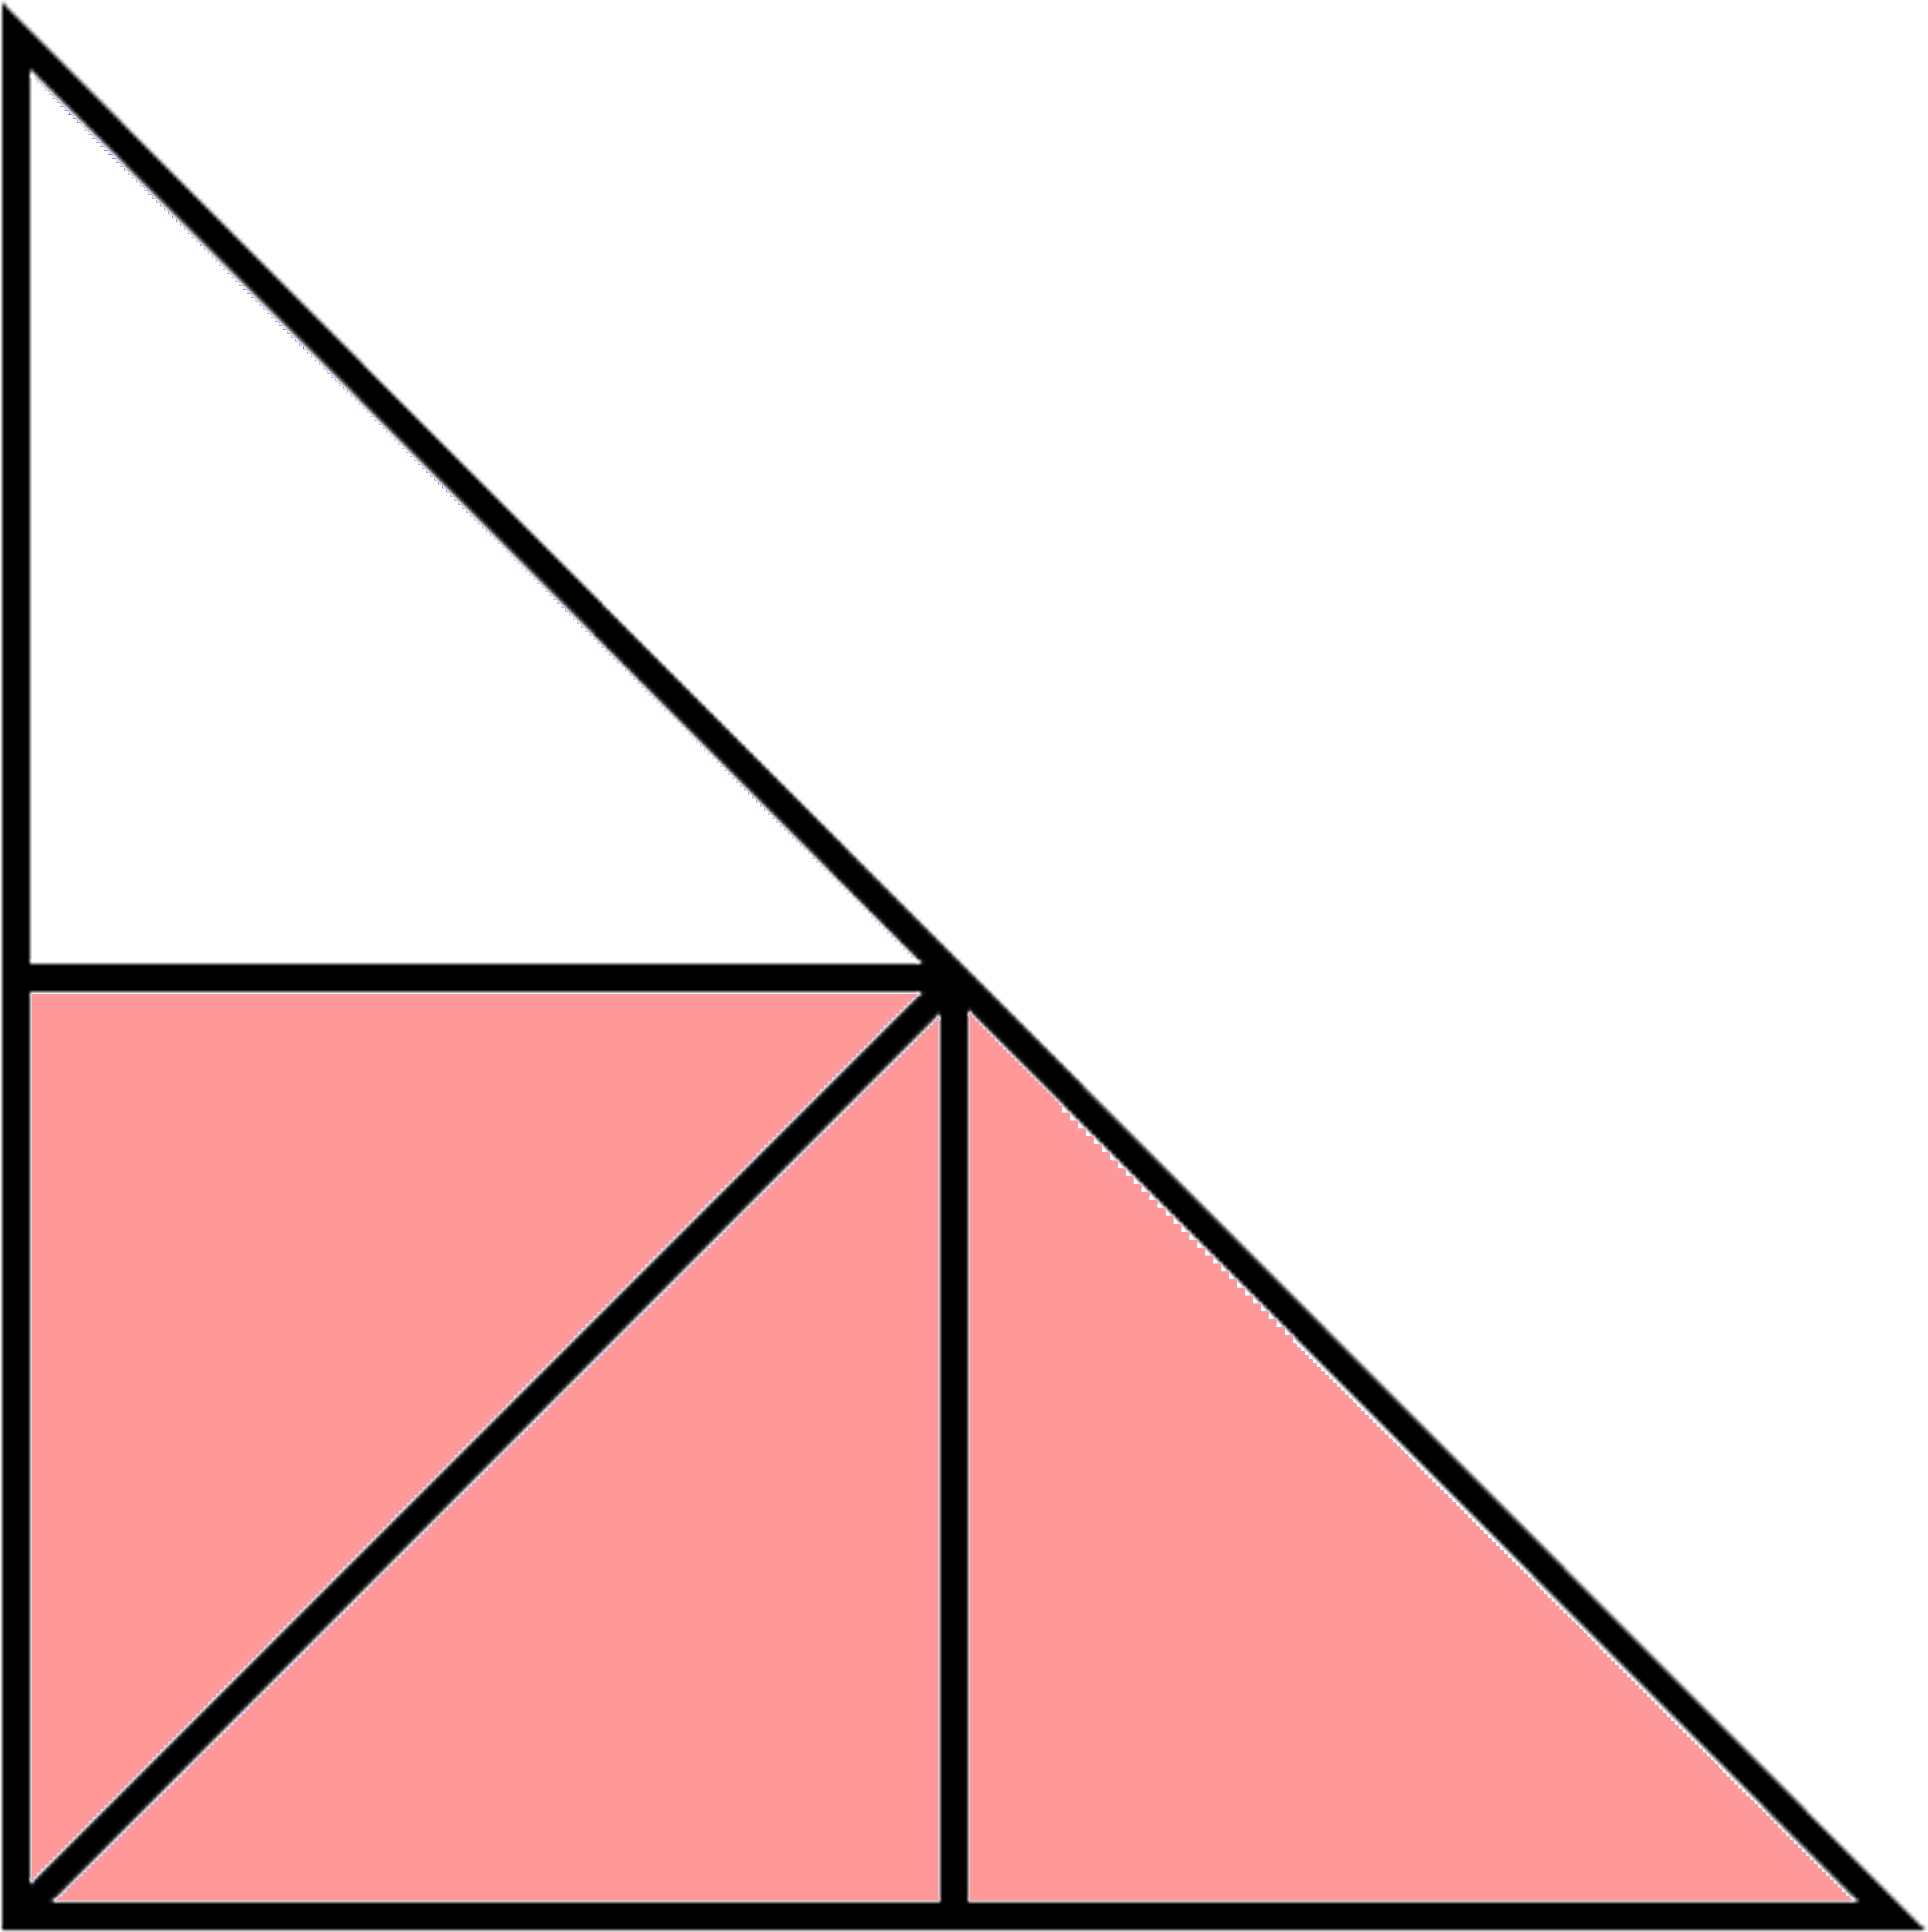
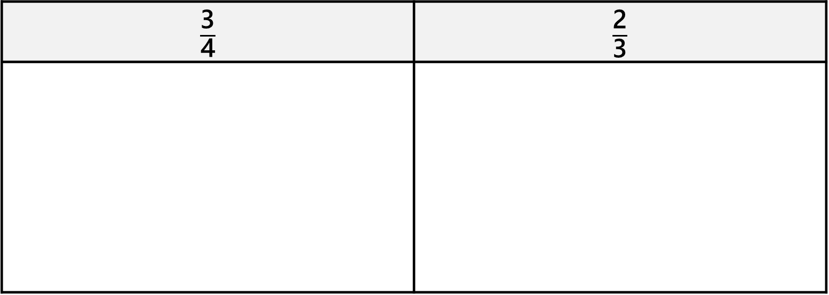
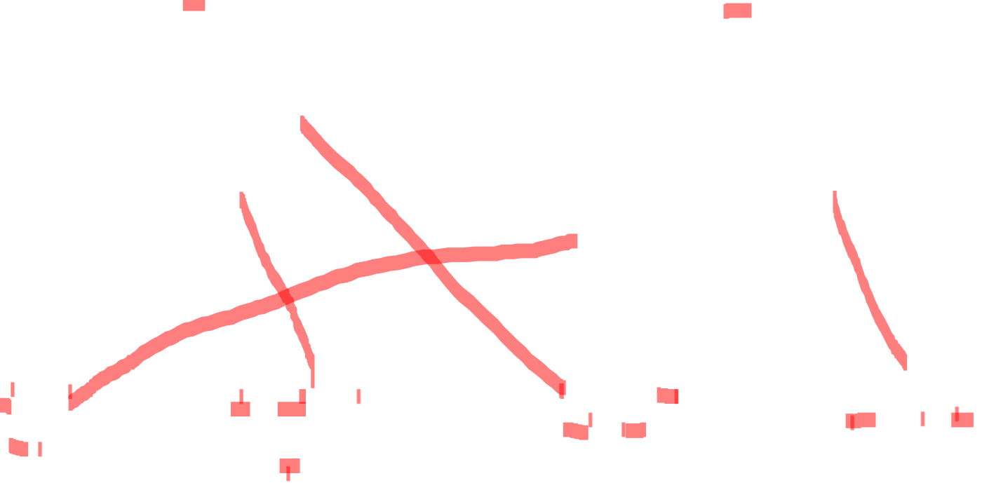
Fluency
Sort the shapes below.
$\frac{\text{3}}{\text{4}}$ | $\frac{\text{2}}{\text{3}}$

Slide 8
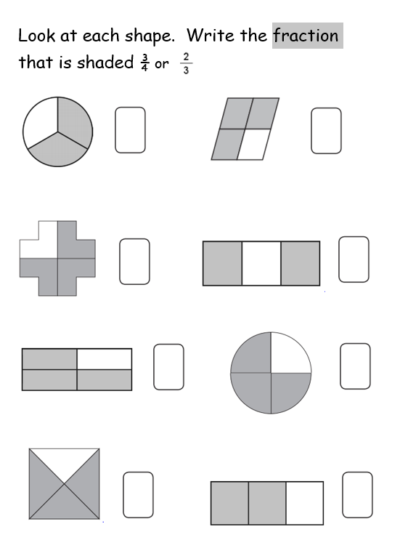
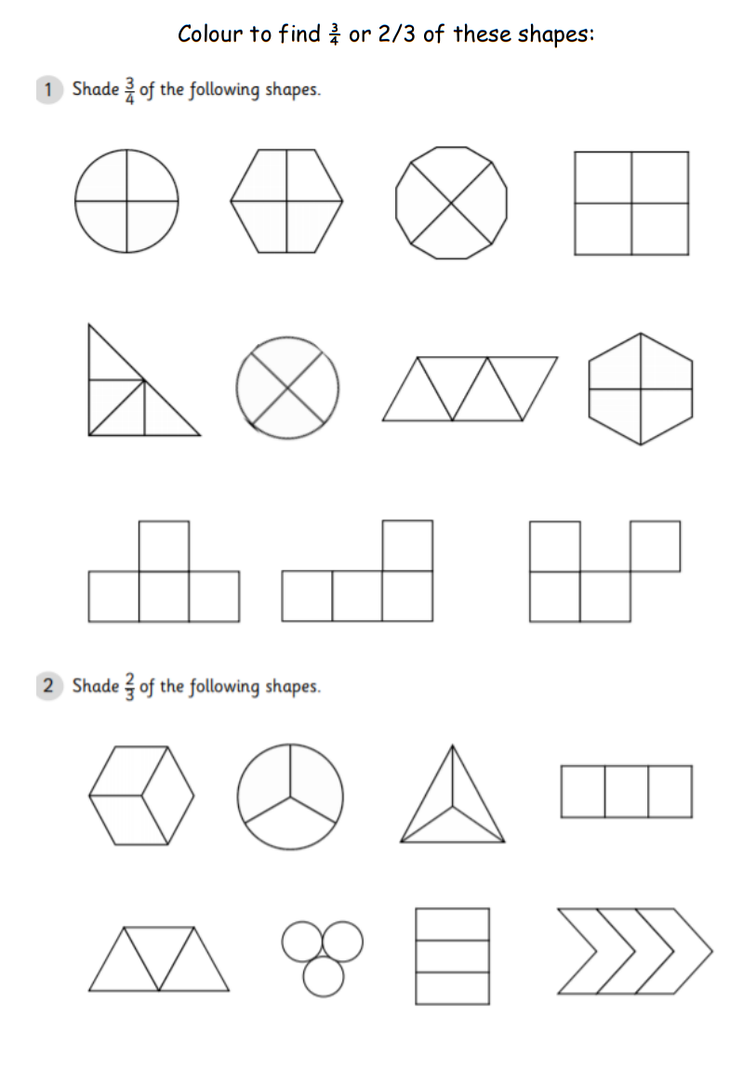
Now complete both of the worksheets in the folder.
First colour either 3 quarters or two thirds of each shape.
Next look carefully at each shape to see how much has been shaded. Then write this as a fraction.

