Slide 1
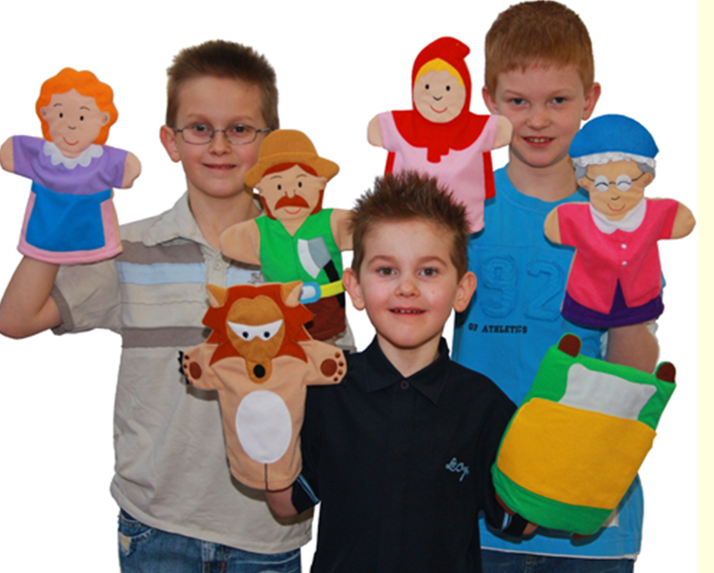
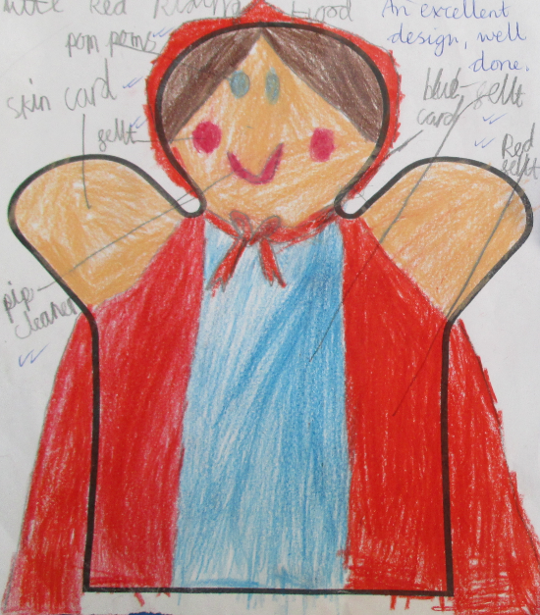
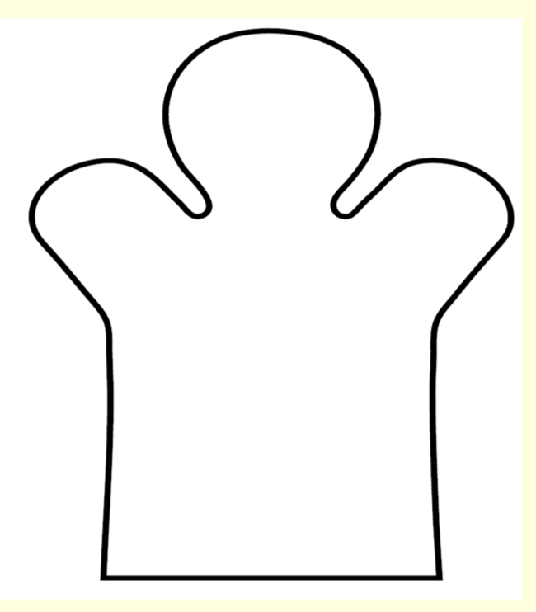
LO: To make a hand puppet from paper

Slide 2
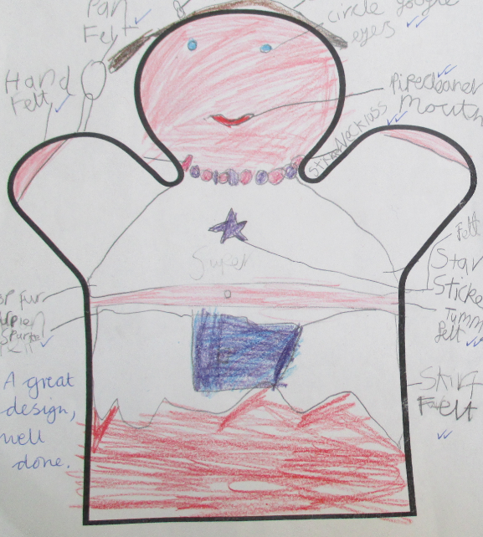
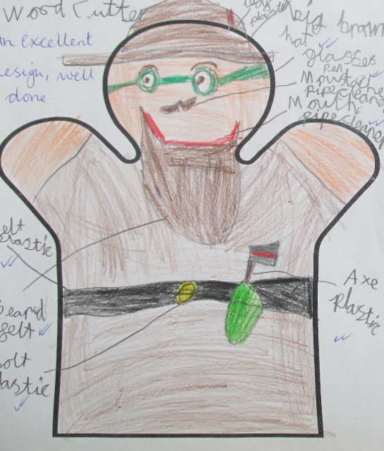
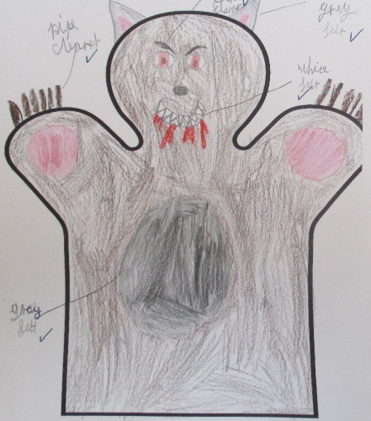
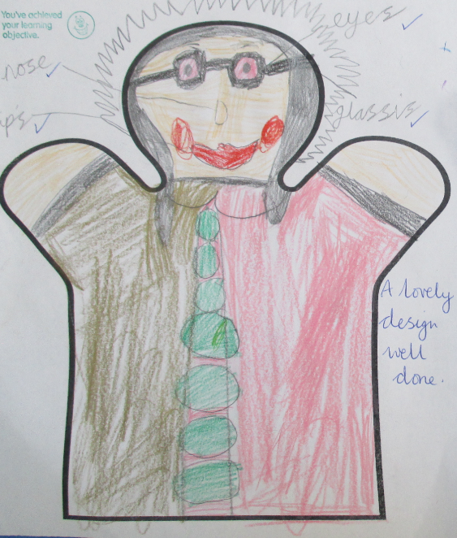
Last week you designed a Little Red Riding Hood character hand puppet.
Your designs may look similar to these – Little Red Riding Hood, Mum, Wood Cutter, Wolf or Grandma.

Slide 3
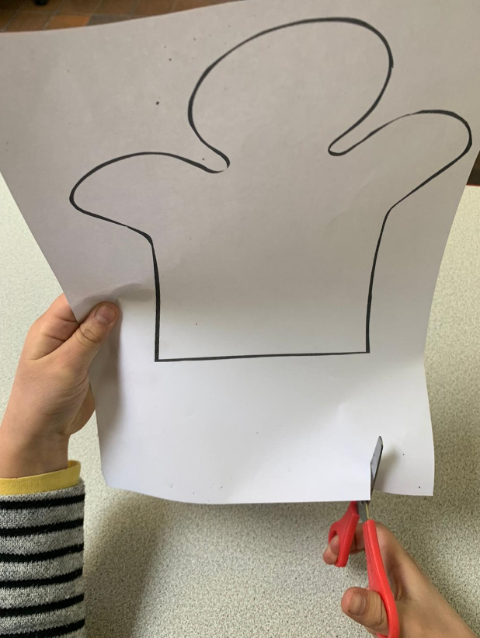
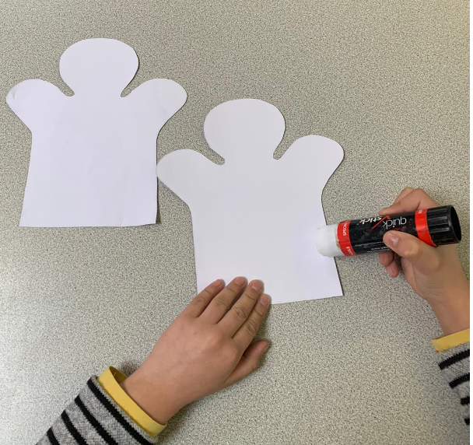
Today you are going to use your design to help you
make a puppet from paper.
First print out two hand puppet shapes from the folder.
2. Then carefully cut them out.
3. Next glue around the edge of one puppet shape leaving the bottom straight edge, (this is where you will put your hand), and stick the two pieces together.

Slide 4
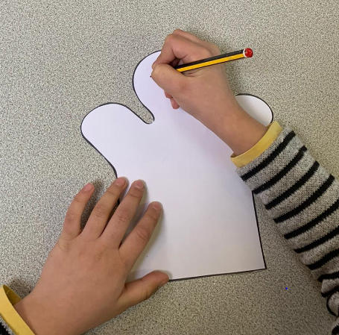
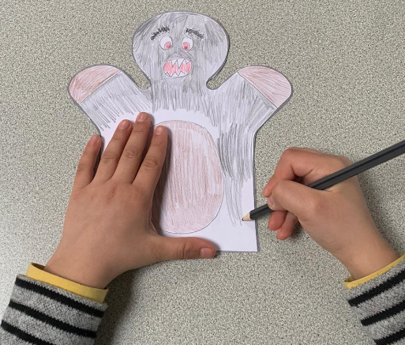
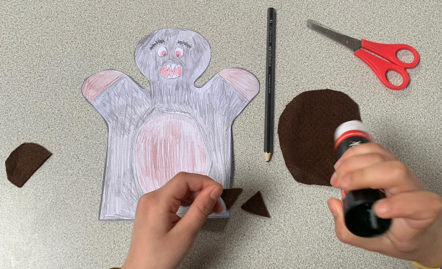
4. Now use the design, that you made last week, to help you decorate your puppet. Use a pencil to draw on the features first.
5. After that use coloured crayons or felt tip pens to colour the front and back of your puppet.
6. Then cut out extra features such as ears, paws and a tummy from coloured paper, or fabric if you have any.

Slide 5
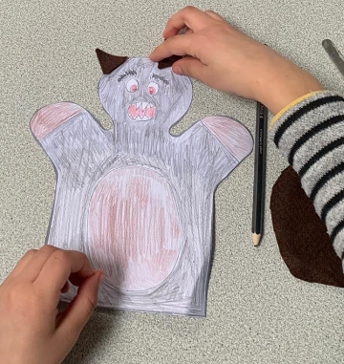
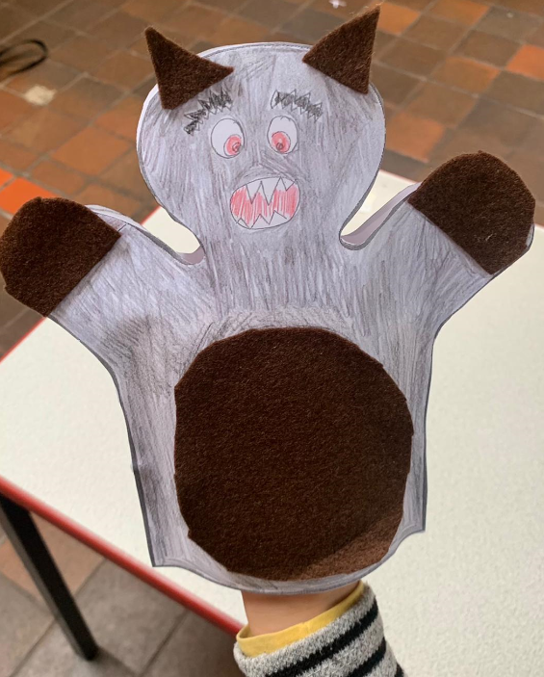
7. Now glue the features into place.
Finally put the puppet on your hand and admire your
work!

