Slide 1

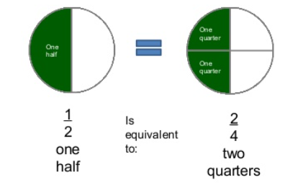


LO: To recoginse $\frac{\text{1}}{\text{2}}$ and $\frac{\text{2}}{\text{4}}$ as equivalent
fractions
Equivalent fractions are
two or more
fractions that mean
the same thing.

Slide 2

What fractions are shown on each shape?

Slide 3
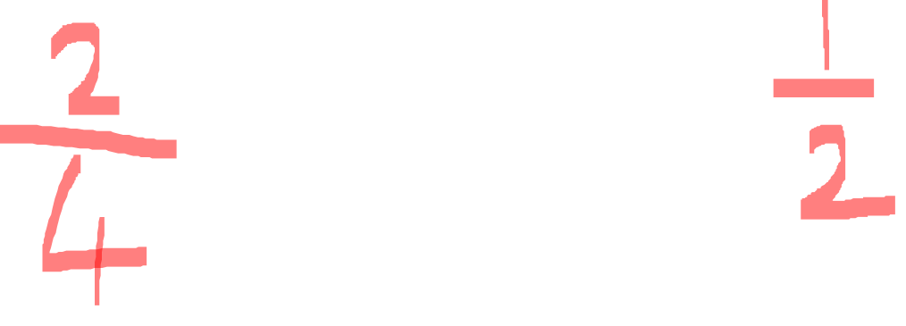
Fluency
What fractions are shown on each shape?

Slide 4
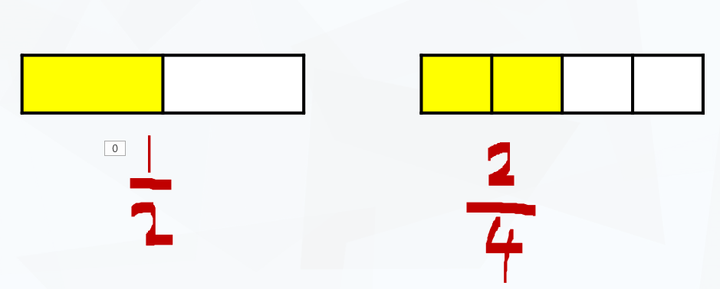
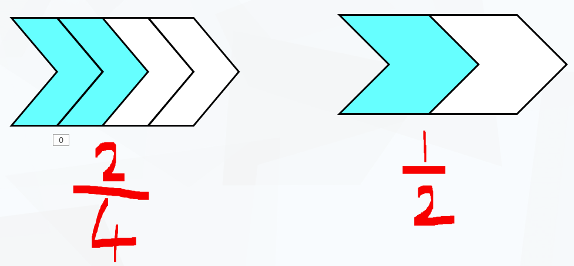

Fluency

Slide 5
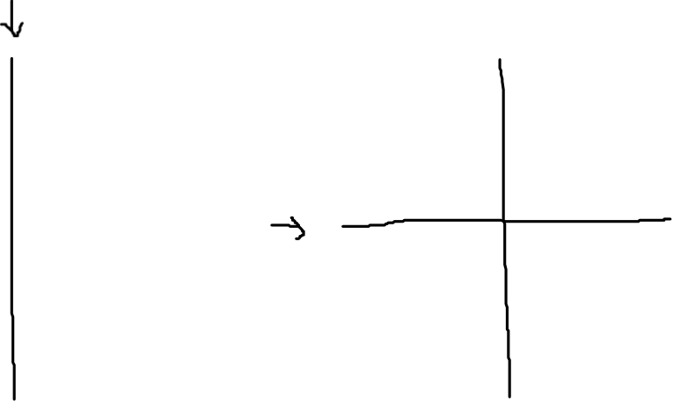
Fluency
Draw the following shapes.
1) Split one of your shape into halves.
2) Split your other shape into quarters.
What do you notice?
What’s the same? What’s different?

Slide 6
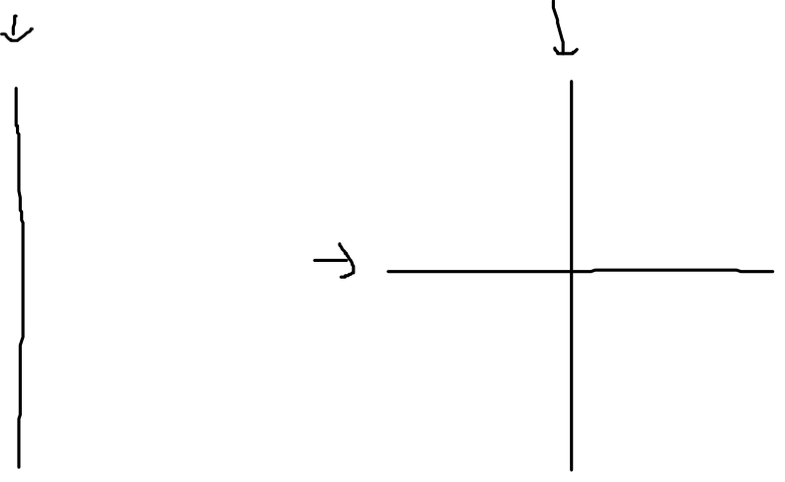
Fluency
Draw the following shapes.
1) Split one of your shape into halves.
2) Split your other shape into quarters.
What do you notice?
What’s the same? What’s different?

Slide 7
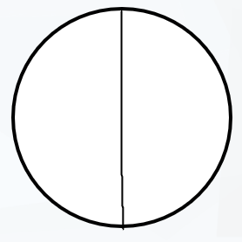
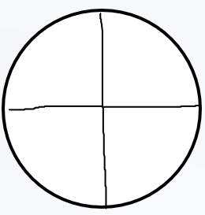
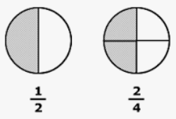

Slide 8
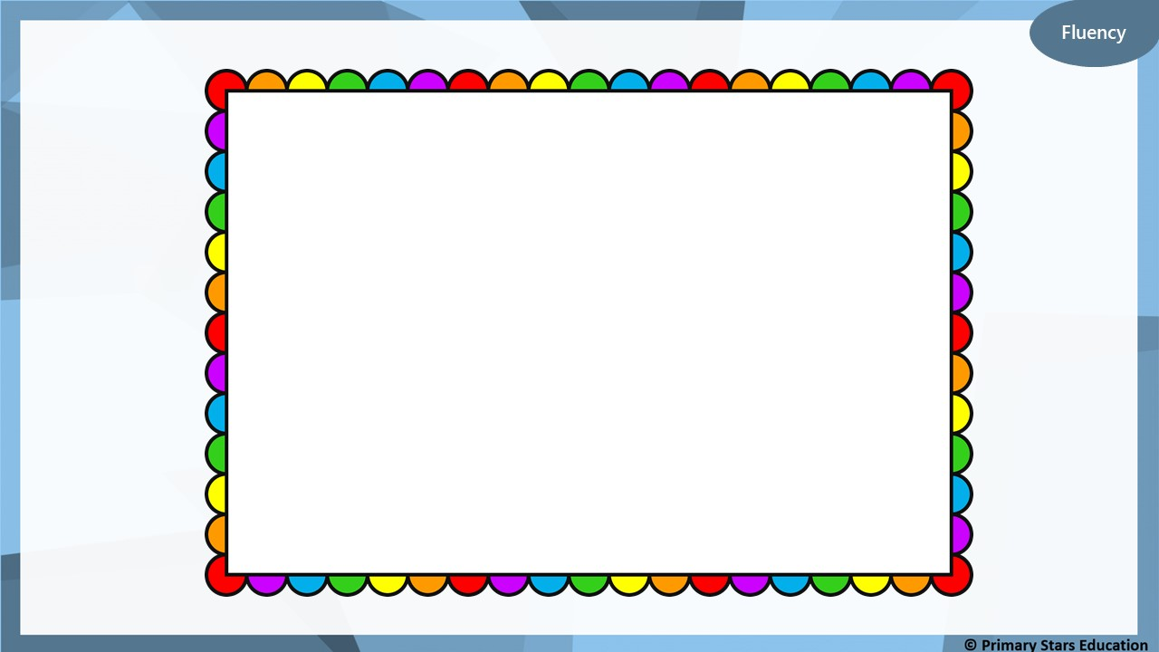
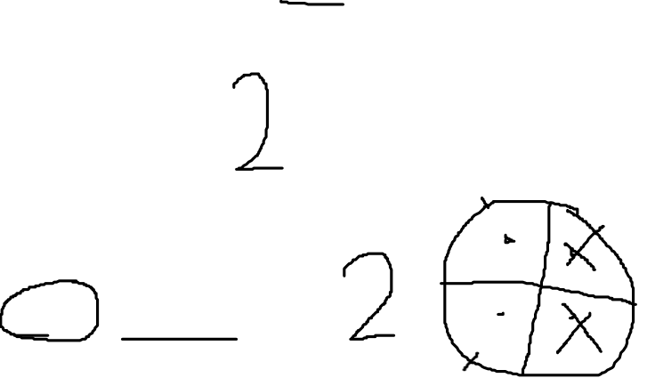
4
Find half.
Find two quarters.
What do you notice about the quantities?

Slide 9
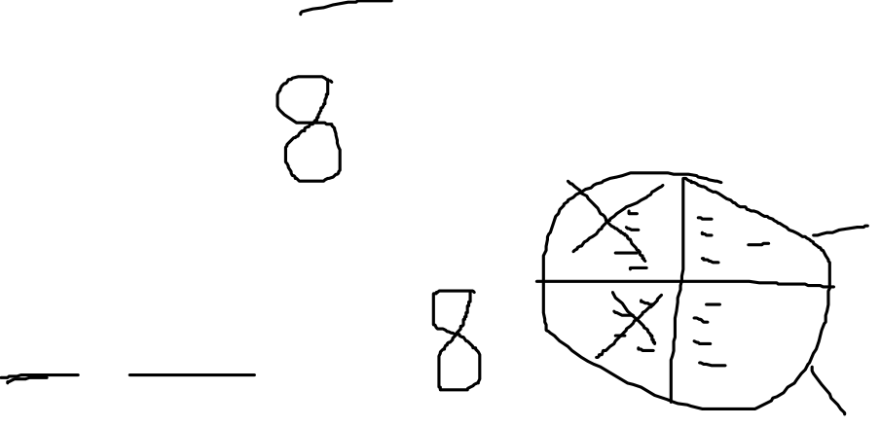
16
Find half.
Find two quarters.
What do you notice about the quantities?

Slide 10
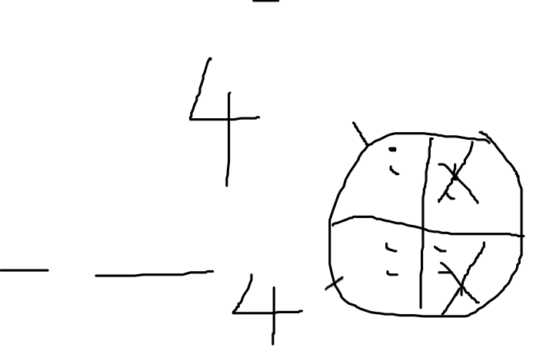
8
Find half.
Find two quarters.
What do you notice about the quantities?

Slide 11
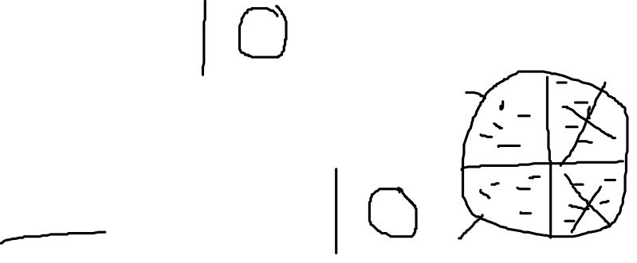
20
Find half.
Find two quarters.
What do you notice about the quantities?

Slide 12


