Slide 1
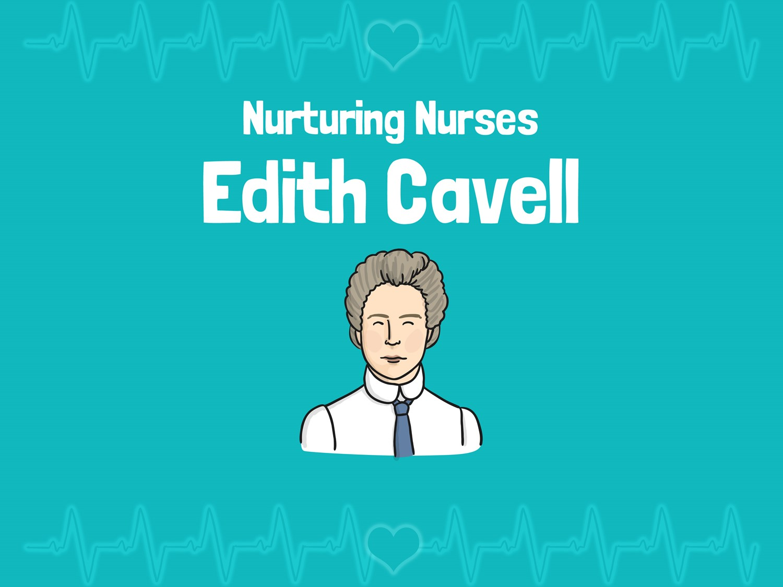


LO: To explain LO: To explain who Edith Cavell was and how she helped soldiers
who Edith Cavell was and how she helped soldiers
LO: To explain who Edith Cavell was and how she helped soldiers

Slide 2

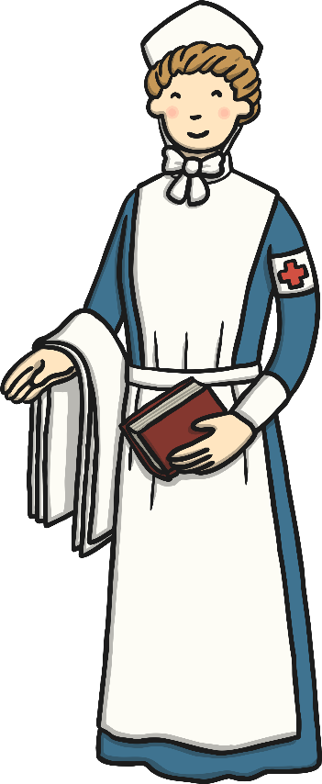
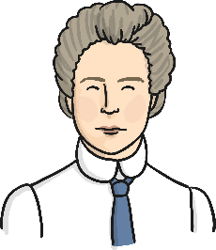
Edith Cavell
Who was Edith Cavell?
Edith was born on the 4th December 1865 in a village in Norfolk.
Edith’s father was a vicar and she learned from the Bible, and him, that it was important to help others. This was one of the things that inspired Edith to become a nurse.
Edith travelled to Belgium to become a governess, and later to Austria to learn about helping the sick. She then returned home to look after her sick father.
In 1896 Edith trained to be a nurse at the Royal London Hospital.
In 1907 Edith went back to Brussels to nurse and was asked by a doctor (who had been inspired by Florence Nightingale) to be in charge of training nurses at a special nursing school

Slide 3
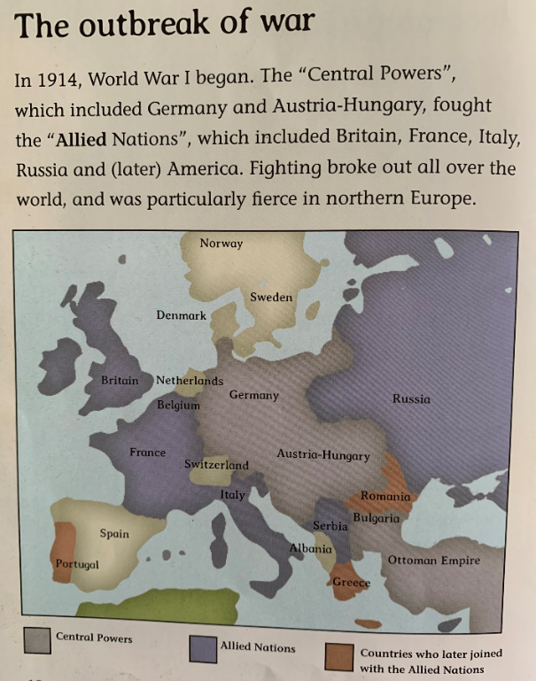
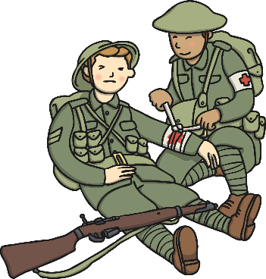
World War One
In August1914, when Germany attacked Belgium, Britain declared war. Edith knew her help was needed so she returned to Belgium. She found her hospital had been turned into a Red Cross Hospital for soldiers from all countries.

Slide 4
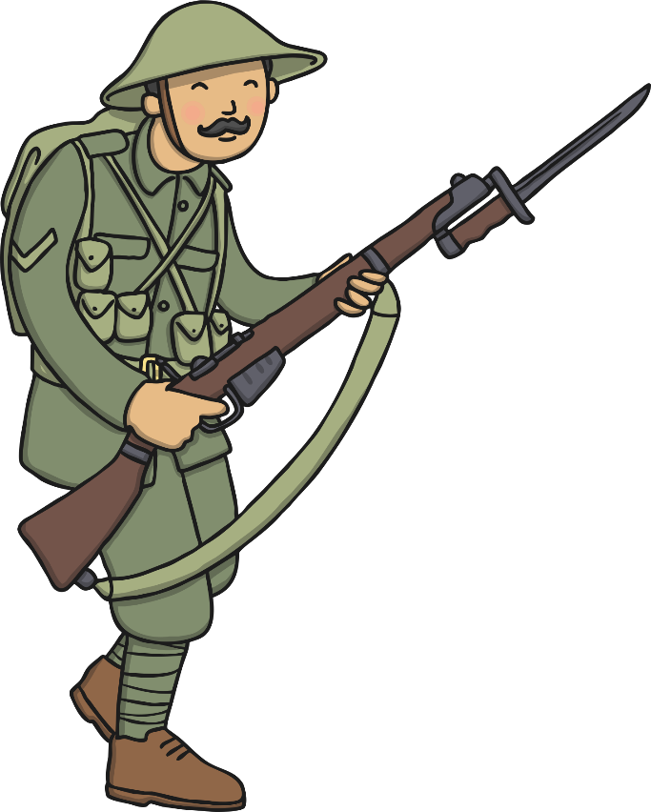

How did Edith help the soldiers?
It did not matter to Edith which country the soldiers were fighting for. Edith treated wounded soldiers from both sides of the battle. She worked hard and saved the lives of many soldiers.
She also hid over 200 British, Belgian and French soldiers from the Germans, keeping them safe at the nursing school where she lived. She kept this a secret from the other nurses as she did not want anyone else getting in trouble with the Germans. Later, Edith bravely helped many of the soldiers escape to safety.

Slide 5
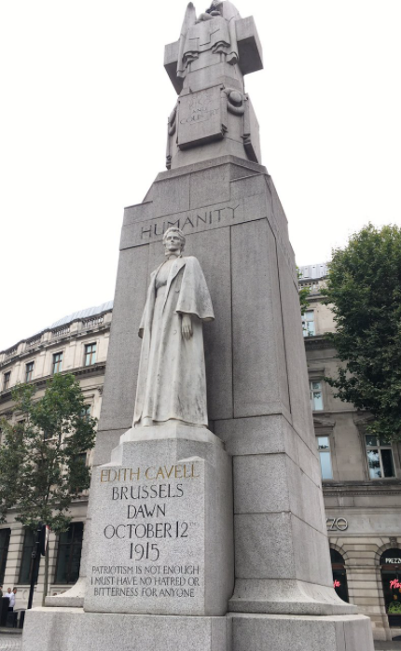
Edith Was Arrested
In 1915 the German authorities discovered that Edith had been helping their enemies escape. She was arrested and put in prison where she was later found guilty of treason and sentenced to death. Edith Cavell was shot by a German firing squad on the 12th October 1915.
Before Edith died she forgave the people who were punishing her. She said that she had no hatred or bitterness towards anyone and wanted to be remembered as, ‘a nurse who tried to do her duty’.
Lots of people thought Edith was very brave and heroic because she put her life in danger to help others. There is a statue in London that celebrates Edith’s bravery.

Slide 6
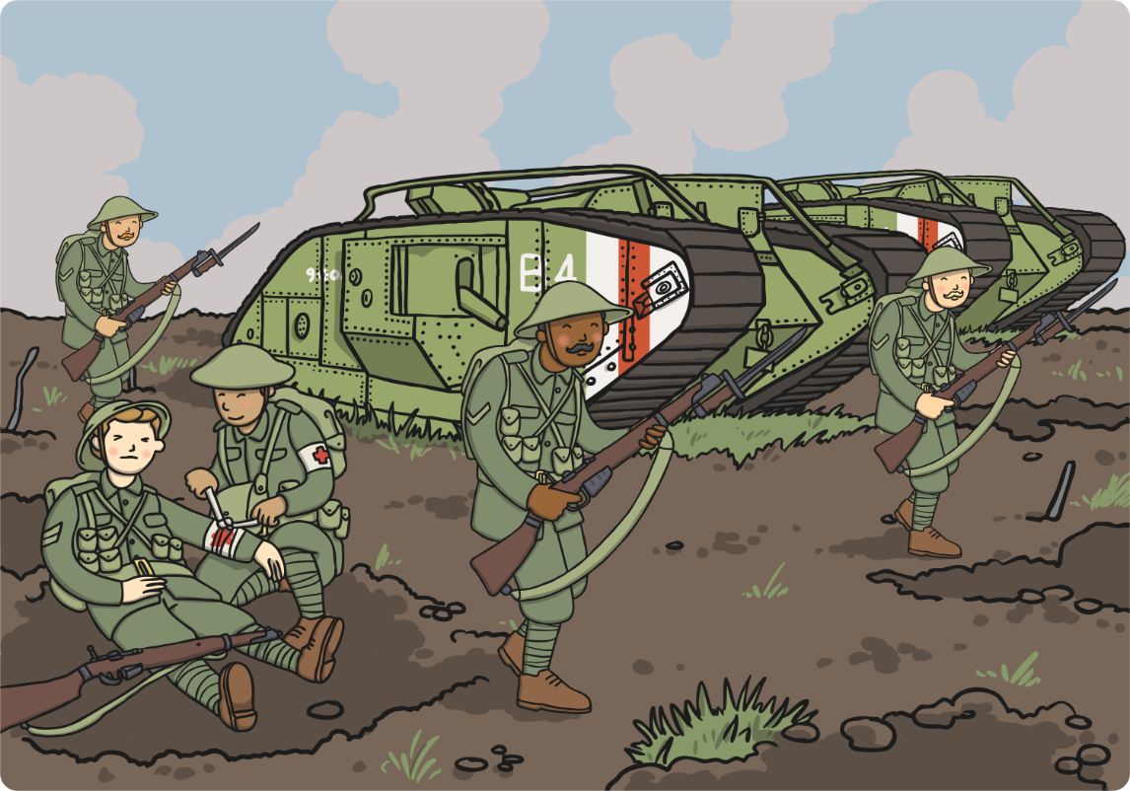
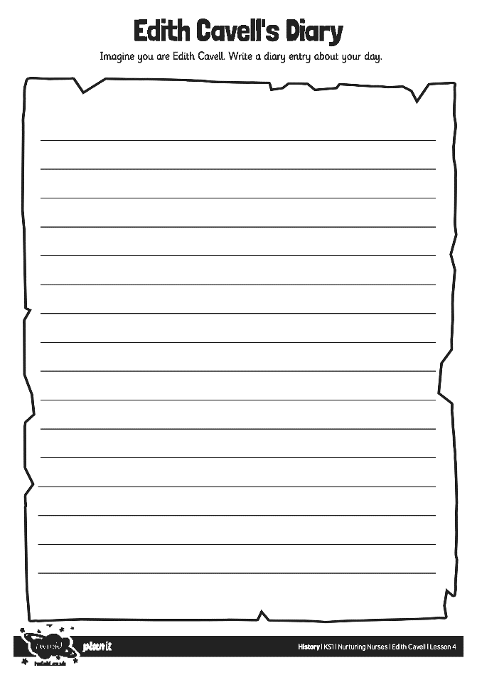
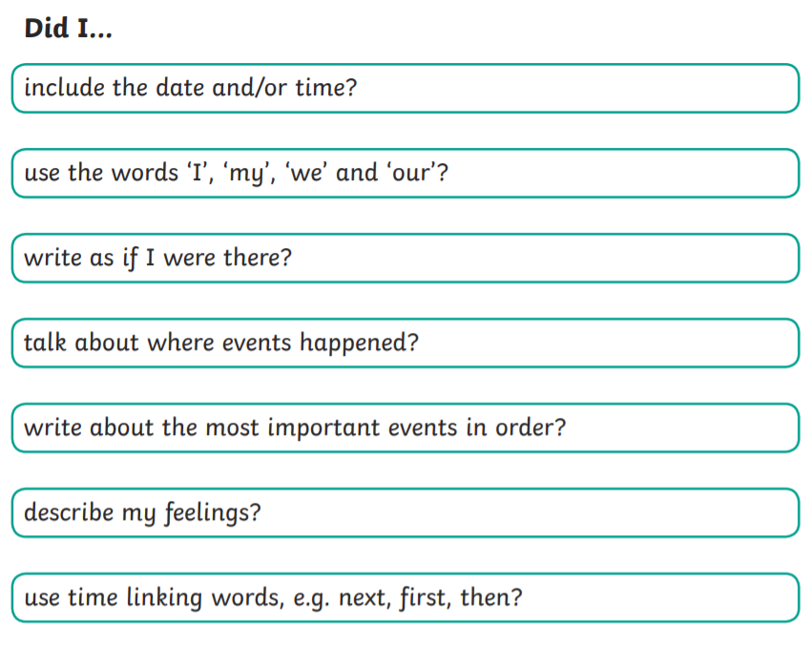
For your activity today your are going to imagine you are Edith Cavell. You are going to write a diary about your day at the
Red Cross hospital.

