Slide 1
LO: To show respect for the rights of others and understand why this is important.

Slide 2
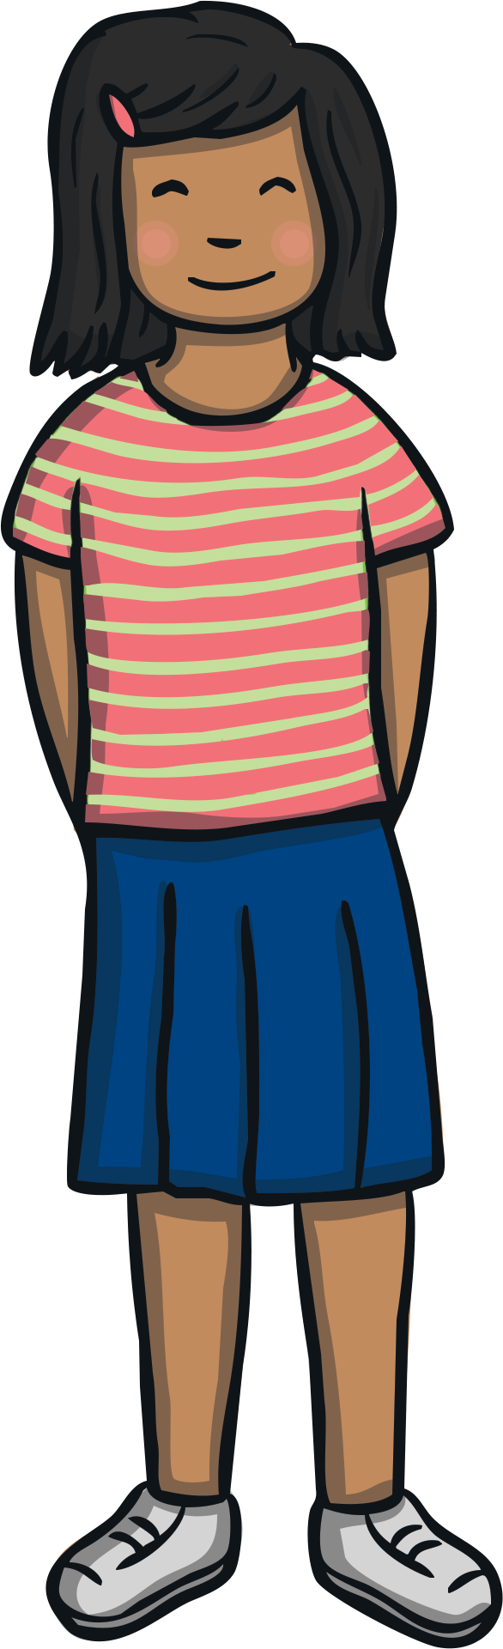
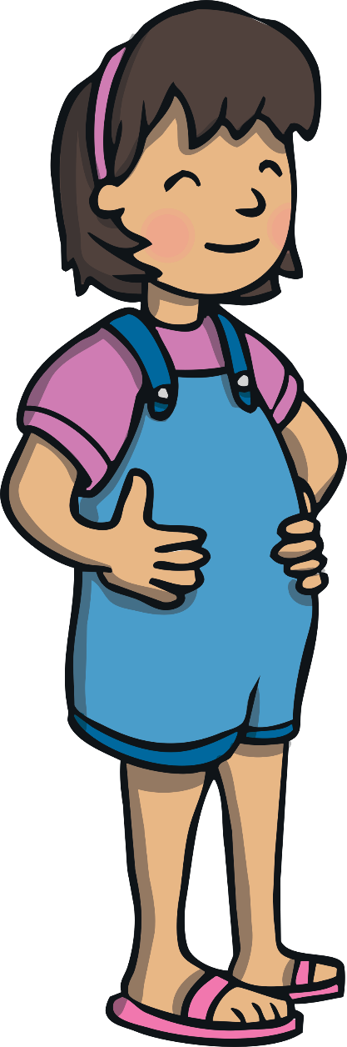
The Big Questions
What could happen if we didn’t show respect for the rights of others?
How can we show respect for the rights of others?

Slide 3
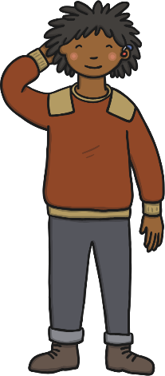
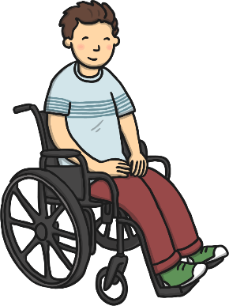
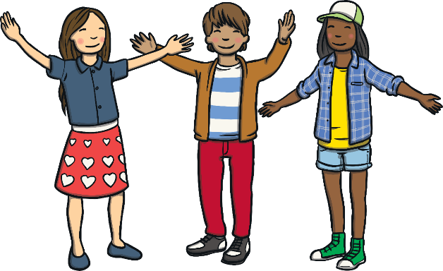
We All Share the Same Rights
A right is something that every person should have because they are a human being.
All people, no matter who they are or where they are in the world, have the same human rights.
Human beings are all different.
This makes the world an exciting and wonderful place to live!
Human rights show that every person in the whole world is important.
Human rights help make the world a better place.
They help people to be treated fairly and to have what they need to be happy and healthy.

Slide 4

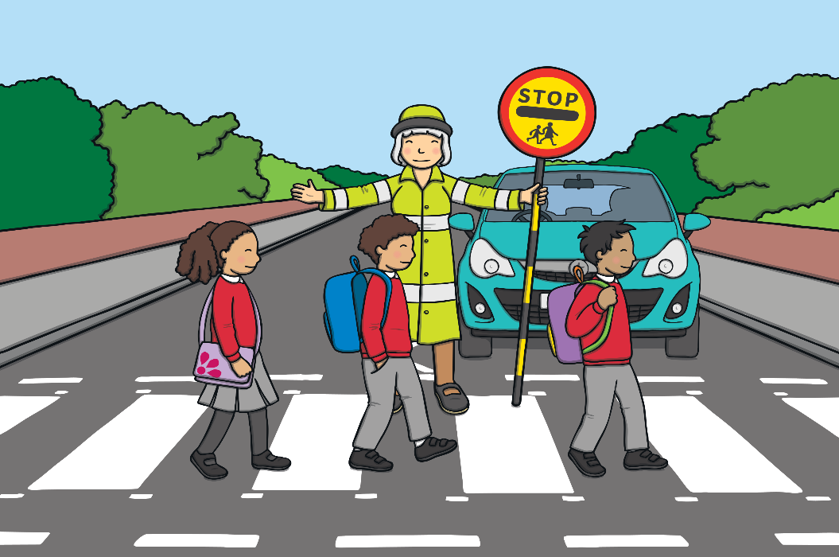
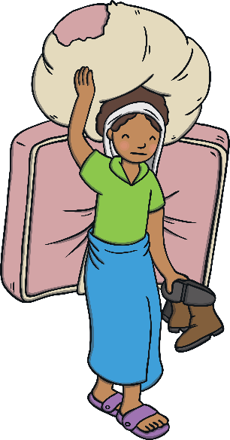
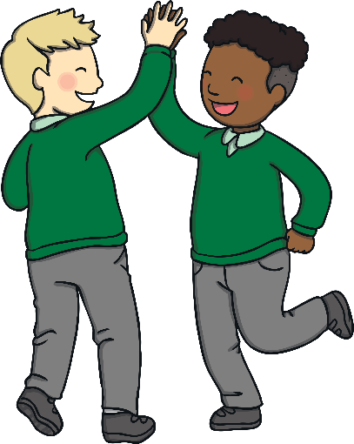
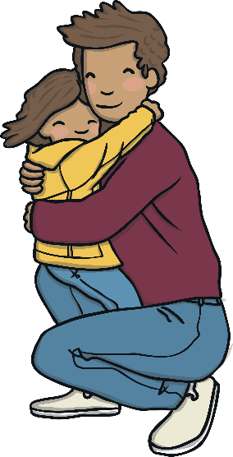
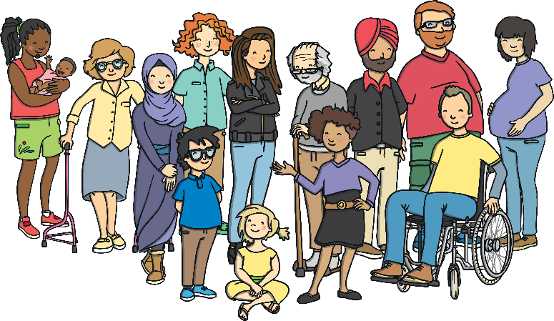
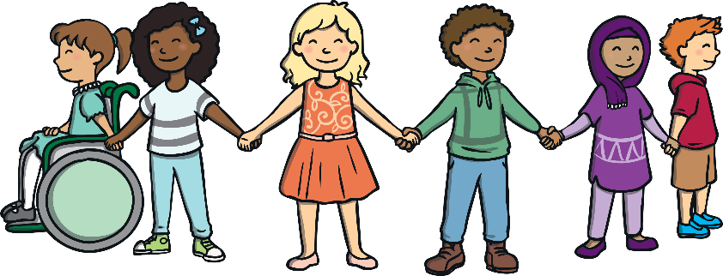
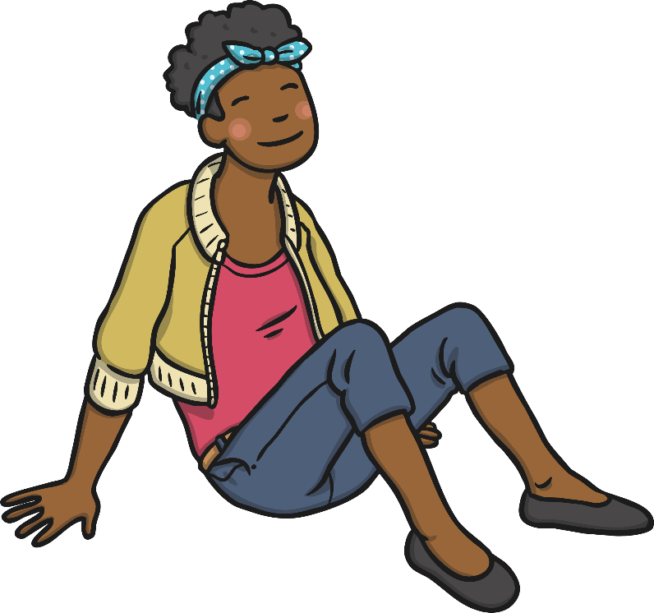
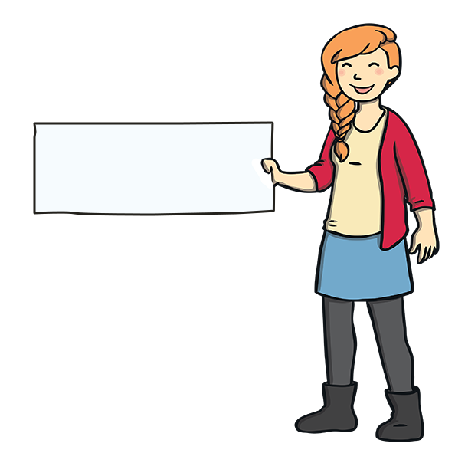
We All Share the Same Rights
There are lots of rights that all people share.
All people have the right to:
leave their country if they are not safe;
be who they want
to be.
be treated with kindness and respect;
feel valued;
be treated fairly;
be safe;

Slide 5
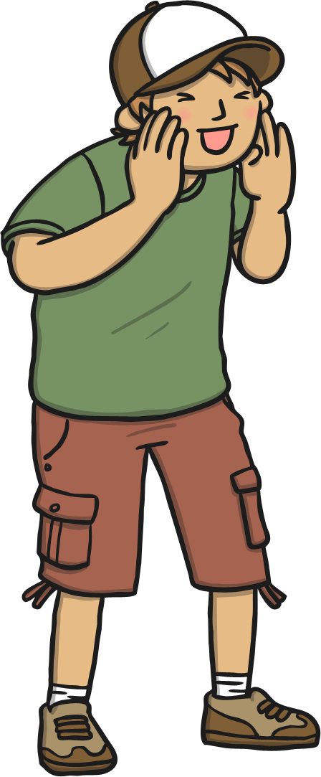
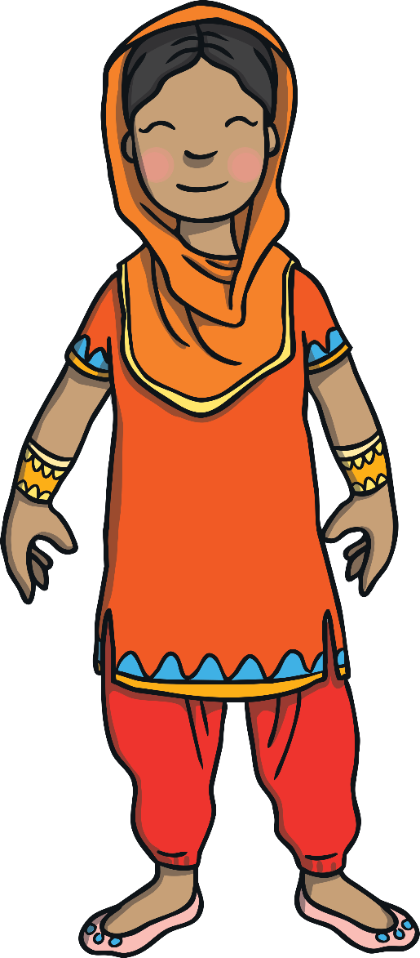
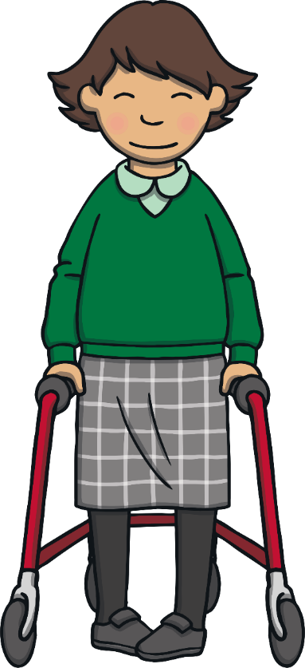
What does ‘respect’ mean?
Respect means you think carefully about the feelings, wishes and rights of others.
Showing respect for others is important – it helps them feel safe, happy loved and cared for.
You show respect through the choices you make, the way you behave and the things that you say.

Slide 6
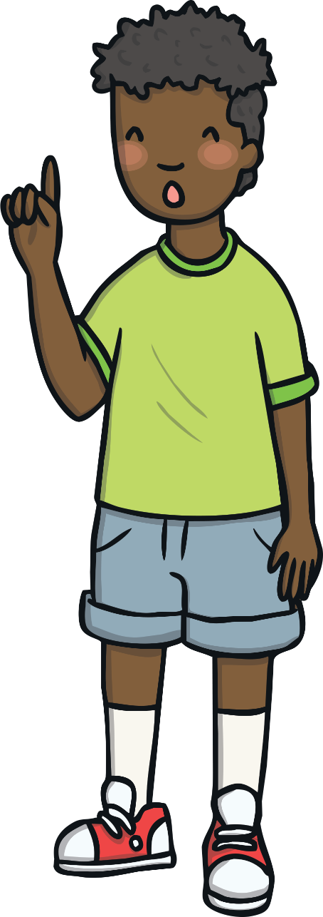



Respecting the Rights of Others
Remember, all people share the right to be safe, to be treated fairly, to be treated with kindness and respect, to feel valued, to leave their country if they are not safe and to be who they want to be.

Slide 7
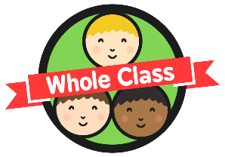
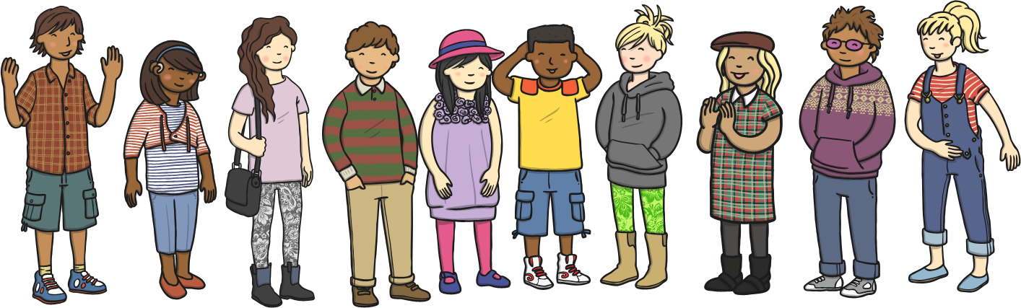
Respecting the Rights of Others
We can listen to everybody’s thoughts and ideas.
We can let people be who they want to be and not make fun of them or laugh at them.
We can take time to learn about and learn from people who are different from us.
We can take time to show care and love to others.
We can help people who are sad, lonely or frightened.
We can include everyone.
We can be kind to everyone.
We can show respect for the rights of others in lots of ways.

Slide 8
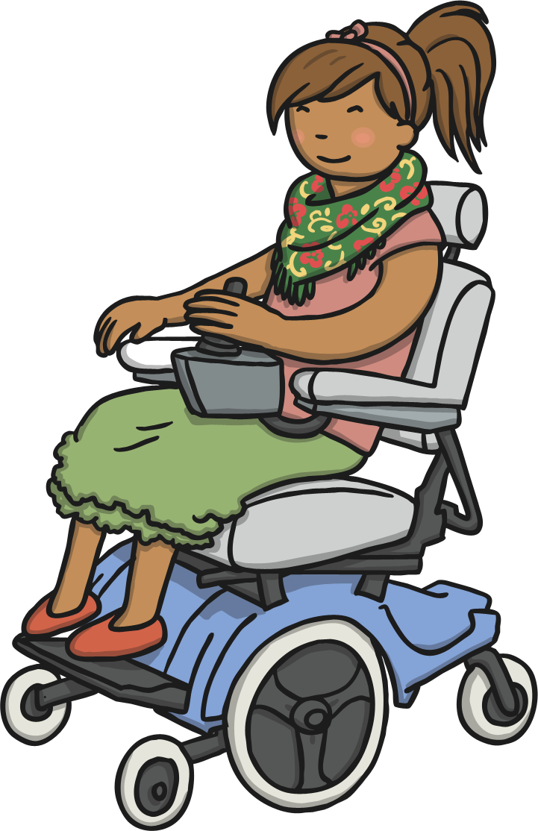
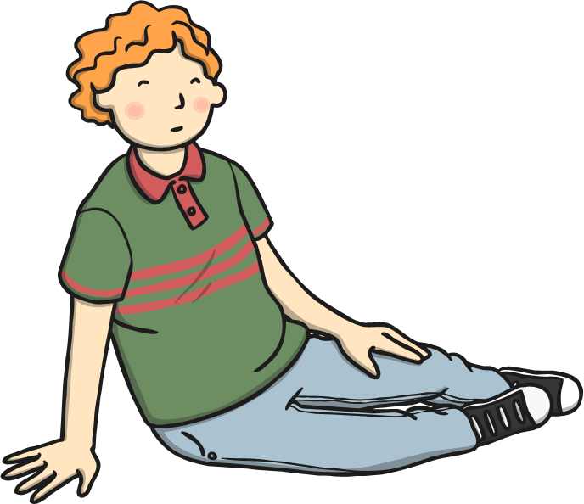
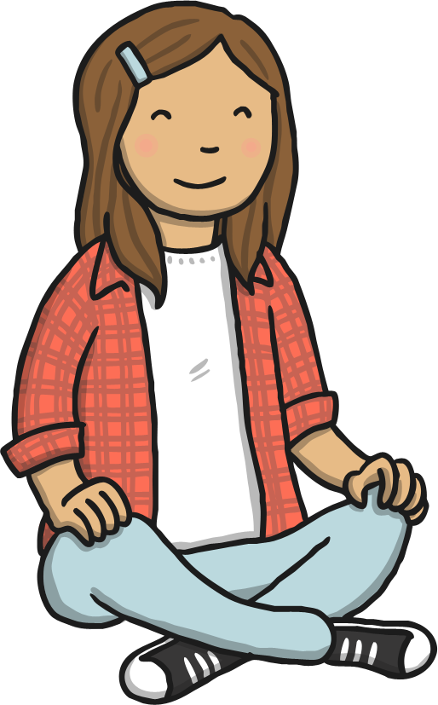
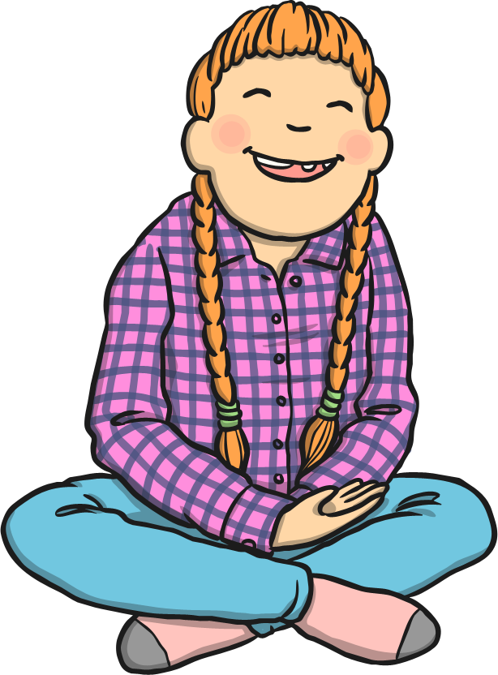
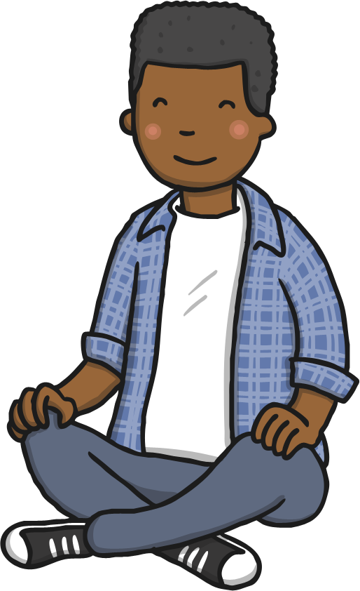
How do you think people feel when their rights aren’t respected?
Showing respect for the rights of others is important – it helps all people to feel safe, loved and cared for. It can help all people feel happy inside.
When people’s rights are not respected, they can feel sad, angry, lonely and frightened. These feelings can lead to people falling out with each other.

Slide 9
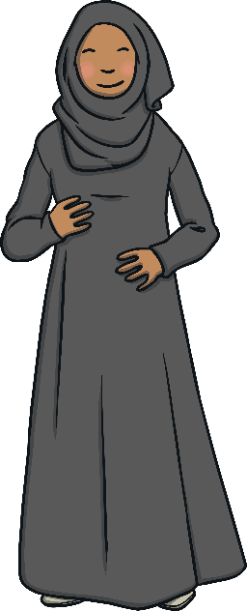
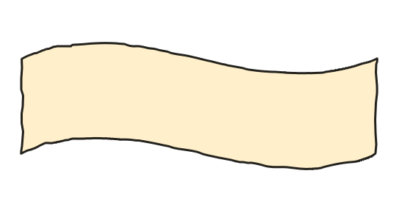
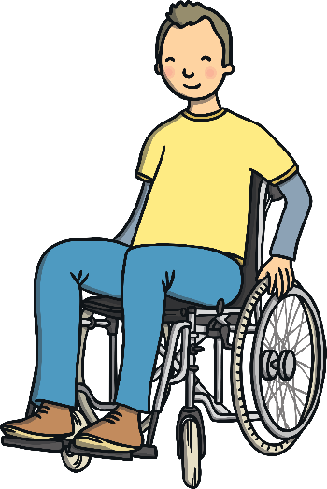
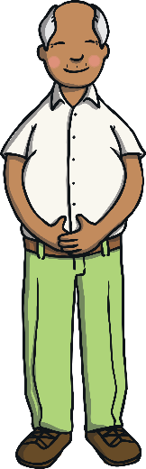
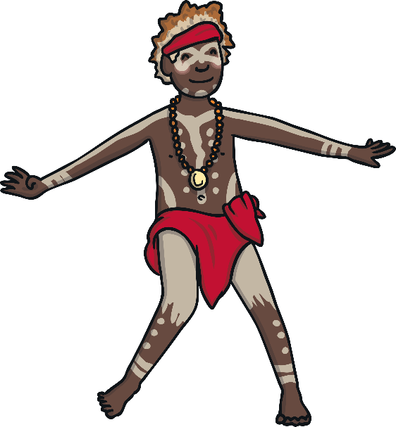
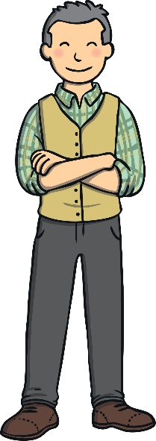
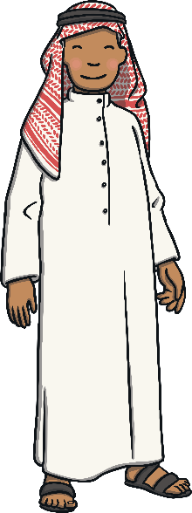
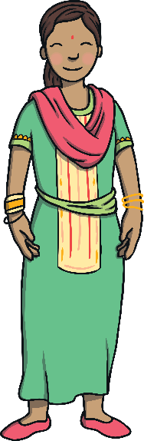
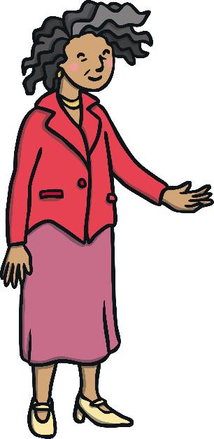
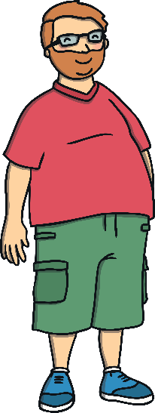
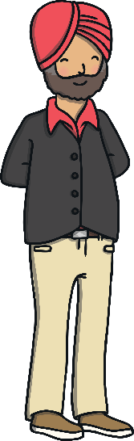
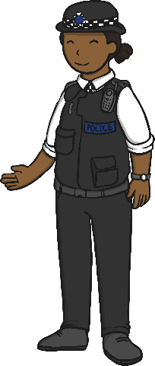
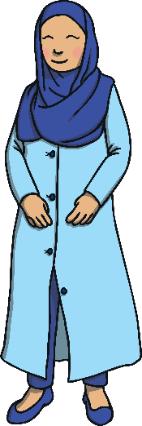
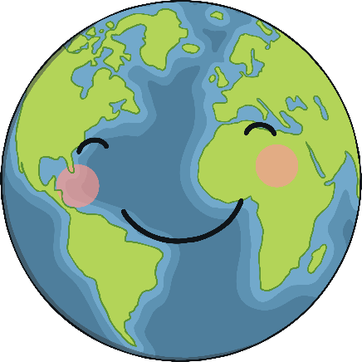
Rights without Respect
There are people all over the world working really hard to make sure that people’s rights are respected. We can do our bit by respecting the rights of others in school and in our
local community.
Let’s be a rights-respecting class and help others feel happy on the inside!

Slide 10
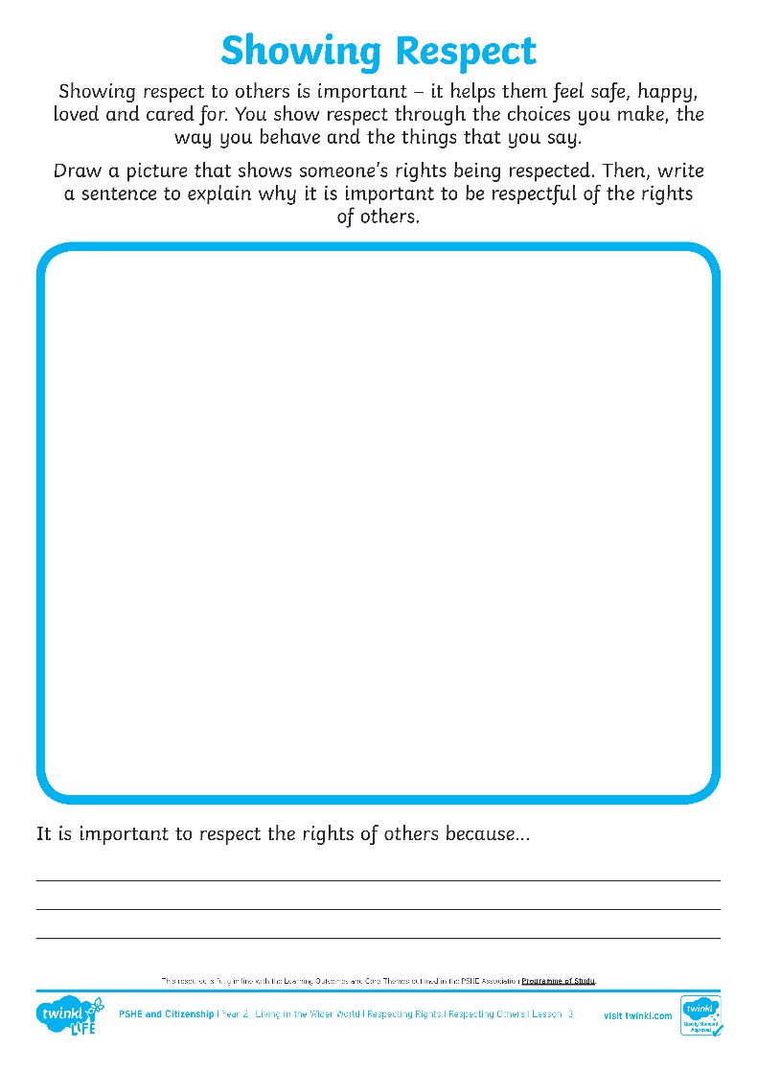
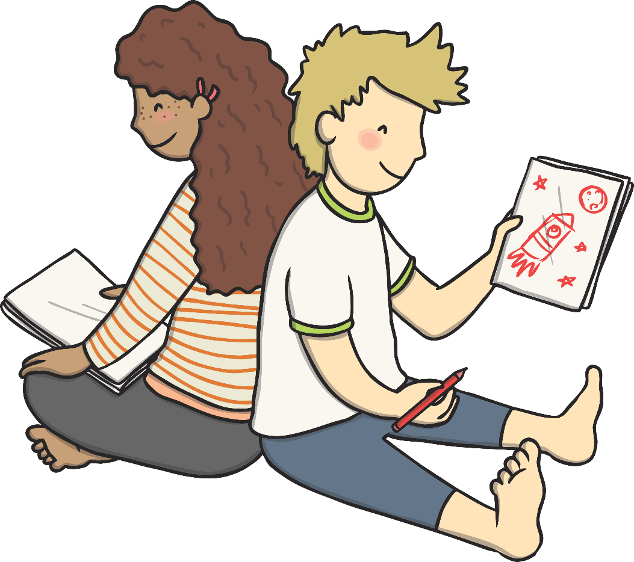
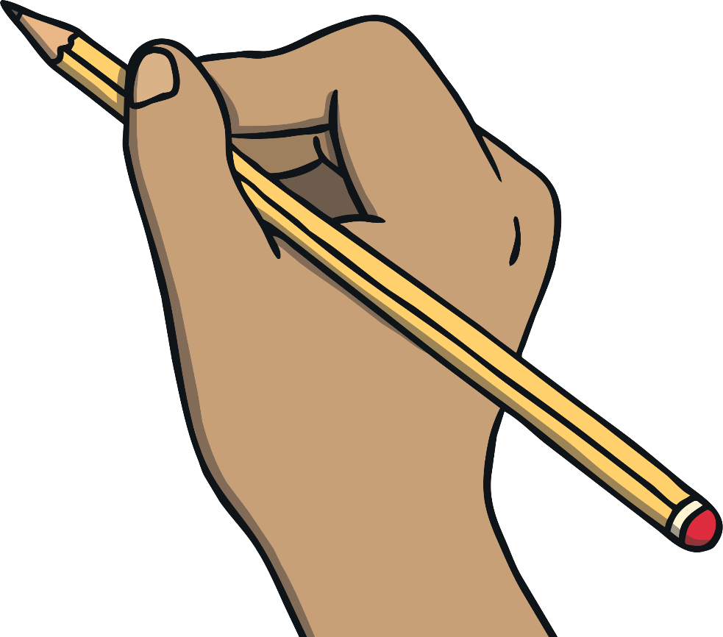
Draw a picture that shows someone’s rights being respected.
Then, write a sentence to explain why it is important to be respectful of the rights of others.

