Slide 1


LO: To write a diary entry.

Slide 2
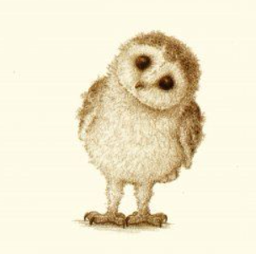
Can you remember who Plop met?

Slide 3
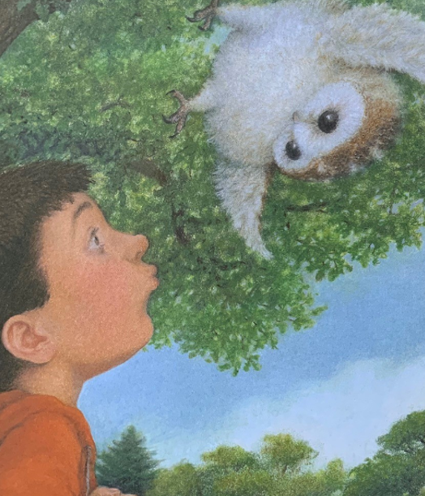
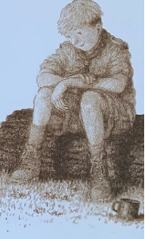
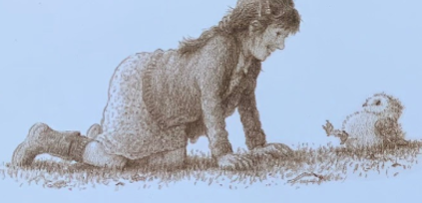
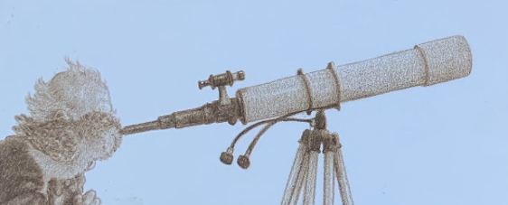
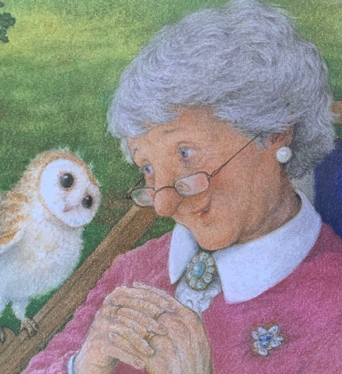
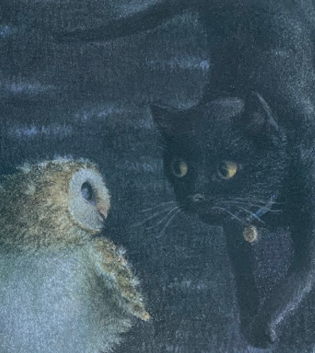

Slide 4
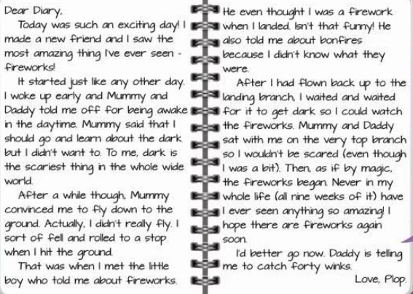

Slide 5
Diary writing
Written in the first person – I, me, my, we
Written in the past tense
Describes the events that happened
Describes feelings
Uses time words – first, next, then, after that

