Slide 1


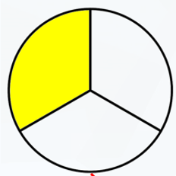
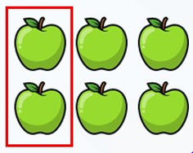

LO: To recognise a third

Slide 2

When we write a fraction…
The top number shows how many parts of the whole we are talking about.
The bottom number shows how many parts the whole has been split into.

Slide 3

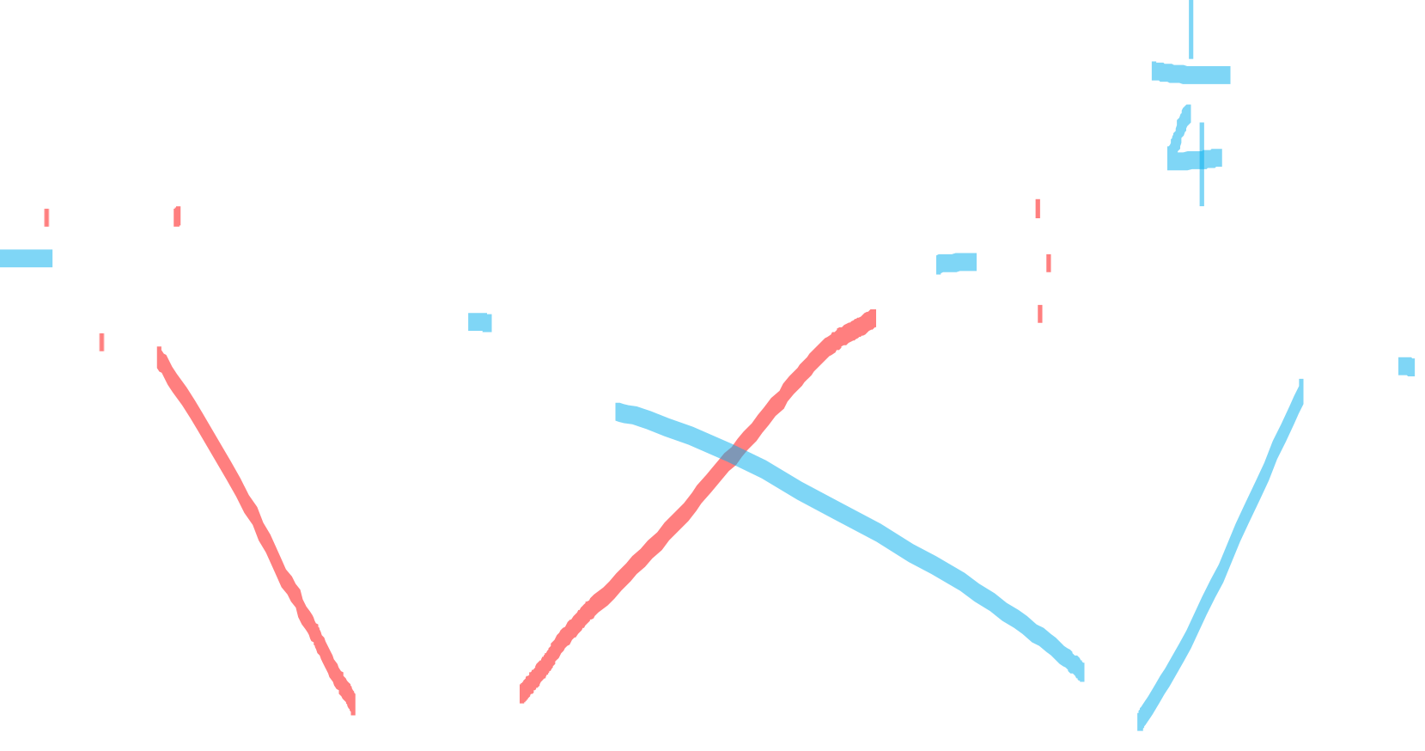
Fluency
Which pictures represent $\frac{\text{1}}{\text{3}}$ ?
Thirds
Not thirds

Slide 4

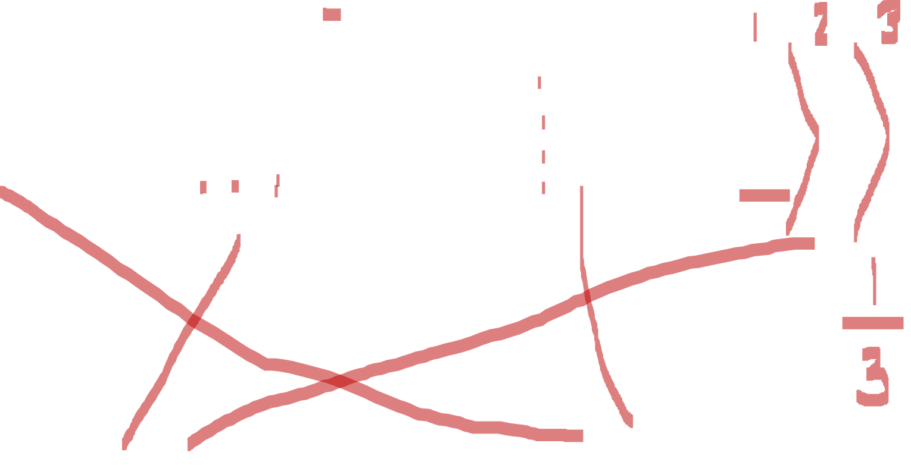
Fluency
Which pictures represent $\frac{\text{1}}{\text{3}}$ ?
Thirds
Not thirds

Slide 5
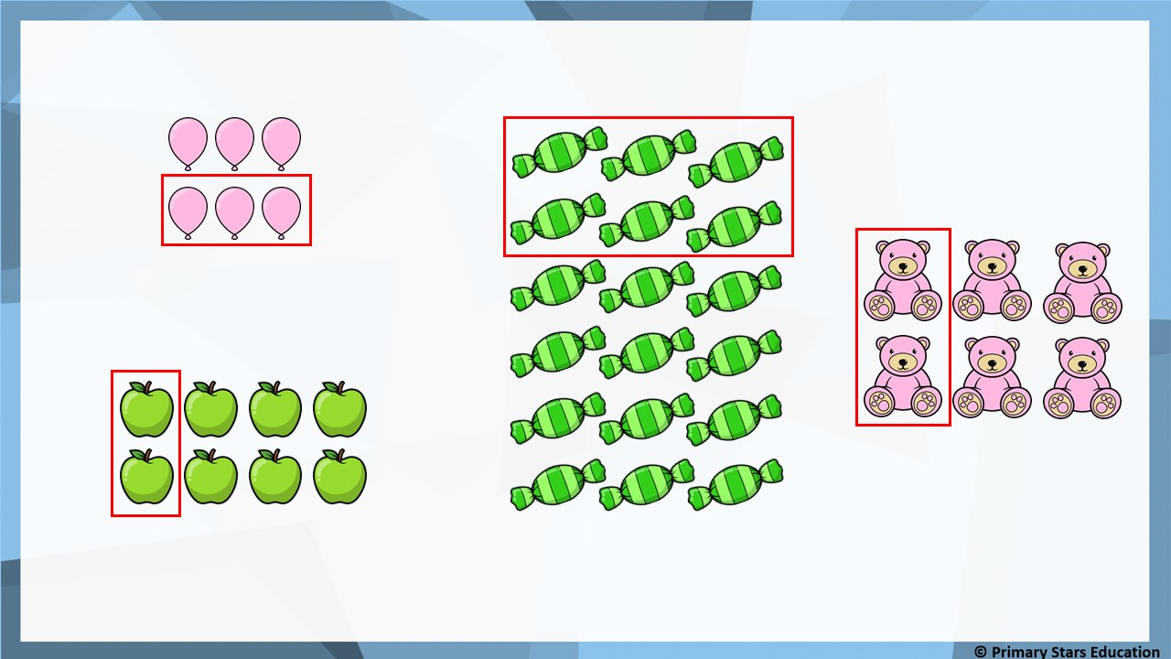
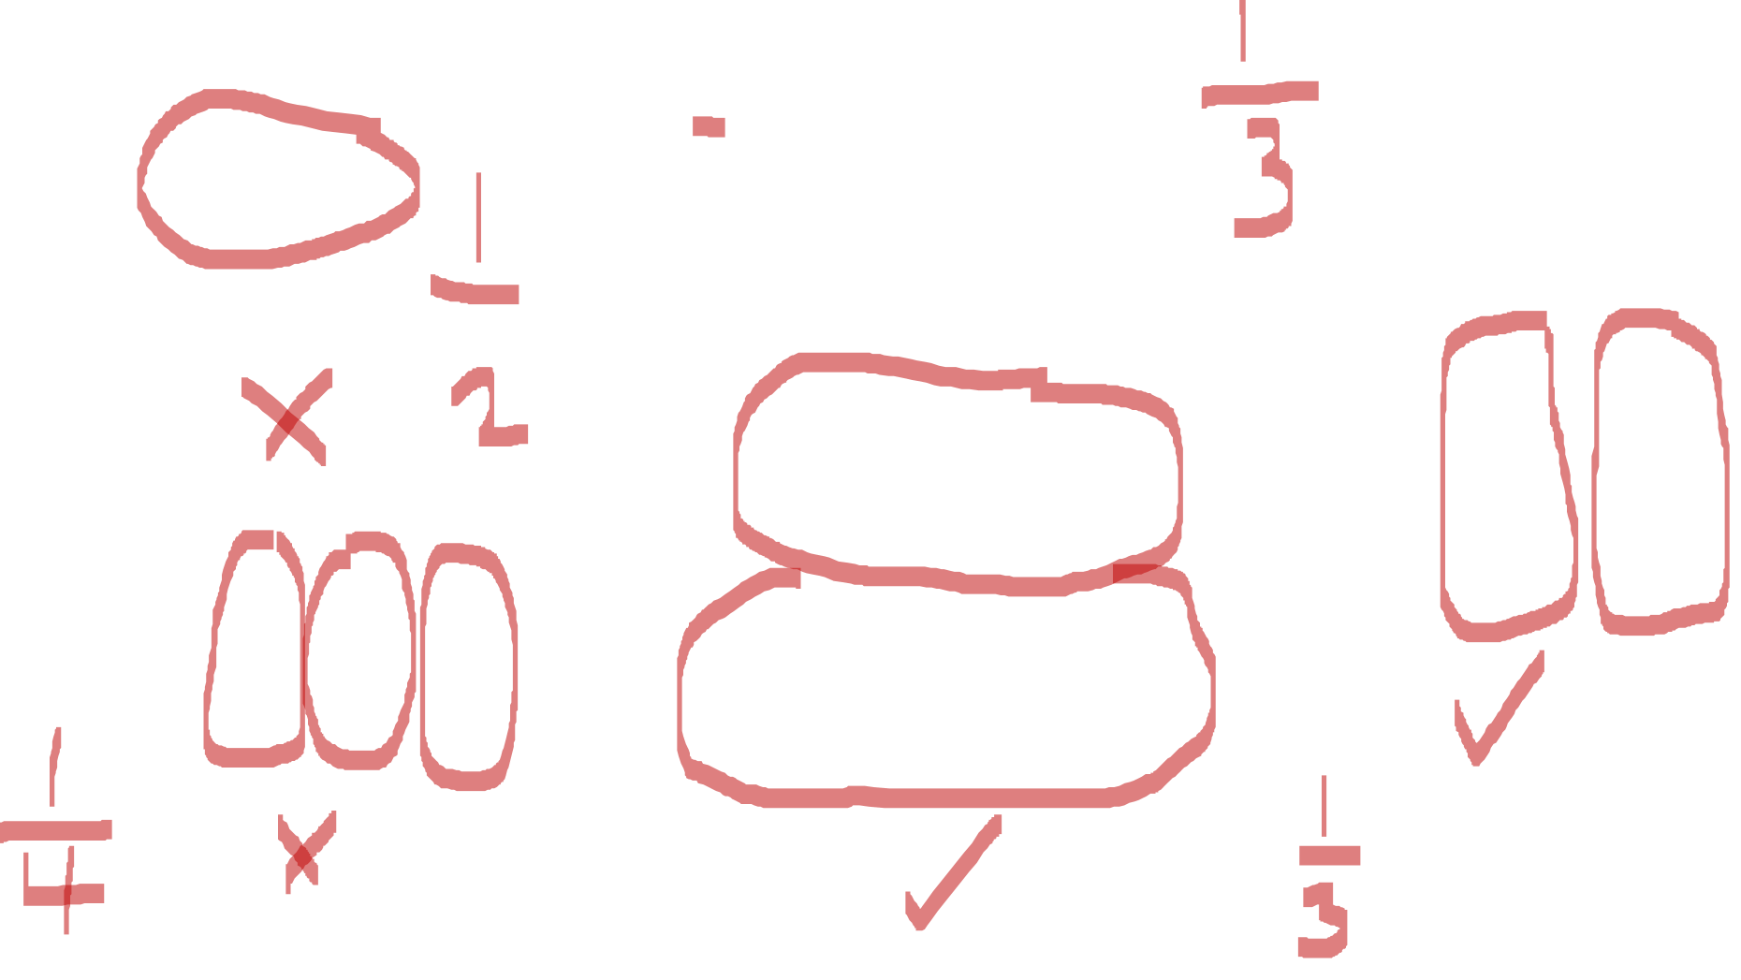
Fluency
Which pictures represent $\frac{\text{1}}{\text{3}}$ ?

Slide 6
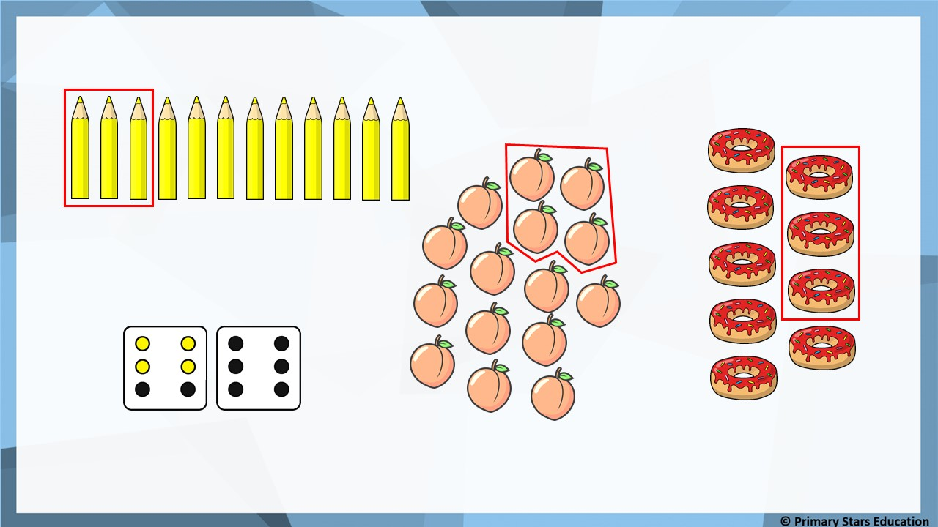
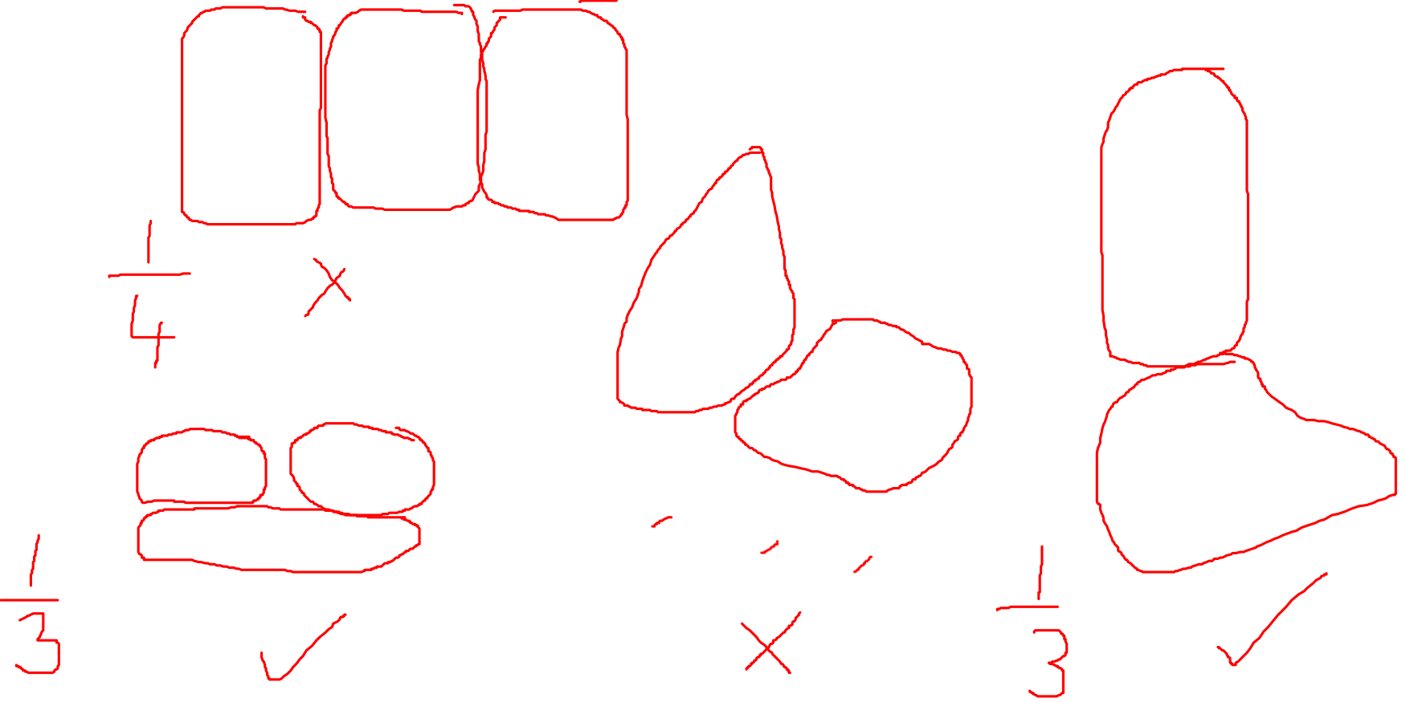
Fluency
Which pictures represent $\frac{\text{1}}{\text{3}}$ ?

Slide 7

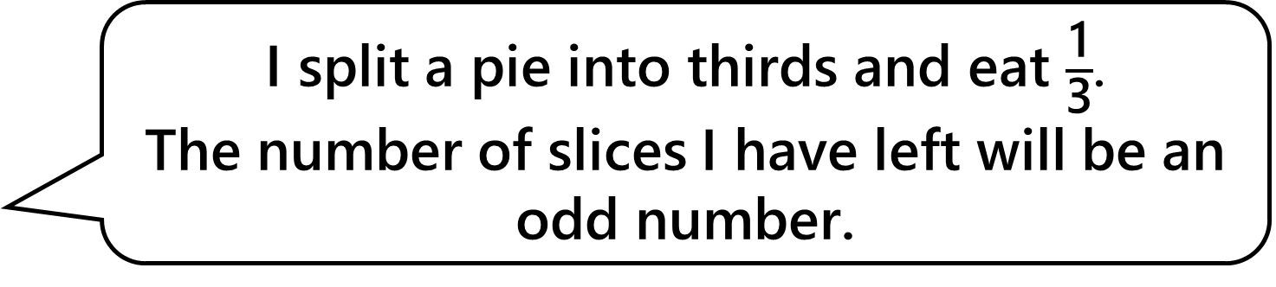
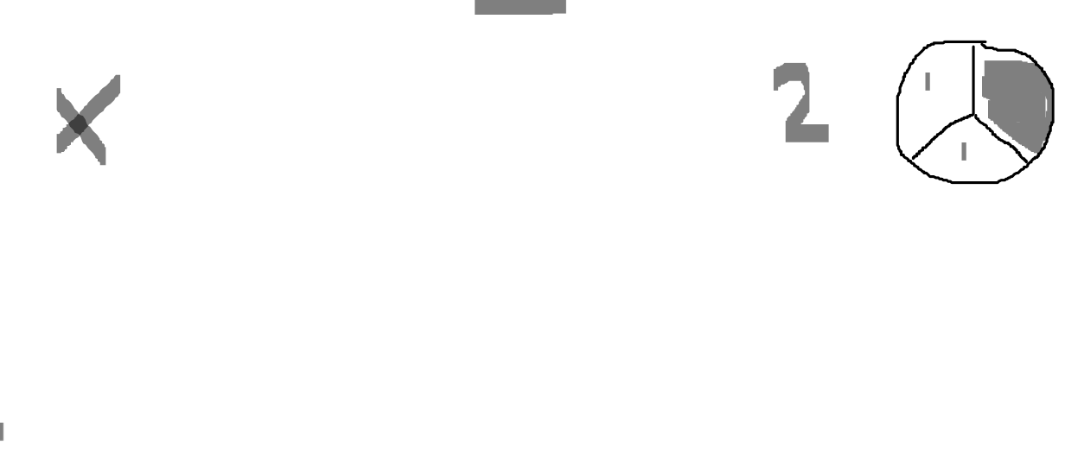
Rob says,
Reasoning
I split a pie into thirds and eat $\frac{\text{1}}{\text{3}}$.
The number of slices I have left will be an odd number.
Is Rob correct?
No, Rob is incorrect.
If a pie is split into thirds then it is split into 3 equal pieces. If one piece is eaten then there will be 2 pieces left.
2 is an even number.

Slide 8
Problem solving
How can this shape be split up into thirds?

Slide 9
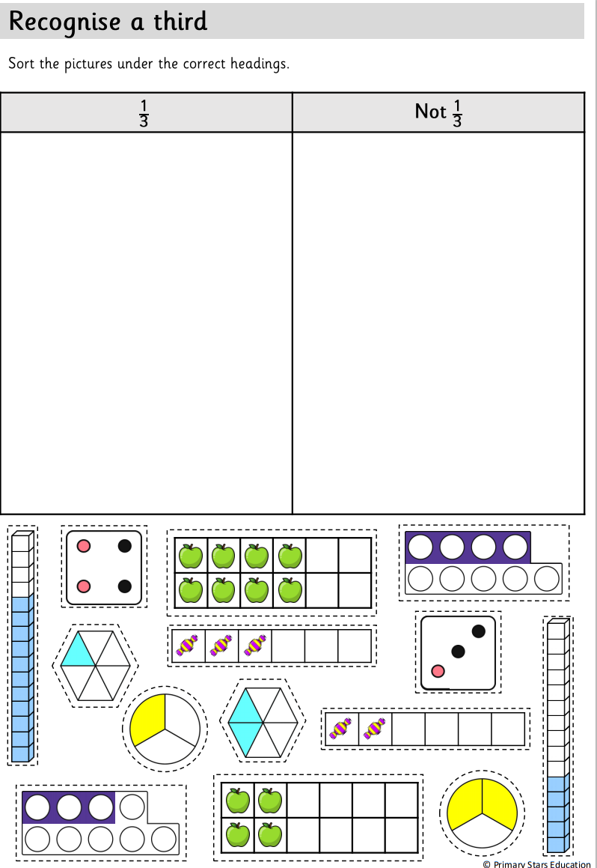
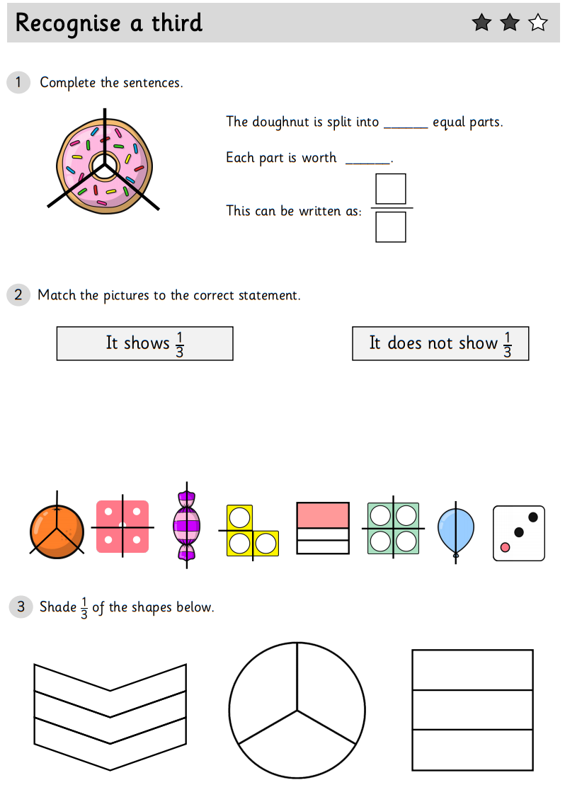
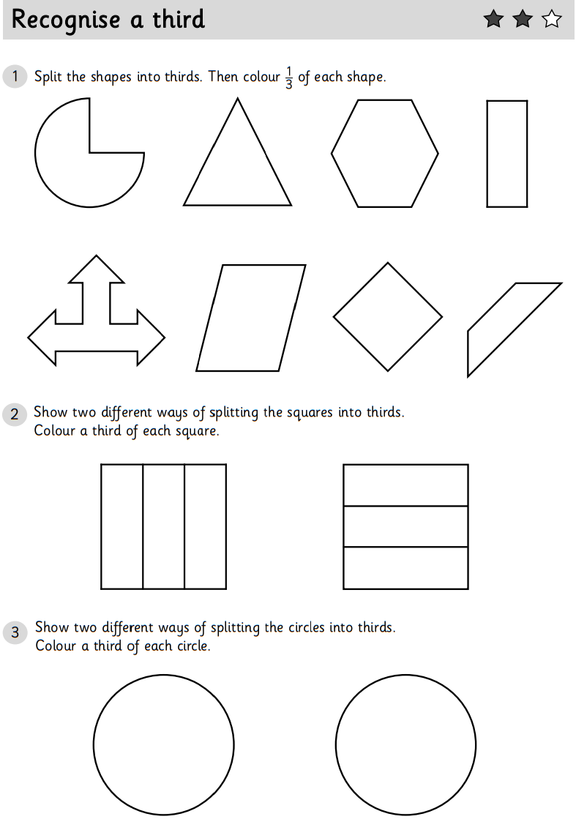
We would like you to complete two pieces of work today. For the first piece you need to cut the pictures out and correctly sort them under the headings 1/3 or not a 1/3 . For your second piece of work choose two 1, 2 or 3 Star worksheets to complete.

