Slide 1


LO: To solve division problems by grouping or sharing

Slide 2

You can divide by…
or
Sharing
Grouping
9 ÷ 3 =
3
9 ÷ 3 =

Slide 3
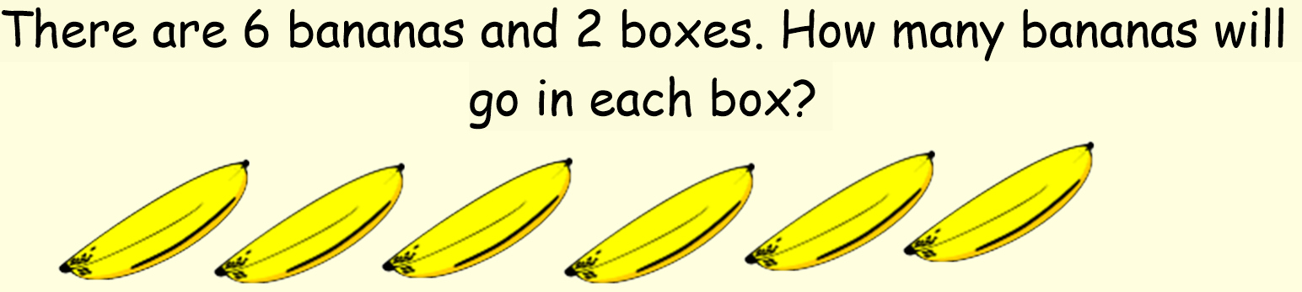

6 ÷ 2 =
3

Slide 4
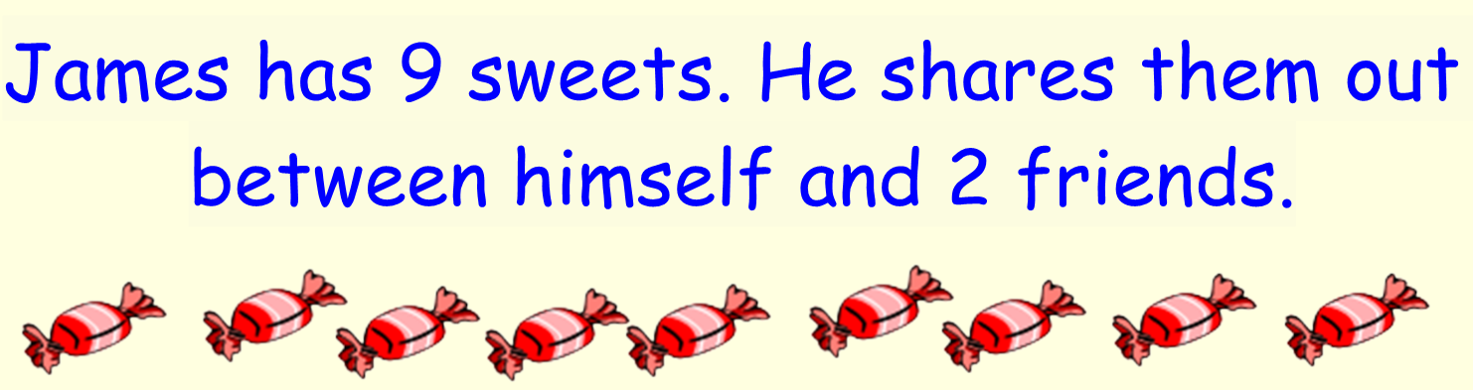

9 ÷ 3 =

Slide 5
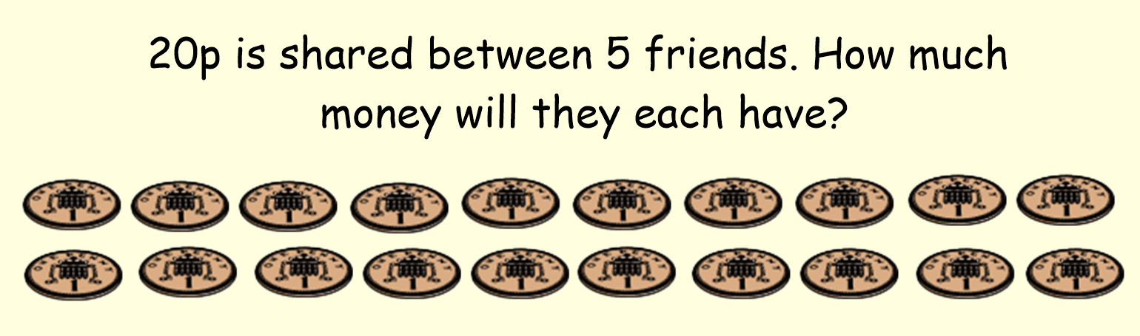
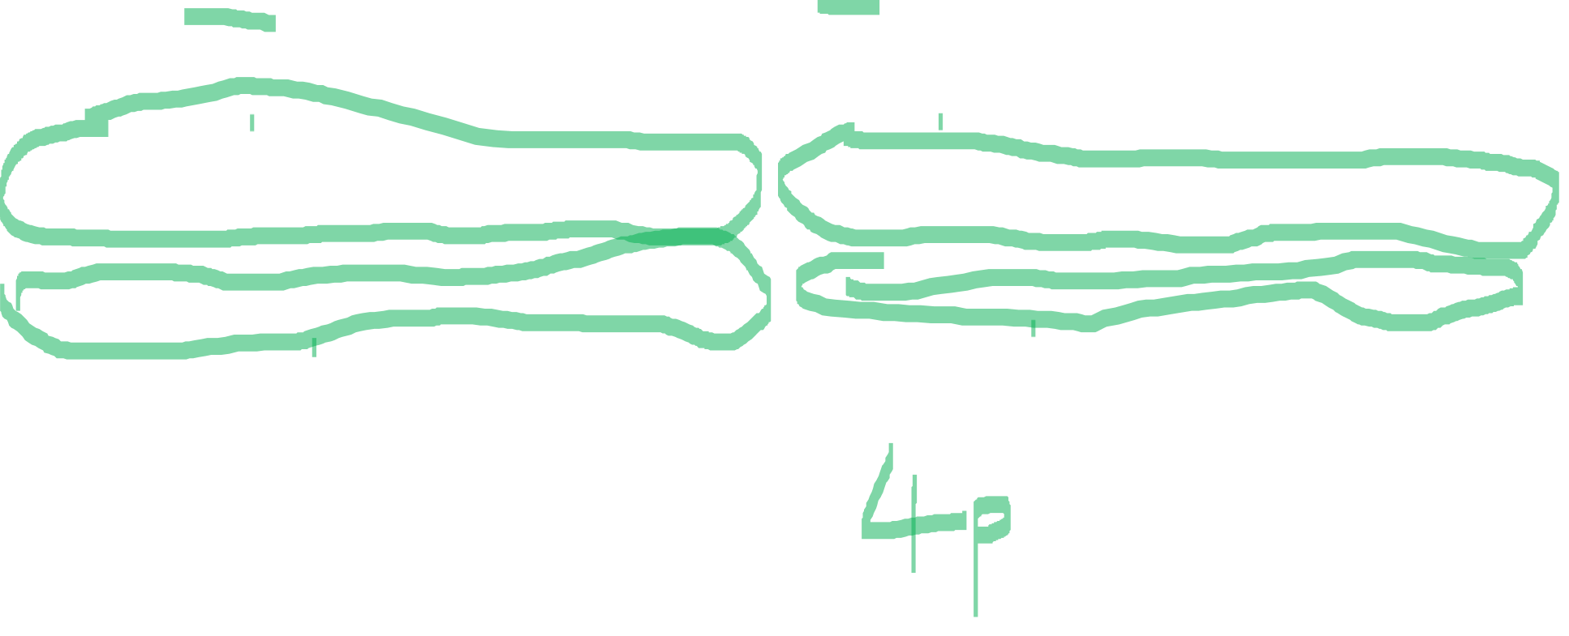
20 ÷ 5 =

Slide 6
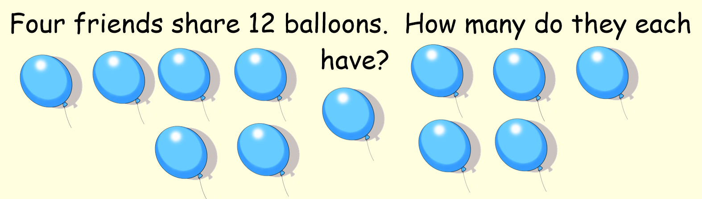
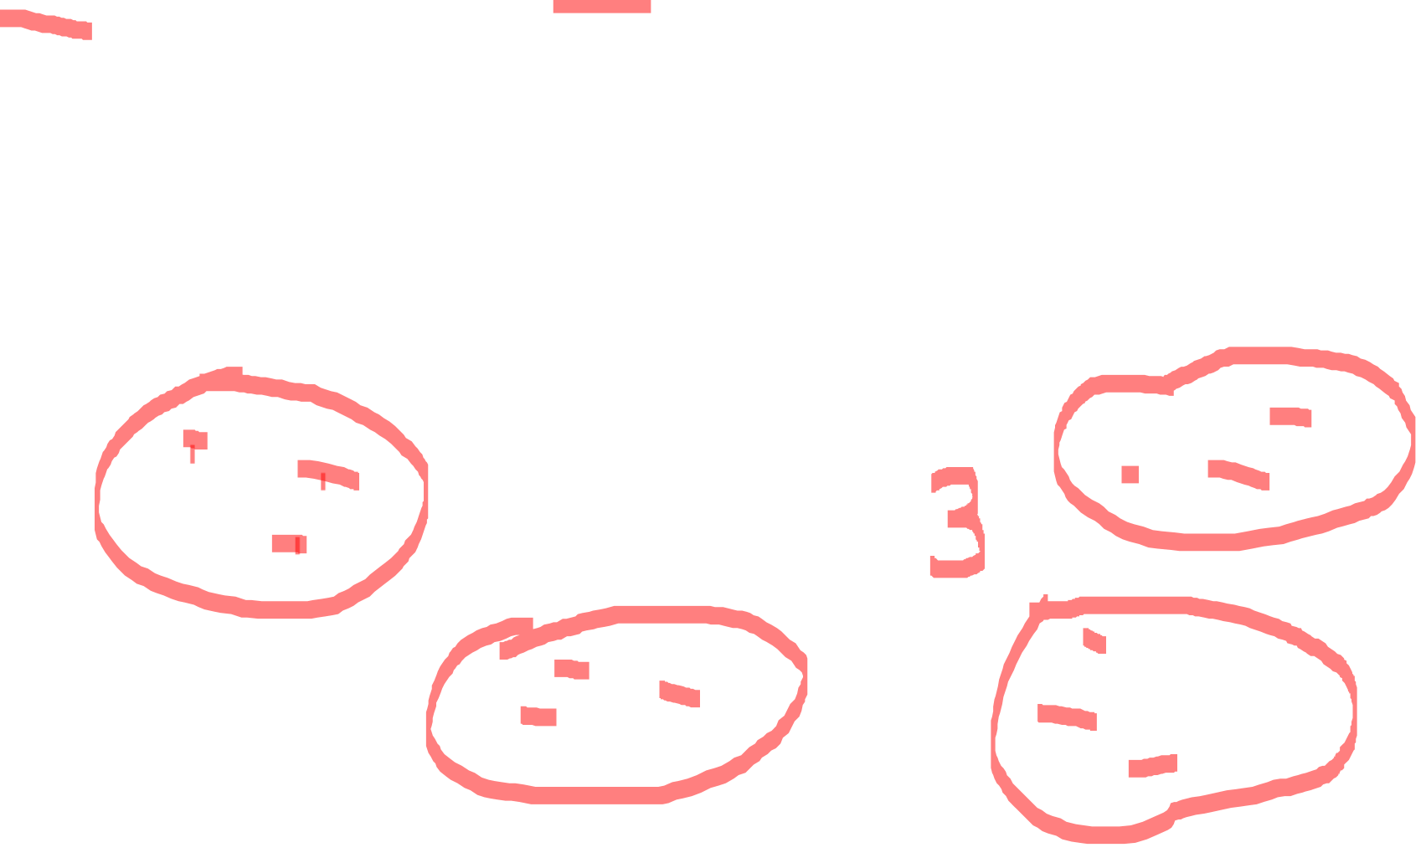
12 ÷ 4 =

Slide 7
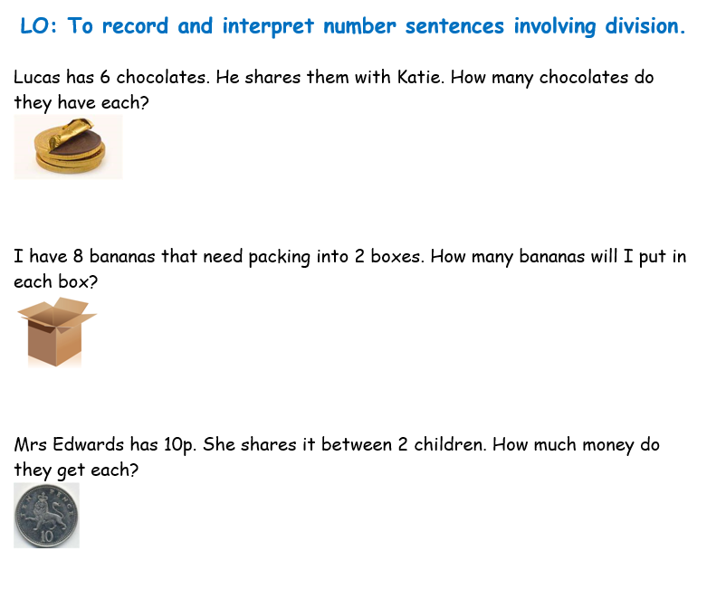
Now you are going to choose a worksheet
from the folder to complete.
Remember to underline the important
information and write out your division
sum first.
You can choose either the grouping or
sharing method to solve each sum.
8 ÷ 2 =

