Slide 1



LO: To divide numbers by grouping

Slide 2


The first number tells us how many objects there are.
The second number tells us how many to put in each group.

Slide 3

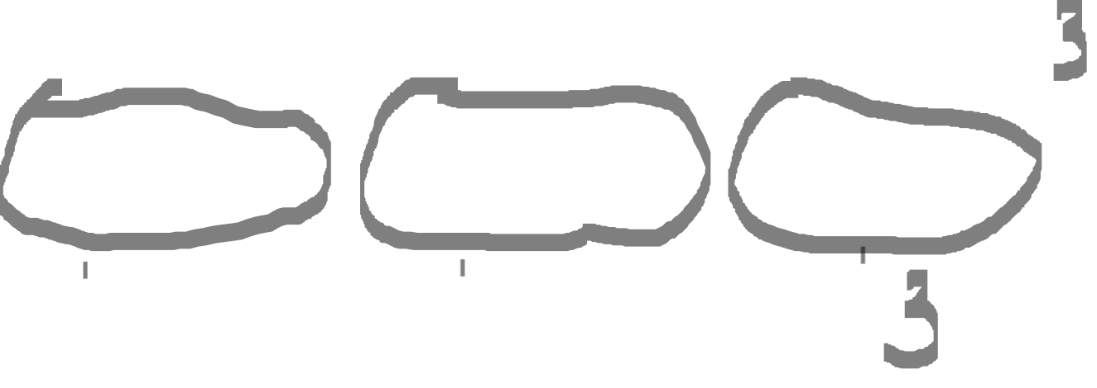

Slide 4



Slide 5



Slide 6

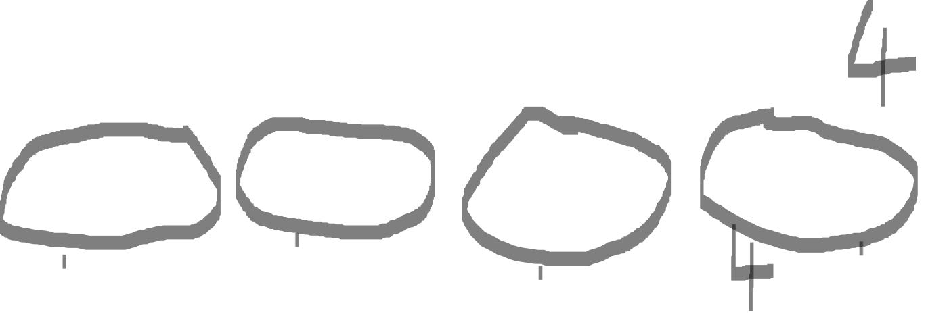

Slide 7

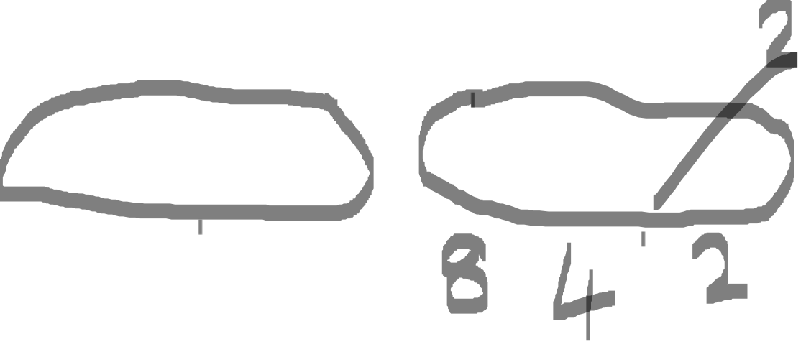

Slide 8



Slide 9
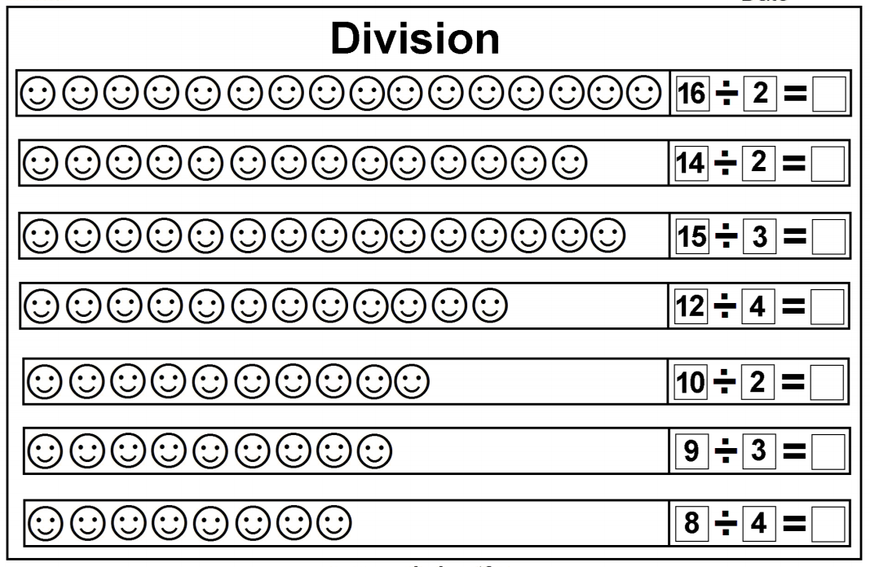
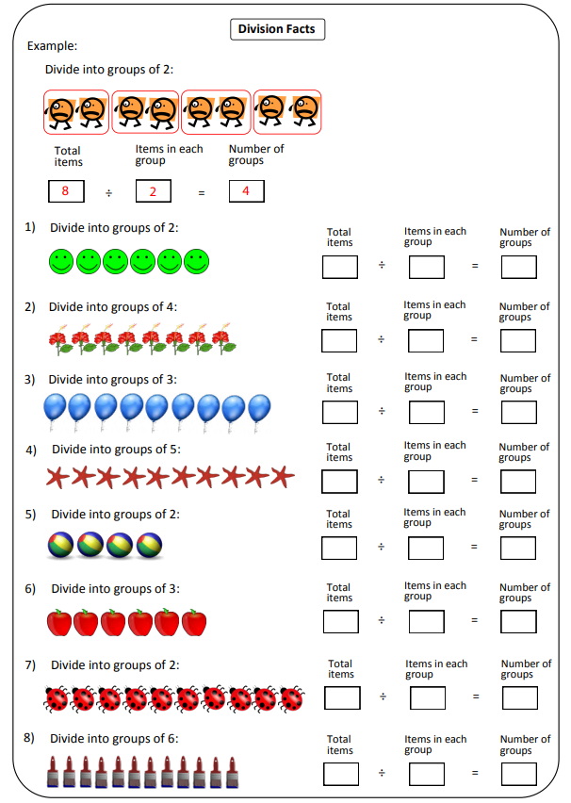

Choose a worksheet from
the folder and use the
grouping method to solve
the divisions.

