Slide 1



LO: To divide numbers by grouping

Slide 2


6 ÷ 2 =
The first number tells us how many objects there are.
The second number tells us how many to put in each group.

Slide 3

Group the counters in 2s
8 ÷ 2 =

Slide 4

Group the counters in 2s
4 ÷ 2 =

Slide 5

Group the counters in 2s
10 ÷ 2 =

Slide 6

Group the counters in 3s
6 ÷ 3 =

Slide 7

Group the counters in 3s
9 ÷ 3 =

Slide 8

Group the counters in 5s
10 ÷ 5 =

Slide 9
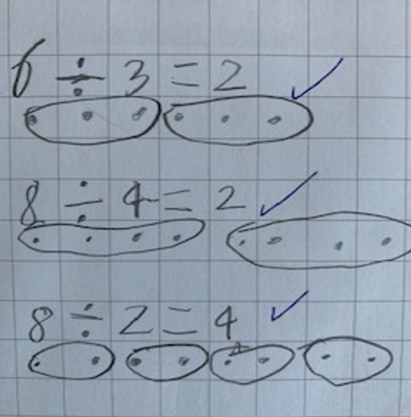
Set your work out like this:
Write your sum out first
Read the first number in your sum and draw that many dots in a line
Now look at the second number and group that number of dots
Try to leave a line between each sum to help you set your work out clearly

