Slide 1

Learning Objective
LO: To compare the differences between things that are living, dead and have never been alive.

Slide 2

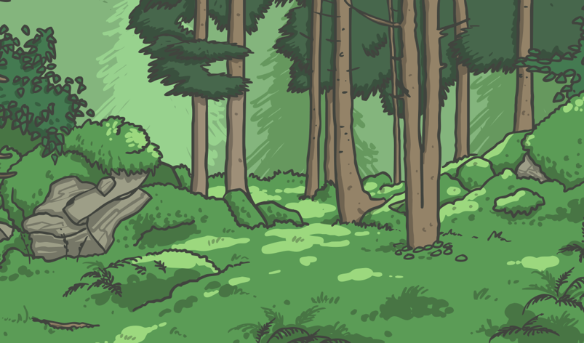
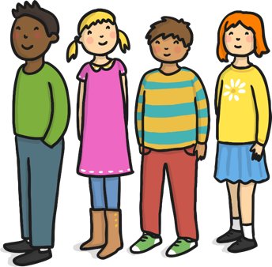
I’m Alive!
We are all alive!
What do we do that lets us know we are alive?

Slide 3



Life Processes
All living things do certain things to stay alive.
These are called life processes.
Animals, including humans, do these things.
Plants do too, although they do them in different ways.
We can remember these things by
thinking about Mrs Gren .

Slide 4
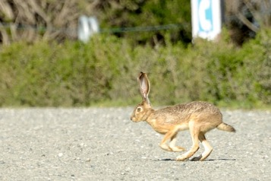
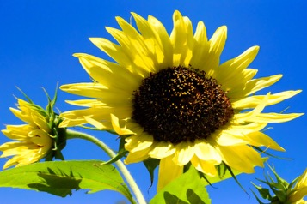
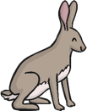

MRS GREN M - Movement
A sunflower moves to
turn its face towards the sun.
A hare runs to
escape from danger.
ATTRIBUTION - Photo courtesy of Don DeBold and Scott Hudson (@flickr.com) - granted under creative commons licence - attribution

Slide 5
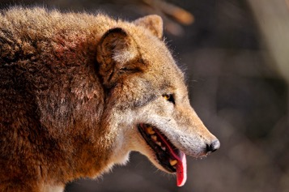
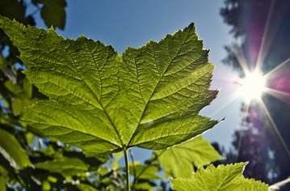


MRS GREN R - Respiration
Mammals breathe through their mouths and noses.
Plants take in and give out gases through their leaves.
ATTRIBUTION - Photo courtesy of Tambako the Jaguar and Waledro (@flickr.com) - granted under creative commons licence - attribution

Slide 6
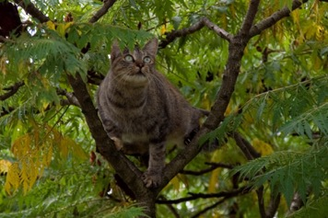
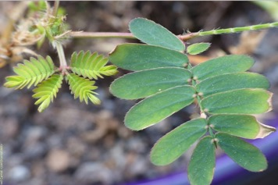
MRS GREN S – Sensitivity
Animals use their senses to see, hear, taste, touch and smell the world around them.
Plants can also detect changes in the environment. This mimosa plant curls up when you touch it!
ATTRIBUTION - Photo courtesy of Domenico Salvagnin and Carnat Joel (@flickr.com) - granted under creative commons licence - attribution

Slide 7
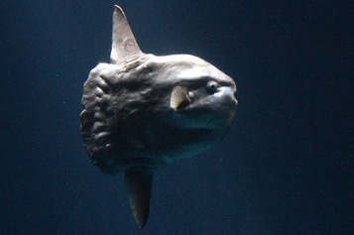
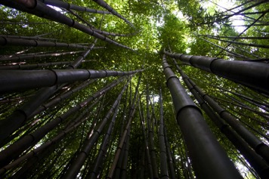

MRS GREN G - Growth
This ocean mola started life as an egg not much bigger than a full stop. It will grow to weigh about 1000 kg- this is the same size as a large bull!
Bamboo can grow up to 3cm every hour.
ATTRIBUTION - Photo courtesy of Sandip Bhattacharya and The Pug Father (@flickr.com) - granted under creative commons licence - attribution

Slide 8
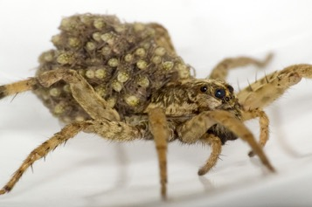
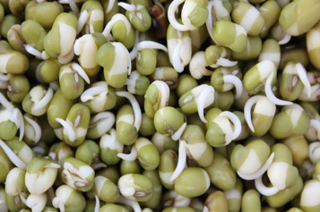

MRS GREN R - Reproduction
This wolf spider has her babies on her back.
Each seed contains a tiny miniature plant ready to grow.
ATTRIBUTION - Photo courtesy of Ralph Arvesen and U.S. Department of Agriculture (@flickr.com) - granted under creative commons licence - attribution

Slide 9
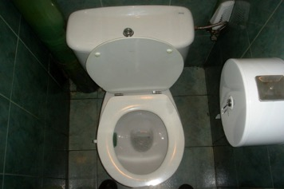
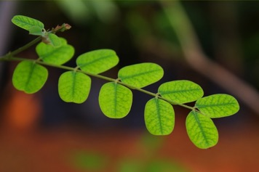


MRS GREN E - Excretion
How do you get rid of waste products from your body?
Left over gases and water leave plants through their leaves.
ATTRIBUTION - Photo courtesy of boxface and Pranav Yaddanapudl (@flickr.com) - granted under creative commons licence - attribution

Slide 10
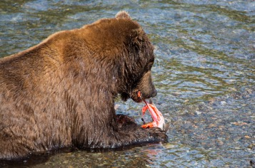

MRS GREN N - Nutrition
Some animals eat plants, and some eat other animals.
Bears eat both, like people!
Green plants make their own food using the energy from the sun.
ATTRIBUTION - Photo courtesy of Christoph Strassler and NielsWPhotography (@flickr.com) - granted under creative commons licence - attribution

Slide 11
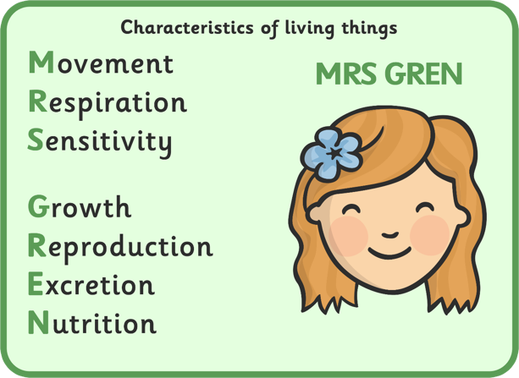
All living things do these things to stay alive:

Slide 12













Living or Not?
Which of these are living?
Which are non-living?
How can you tell?

Slide 13
Living or Not?
Living
Non-living

Slide 14





Living or Not?
Living things have life processes.
They need food, water and air to stay alive.
They can sense changes in the environment.
They can move, grow and reproduce.
Non-living things can be things that were once living or part of a living thing, or they can be things that have never been alive.
They do not need food, water or air.
They cannot reproduce.
v
v

Slide 15












Dead or Never Alive?
Many non-living things have never been alive but some of them were once part of a living plant or an animal.
Which of these non living things are dead, and which were never alive?
It may help to think of what the thing is made from.

Slide 16



Dead or Never Alive?
Things made of materials like metal, rock, plastic, glass and sand have never been part of a living thing.
Never alive

Slide 17

Dead or Never Alive?
All of these things are non-living,
but they used to be part of a
living thing.
Dead
Which living thing were they part of?

Slide 18


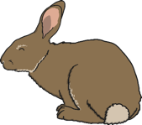

How Can You Tell?
Is this rabbit living, dead or has it never been alive?
How can you tell?

Slide 19


How Can You Tell?
Is this pinecone living, dead or has it never been alive?
How can you tell?

Slide 20
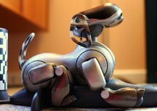
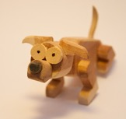
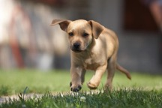
Which One Am I?
Living, Dead or Never Alive
ATTRIBUTION - Photo courtesy of Alden Chadwick, Sergey Galyonkin and Szlivka Robert (@flickr.com) - granted under creative commons licence - attribution

Slide 21
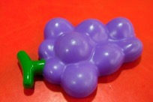
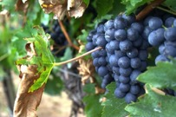
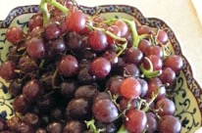
Which One Am I?
Living, Dead or Never Alive
ATTRIBUTION - Photo courtesy of Steven Depolo, tribp and kirybabe (@flickr.com) - granted under creative commons licence - attribution

Slide 22

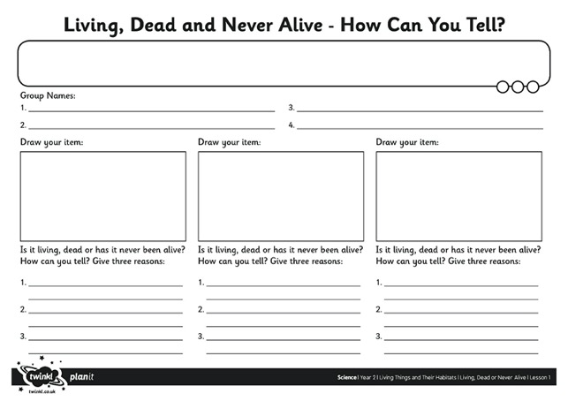







How Can You Tell?

Slide 23



Remember Mrs Gren!

