Slide 1
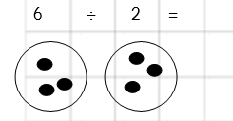

LO: To divide numbers by sharing

Slide 2

3
9 ÷ 3 =

Slide 3

5
10 ÷ 2 =

Slide 4

2
8 ÷ 4 =

Slide 5

2
6 ÷ 3 =

Slide 6

4
12 ÷ 3 =

Slide 7

3
30 ÷ 10 =

Slide 8


