Slide 1
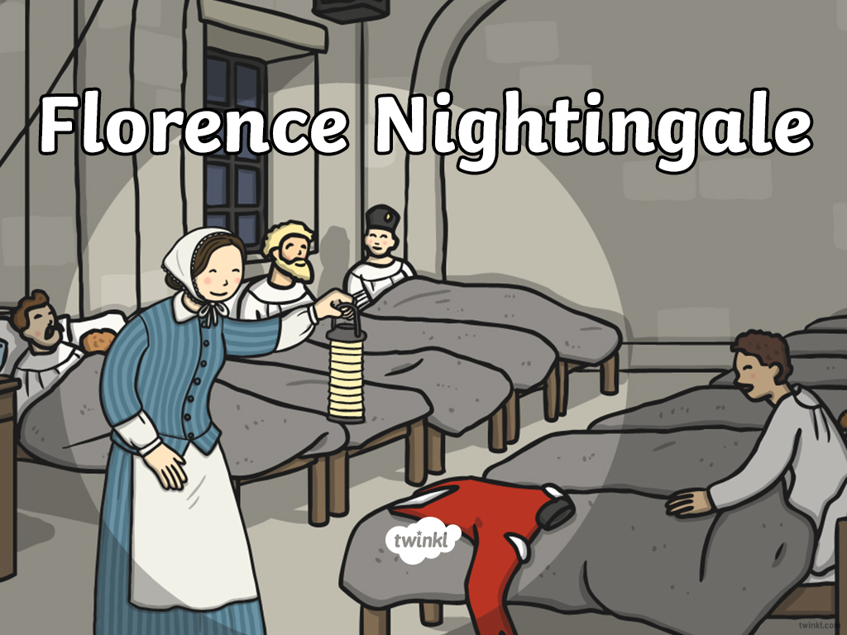


Slide 2
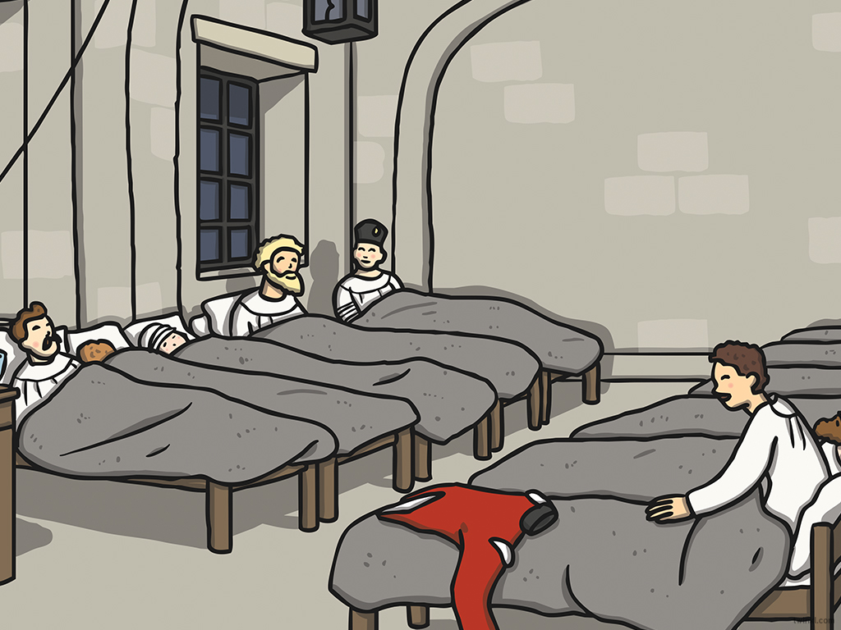

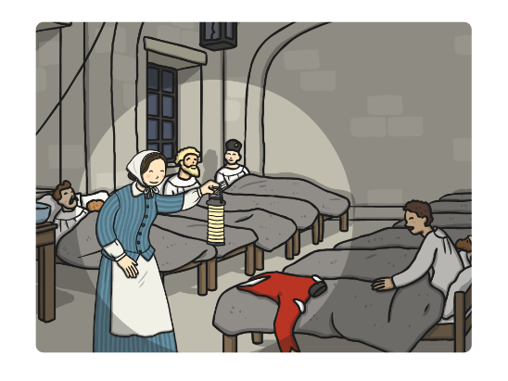
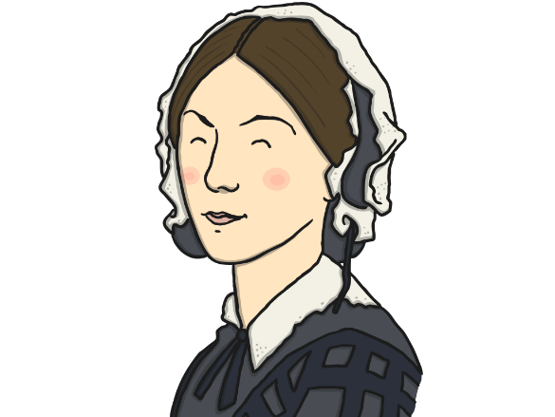
Click a date to find out more about Florence Nightingale
1837
1854
1856
1896
1853
1854
1859
1851
1854
1857
1910
1820
1853
1855
1883

Slide 3

1820
Florence Nightingale was born on the 12th of May in 1820.

Slide 4

1837
Florence felt God call her to serve him.
She campaigned for better care in hospitals.

Slide 5
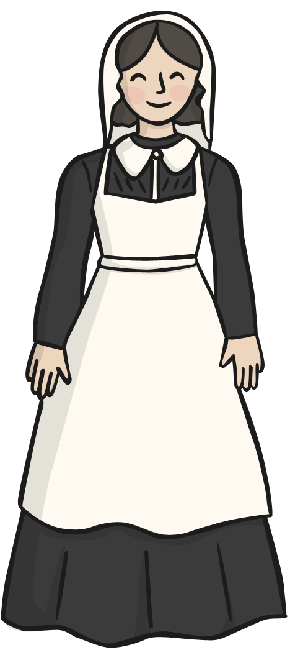
1851
Florence became a nurse.

Slide 6
1853
Florence was made superintendent at a medical centre for women in London.

Slide 7

1853
The Crimean War broke out.

Slide 8

1854
Florence went to Turkey to care for wounded soldiers.

Slide 9

1854
Florence made sure the hospitals were clean and saved many lives.

Slide 10
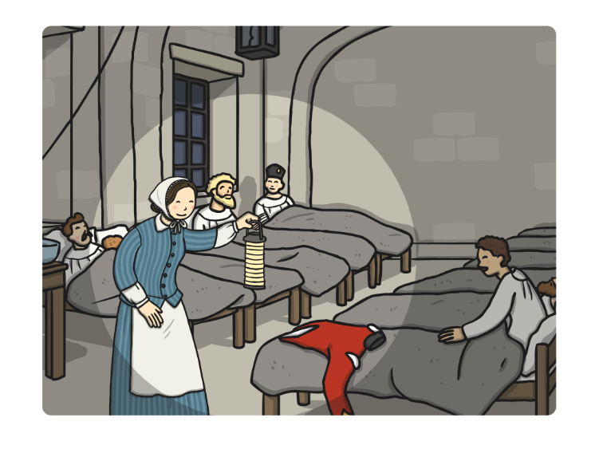
1854
Florence was named ‘Lady of the Lamp’ as she cared for people through the night with a lamp in her hand.

Slide 11

1855
People gave lots of money to the Nightingale
Fund for the training of nurses.

Slide 12
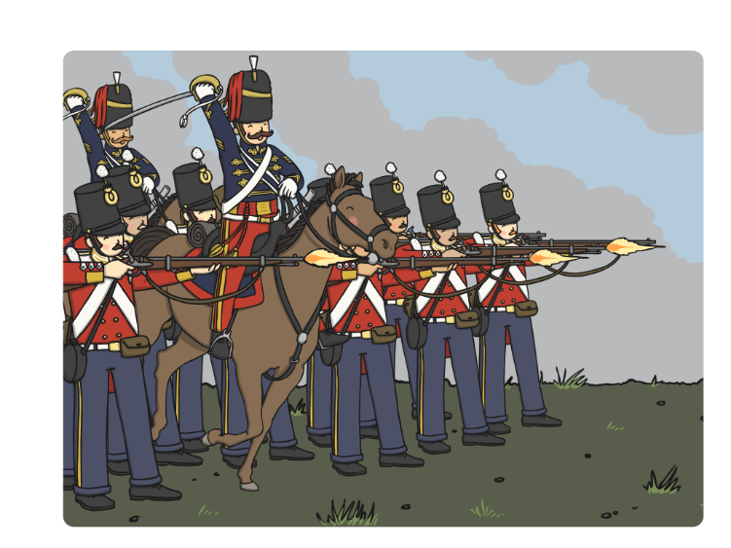
1856
The Crimean War ended.

Slide 13
1857
Florence returned to England as a heroine.

Slide 14
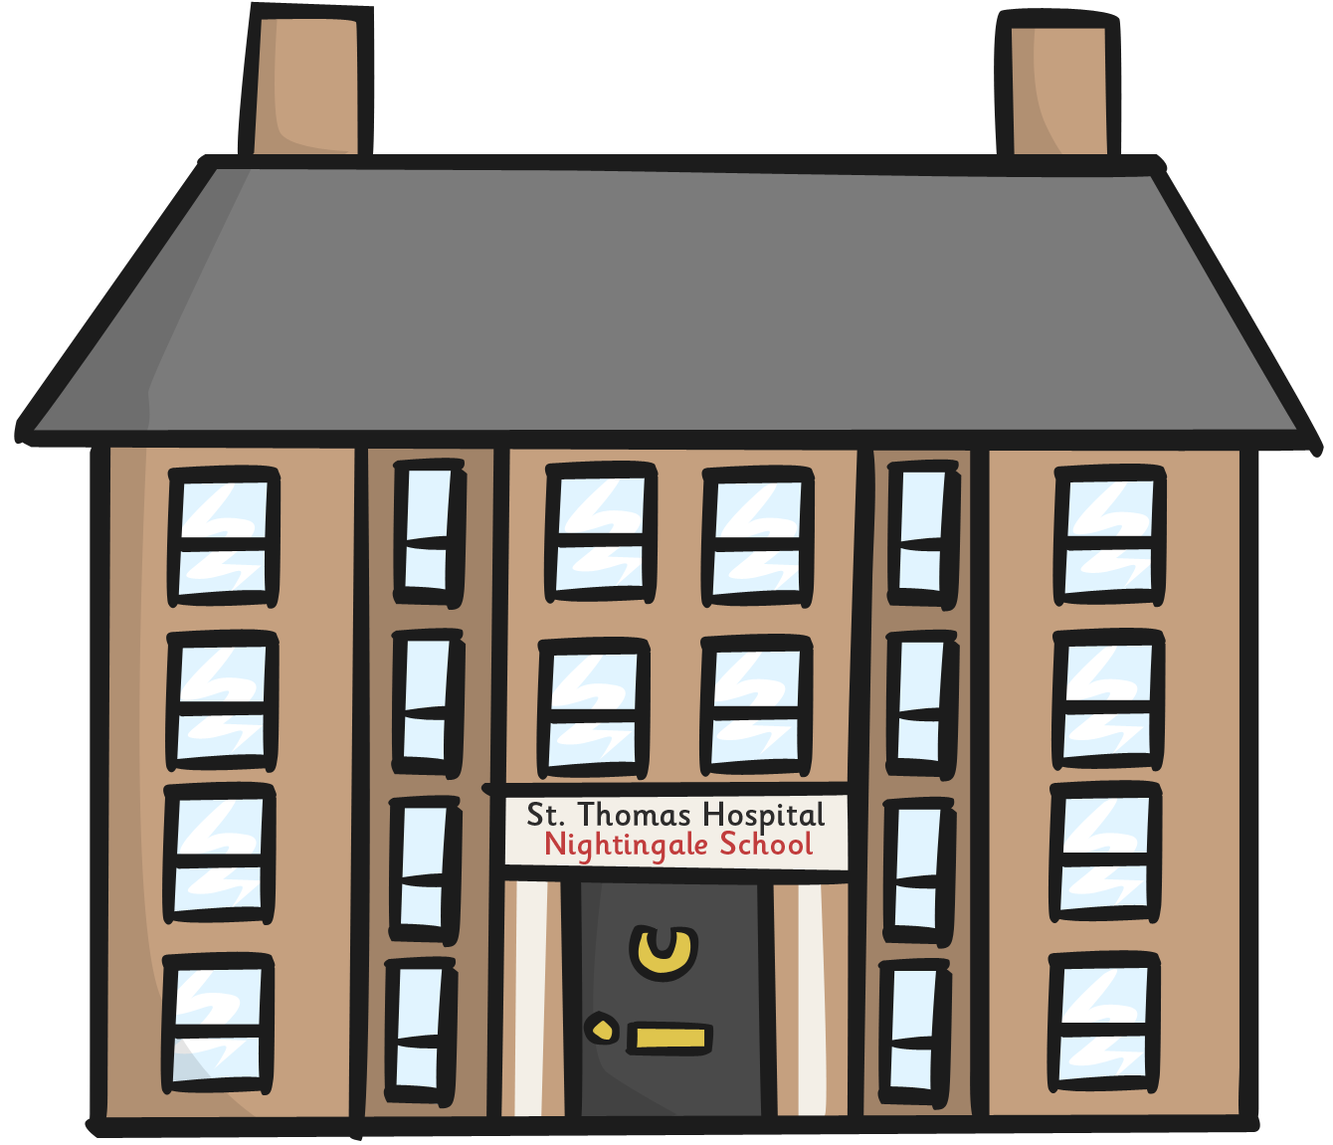
1859
The Nightingale Training School was opened.

Slide 15
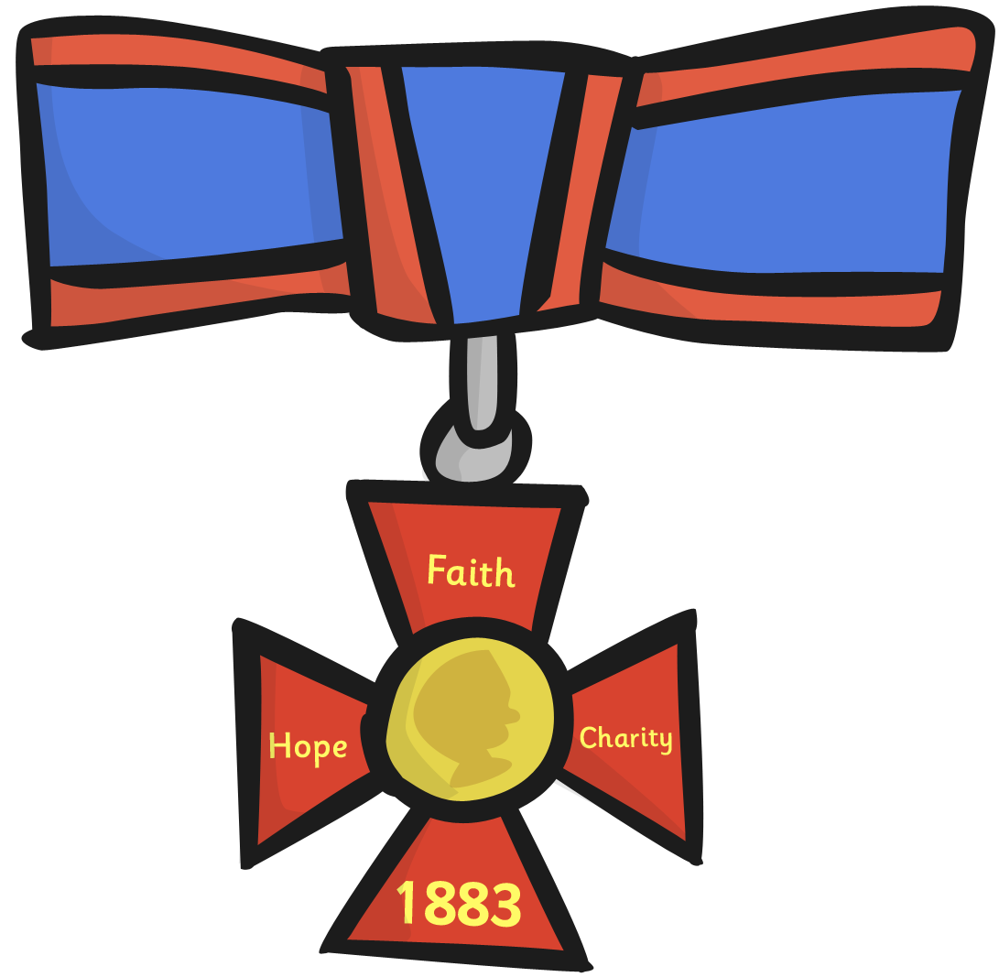
1883
Queen Victoria awarded Florence the Royal Red Cross.

Slide 16
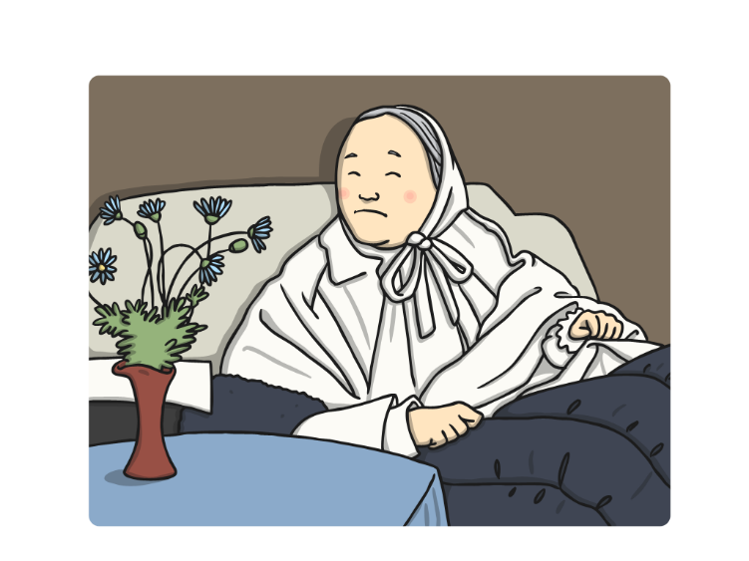
1896
Florence became so ill she couldn’t leave her bed.

Slide 17
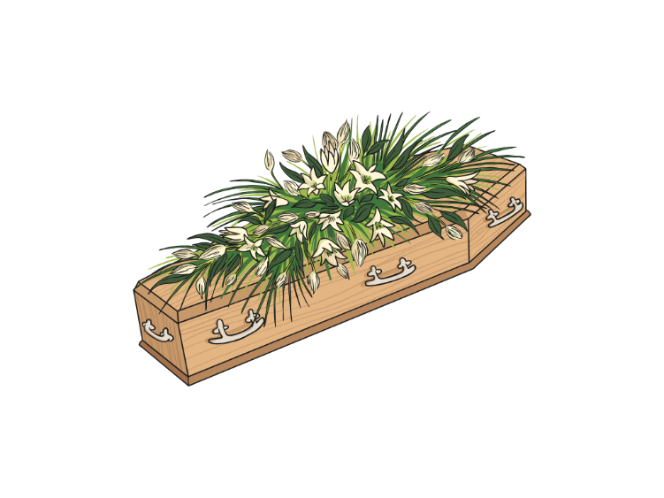
1910
Florence Nightingale died on the 13th of August.

Slide 18


