Slide 1

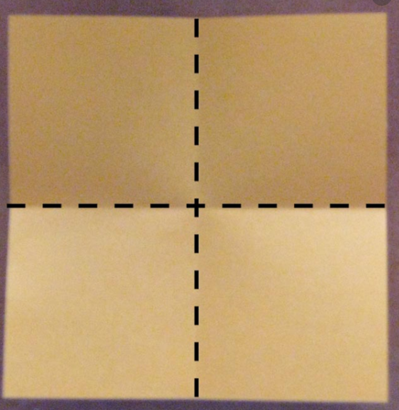

LO: To find one half and one quarter of a shape.

Slide 2
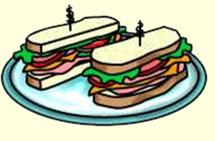

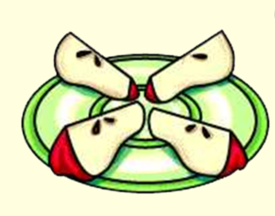
A fraction is a part of a whole number and a way to split up a number into equal parts.
Halves and quarters are fractions.
Fractions are useful whenever we need to split things up.

Slide 3
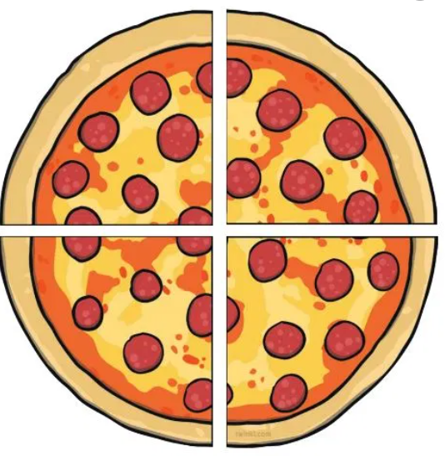
I have split this pizza into two equal parts.
Each part is a fraction. We call these parts halves.
I have split this pizza into four equal parts.
Each part is a fraction. We call these parts quarters.
It is important that the parts are equal.

Slide 4
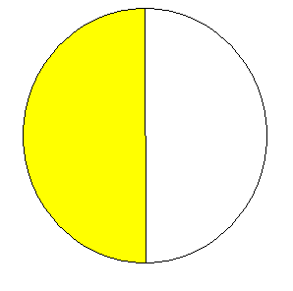
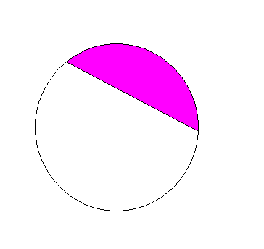
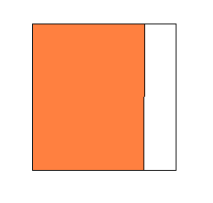
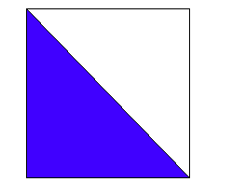
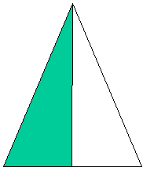
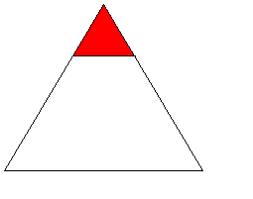
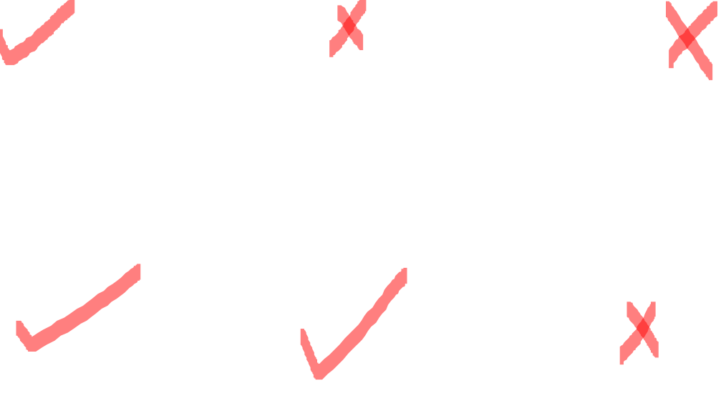
Which of these shapes are split into halves?

Slide 5
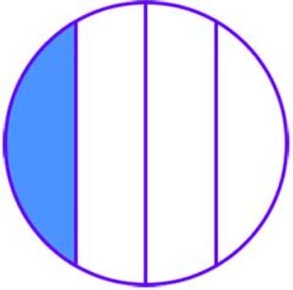
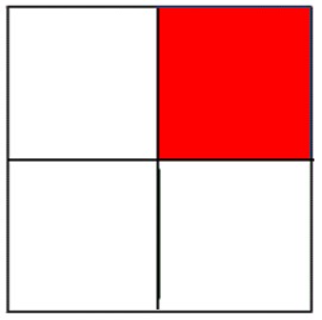
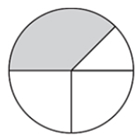
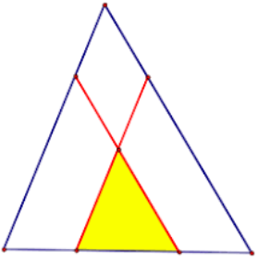
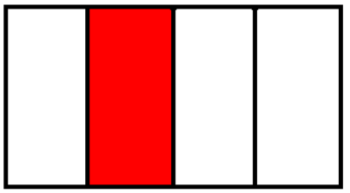
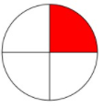

Which of these shapes are split into quarters?

Slide 6
We write fractions like this:
Fractions are made up of 2 different parts.
One part on the top and one part on the bottom.

Slide 7

The top and bottom parts of the fraction have different meanings.
The top number shows how many parts of the whole we are talking about.
The bottom number shows how many parts the whole has been split into.

Slide 8
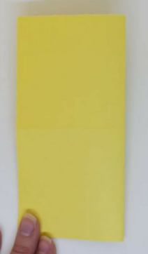


We can find half and quarter of a shape by
cutting it out and folding it equally.

Slide 9
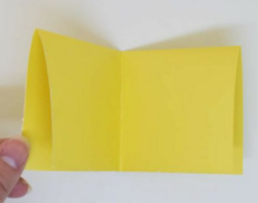

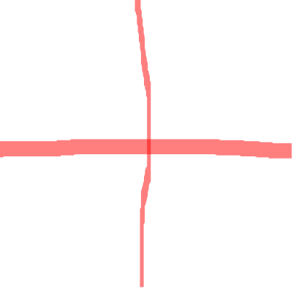

Slide 10
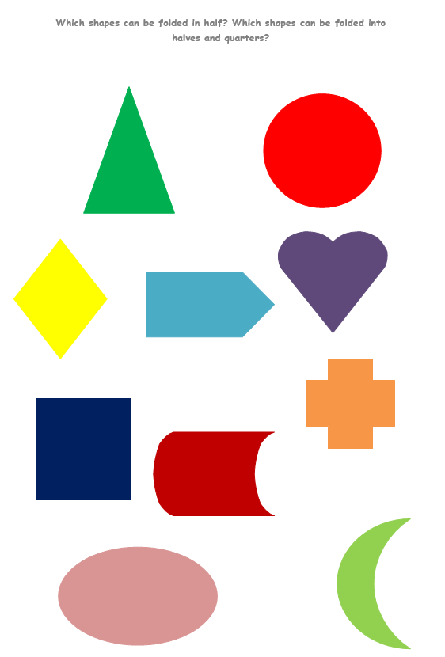
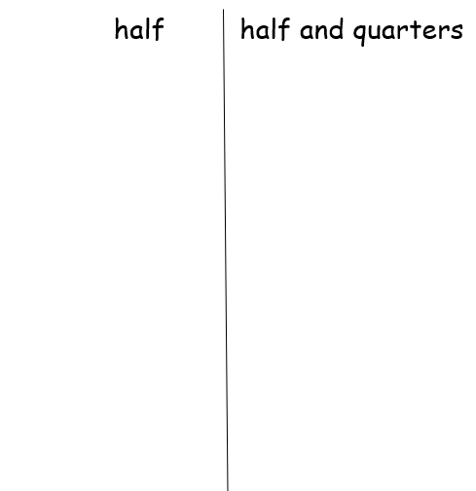
Your challenge today is to find out-
Which shapes can be folded in half?
Which shapes can be folded in half and into quarters?

