Slide 1


LO: To make a fact file about an Arctic or desert habitat

Slide 2
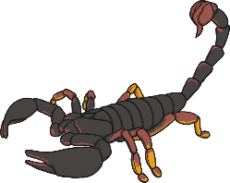
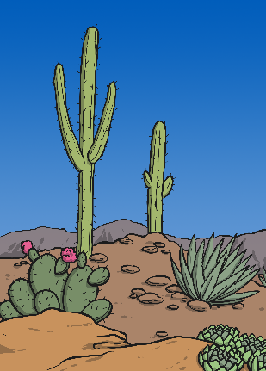
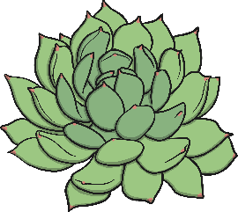

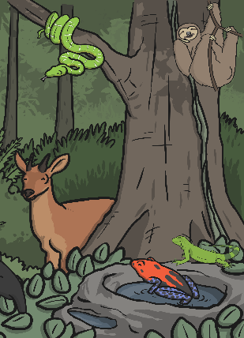

World Habitats
Do you remember how plants and animals rely on the environment around them to provide them with everything they need?
This means they have to live somewhere that has the right conditions to help them stay alive and well.
Because different places around the world have different conditions, the plants and animals that live there are different too.
These different animals and plants all have special ways to survive in their special habitats.

Slide 3
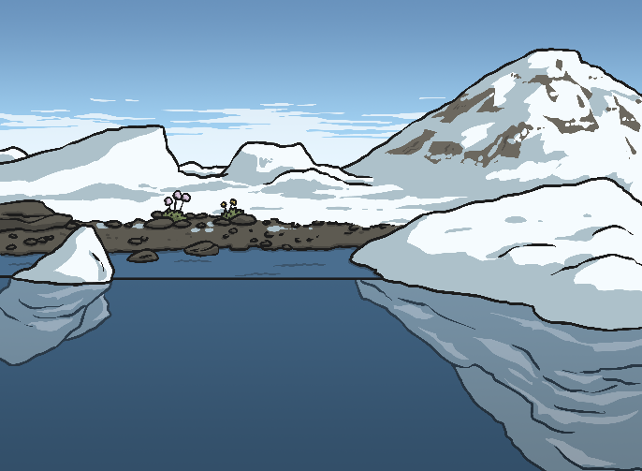

World Habitats
Arctic
We are going to find out about some of the different habitats around the world, and some of the different plants and animals that live there.
This week we will look at Arctic and desert habitats.
Desert

Slide 4
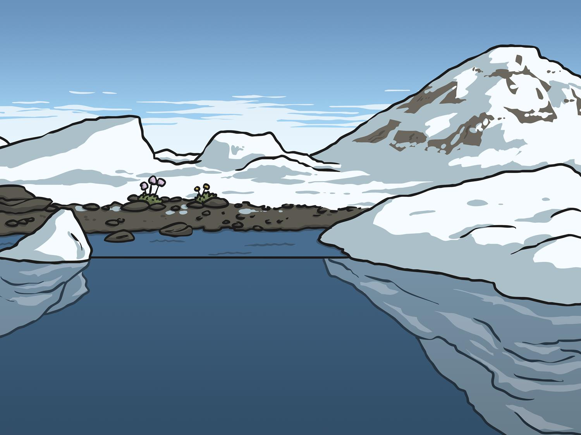
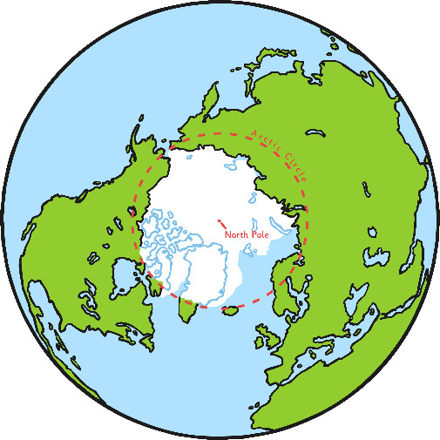
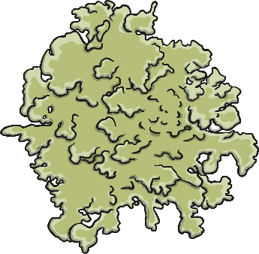
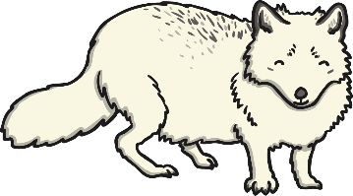
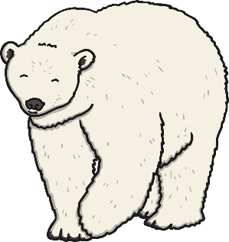
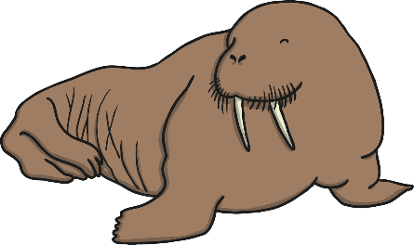
The Arctic
The Arctic Circle is located at the very top of the Earth. It is very cold in the Arctic all year round.
The only plants that can grow in the Arctic region are grass and mosses. Trees are unable to grow because the ground stays frozen all year round. In some places in the Arctic it is too cold for anything to grow at all.
There are many land mammals in the Arctic including ox, reindeer, artic foxes, weasels, wolves, polar bears and brown bears.
Seals, walruses and whales live here and feed from the plankton and fish in the sea.

Slide 5
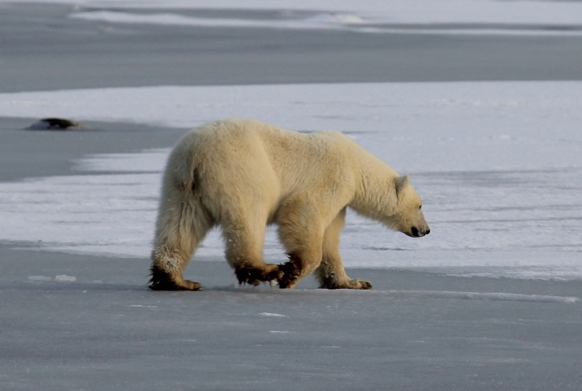
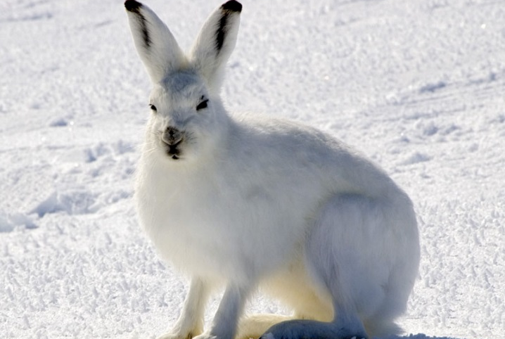
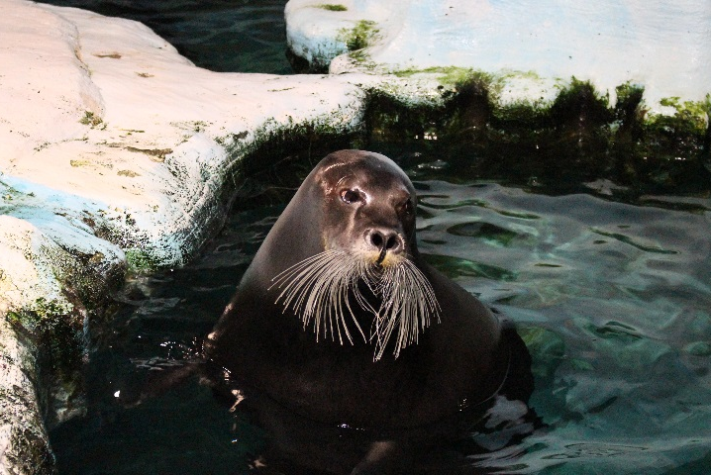
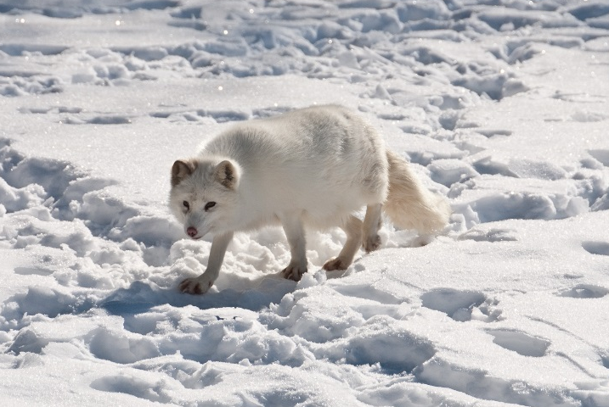
Animals of the Arctic
Photos courtesy of Emma, Steve Sayles, Lee Dyer and Bering Land Bridge National Preserve (@flickr.com) - granted under creative commons licence - attribution

Slide 6
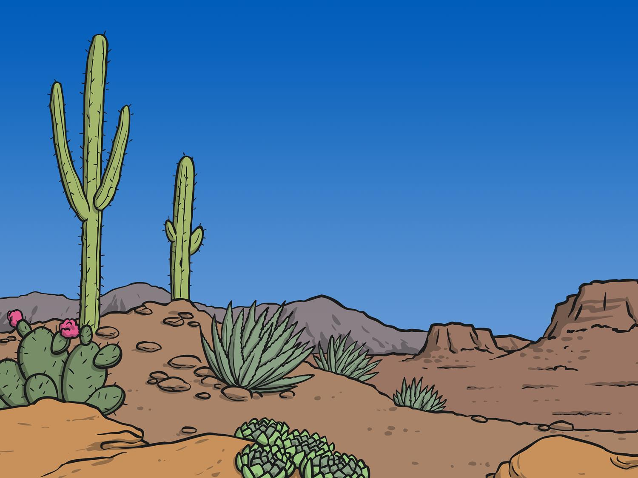


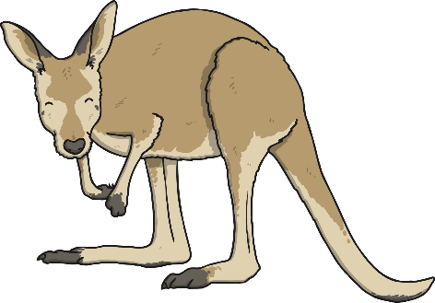
Deserts
Because there is such little water in the desert, not many living things can survive here. Animals and plants that live here are specially adapted to the harsh, dry conditions.
Many desert plants have leaves that collect and store water. Since water is so scarce, most desert animals get their water from eating these plants, or from the blood and body tissues of their prey.
Some animals, like kangaroos and lizards, live in burrows which do not get too hot or cold and have damp air inside. These animals stay in their burrows during the hot days, coming out at night to feed.
Camels can drink large amounts of water at one time and can survive as long as two weeks without drinking. They have large spread out feet that help them to walk on the soft sand.

Slide 7
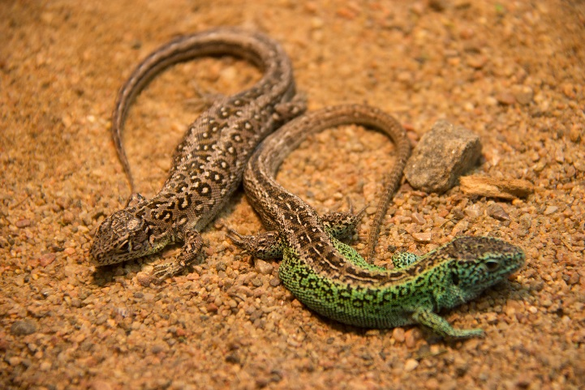
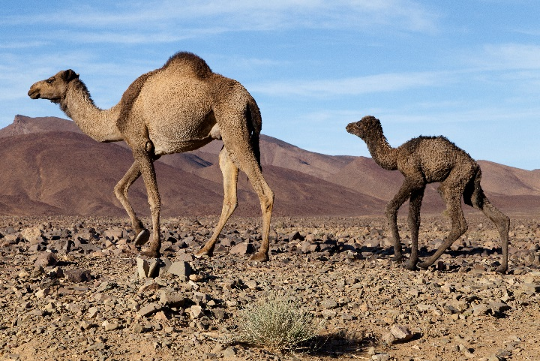
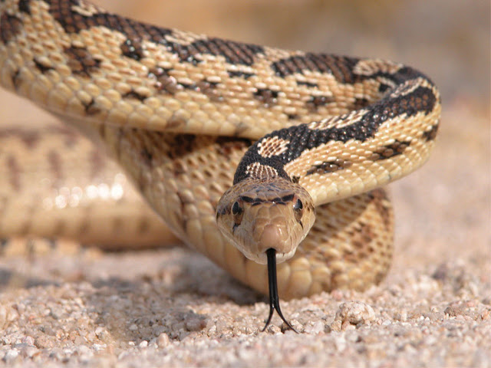
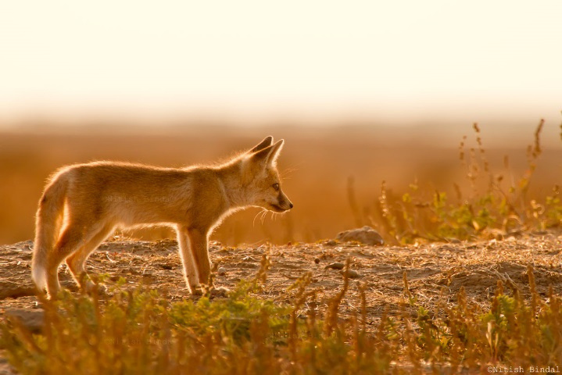
Animals the Desert
Photos courtesy of Susanne Nilsson, SuperCar-RoadTrip, Bryan Adams and Nitish Bindal Agrawal (@flickr.com) - granted under creative commons licence - attribution

Slide 8
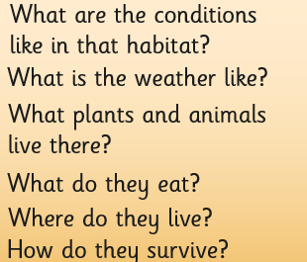
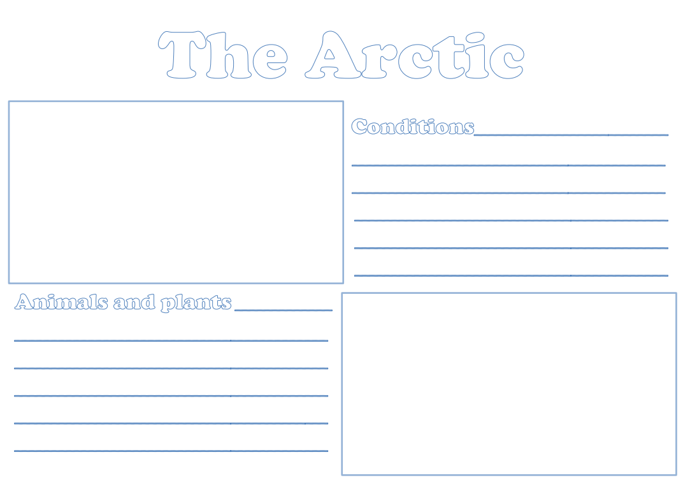
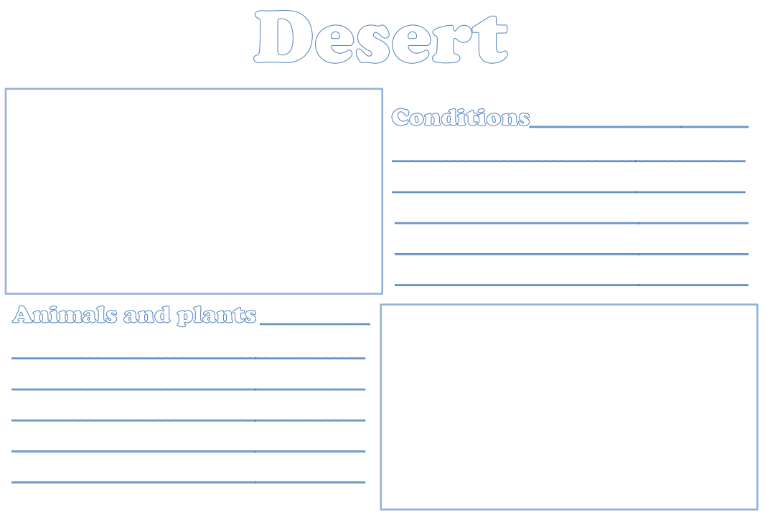
Researching Habitats
You are going to do some research about Arctic and desert habitats.

