Slide 1
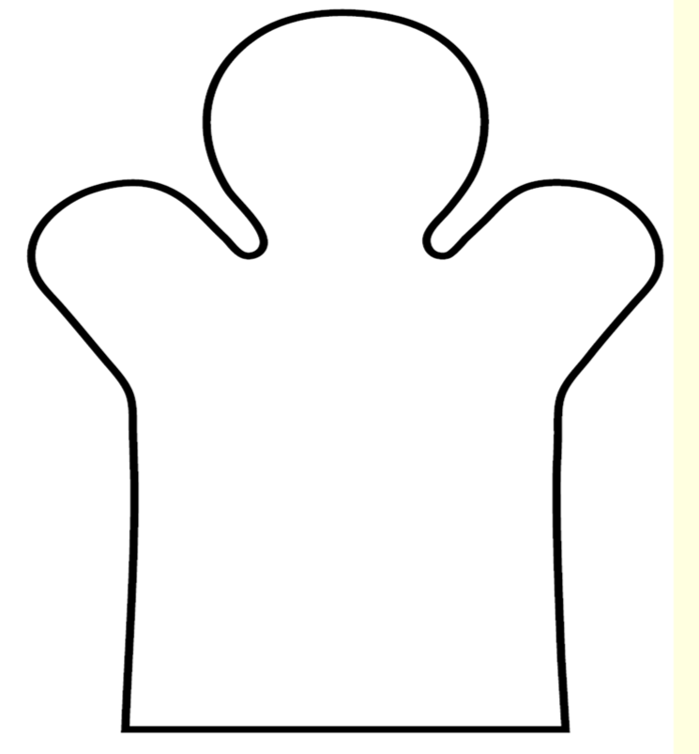
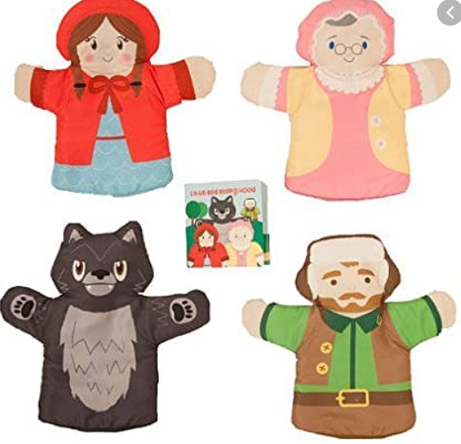
LO: To design a hand puppet from the
Little Red Riding Hood story

Slide 2
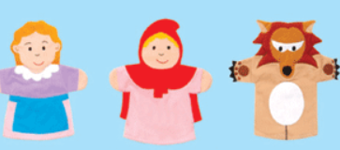
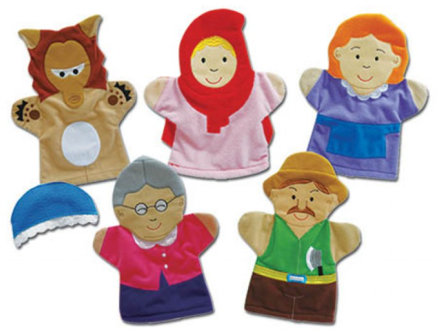
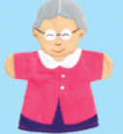
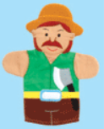
Little Red Riding Hood
Which character
will you
choose?
Woodcutter
Mum
Wolf
Look at these hand puppets to help you design your own.
Grandma

Slide 3
Draw you design on the planning sheet.
Remember to add detail such as ears for the Wolf, a hat for Grandma, a hood and basket for Little Red Riding Hood or an axe for the Woodcutter.

