Slide 1

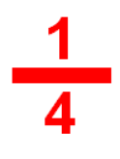
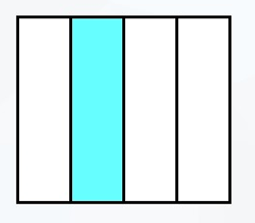
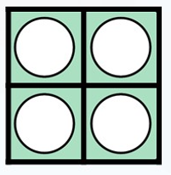
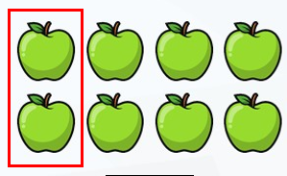

LO: To recognise a quarter

Slide 2
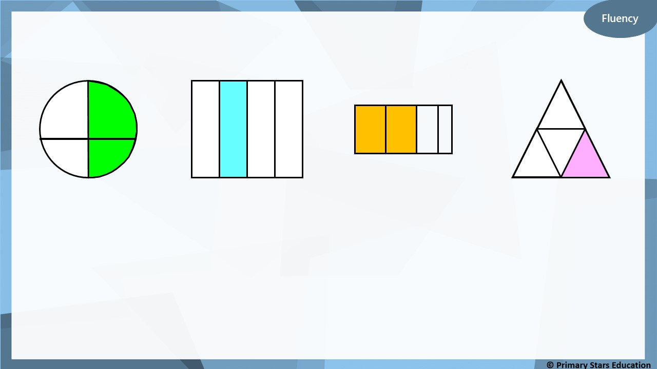
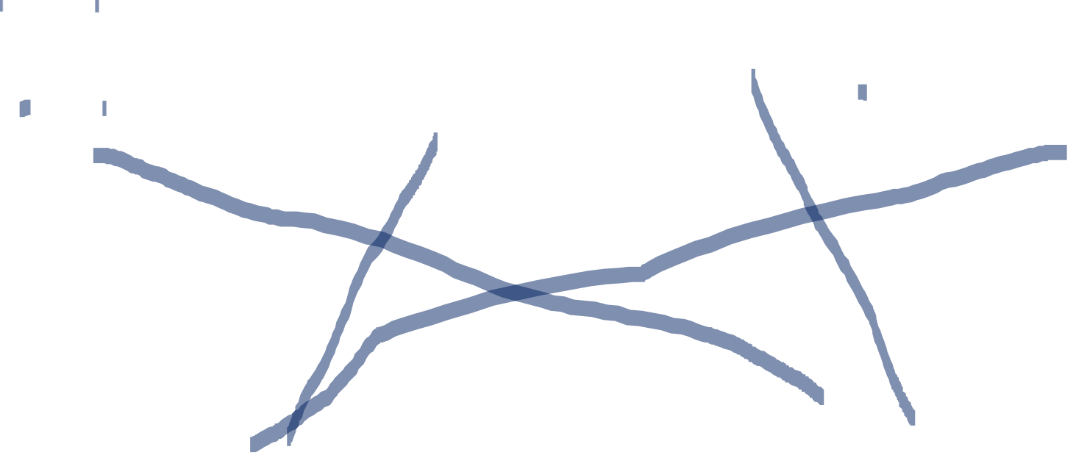
Which pictures represent $\frac{\text{1}}{\text{4}}$ ?
Quarters
Not quarters

Slide 3
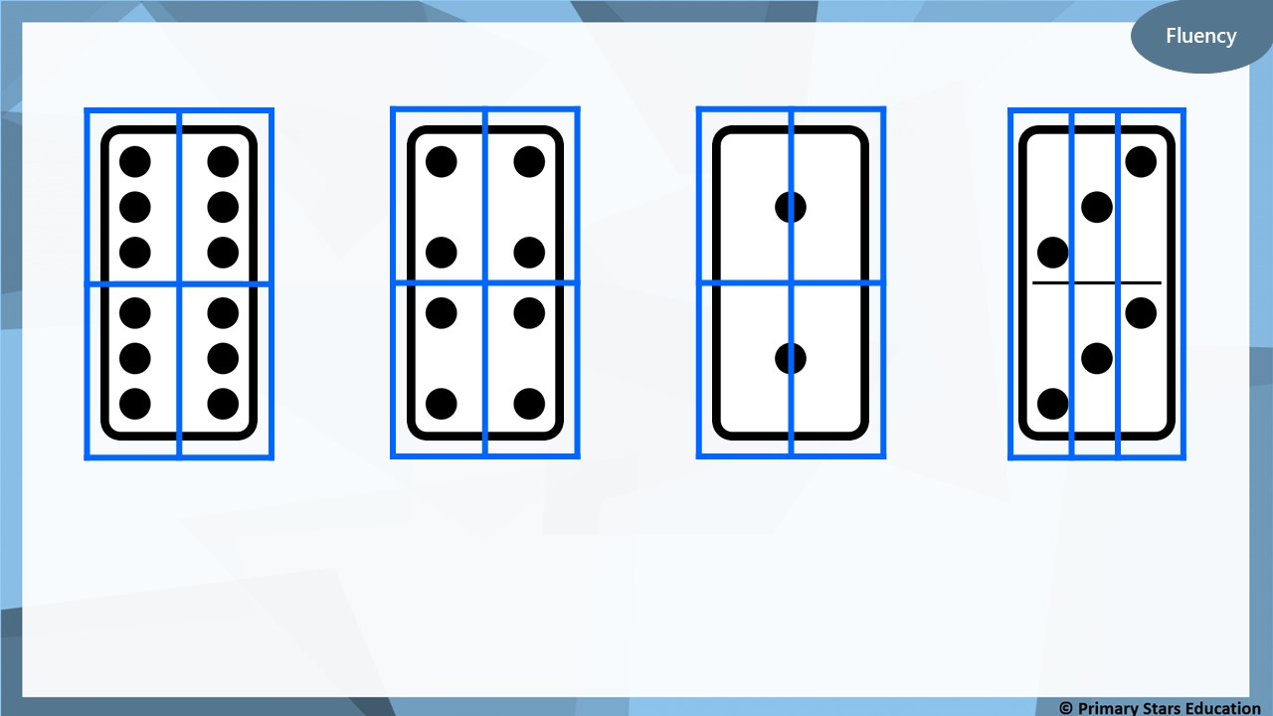
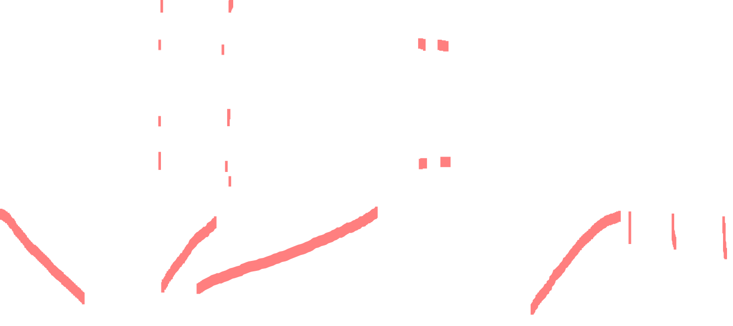
Which pictures show quarters?
Quarters
Not quarters

Slide 4
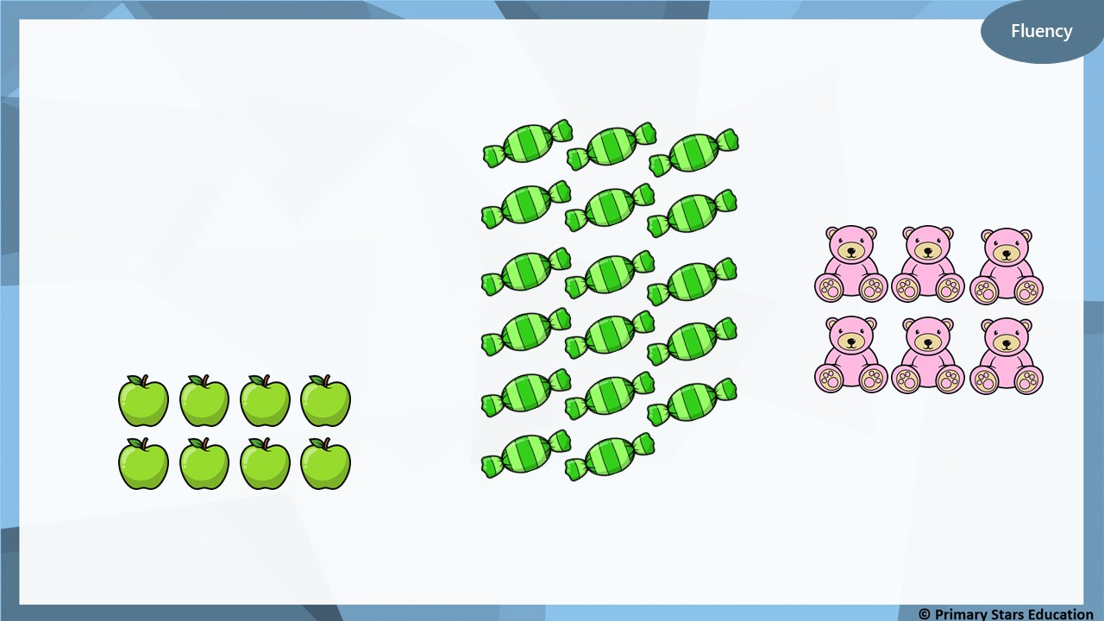
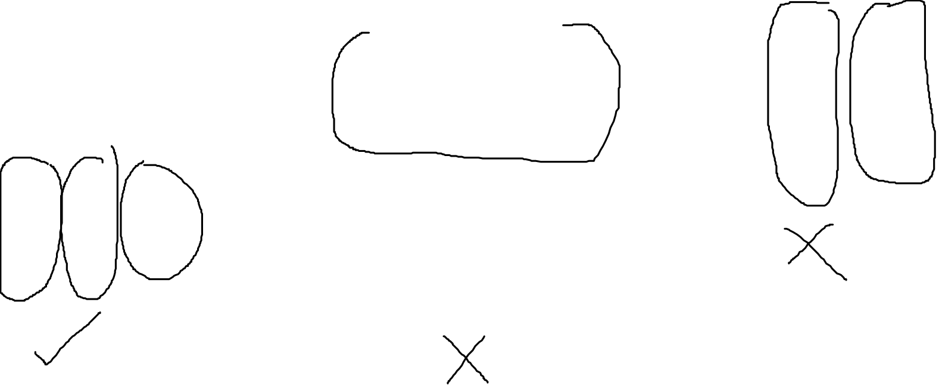
Which picture represent $\frac{\text{1}}{\text{4}}$ ?

Slide 5
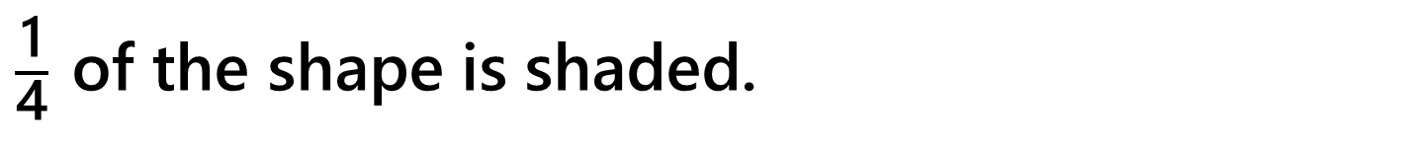
Reasoning
$\frac{\text{1}}{\text{4}}$ of the shape is shaded.
True or false?
True.
Explain your answer.
4 equal triangles make up the 1 large triangle.

Slide 6
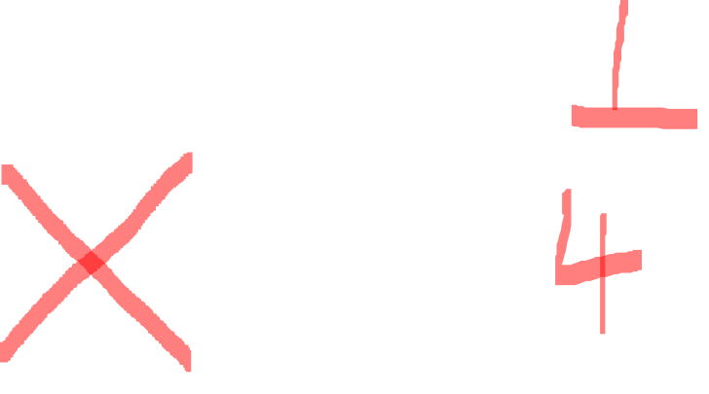
Problem solving
How can this shape be split into quarters?
Draw lines to show this.

Slide 7
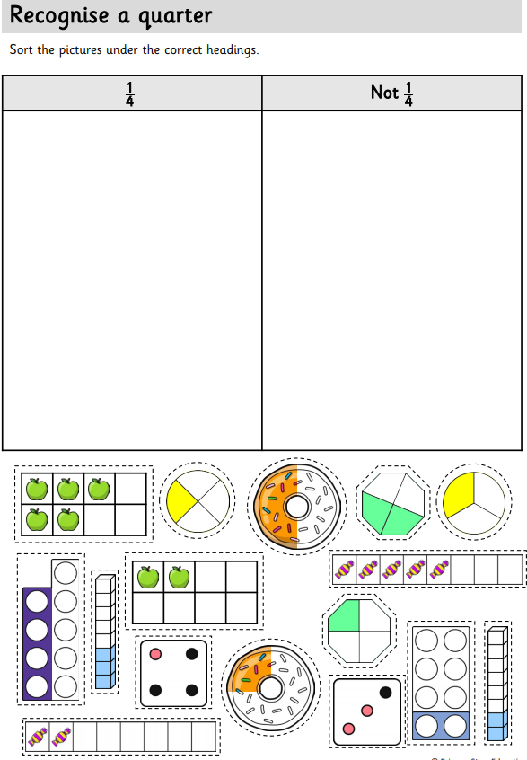
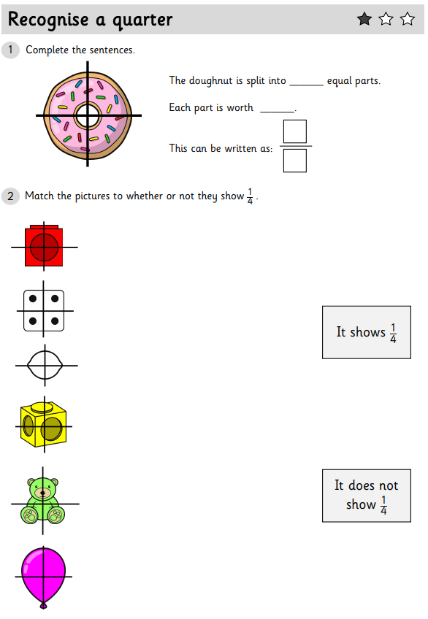
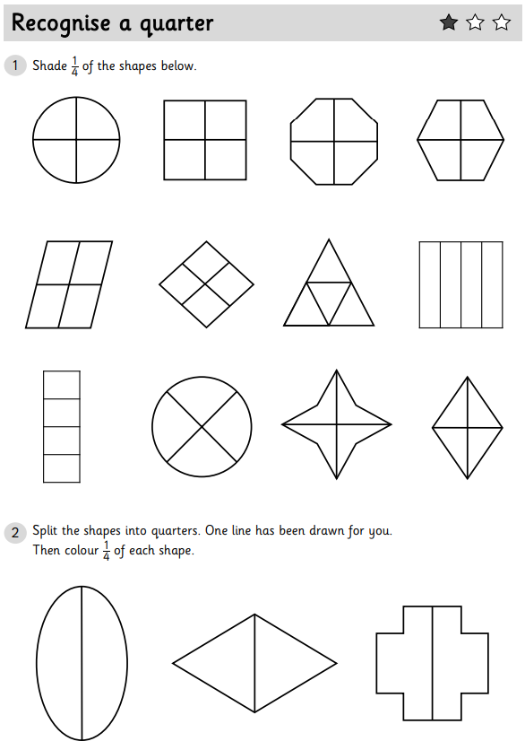
We would like you to complete two pieces of work today. For the first piece you need to cut the pictures out and correctly sort them under the headings ¼ or not a ¼ . For your second piece of work choose two 1, 2 or 3 Star worksheets to complete.

