Slide 1



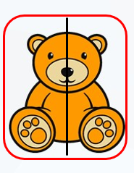
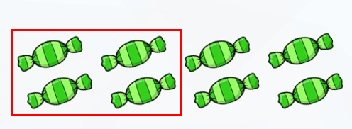
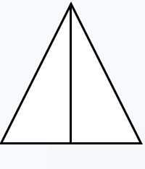

LO: To recognise a half

Slide 2
Fluency
What is a fraction?
1
The top number shows how many parts there are.
2
The bottom number shows how many parts make the whole.

Slide 3

Fluency
Which pictures represent $\frac{\text{1}}{\text{2}}$ ?

Slide 4

Fluency
Which pictures represent $\frac{\text{1}}{\text{2}}$ ?

Slide 5
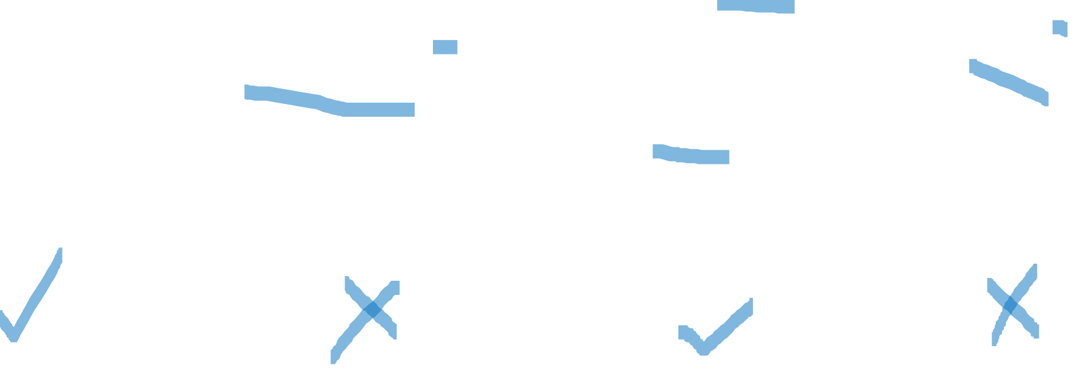
Fluency
Which pictures represent $\frac{\text{1}}{\text{2}}$ ?

Slide 6
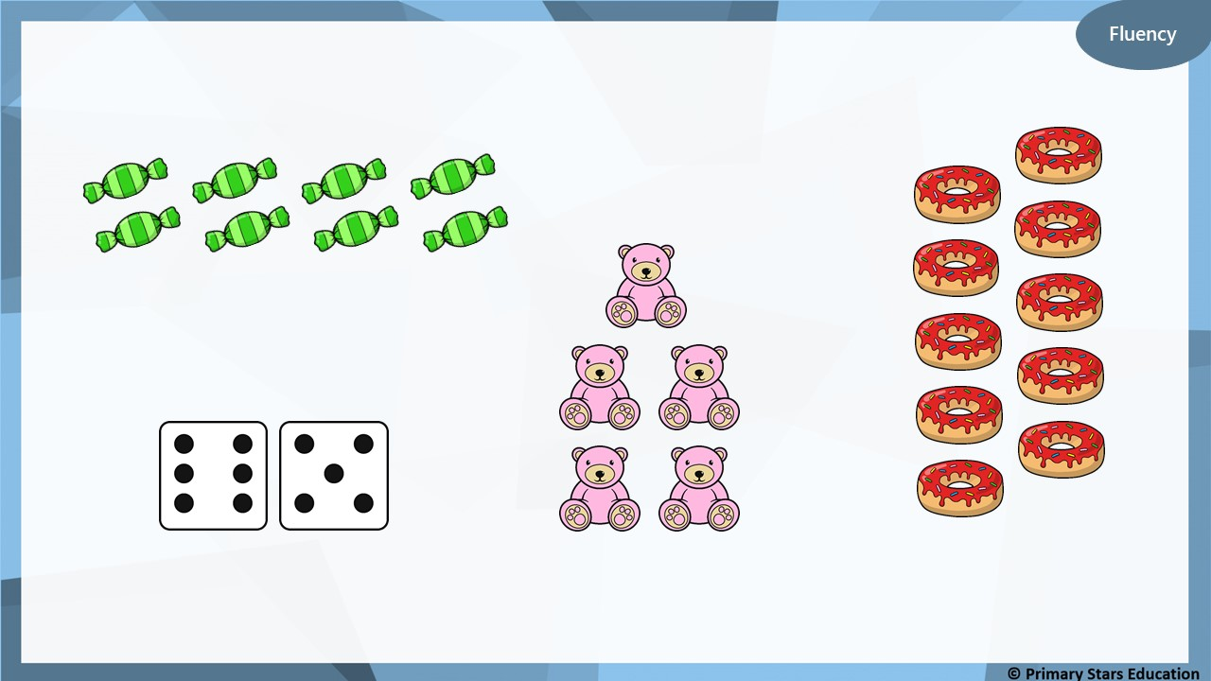
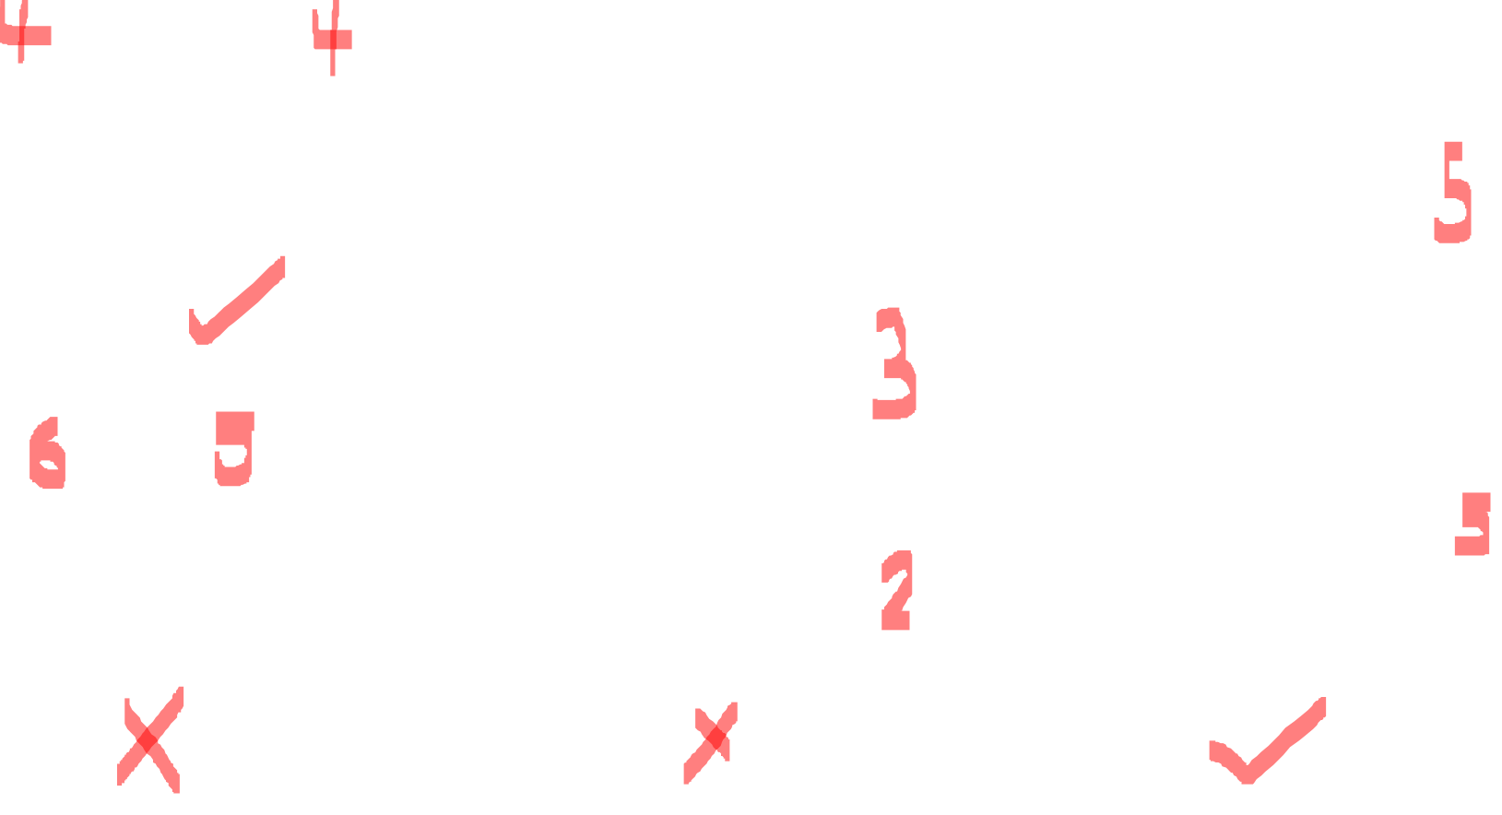
Which pictures represent a half?

Slide 7
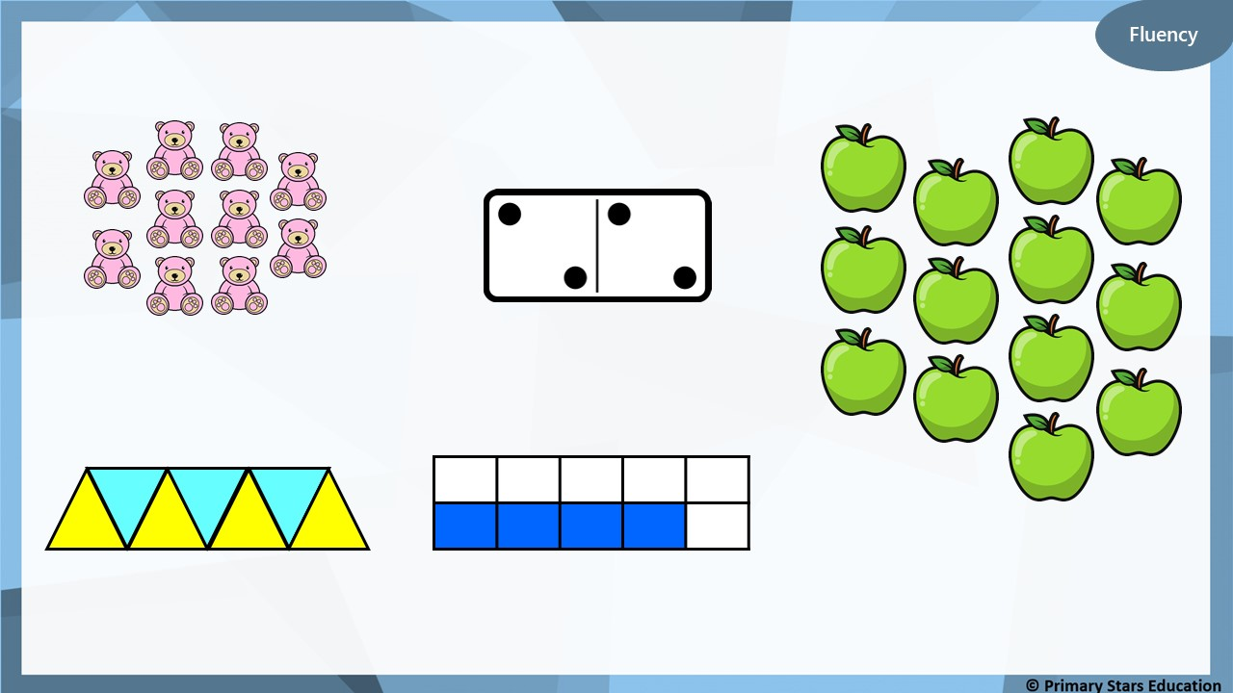
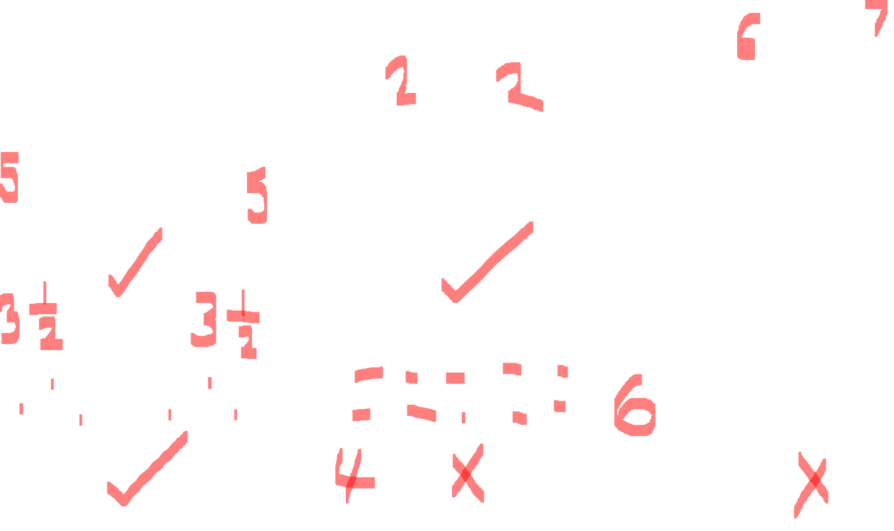
Which pictures represent a half?

Slide 8
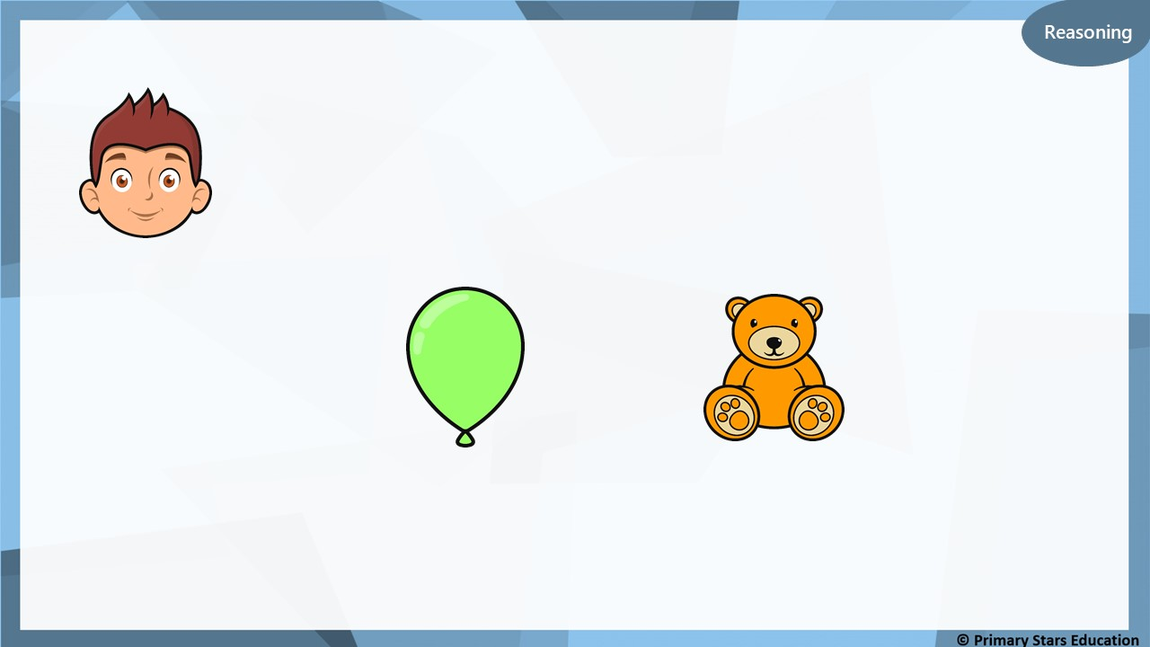
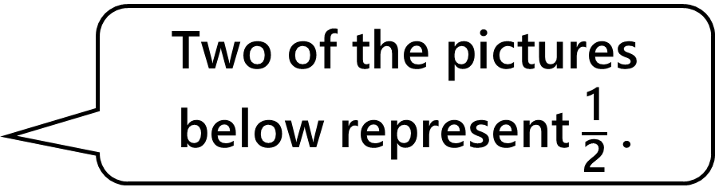
Matt says,
Two of the pictures below represent $\frac{\text{1}}{\text{2}}$ .
Is Matt correct?
No, only one of the pictures represents a half (the bear).

Slide 9
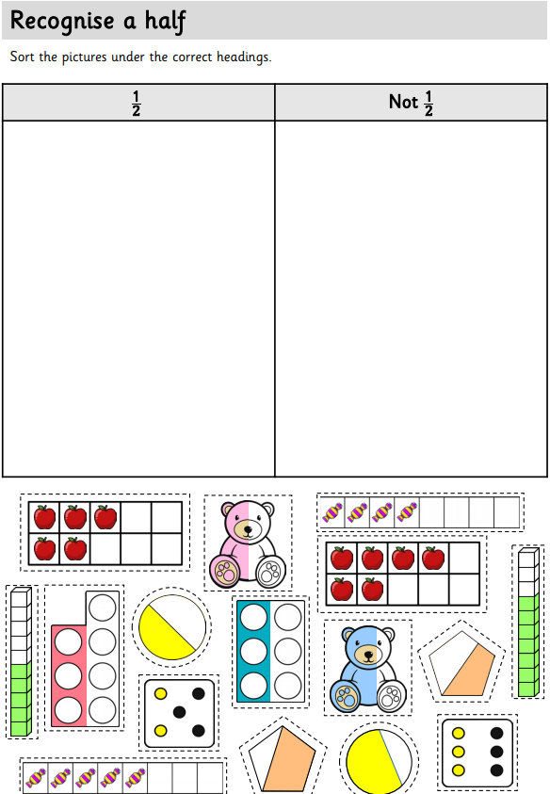
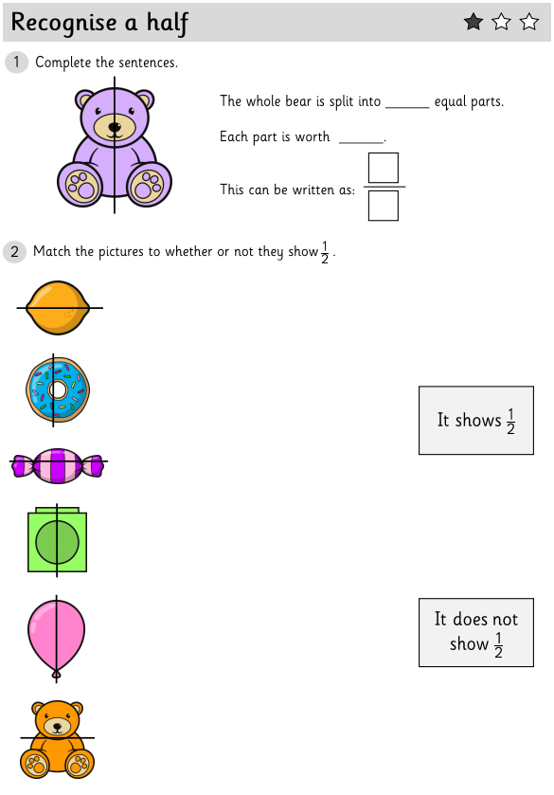
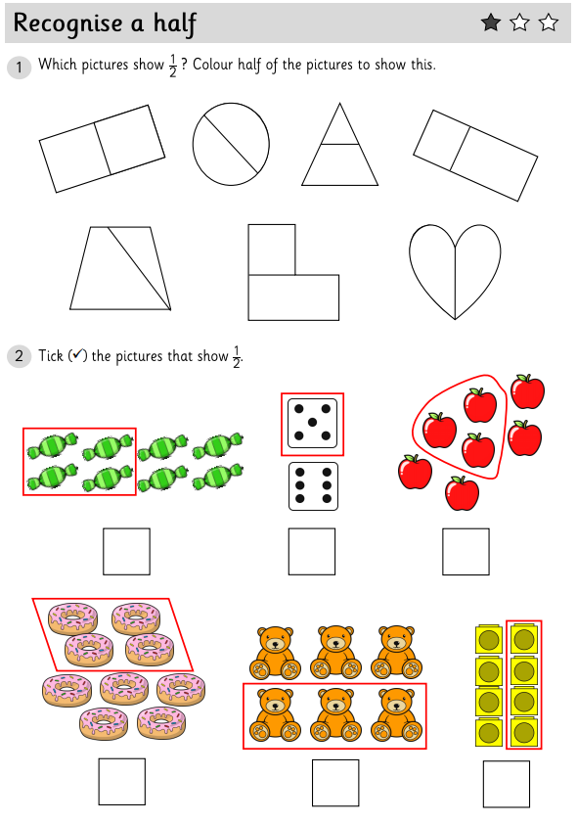
We would like you to complete two pieces of work today. For the first piece you need to cut the pictures out and correctly sort them under the headings ½ or not a ½ . For your second piece of work choose two 1, 2 or 3 Star worksheets to complete.

