Slide 1
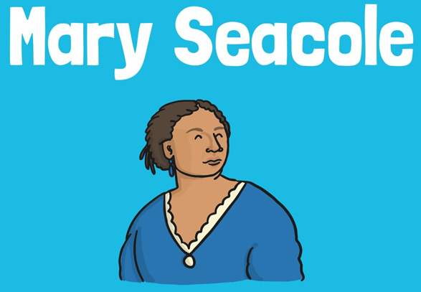

LO: To explain who Mary Seacole was and how she improved nursing

Slide 2
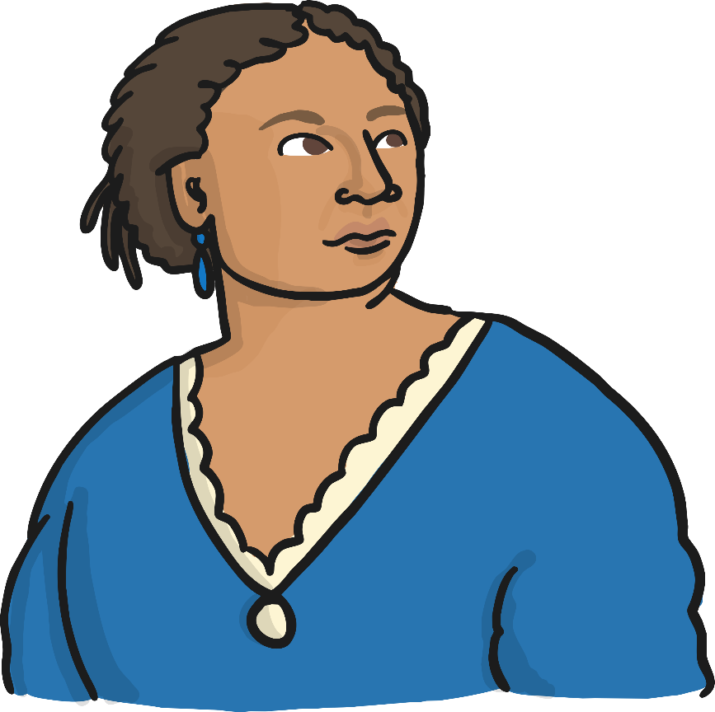
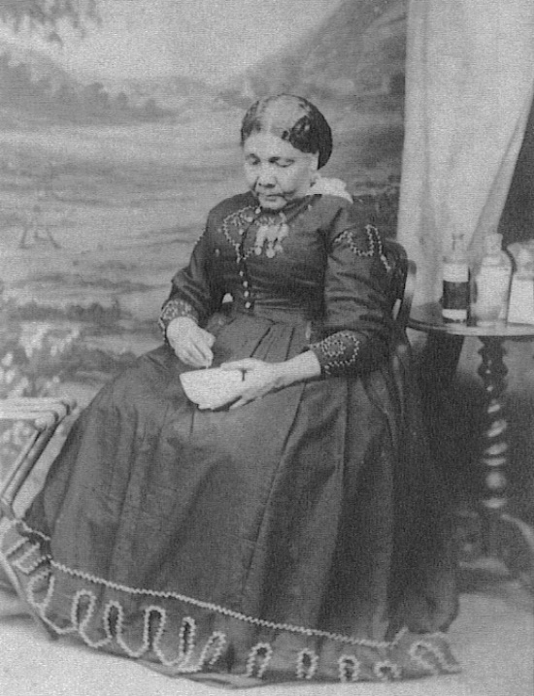
Who Was Mary Seacole?
Mary Seacole is remembered for her role in helping wounded soldiers in the Crimean War.

Slide 3
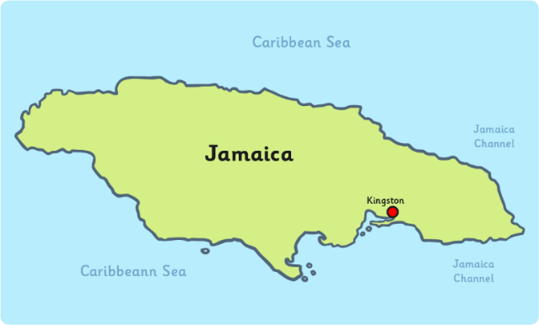
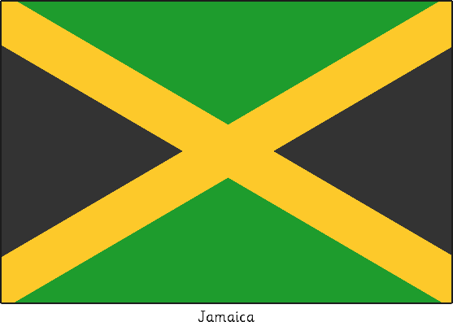
The Life of Mary Seacole
Mary was born in Kingston,
Jamaica on 23rd November 1805.
Her father was a Scottish soldier
and her mother was a Jamaican ‘doctress’ or healer, who used a variety of herbal remedies that came from African and Caribbean culture.
Mary’s mother ran a boarding house for injured soldiers and it is here Mary learnt her nursing skills.
On 10th November 1836, Mary married Edwin Seacole in Kingston. Sadly, he died 8 years later.

Slide 4
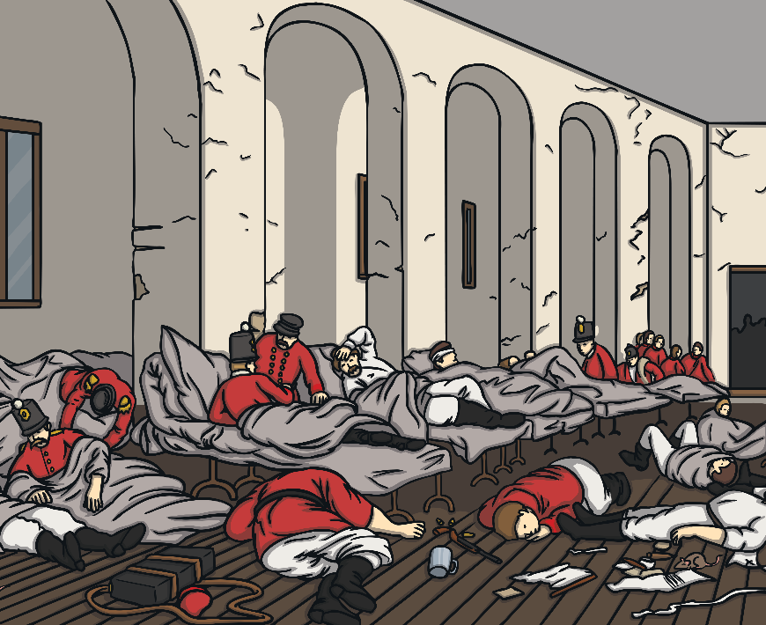
The Crimean War
The Crimean War began on 16th October 1853 and lasted for 3 years.
Mary heard that the hospitals were short of nurses and wanted to help treat the injured soldiers. Sadly she was turned down, along with several other nurses.
But that didn’t stop Mary. She saved up her own money and travelled to the Crimea in a ship stocked with medical supplies. Several weeks later she finally arrived to find the soldiers in a terrible state!

Slide 5
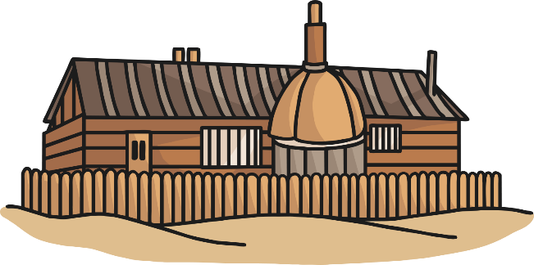
The Crimean War
Many of the men were cold, dirty and hungry. The sick and injured were not being cared for.
Mary decided something had to be done so she opened her own ‘British Hotel’ near the battle fields - a hospital for the soldiers.
The hotel was a place where British soldiers could rest and buy hot food and drinks.
Mary used the money spent at the hotel to help treat and care for the sick and wounded soldiers. She also went to the battle fields to help the injured men.
The soldiers had a lot of respect for Mary and called her ‘Mother Seacole’

Slide 6
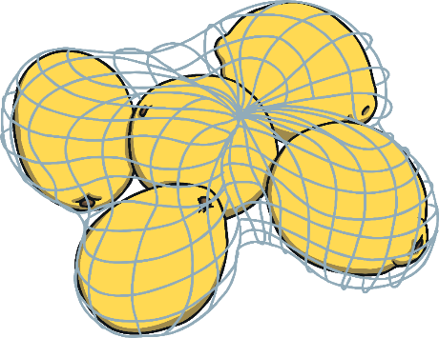
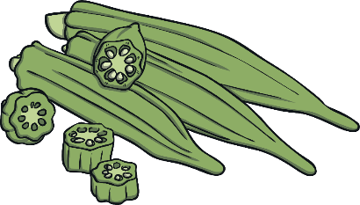

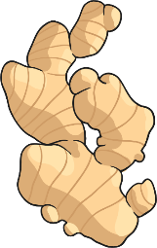
Mary’s Herbal Remedies
Mary used herbal remedies she had learnt from her mother to treat the soldiers.
She would often grind them in a pestle and mortar, mix them in a bowl or heat them over a fire.
    Some of the ingredients she used included:
    Aloe Vera – mixed to help heal cuts and wounds.
    Lemongrass – boiled to help a fever.
    Ginger – ground to help with an upset
    stomach.
    Lemons – mixed to help coughs.
    Okra – chopped to help heal boils.
Some countries still use these remedies, or ones inspired by them, today.

Slide 7
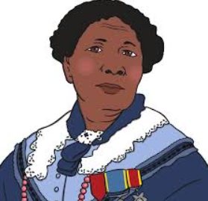

After the War
Mary returned to Britain after the war but she was in poor health and had no home.
Many people had heard about her good work and raised money to help her.
Mary was awarded military medals for her
bravery during the war.
In 1857 Mary wrote about her life in a book called
The Wonderful Adventures of Mrs Seacole in Many Lands .
Mary died on 14th May 1881, aged 76, at her home in Paddington, London.
Her work was sadly forgotten until around 100 years after her death, when a group of Jamaican nurses wanted to know more about her and started making her name famous again. Mary Seacole will forever be remembered as an incredible woman and inspiring role model.

Slide 8
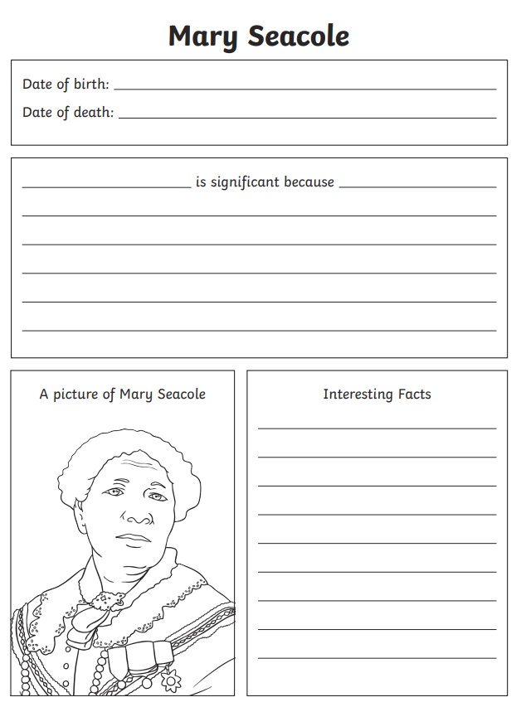
Now you are going to make a fact file about Mary Seacole’s life.

