Slide 1
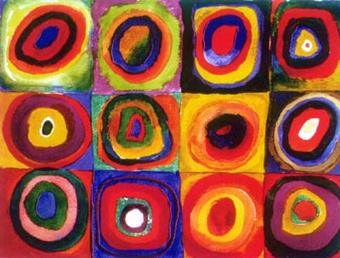

ARTS WEEK
Wassily Kandinsky

Slide 2
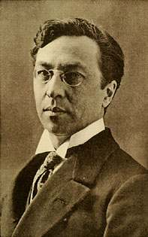
Kandinsky was born on December 16th 1866 in Russia.
When he was 30, he left his job as a university teacher and went to art school. He found art school easy and excelled at his studies.

Slide 3
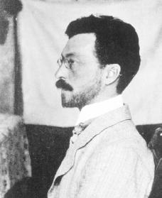
Music helped him create his paintings. He especially loved opera.
As a child he loved music and learned to play the piano and the cello.
Music helped him create his paintings. He especially loved opera.
Kandinsky thought a lot about colours and how they make people feel. He believed that colours had a soul.

Slide 4
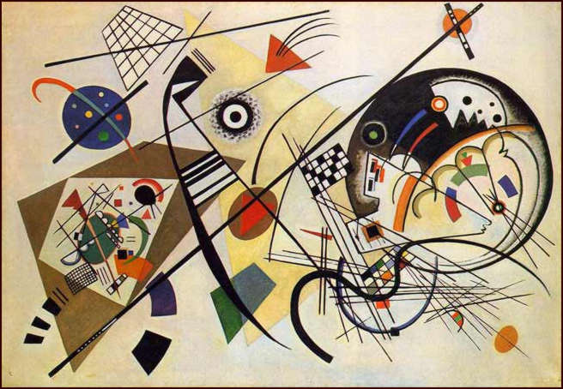
Kandinsky said “I see colour when I hear music.”

Slide 5
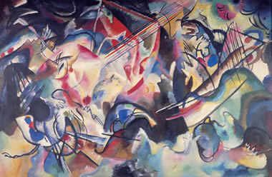
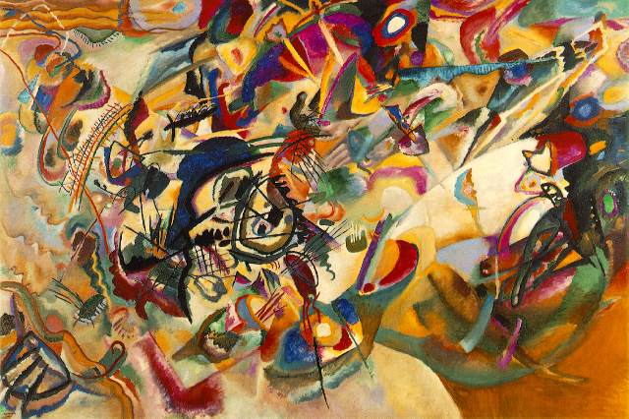
Some of Kandinsky’s paintings were inspired by the music composed by a man called
Richard Wagner.
He used to listen to his music while he painted and try to paint what he heard.

Slide 6
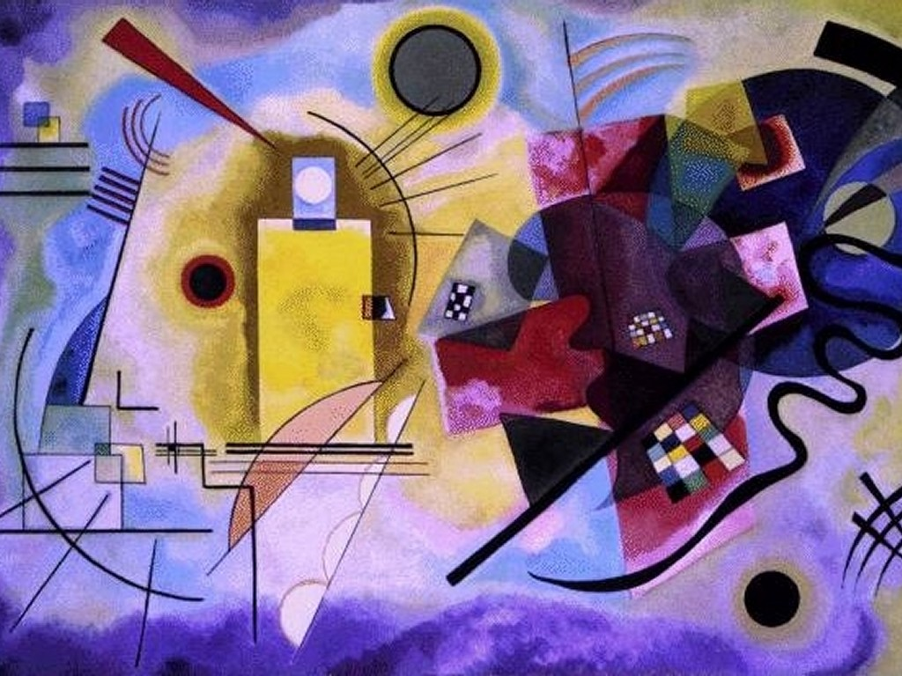
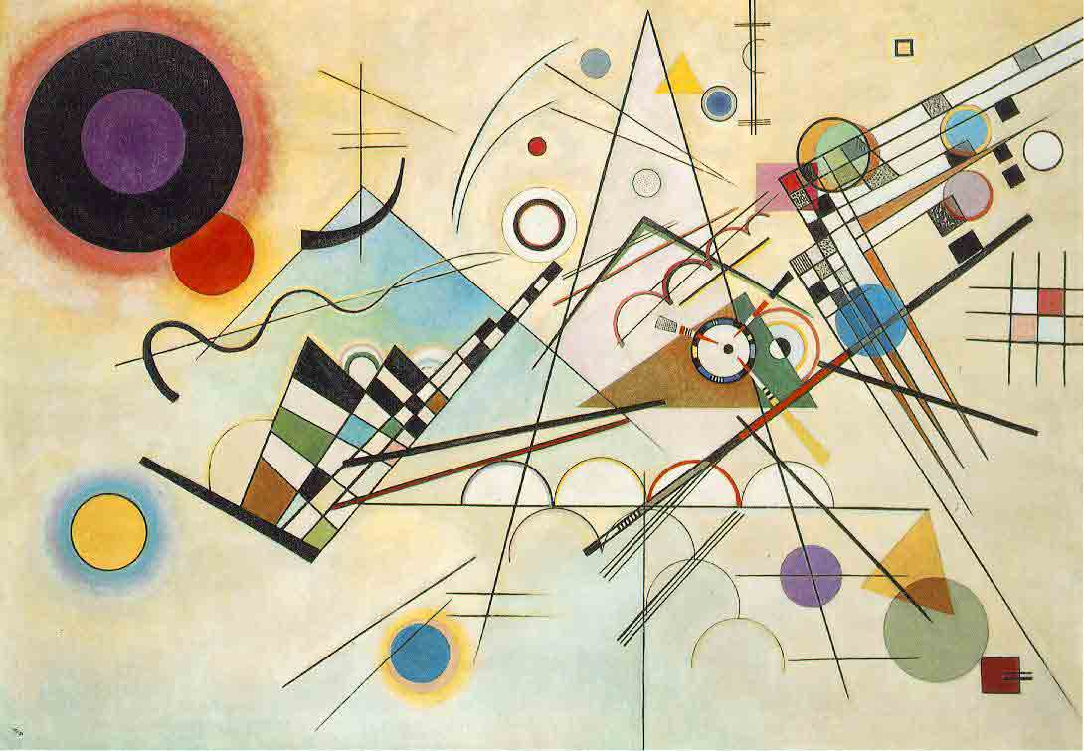

Slide 7
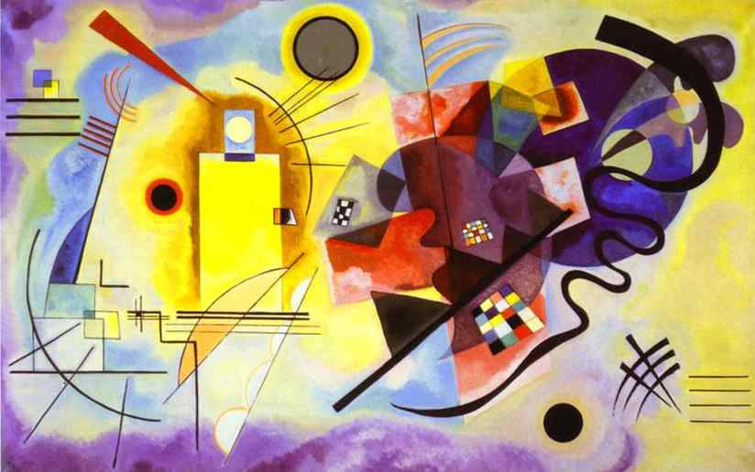

We will all see something different when we look at his work.
His paintings are made up of lots of shapes.
Kandinsky’s artwork is called abstract.

Slide 8
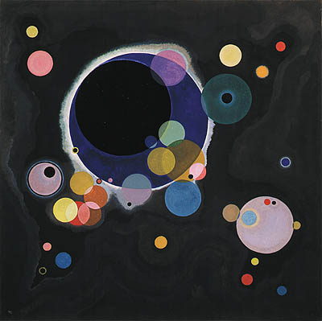
Other painters that came after him learned a lot from Kandinsky’s ideas.

Slide 9
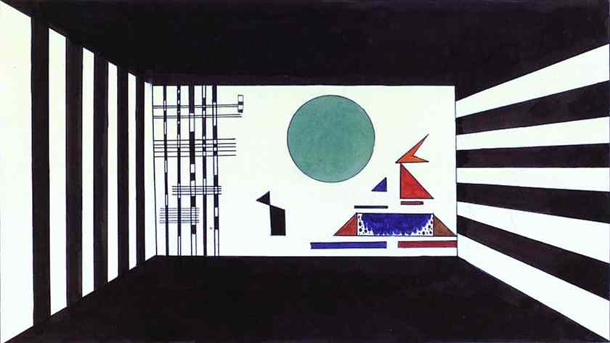
Kandinsky died in December 1944. He was 78 years old.

Slide 10
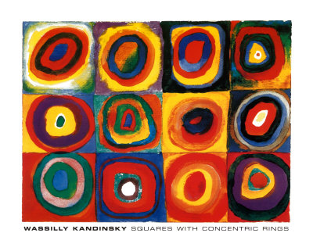

Slide 11

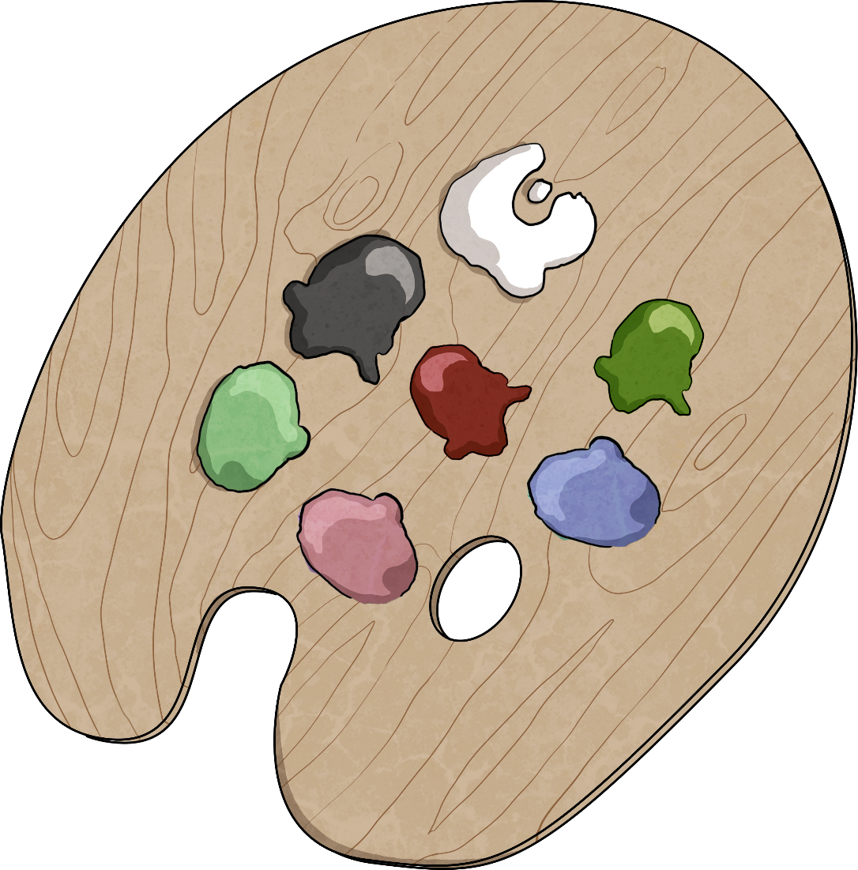
Before we paint, let’s learn about…
Colour Mixing

Slide 12
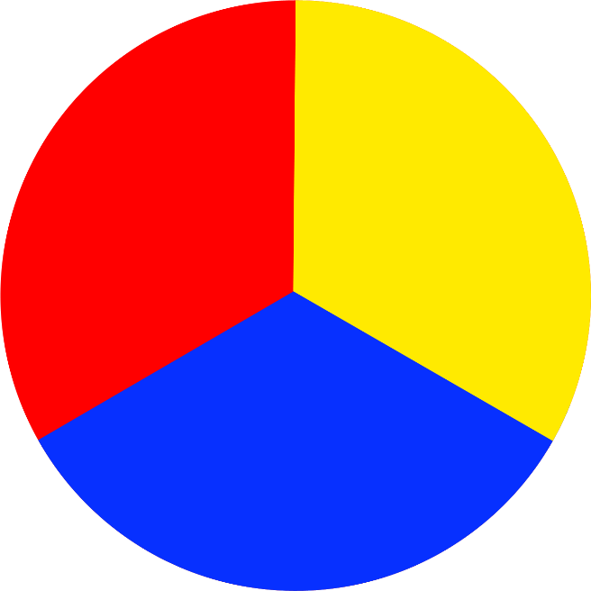
Primary Colours
Primary colors cannot be made by mixing other colours.
The primary colours are red, yellow, and blue.
Primary colours can be mixed together to make other colors.

Slide 13

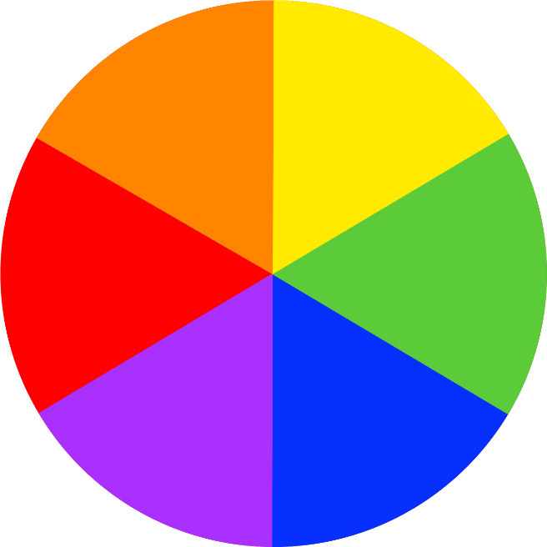
Secondary Colours
You use
primary colours to make secondary colours.

Slide 14



Mixing Secondary Colours

Slide 15
Mixing Tints
If you add white to a colour, you can make tints of the original colour.
White makes the colour lighter.

Slide 16
Mixing Shades
If you add black to a colour, you can make shades of the original colour.
Black makes the colour darker.

Slide 17
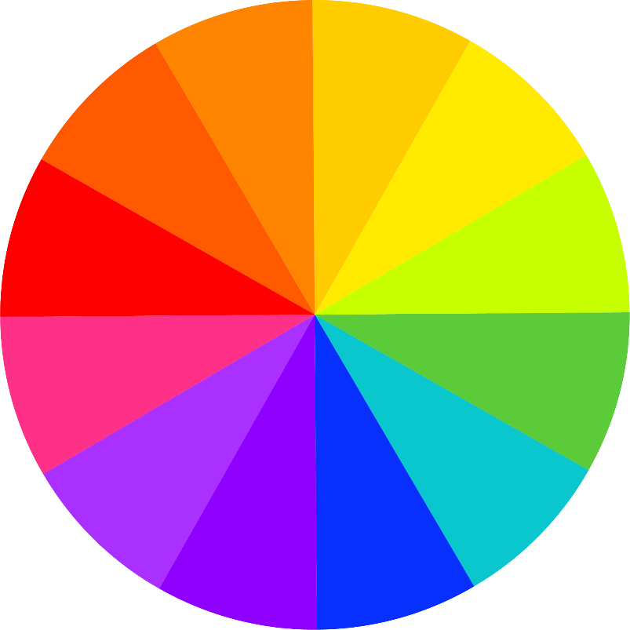
Warm and Cool Colours
Warm colours
Cool colours
Red, orange, and yellow are warm colours. They make us think of sun, warmth, and cozy things.
Green, blue, and purple are cool colours. They make us think of fresh, calm, and chilly things.
-----------------------------

Slide 18
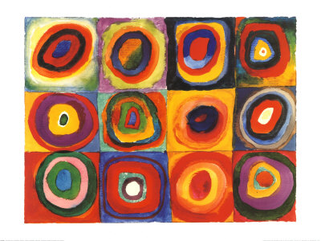


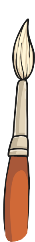

Kandinsky Circle Painting
Paper
Paints – Primary Colours
Paint Brush
Water

Slide 19
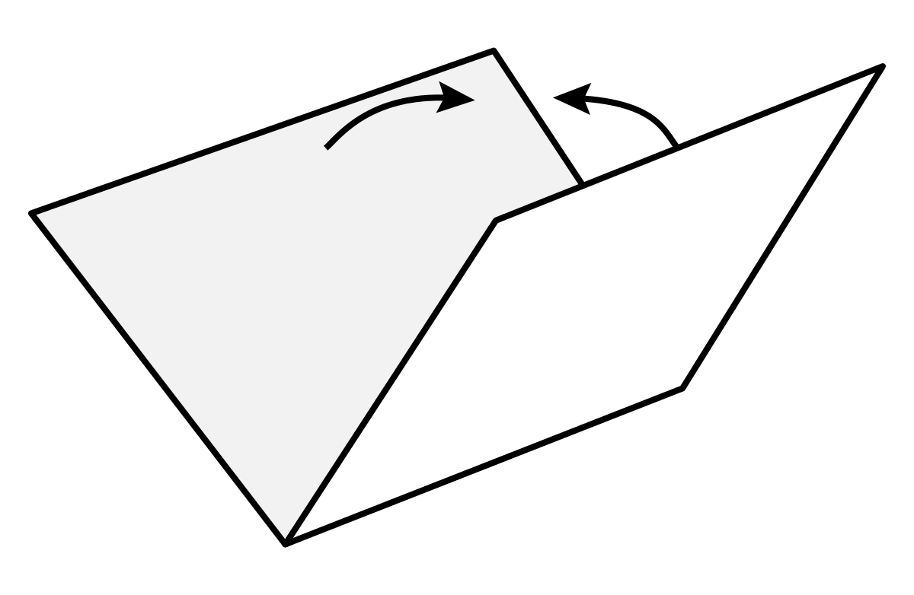
Step 1.
Fold you paper or card in half.
Then in half again to create a template for your circles.

Slide 20
Step 2.
In each square of your template, paint a dot. Use a different colour for each one.

Slide 21




Step 3.
Around each dot paint a circle of a different colour.
Experiment mixing your primary colours to create different colours.

Slide 22










Step 4.
Paint another circle around the circle of a different colour.

Slide 23



























Step 5.
Keep painting circles until you can’t fit any more in.
Then fill in the gaps with another colour.

