Slide 1

ARTS WEEK
Gratitude

Slide 2
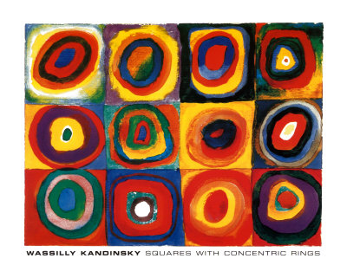
I can discuss things I am thankful for and I can focus on the things I do have, rather than the things I do not have.

Slide 3
Saying Thank You
How can we be thankful for the things that we have?
How can being thankful help to make us happy?

Slide 4
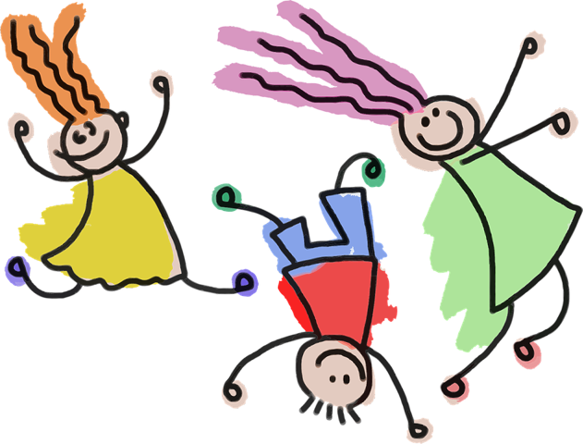
Saying Thank You
When was the last time you said thank you?
Why to we say thank you?
Saying thank you makes us and the other person feel good.

Slide 5
Being Grateful
What does grateful mean?
If you appreciate things, it means that you are pleased when you think of all the things you have and realise how lucky we are.

Slide 6
Being Grateful
Being grateful (or thankful) means that you appreciate things you have in your life, including the people you have around you.

Slide 7
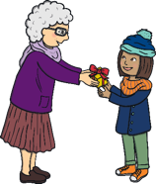



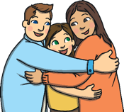
Being Grateful
How can we be grateful towards others?

Slide 8
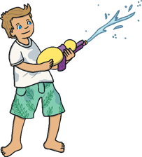


Being Grateful
How can we be grateful, or thankful, for what we have?
we can think about those who are not as lucky as we are;
We can enjoy what we have;
we can look after what we have.

Slide 9

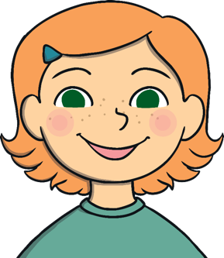
Thankful People are
Happy People
How can being thankful make you happy?

Slide 10
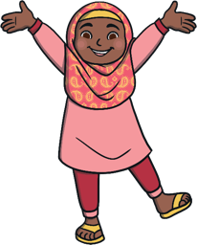

Thankful People are
Happy People
If we think positive thoughts, we feel happier.
If we think negative thoughts, we don’t feel so good.
If we focus on the things we have and think how lucky we are, we will feel good, because this is a positive thought.
If we think about all the things we don’t have, we will feel miserable all the time, as this is a negative thought.
How does being thankful make us happier?

Slide 11

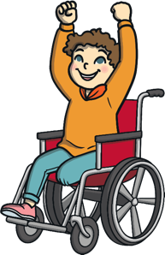
Thank You For the Memories
Even when a time we have enjoyed has ended, or a guest has had to leave, if we have lost a toy we used to love, or a family pet has sadly died, we can still be thankful for the memories we have.
Close your eyes and think carefully about a lovely memory you have about a special time, a special place, or a special person.
Choose a happy memory and think how lucky you are to still have that memory.
Be thankful for that special person, place, or time.

Slide 12
Year R
Task 1
Colour the circles.
As you colour each circle think about something that you are grateful for.
Task 2
Write a sentence about something you are grateful for.
I am grateful for ……………….

Slide 13
Year 1 & 2
Task 1
Create your own circles of gratitude. You can either draw around a different size circles/ cylinder or draw free hand.
Task 2
Write 5 sentences about something you are grateful for.
I am grateful for ……………….
Year 2 – Try to use a variety of sentence starters.

