Slide 1
Tuesday 16th June 2020
L.O To compare two pictures

Slide 2
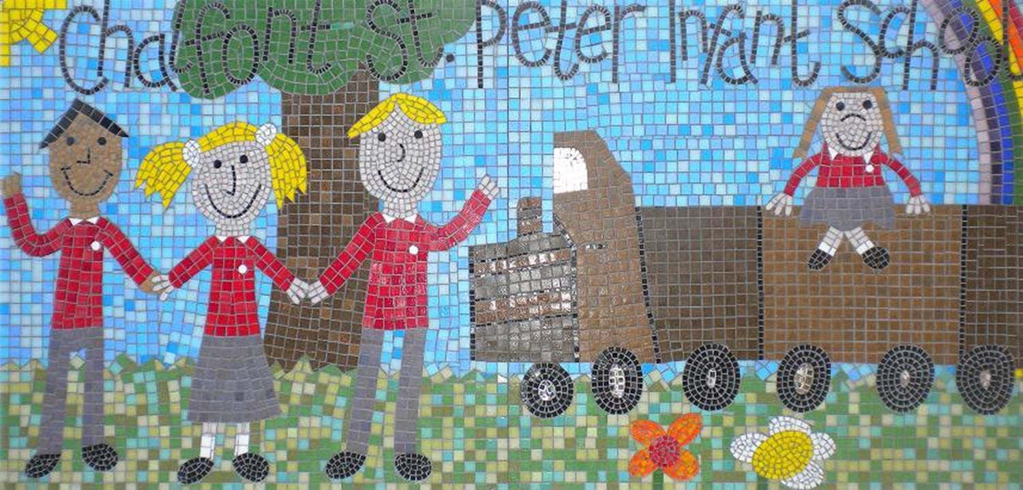
Today we are going to be looking at pictures of schools in India. We are going to talk about what is the same and what is different compared to our school. The schools we are going to compare from India are called SPG English Medium School and The Oxford School

Slide 3
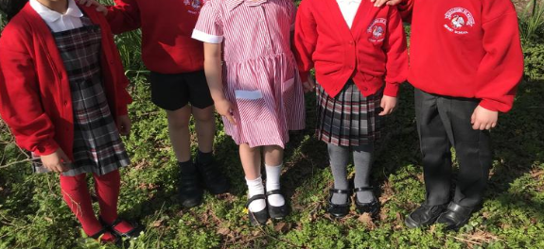
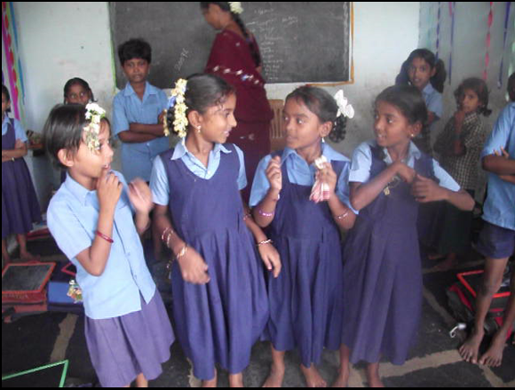
Uniform
Most children wear a uniform to school.
What is the same? What is different?

Slide 4
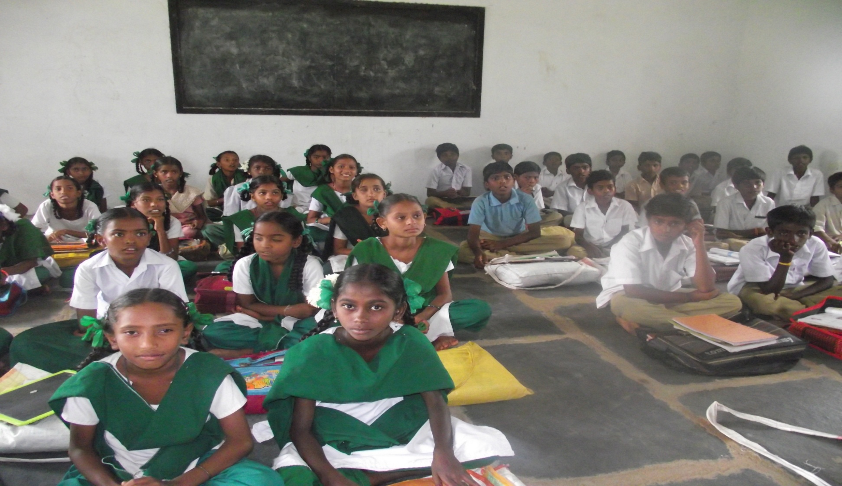
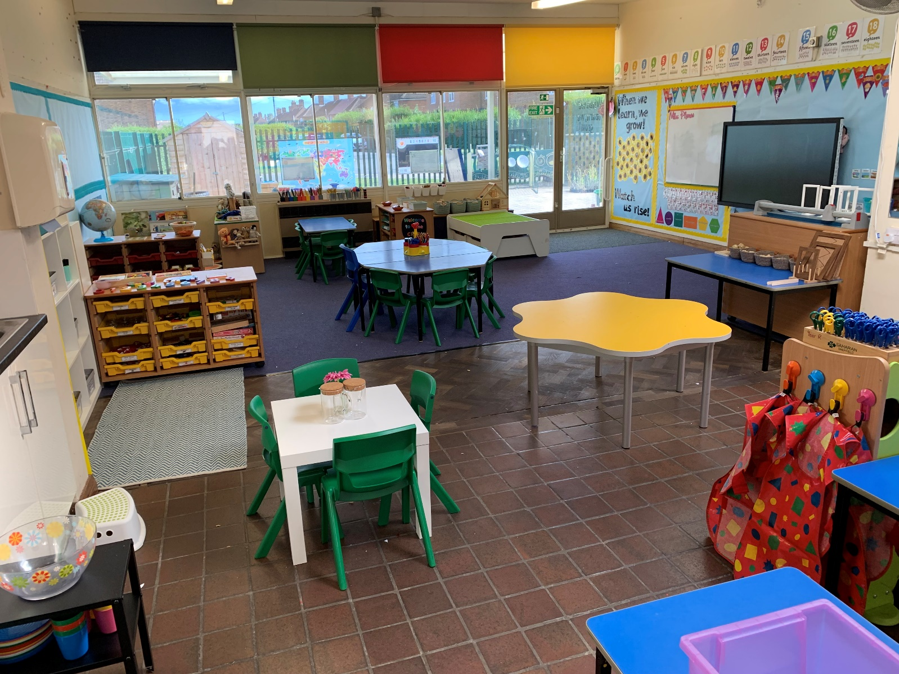
Classroom
In India the children sit on the floor when in lessons. The sit boys on one side and girls on the other.
What is the same? What is different?

Slide 5
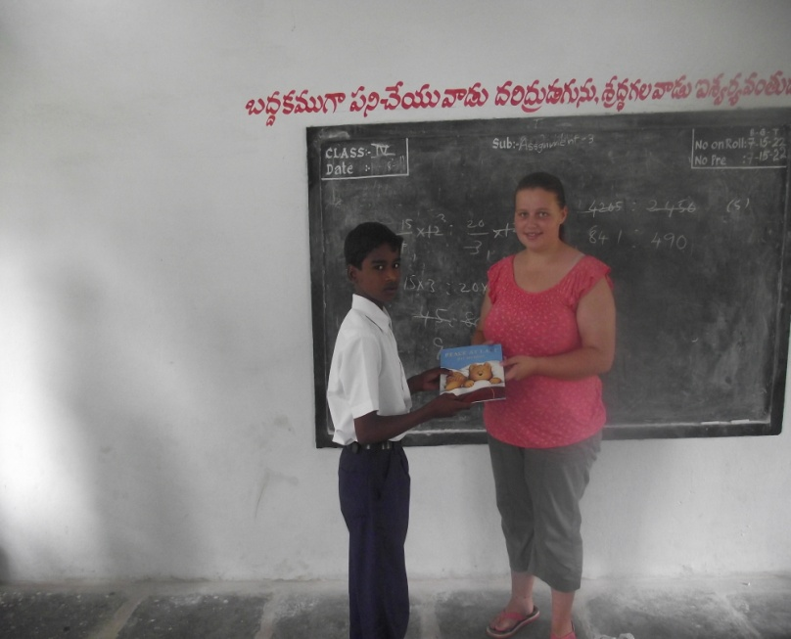
Lessons
In India they have a blackboard at the front of the class. What is the same? What is different?

Slide 6
Look at these pictures and compare them to our school.

Slide 7
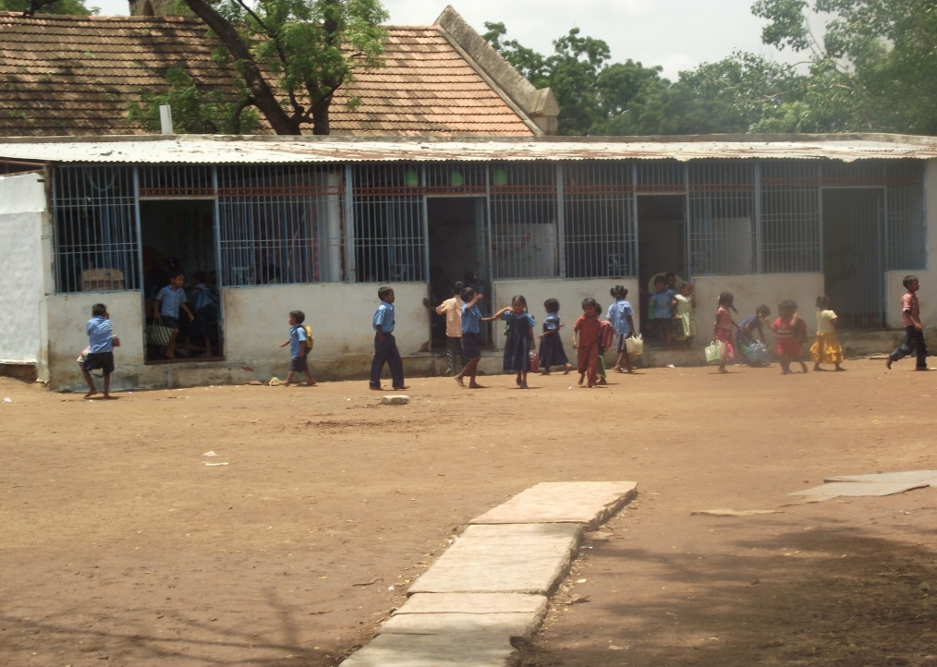

Slide 8
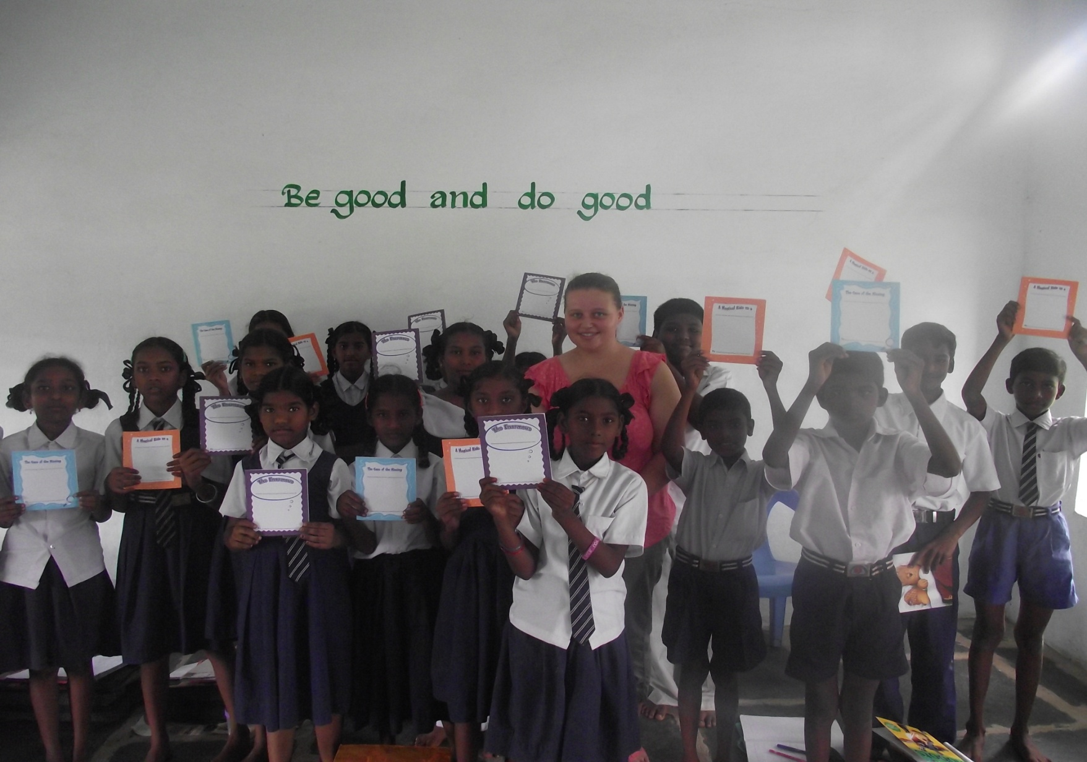

Slide 9
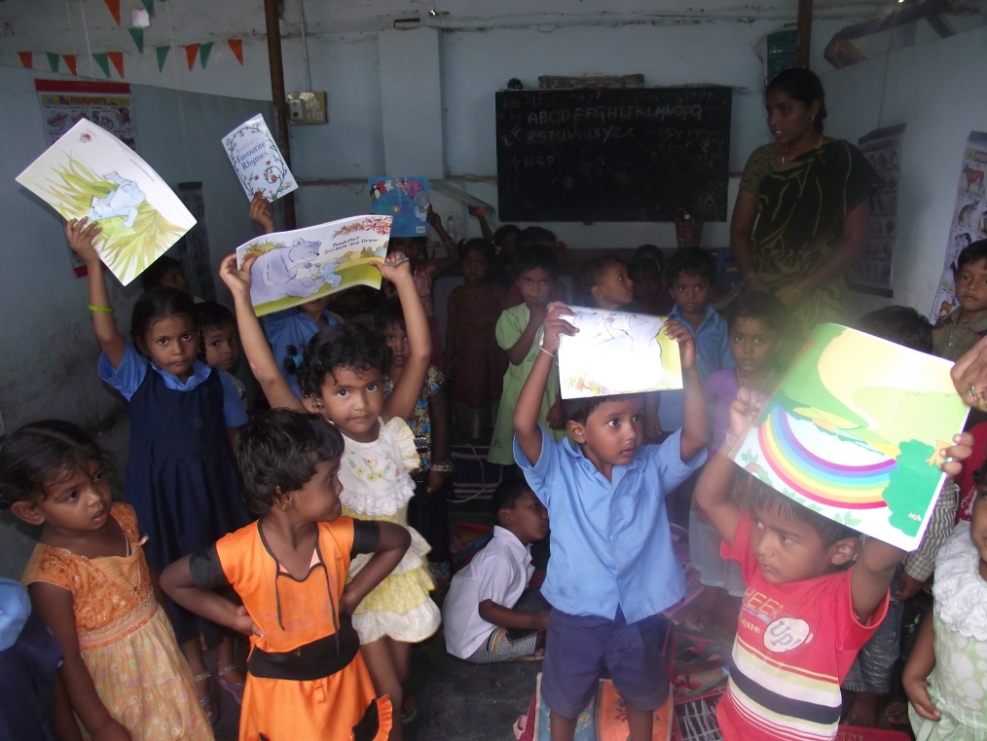

Slide 10
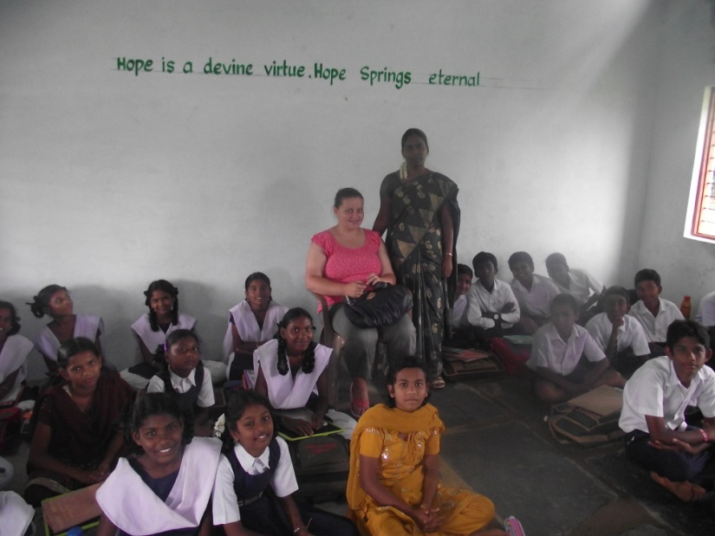

Slide 11
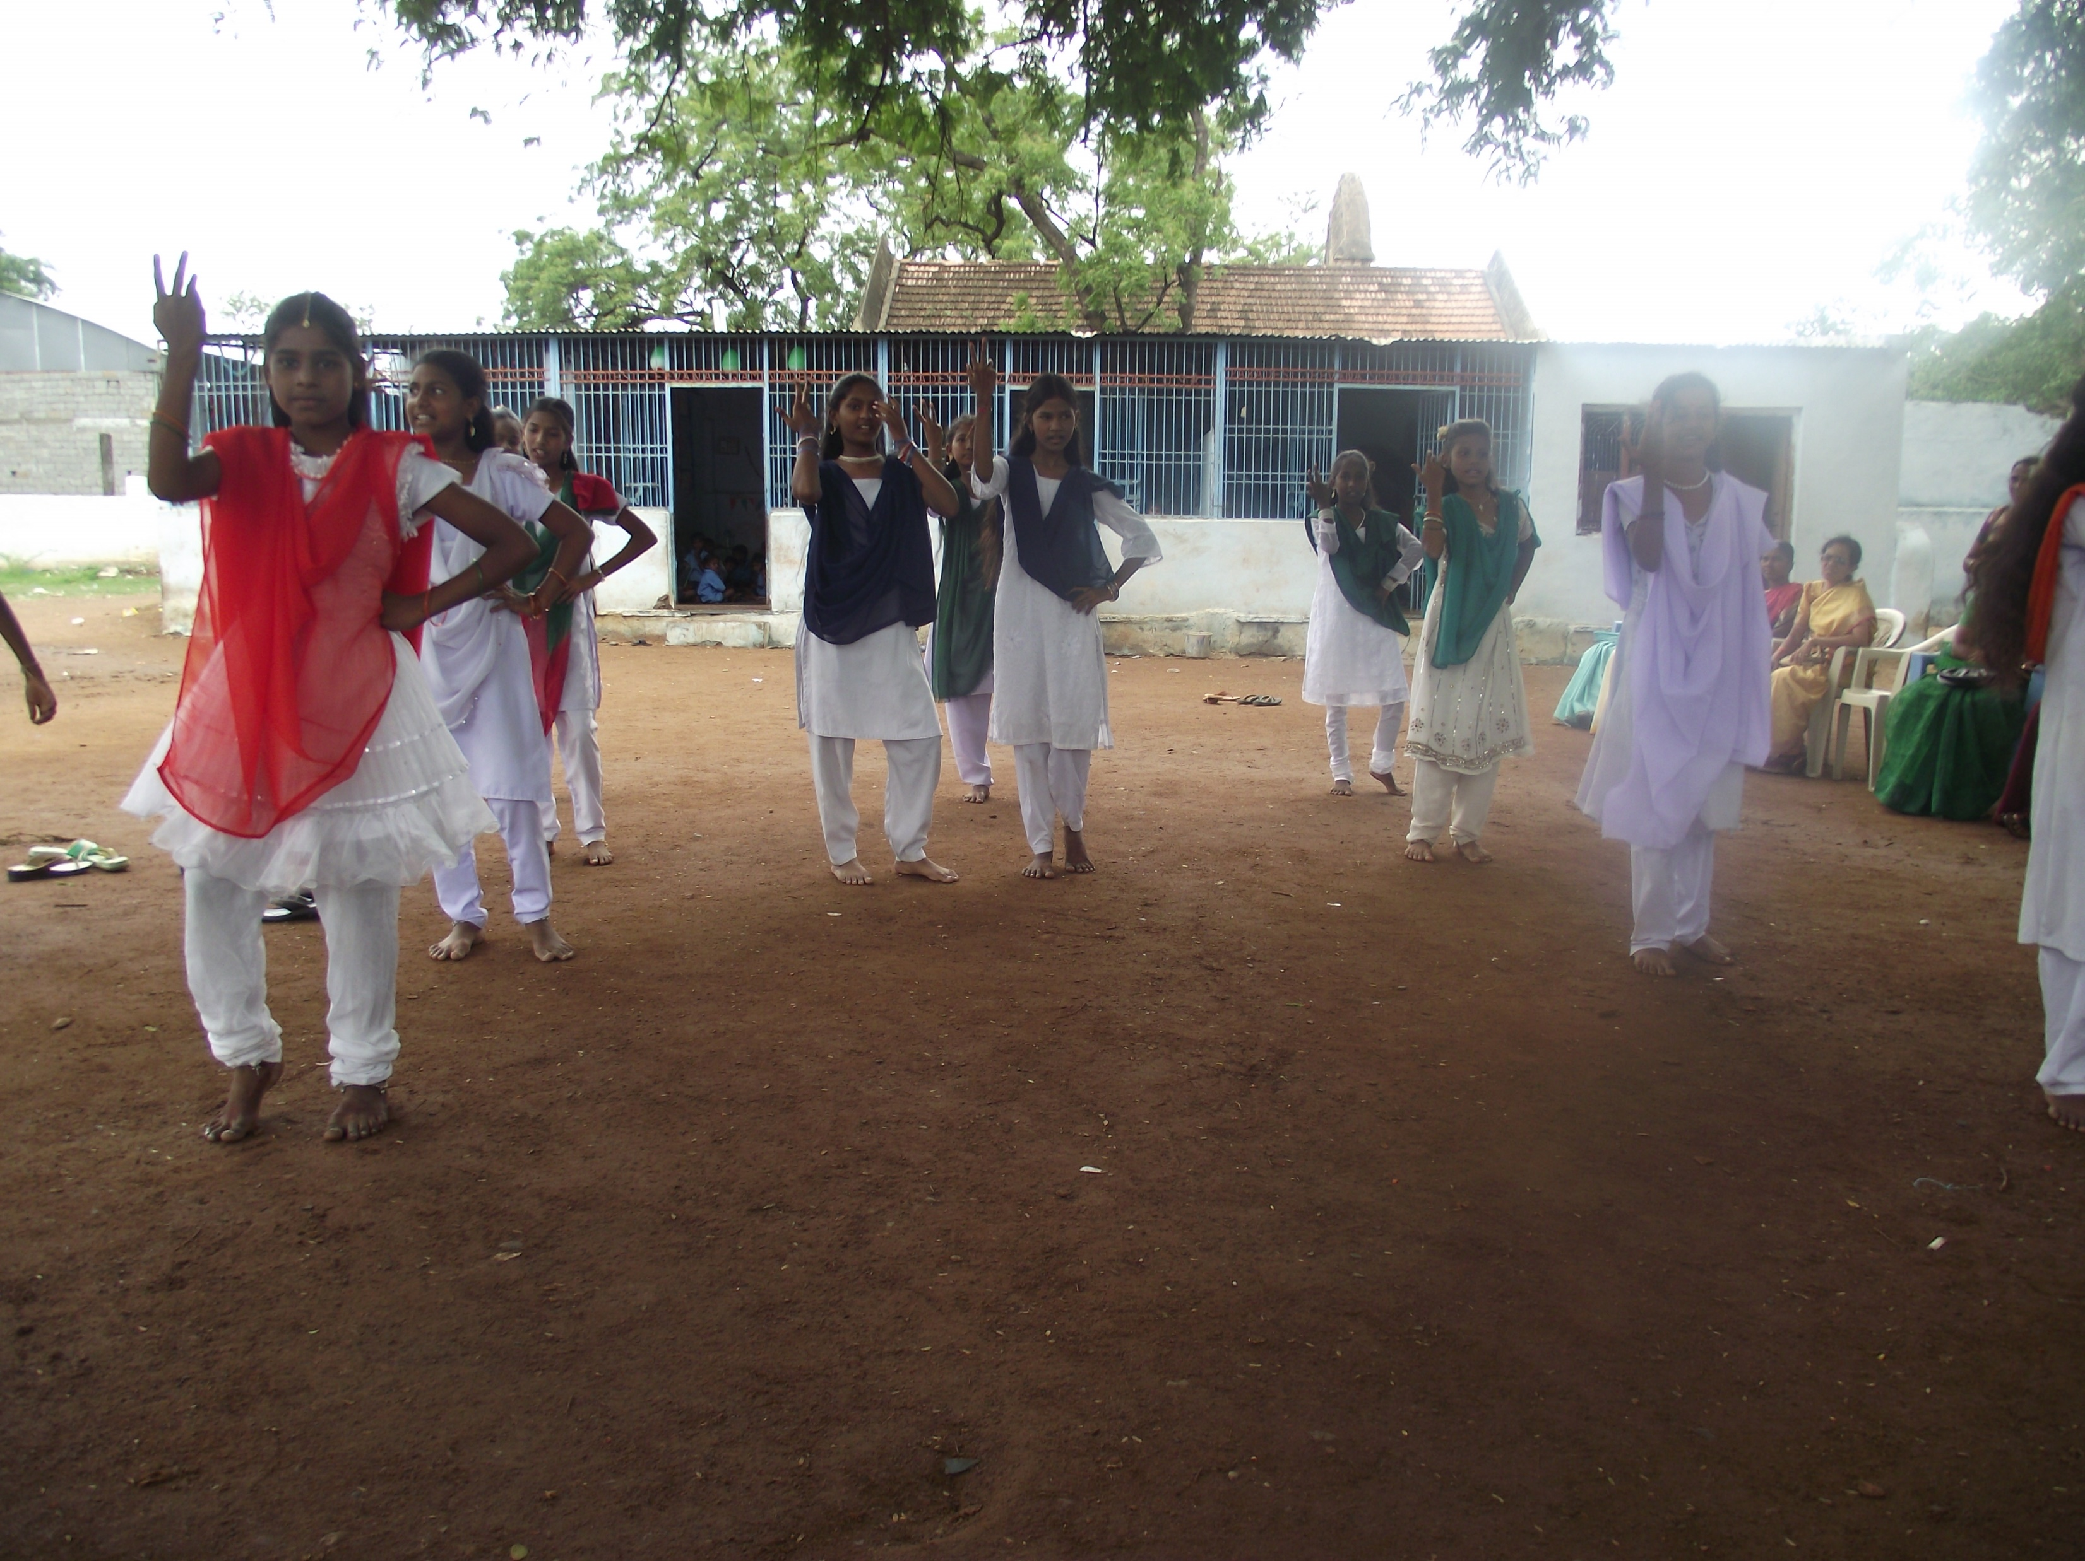

Slide 12
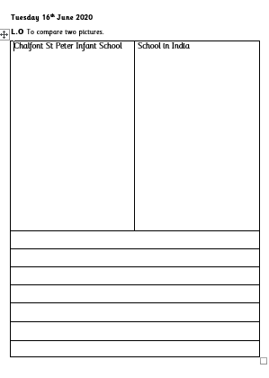
Draw a picture of your classroom and a picture of a school in India’s classroom. Write a sentence about each picture.

