Slide 1

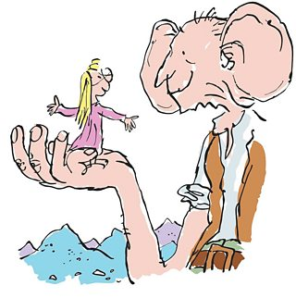
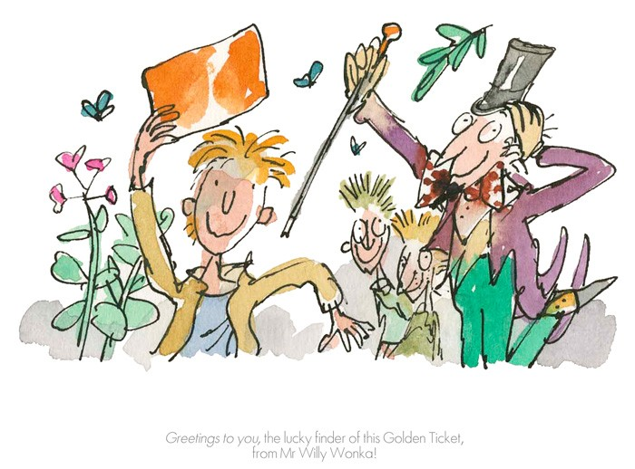
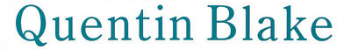

Thursday 25th February

Slide 2
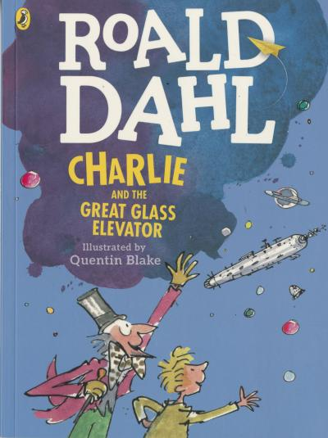

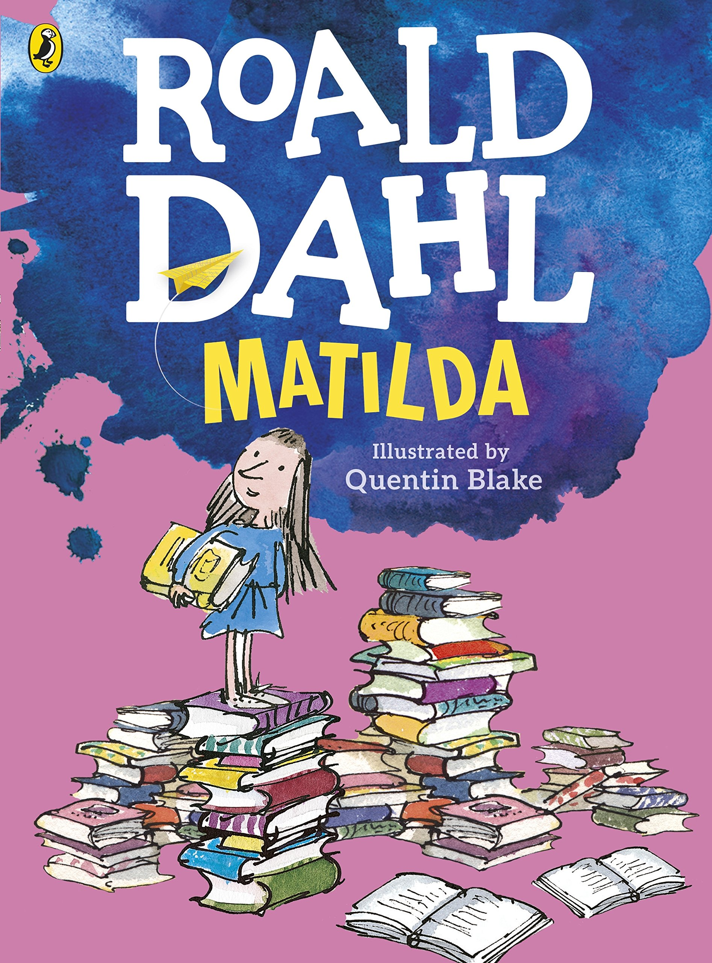
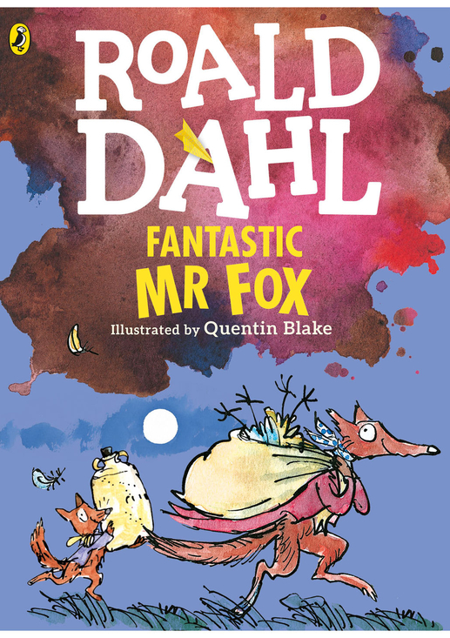
Quentin Blake is an artist and illustrator who is best known for illustrating Roald Dahls stories.

Slide 3

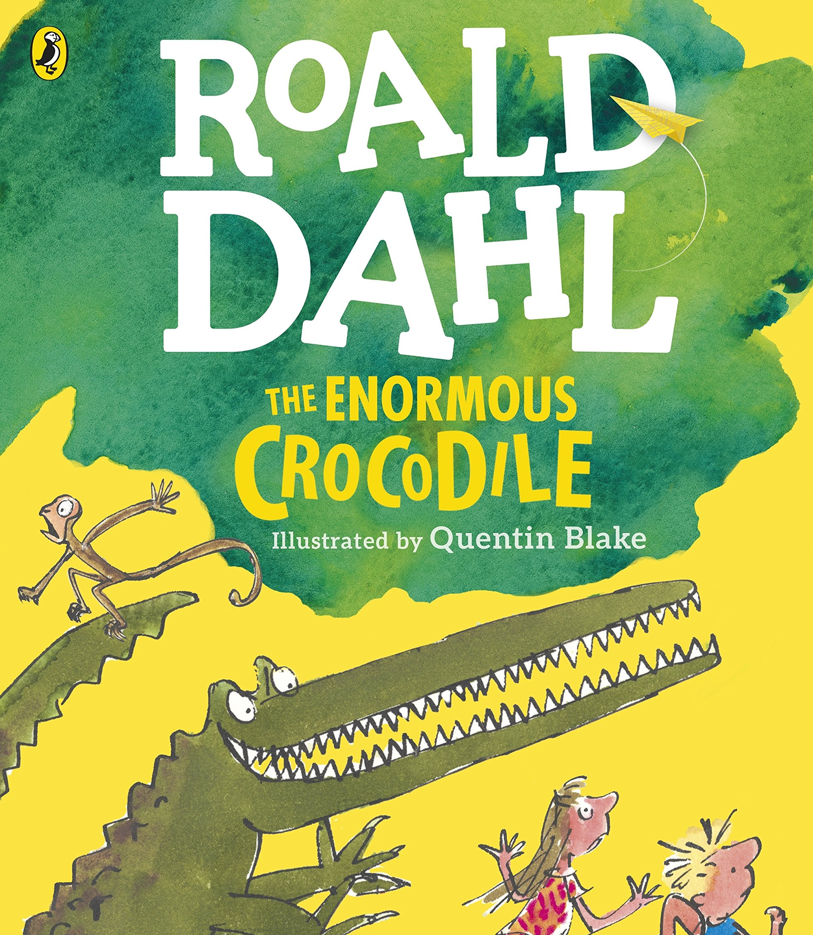
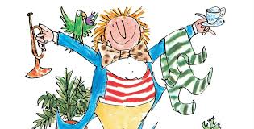
The first book he ever illustrated for Roald Dahl was the enormous crocodile.
Quentin Blake has even written some of his own books such as Mister Magnolia!

Slide 4
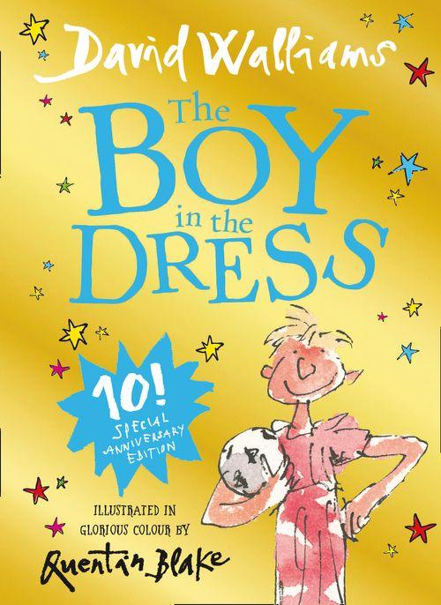
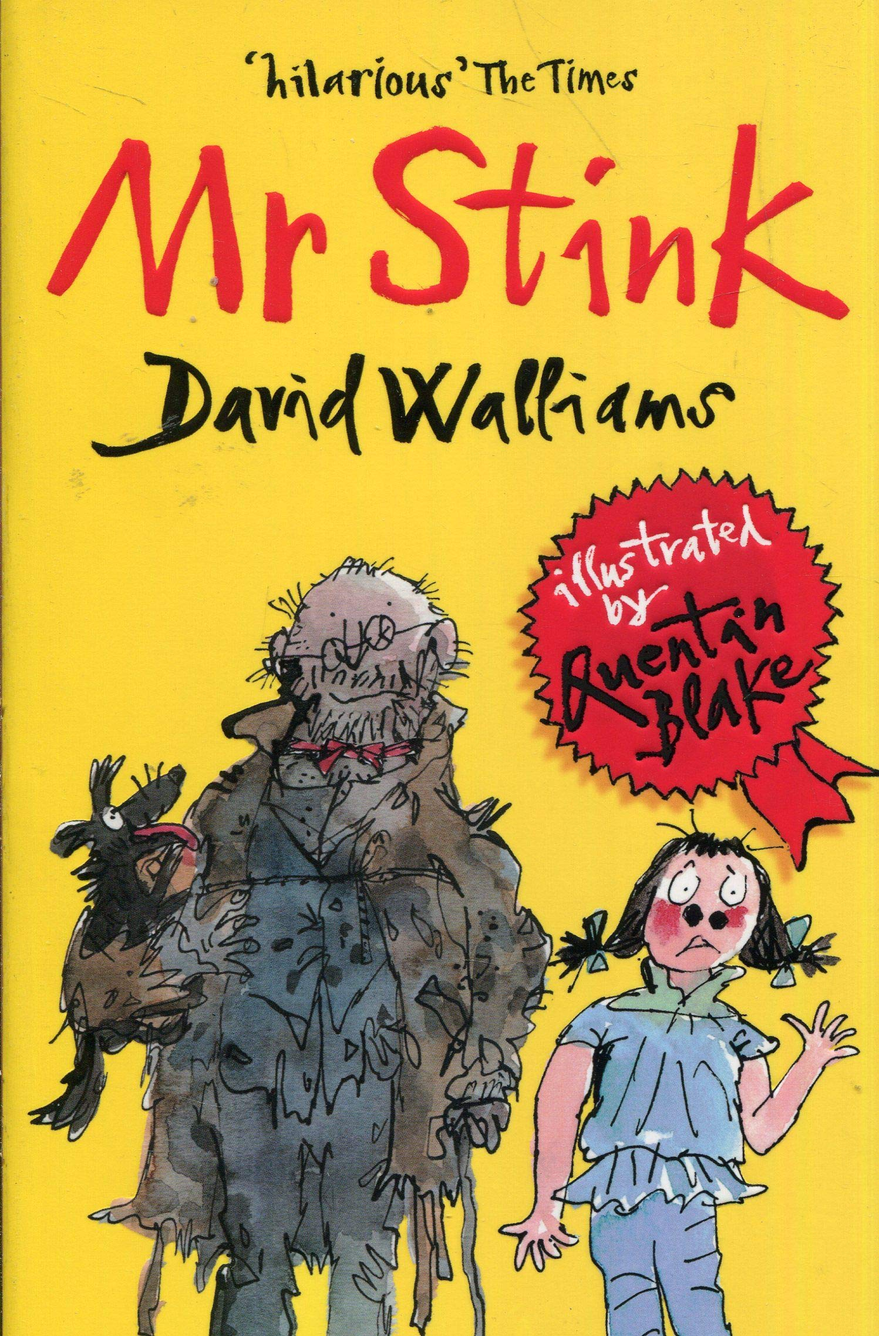

Quentin Blake and David Walliams
Quentin Blake has also illustrated books by David Walliams, do you recognise any of these?

Slide 5
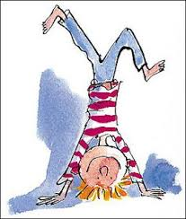
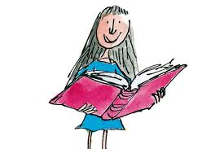
Quentin Blakes Art
Quentin Blake often completes his drawings on watercolour paper using ink and pens.
He likes to plan his drawings before he completes them and does rough sketches on paper.
He uses a lot of thin straight lines for his drawings.
A lot of his drawings are coloured in using watercolours.

Slide 6
Now its your turn to have a go!
Can you create your own design of a chocolate bar from Willy Wonka’s factory?
Take a look at some of the chocolate bars on the next slide to inspire you.
If you would like to listen to Charlie and the Chocolate Factory there is a link here to a reading:
https://www.youtube.com/watch?v=f0t_HDxDj00
Enjoy your creations!

Slide 7




