Slide 1
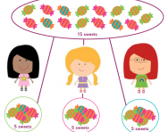
Sharing into Groups

Slide 2
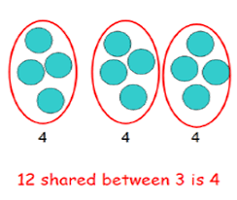
When we share into groups we need to make sure each group has the same number of objects.

Slide 3


Lets practise sharing! Let’s share 10 cakes between 5 people. How many do they each get?

Slide 4
Lets practise sharing! Let’s share 10 cakes between 5 people. How many do they each get?

Slide 5
Lets practise sharing! Let’s share 10 cakes between 5 people. How many do they each get?

Slide 6
Lets practise sharing! Let’s share 10 cakes between 5 people. How many do they each get?

Slide 7
Lets practise sharing! Let’s share 10 cakes between 5 people. How many do they each get?

Slide 8
Lets practise sharing! Let’s share 10 cakes between 5 people. How many do they each get?

Slide 9
Lets practise sharing! Let’s share 10 cakes between 5 people. How many do they each get?

Slide 10
Lets practise sharing! Let’s share 10 cakes between 5 people. How many do they each get?

Slide 11
Lets practise sharing! Let’s share 10 cakes between 5 people. How many do they each get?

Slide 12
Lets practise sharing! Let’s share 10 cakes between 5 people. How many do they each get?

Slide 13
Lets practise sharing! Let’s share 10 cakes between 5 people. How many do they each get?

Slide 14
Each child gets 2 cup cakes!
2
2
2
2
2

Slide 15
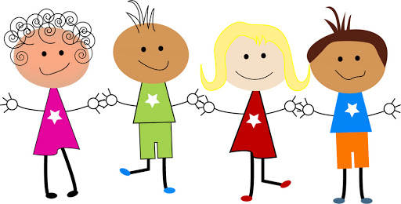

Let’s share 12 flowers between 4 people. How many do they each get?

Slide 16
Let’s share 12 flowers between 4 people. How many do they each get?

Slide 17
Let’s share 12 flowers between 4 people. How many do they each get?

Slide 18
Let’s share 12 flowers between 4 people. How many do they each get?

Slide 19
Let’s share 12 flowers between 4 people. How many do they each get?

Slide 20
Let’s share 12 flowers between 4 people. How many do they each get?

Slide 21
Let’s share 12 flowers between 4 people. How many do they each get?

Slide 22
Let’s share 12 flowers between 4 people. How many do they each get?

Slide 23
Let’s share 12 flowers between 4 people. How many do they each get?

Slide 24
Let’s share 12 flowers between 4 people. How many do they each get?

Slide 25
Let’s share 12 flowers between 4 people. How many do they each get?

Slide 26
Let’s share 12 flowers between 4 people. How many do they each get?

Slide 27
Let’s share 12 flowers between 4 people. How many do they each get?

Slide 28
Each child gets 3 flowers!
3
3
3
3

Slide 29
Remember that when we share into groups we need to make sure each group has the same number of objects.

Slide 30
Can you solve these sharing problems using your toys and resources you have at home?
What is 15 shared between 5?
What is 20 shared between 10?
What is 14 shared between 2?
What is 9 shared between 3?
What is 8 shared between 4?

