Slide 1
Wednesday 10th June 2020
L.O To create a tally chart

Slide 2
Let’s go on a safari!

Slide 3
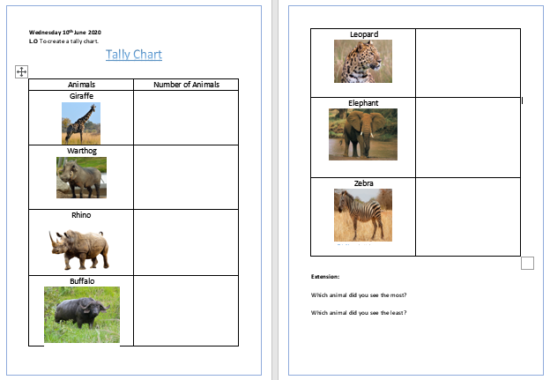
When you see each animal put a tally next to the picture.

Slide 4
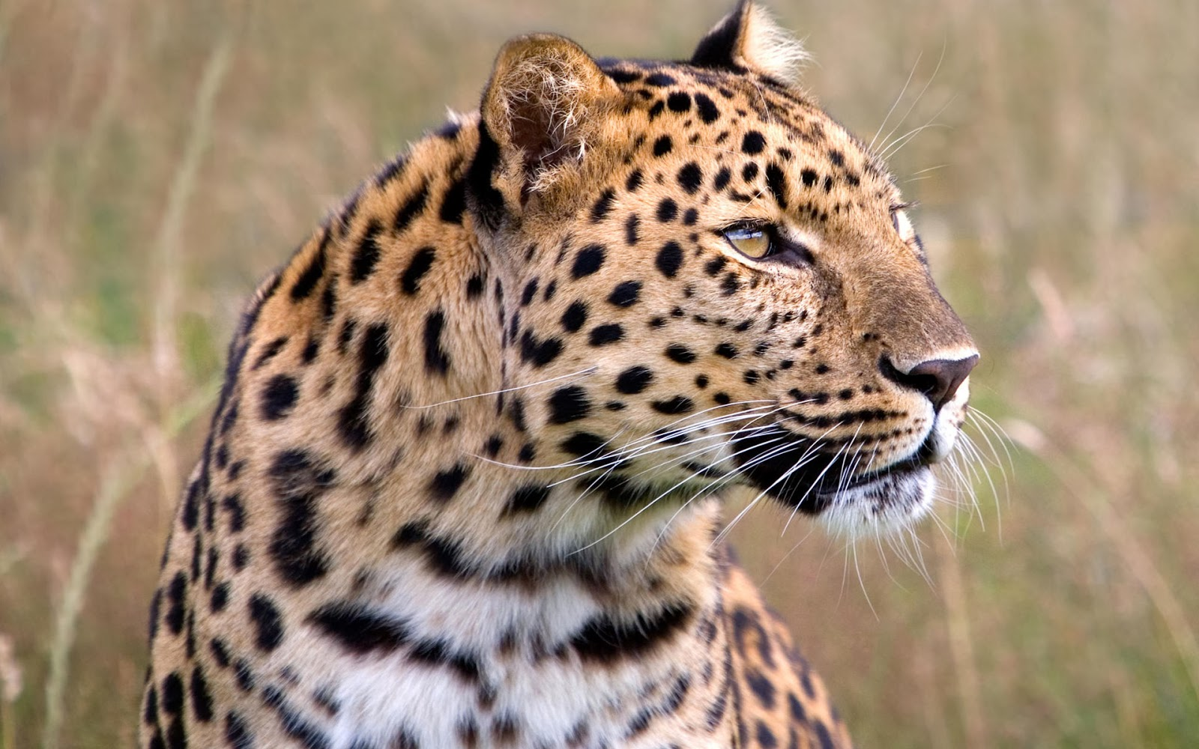
This Photo by Unknown Author is licensed under CC BY

Slide 5
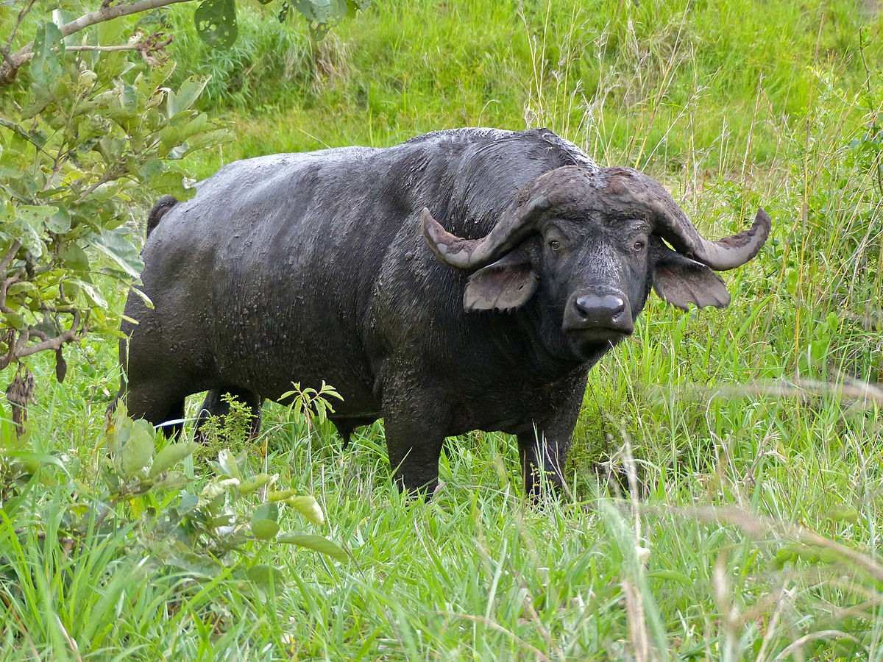
This Photo by Unknown Author is licensed under CC BY-SA

Slide 6
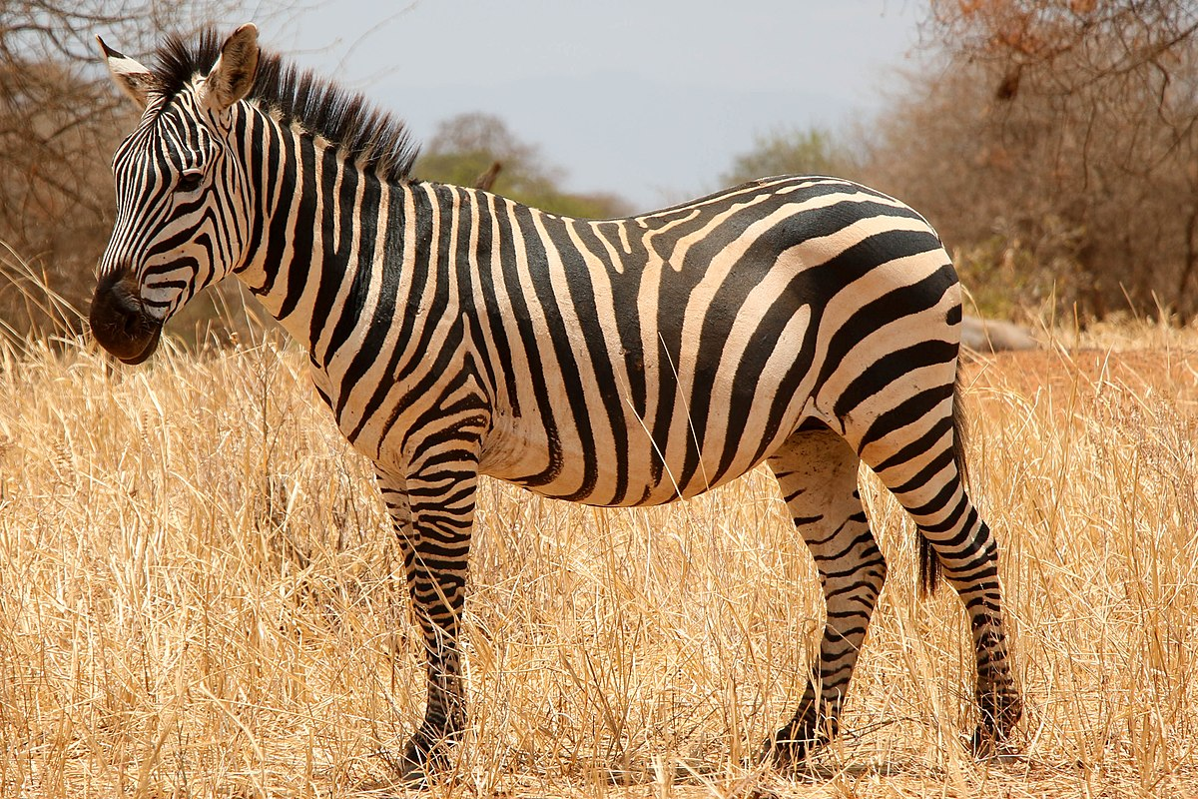
This Photo by Unknown Author is licensed under CC BY-SA

Slide 7
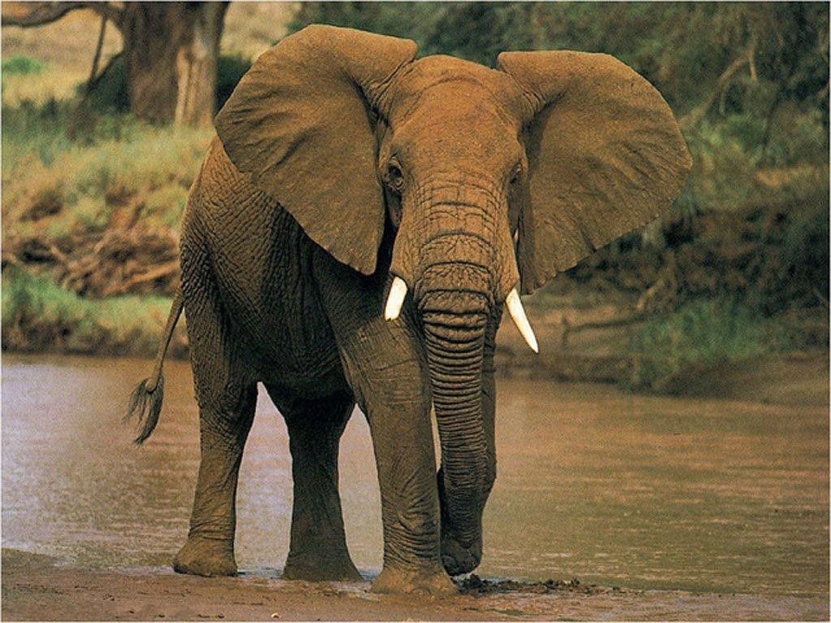

Slide 8
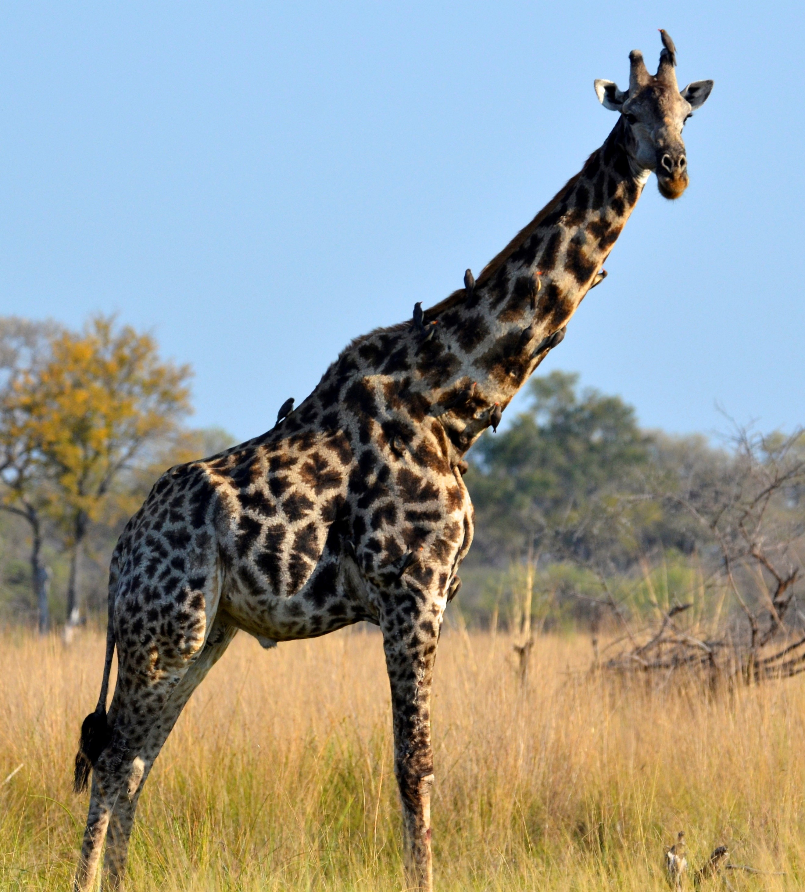

Slide 9
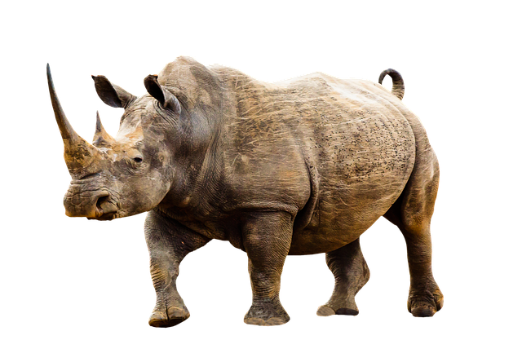

Slide 10
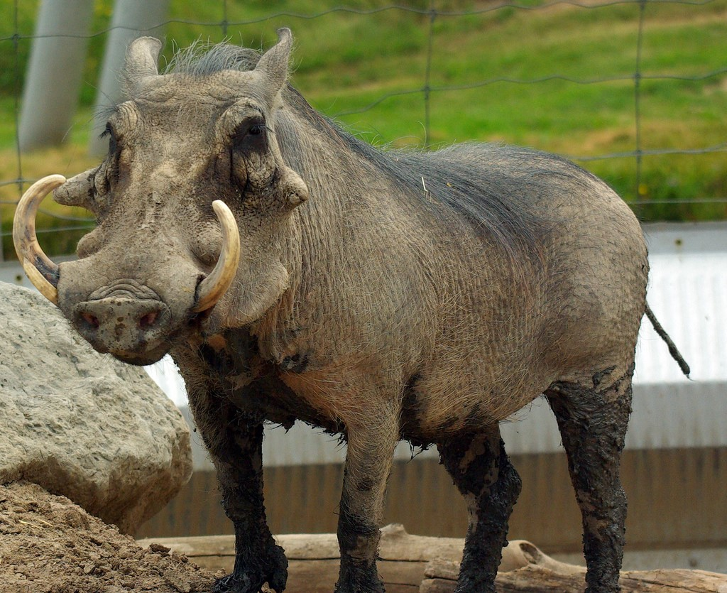

Slide 12
This Photo by Unknown Author is licensed under CC BY

Slide 14
This Photo by Unknown Author is licensed under CC BY-SA

Slide 16
This Photo by Unknown Author is licensed under CC BY

Slide 19
This Photo by Unknown Author is licensed under CC BY-SA

Slide 21
This Photo by Unknown Author is licensed under CC BY-SA

Slide 22
This Photo by Unknown Author is licensed under CC BY

Slide 23
This Photo by Unknown Author is licensed under CC BY-SA

Slide 24
This Photo by Unknown Author is licensed under CC BY

Slide 31
This Photo by Unknown Author is licensed under CC BY-SA

Slide 32
This Photo by Unknown Author is licensed under CC BY-SA

Slide 33
This Photo by Unknown Author is licensed under CC BY-SA

Slide 36
This Photo by Unknown Author is licensed under CC BY-SA

Slide 39
This Photo by Unknown Author is licensed under CC BY-SA

Slide 42
This Photo by Unknown Author is licensed under CC BY-SA

Slide 45
We have finished our safari! Did you enjoy seeing all the animals?
Now count up your tallies and write the number of times you saw each animal in the box.

