Slide 1
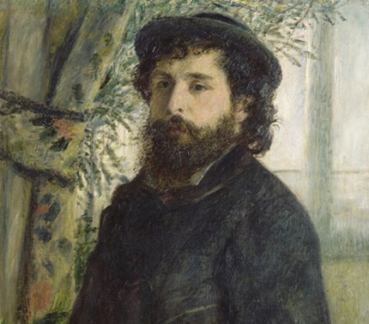

Claude Monet
Thursday 25th February

Slide 2
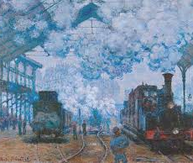
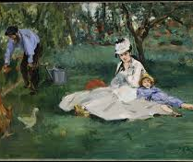
Claude Monet was a French artist who was born in Paris. He enjoyed painting from a young age.
He was an impressionist artist and liked to paint everyday scenes and landscapes like these two.

Slide 3
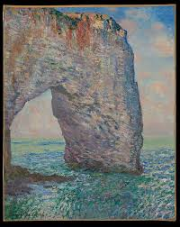
Monet used thick layers of paint and fast brushstrokes to create his paintings.
Monet was one of the first impressionists; they liked to paint outside whilst looking at the scenery.
Before this artists used to always paint in studios.

Slide 4
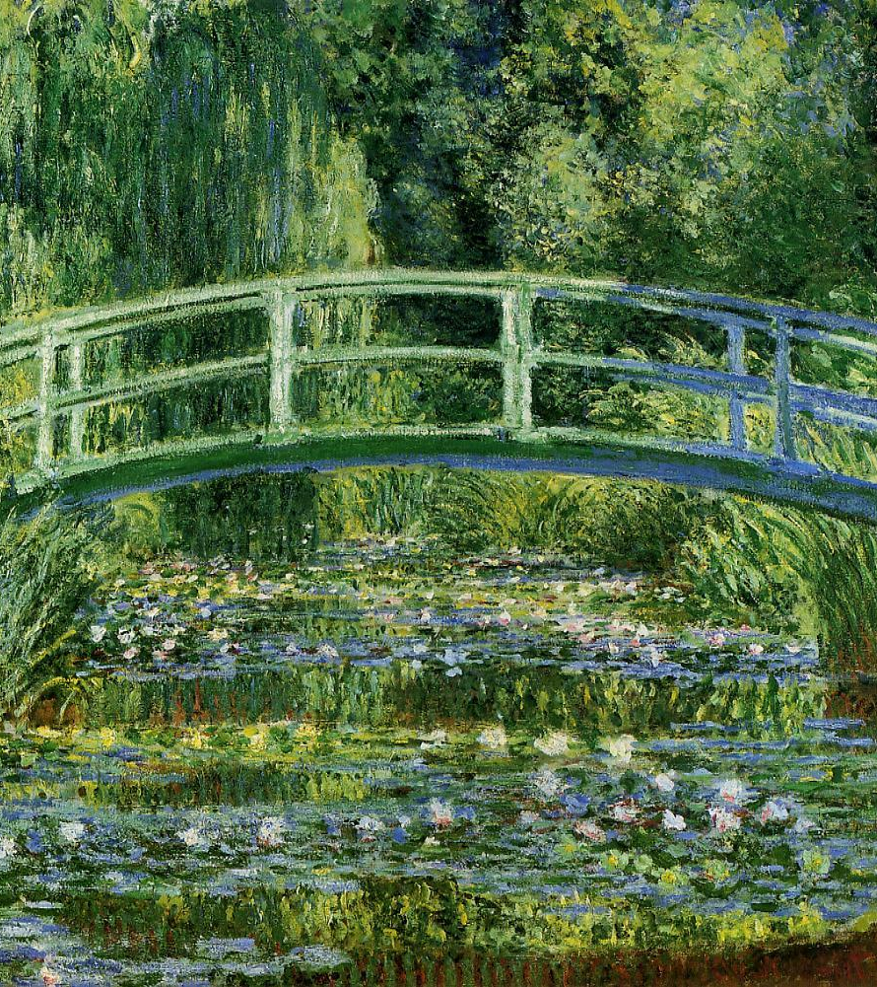
Monet’s Waterlilies
Monet enjoyed painting the waterlilies and bridge which were in his water garden.
Huge paintings of Monet’s waterlilies are in a museum in France called Musée de l’Orangerie in Paris.
Monet liked to paint the same scene lots of times from different angles and with different colours to show the landscapes in a different light.

Slide 5
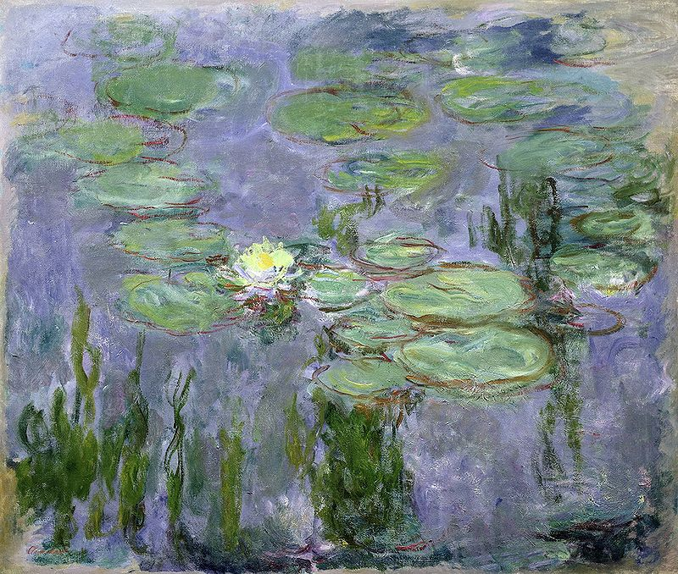
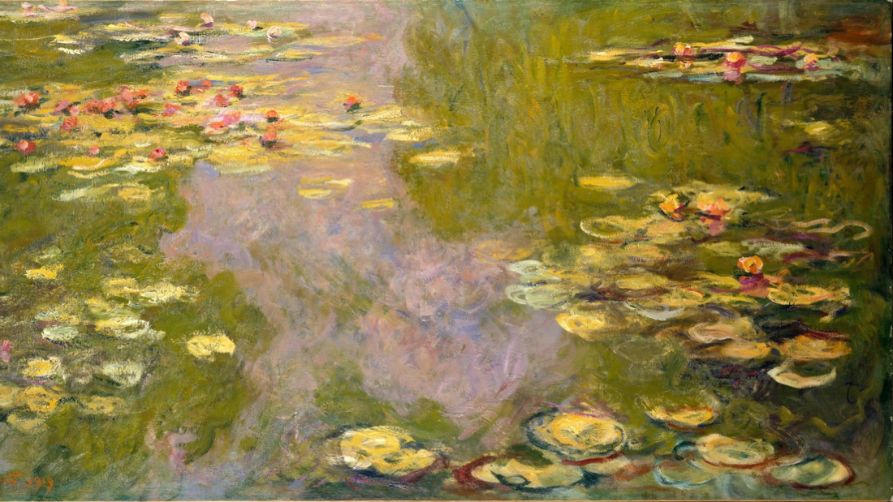
These are some more examples of Monet’s Waterlilies; can you see any similarities and differences between the two pictures?

Slide 6
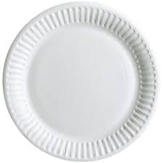
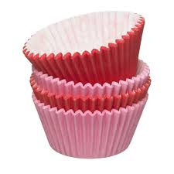
Now it is your turn to have a go!
We would like you to create your own version of Monet’s waterlilies using the paper plate and the cupcake cases in your art pack.
Can you have a go at painting or drawing a background on your paper plate and then use the cupcake cases to create some waterlilies.
On the next slide we will put some pictures up of the
waterlilies to help you!

Slide 7


