Slide 1
All About Chickens!

Slide 2
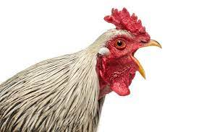
Learning Objective:
To design a chicken coop!

Slide 3
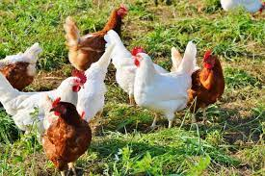
Yesterday, we learnt some non-fiction facts about chickens! Can you remember any of these facts?

Slide 4
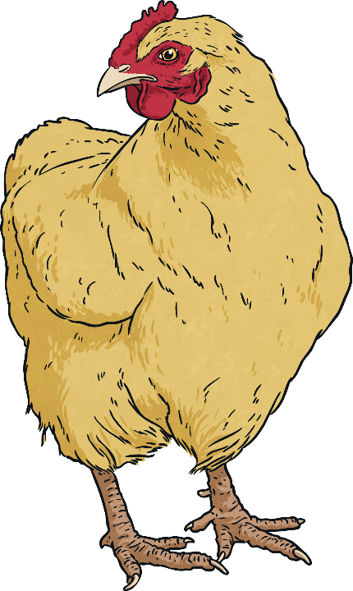
Facts About Chickens
There are 25 billion chickens on Earth, which is more that any other bird.
Chickens cannot fly; they can fly 1-2 metres off the ground but are unable to go any higher and they flop down to the ground again.
Baby chickens are called chicks. Female chickens are called pullets until they can begin laying eggs and then they are called hens. Male chickens are usually called roosters, cocks or cockerels.
Chicken is a popular food all around the world - the bird
provides both meat and eggs, which is a main source of
food for many people.
Chickens are omnivores, which means they eat fruits and vegetables as well as bugs and insects.

Slide 5
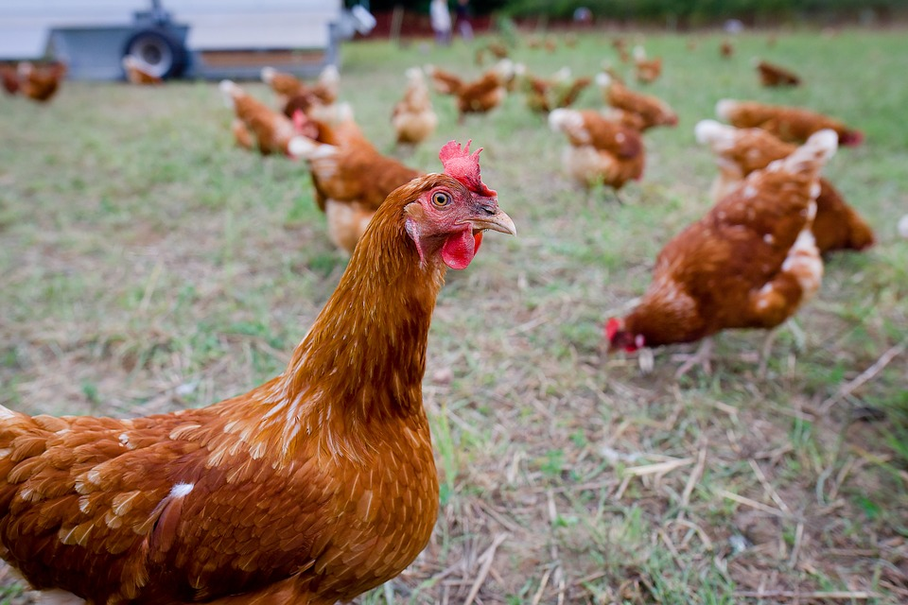
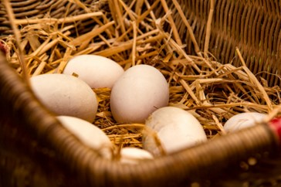
What Chickens Need
In order to live happy and healthy lives, chickens have certain things that they need. If you are keeping chickens you must look after them carefully. Chickens need a warm, cosy place to sleep. They need food and water. If you do not give them these things they will lose their feathers. If you are mean to them, they will stop laying eggs.
Photo courtesy of tlemens and congerdesign (@pixabay.com) - granted under creative commons licence – attribution

Slide 6
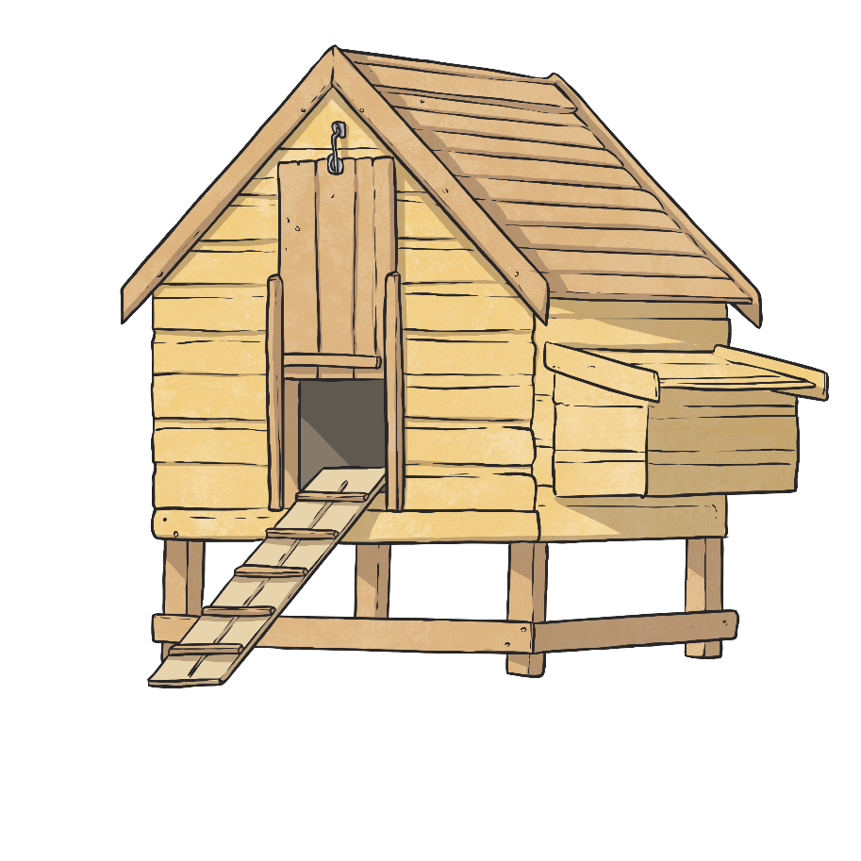
What Chickens Need
Healthy chickens always need:
clean drinking water;
food to graze on such as fruits, vegetables, grains, bugs and insects
space to scratch around because that is what they like doing
housing that protects them from outside predators such as foxes, cats and dogs;
shelter from the cold, wind and rain as well as harsh sun;
a nesting spot to lay eggs in quiet and privacy.

Slide 7
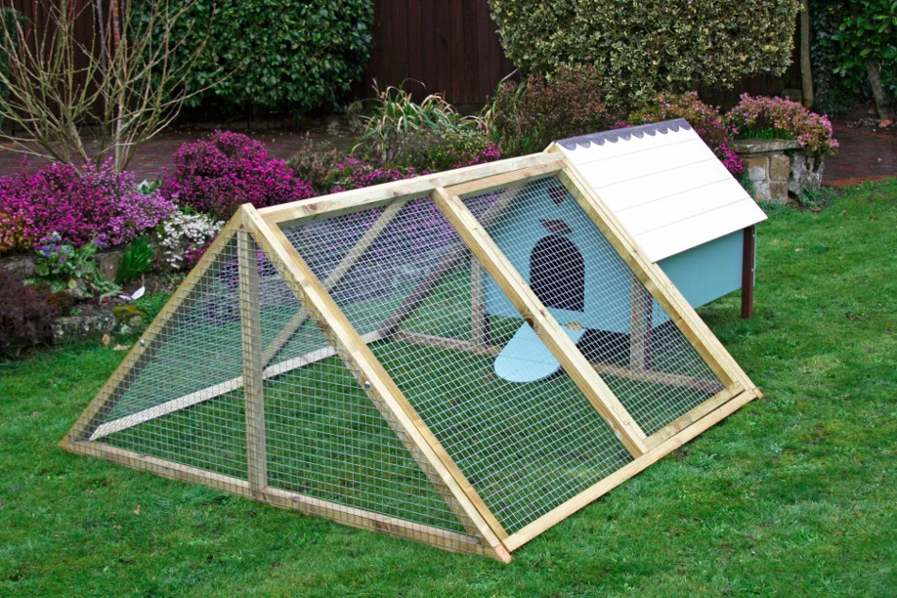
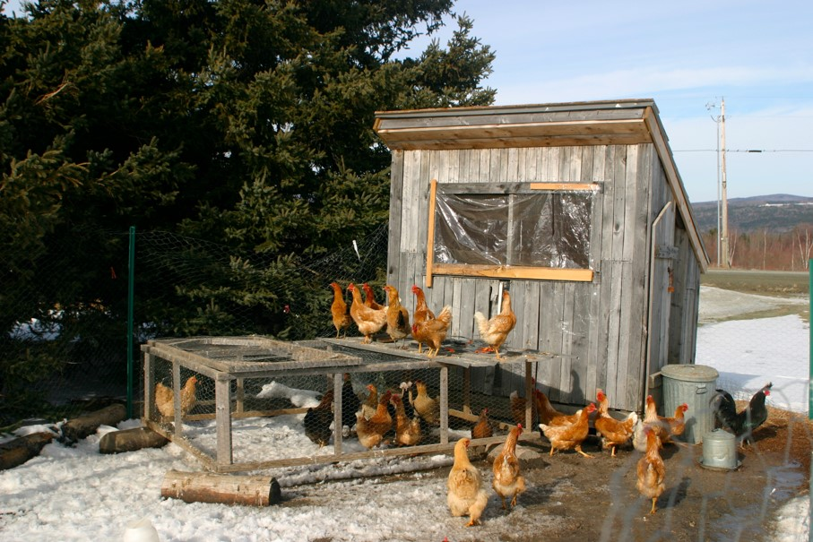
Chicken Coop
Chickens need a little home called a Chicken Coop. It must be strong with a strong door so that foxes cannot get in!
Photo courtesy of ChickenMan and JaredandCorin (@wikimedia.com) - granted under creative commons licence – attribution

Slide 8
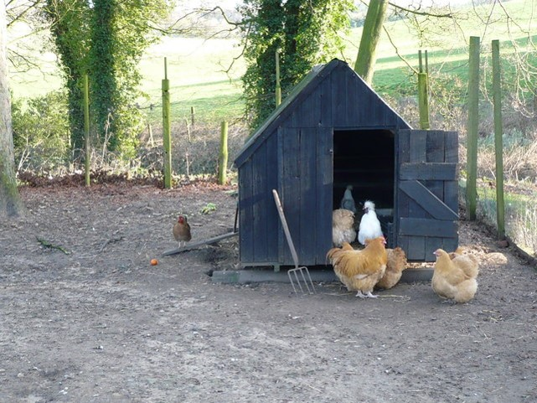
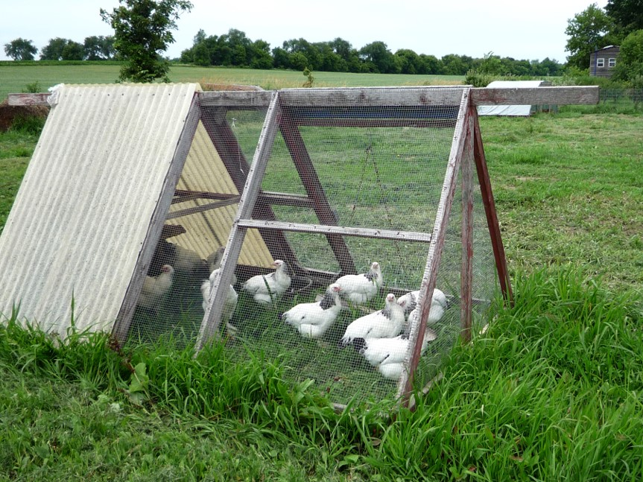
Chicken Coop
What do you notice about these chicken coops? Are they both strong? Will they protect the chickens from predators?
Photo courtesy of PhilCatterall and Jessica Reeder (@wikimedia.com) - granted under creative commons licence – attribution

Slide 9
Designing a Chicken Coop
Many people keep chickens in their back gardens to produce eggs. This is a great way to get eggs without going to the shops!
Today you are going to design a Chicken Coop!
You will need to consider the following:
What chickens need to live a healthy and happy life.
Where your chicken coop will be in your back garden.
Which materials you would use to make the chicken coop.
The structure of the chicken coop and how it would provide a safe shelter for the hens away from foxes.

Slide 10
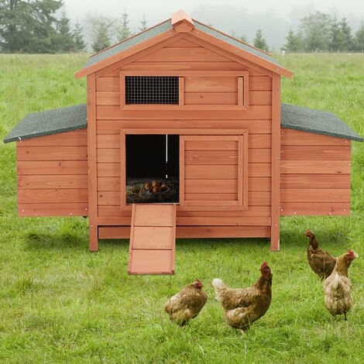
Ideas for a Chicken Coop
Photo courtesy of PhilCatterall and Jessica Reeder (@wikimedia.com) - granted under creative commons licence – attribution

Slide 11
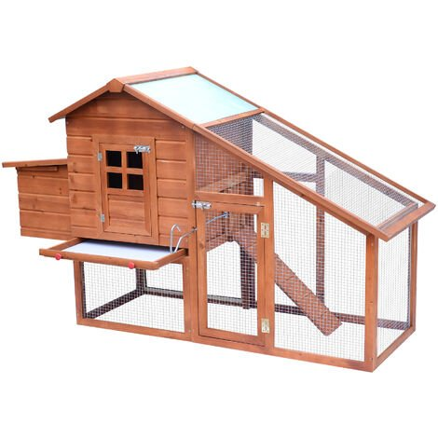
Ideas for a Chicken Coop
Photo courtesy of PhilCatterall and Jessica Reeder (@wikimedia.com) - granted under creative commons licence – attribution

Slide 12
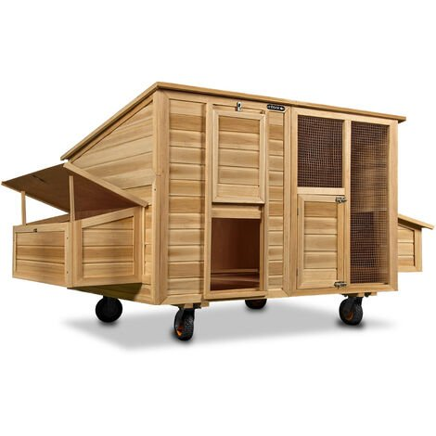
Ideas for a Chicken Coop
Photo courtesy of PhilCatterall and Jessica Reeder (@wikimedia.com) - granted under creative commons licence – attribution

Slide 13
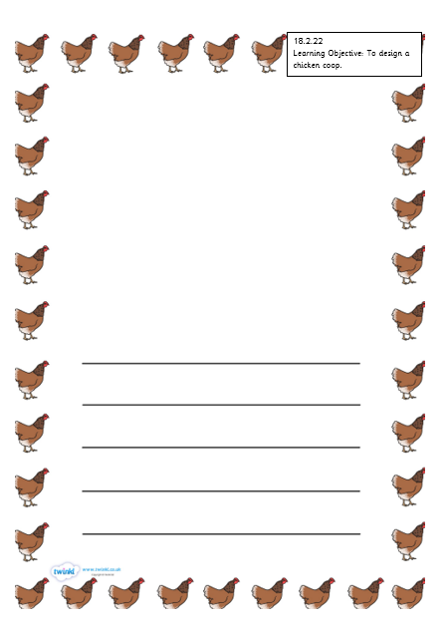
Let’s Design!
Design a warm an cosy Chicken Coop.
Remember to keep them safe from any animals who may wish to eat chickens!
Do they have a safe and quiet place to lay their eggs?
Don’t forget to give the coop a strong door to protect them during the night!
Finally, describe your chicken coop. Use the sentence rules.
Photo courtesy of PhilCatterall and Jessica Reeder (@wikimedia.com) - granted under creative commons licence – attribution

