Slide 2
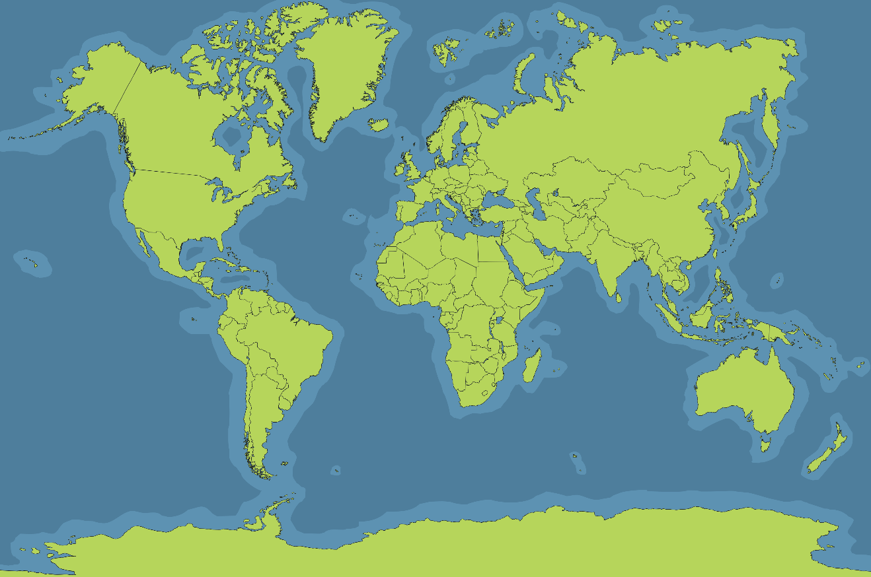
Where Is New Zealand?
New Zealand is a country in Oceania.
New Zealand is surrounded by the Pacific Ocean.
New Zealand

Slide 3
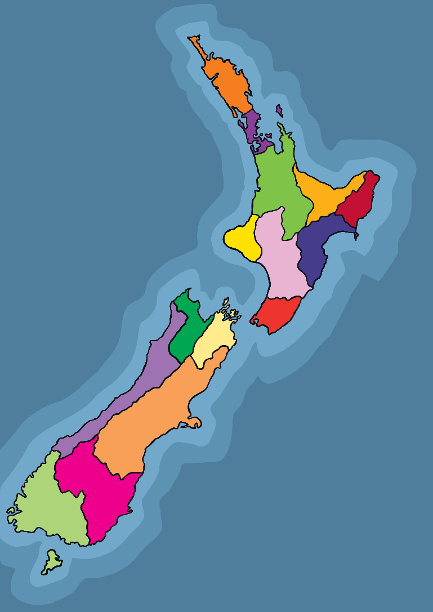
Facts About New Zealand
New Zealand is made up of two main islands; the North island and the South island, and around 600 smaller islands.
The capital city of New Zealand is Wellington, which is on the
North island.
The biggest city is Auckland, which is on the North island.
The third largest city is Christchurch, which is on the South Island.
Wellington

Slide 4
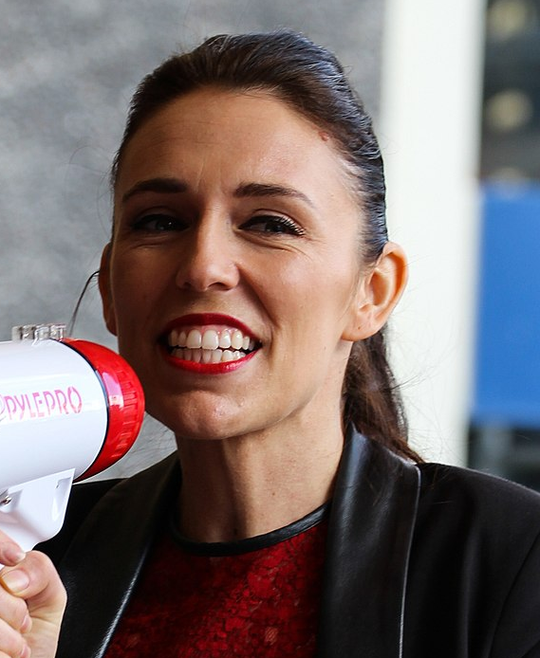

Facts About New Zealand
New Zealand has a population of almost 5 million.
The Prime Minister of New Zealand is
Jacinda Ardern.
The currency is the New Zealand Dollar.
The main language spoken in New Zealand is English but Māori is spoken too.
Jacinda Ardern
“Jacinda Ardern” by [Ulysse Bellier] is licensed under CC BY 2.0

Slide 5
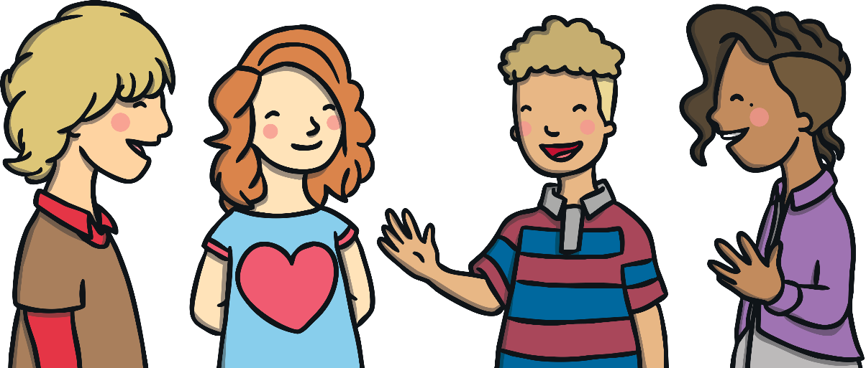
Some Maori Phrases
Kia ora (kee oh-ruh):
Hi
Mōrena (moh-reh-nuh):
Good morning
Haere mai (hi-reh my):
Welcome
E noho rā (eh noh-hoh rah):
Goodbye

Slide 6
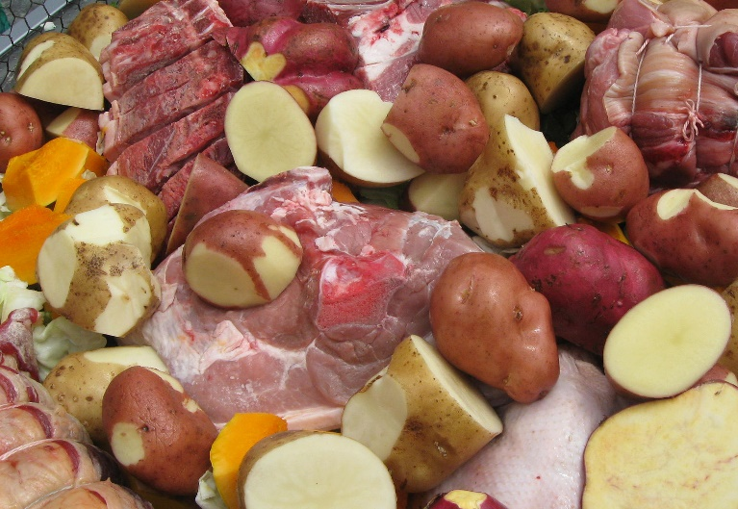
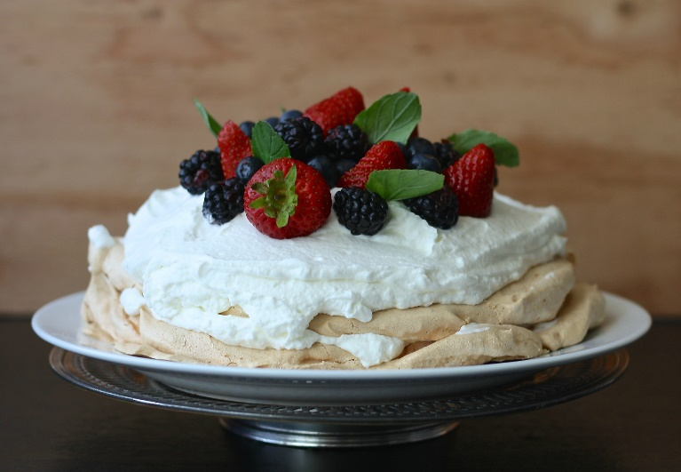
New Zealand Food
Hangi is a traditional Mãori way of cooking. It involves meat and vegetables slow-cooked in an underground oven.
Pavlova is a much-loved dessert in New Zealand, made from meringue and fresh fruit. People from Australia and New Zealand often argue over where it was invented!
“Hangi” by [Sarah M Stewart] is licensed under CC BY 2.0

Slide 7
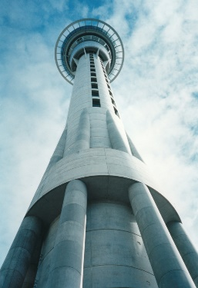

Sky Tower
Sky Tower is the tallest building in New Zealand.
It can be found in the city of Auckland, on the North island.
There is a revolving restaurant at the highest point and people can even bungee jump from the top of it!
“Sky Tower” by [Sids1] is licensed under CC BY 2.0

Slide 8
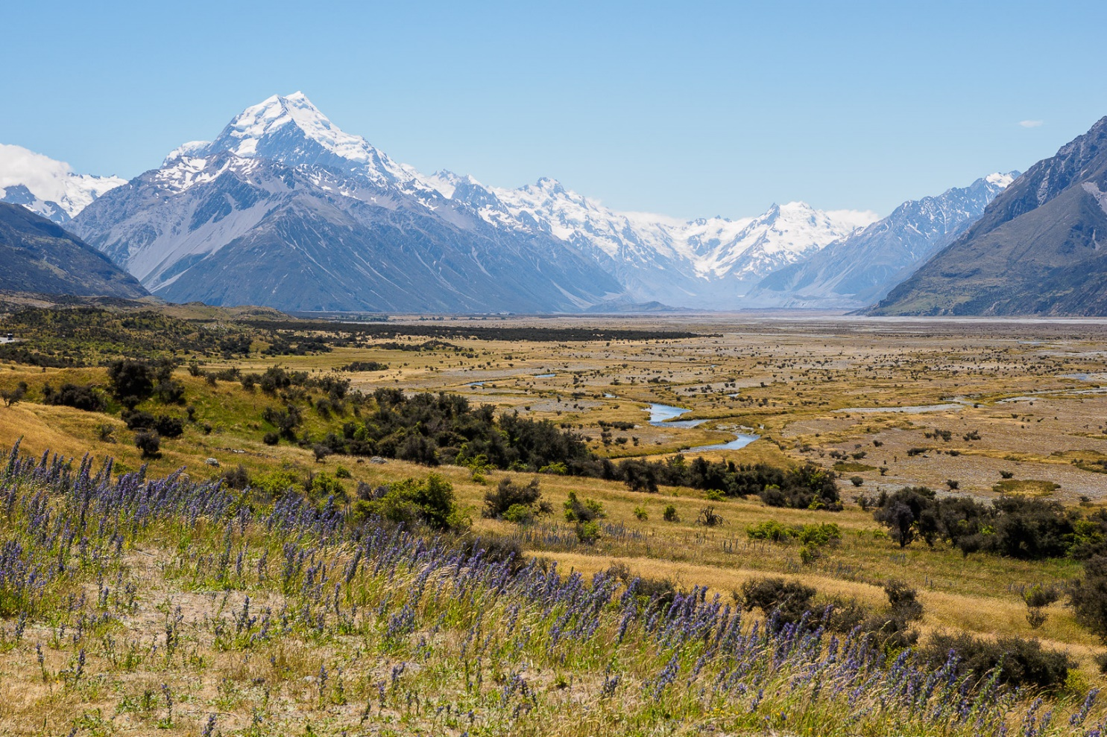
Mount Cook
Mount Cook is the highest mountain in New Zealand.
It is 3724 metres high.
It is extremely popular with mountain climbers and tourists.
“Mount Cook” by [Stefan Wagener] is licensed under CC BY 2.0

Slide 9
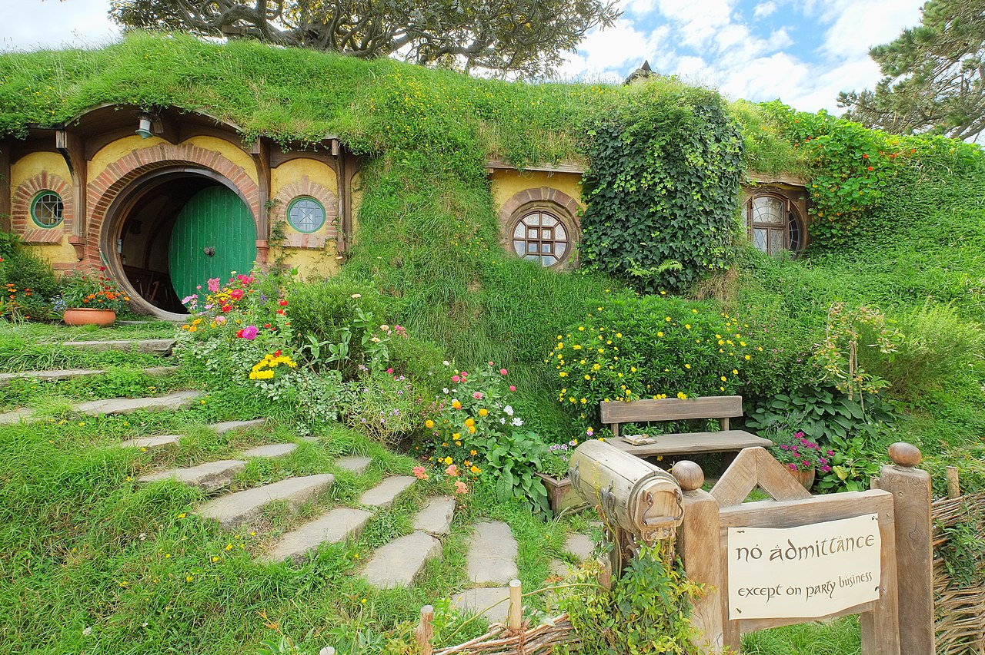
Famous Scenes
The Lord of the Rings trilogy and The Hobbit trilogy were filmed in lots of different areas in New Zealand. People come from far and wide to visit these places.
Some of the sets from the films are still there and many people visit them each year.

