Slide 1
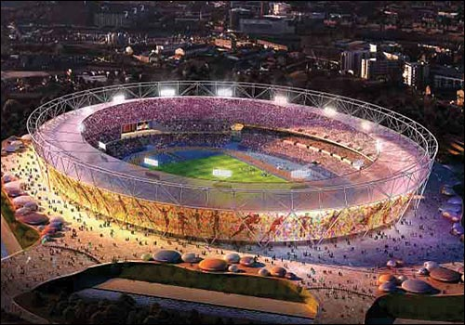

The Paralympic Values

Slide 2
The Paralympic Values
It takes more than being a brilliant sports man
or woman to become a Paralympian.
Top class athletes try to live according to a set of beliefs
and ideas that help them to be the best they can be,
and to respect other competitors.
These are called the Paralympic Values.

Slide 3
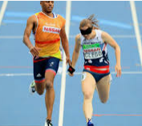
The Paralympic Values
Paralympic Values
determination
courage
equality
inspiration

Slide 4
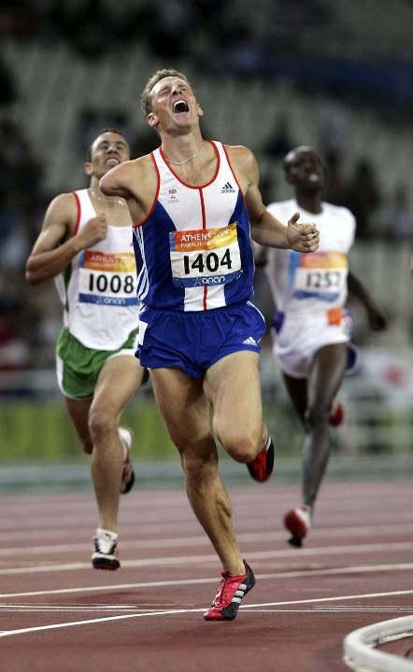
Determination
Athletes are very
determined and try very
hard to do their best.
It is much easier to give up
than it is to carry on at
something which is
physically and mentally
demanding.

Slide 5
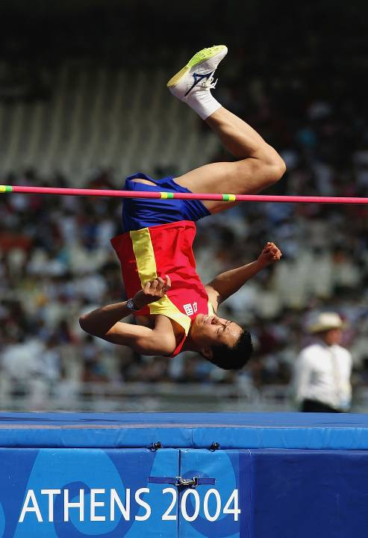
Courage
Olympians and
Paralympians show a lot
of courage.
Many of the events
require them to push their
bodies to the limits and
eliminate any fears.

Slide 6
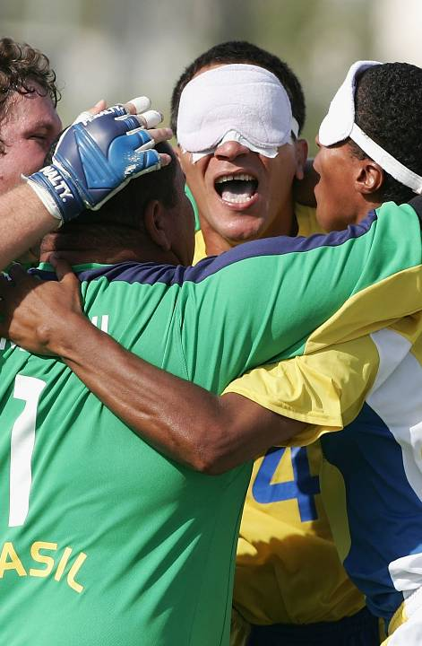
Equality
Every athlete has the right
to be treated fairly and
equally.
Paralympians are all
outstanding athletes.

Slide 7
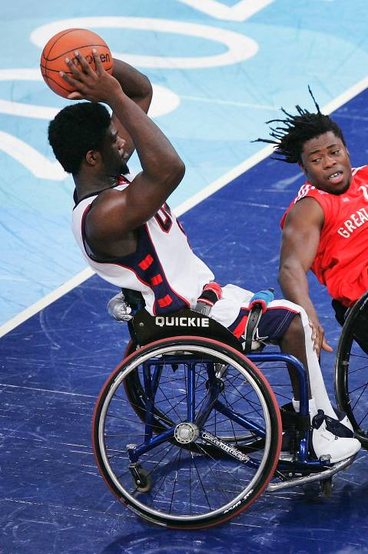
Inspiration
Olympic and Paralympic
athletes have been
inspired by others and
now they hope to
inspiring us.

Slide 8
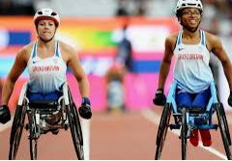
The Olympic and Paralympic Values
Paralympic Values
determination
courage
equality
inspiration

