Slide 1

Wednesday
10th February 2021

Slide 2
L.O: To tell the time to quarter past the hour.

Slide 3

Starter
https://www.bbc.co.uk/teach/supermovers/ks1-maths-telling-the-time/zk4t8xs

Slide 4
What do the big hands and small hands mean on a clock?
The big hand is the minute hand. It tells us how many minutes past or to the next hour.
The small hand is the hour hand. This tells us which hour it is.

Slide 5
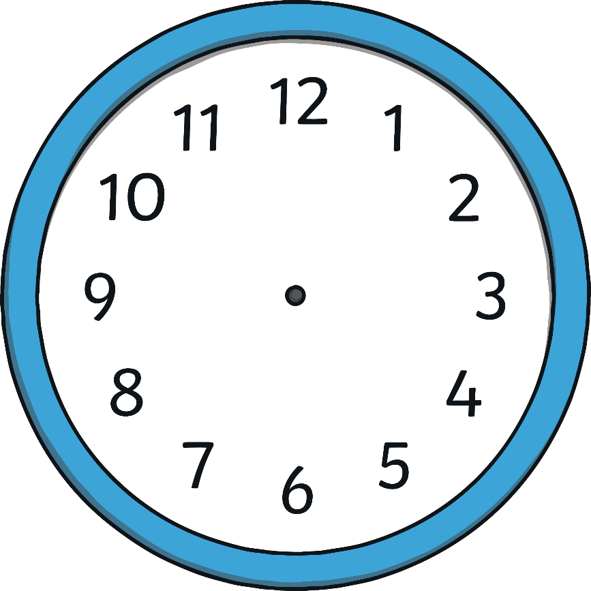
What Time Is It?
6 o’clock.

Slide 6
What Time Is It?
Half past 1

Slide 7

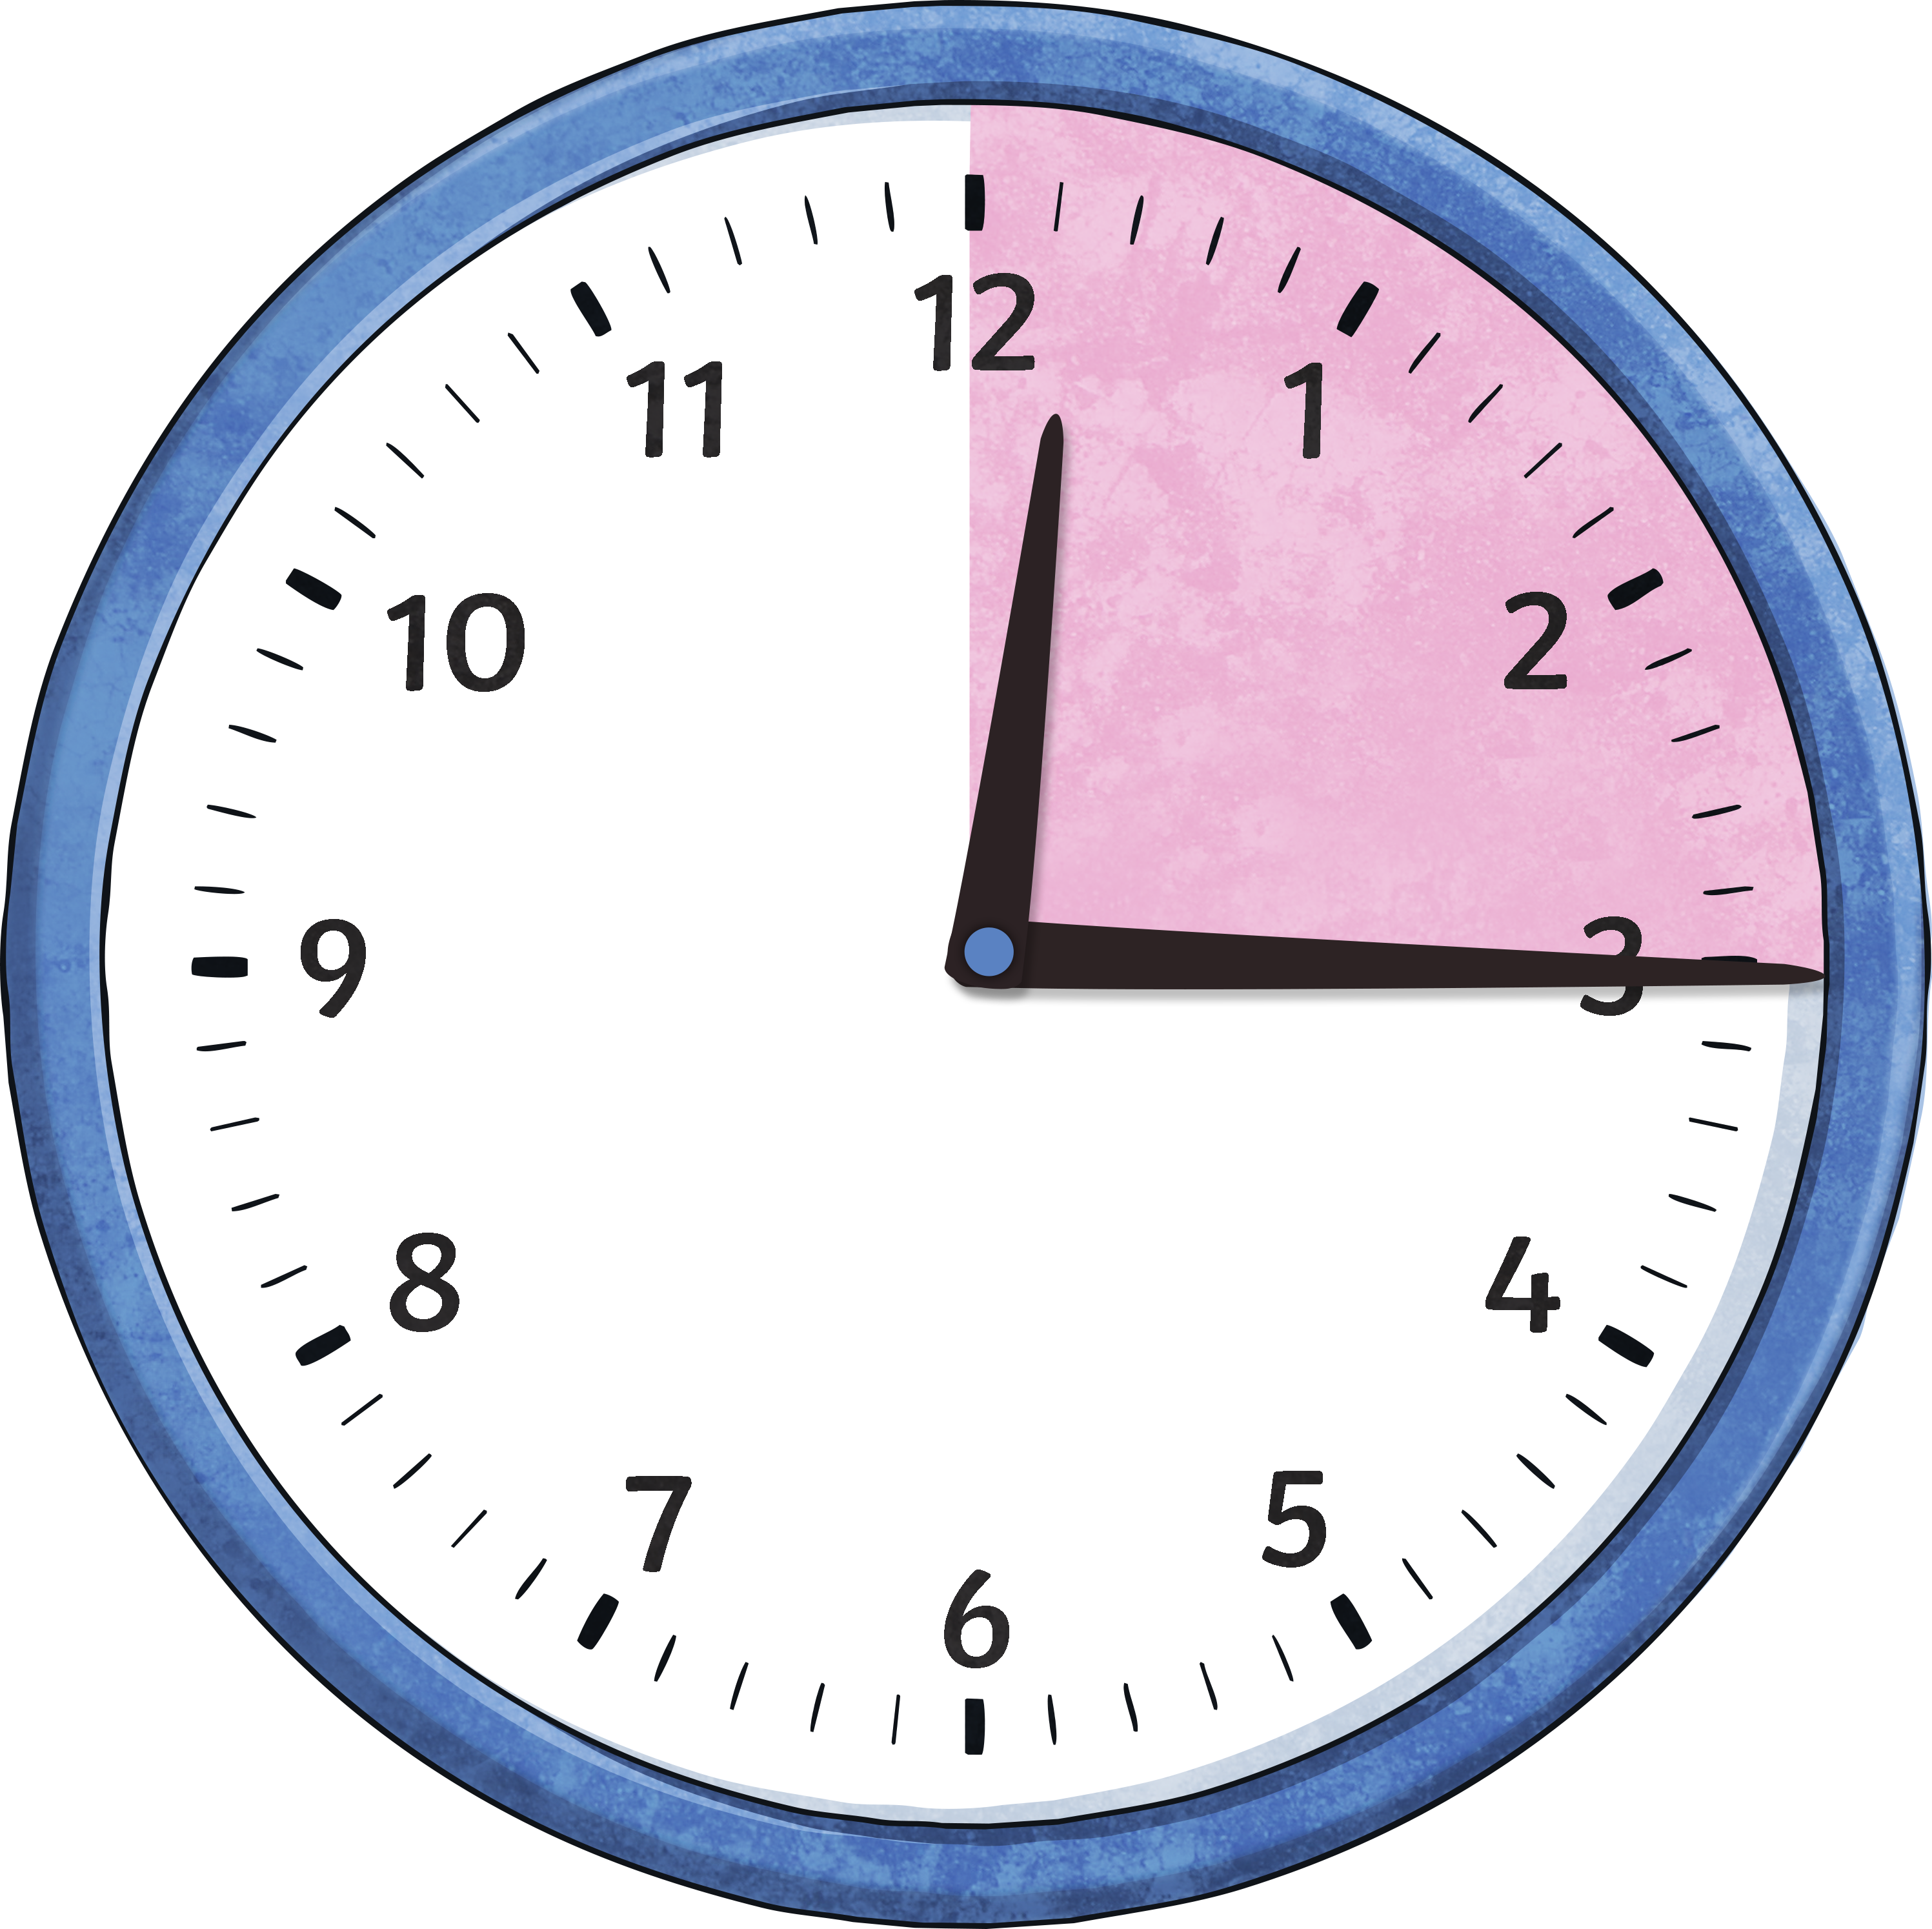
What Time Is It?
The minute hand is on the 3

Slide 8
What Time Is It?
The minute hand is on the 3

Slide 9
What Time Is It?
Quarter past 7

Slide 10
What Time Is It?
Quarter past 3

Slide 11
What Time Is It?
Quarter past 11

Slide 12
What Time Is It?
Quarter past 9

Slide 13
Does this say quarter past 12?
No!

Slide 14
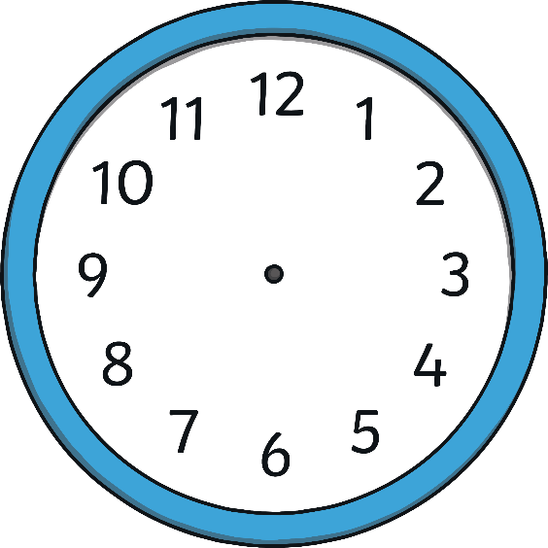


What Time Is It?
Which clock shows quarter past 2

Slide 15
What Time Is It?
Which clock shows quarter past 4?

Slide 16
What Time Is It?
Which clock shows quarter past 10 ?

Slide 17
Task:
2

Slide 18
Task:

Slide 19
Task:
Quarter past 11

Slide 20
Task:
Quarter past 11

