Slide 1
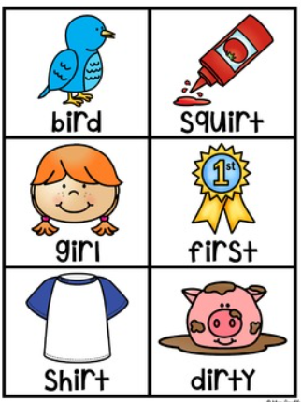
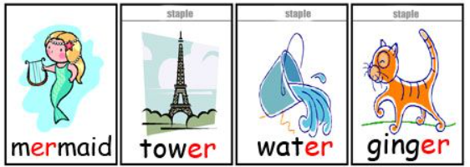

er

Slide 2

fern

Slide 3

her

Slide 4
shower

Slide 5
stern

Slide 6

burger

Slide 7

term

Slide 8
jumper

Slide 9
sister

Slide 10
mermaid

Slide 11
tower

Slide 12
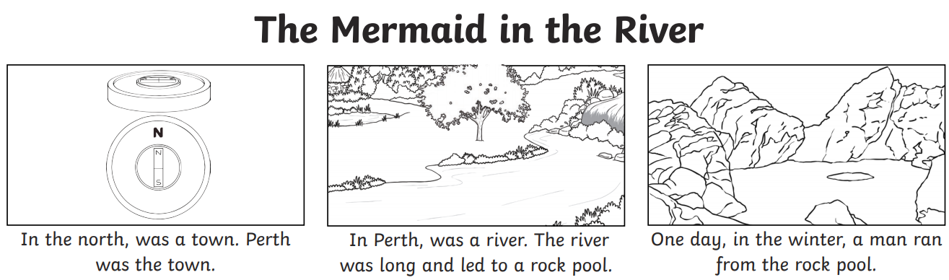
Read the story and circle all the words that contain the ‘er’ digraph.

Slide 13
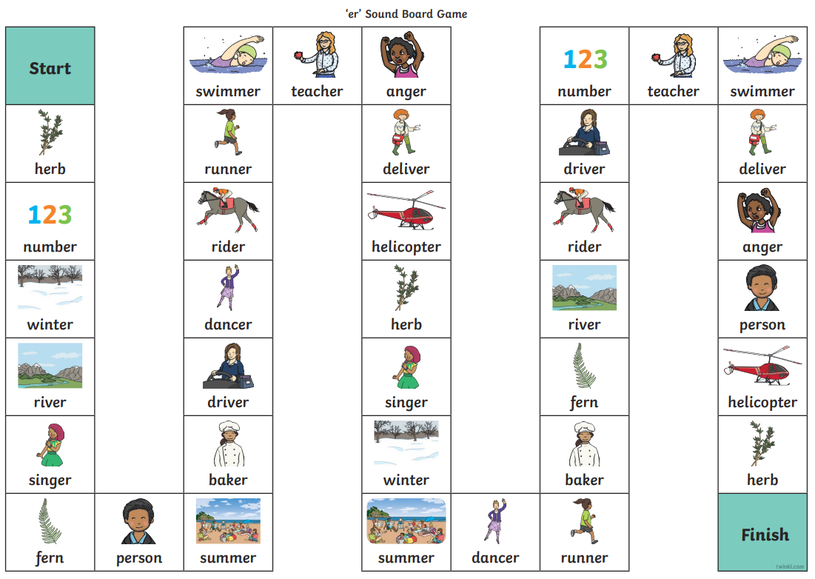
Play the game using a dice and your reading skills!

